Slide 1

unvibe
PRIVATE BETA
Understand the
code AI writes.
A desktop learning layer for people building with AI coding tools.
AI writes the code.
Unvibe helps you understand it.
2026

Slide 2
THE PROBLEM
02
AI coding is faster.
Understanding is now the bottleneck.
Teams can generate and ship more code than ever. The gap is confidence: what changed, why it works, and whether the builder can maintain it.
Context disappears
Review gets deferred
Knowledge does not compound
Generated changes arrive inside unfamiliar files, patterns, and dependencies.
People accept code to keep momentum, then lose the moment when learning could happen.
Explanations live in chat windows instead of becoming a durable personal learning history.

Slide 3
THE ANSWER
03
Unvibe turns each AI-generated change into a learning moment.
It sits beside the existing coding workflow: explain the change with project context, let the user choose depth, then retain the learning.
1
2
3
4
5
Change
→
Review
→
Explain
→
Check
→
Remember
AI or developer updates code
Quiet prompt, no context switch
Beginner to Expert depth
Test understanding when ready
History, study, and progress

Slide 4
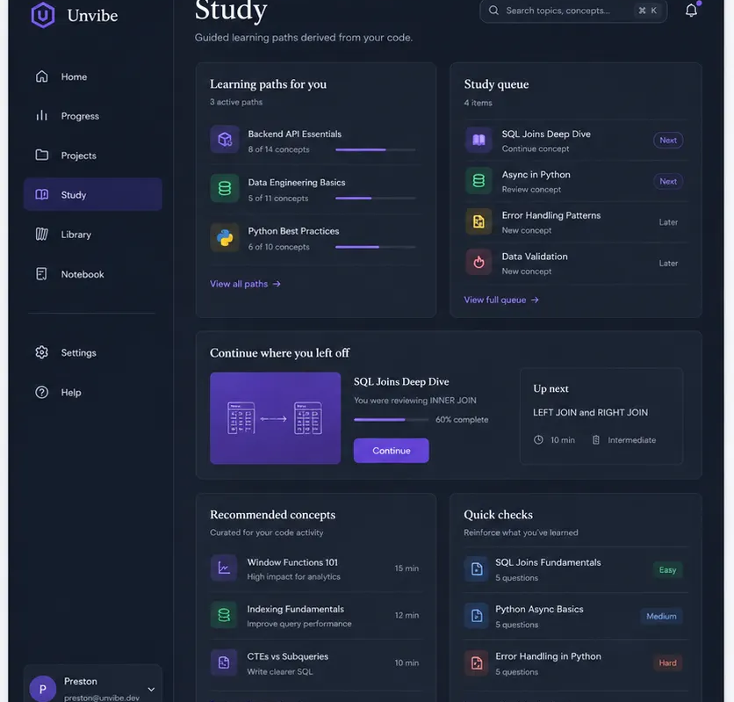
THE PRODUCT
04
One calm companion app.
Five places to keep learning moving.
The product is not another code generator. It is the layer that makes AI-assisted work understandable and memorable.
01
Study
Revisit what needs attention.
02
History
See the work you actually learned from.
03
Quiz
Test understanding inside real explanations.
04
Progress
Track cautious evidence and streaks.
05
Plan
Manage Free, Pro, or Teams.

Slide 5
TRUST
05
Privacy is part of the product architecture, not a settings afterthought.
Unvibe is designed so private repository content is handled deliberately before any approved cloud analysis.
1
2
3
Filter locally
Preview context
Keep boundaries
Secrets, env files, keys, ignored folders, and binaries are excluded before a remote request.
Per-repository consent makes it clear what context is approved for explanation.
The backend never reads the repository. Users retain control over what leaves their machine.

Slide 6
LEARNING LOOP
06
Learning compounds when it is connected to real work.
Unvibe records activity, concepts, and comprehension signals so a developer can build understanding over time without invented mastery scores.
Explain
→
Choose depth
→
Check
→
Save
→
Review
What this change does
New to Expert
One meaningful question
History and snippets
Needs-review queue
The result: better verification today, stronger technical judgment tomorrow.

Slide 7
BUSINESS MODEL
07
A simple model that earns trust before it earns revenue.
Free removes the API-key and payment barrier. Paid plans expand capacity, advanced learning, and shared team workflows.
Free
Pro
Teams
$0
$8/mo
$8/member/mo
30 explanations/month
1 active project
Saved learning history
$96/year
Higher limits
Advanced learning tools
2-seat minimum
Shared workspaces
Roles and centralized billing
Test-mode billing only until approved production configuration is in place.

Slide 8
GO-TO-MARKET
08
The beta is designed to learn where understanding breaks down.
The initial go-to-market is intentionally focused: people already using AI coding tools who want to stay accountable for the code they ship.
Private beta
Prove the loop
Expand responsibly
Invite early builders who use AI coding tools every day and can share high-signal workflow feedback.
Measure whether explanations, checks, and review queues create repeat learning behavior.
Add team workflows after the individual learning loop is trusted, reliable, and privacy-safe.
No public download claim until a real signed build is ready.

Slide 9
ROADMAP
09
What we are building next is depth, not distraction.
The product roadmap follows the learning loop: make the core experience reliable first, then extend the context and collaboration around it.
Now
Desktop beta, context-aware explanations, comprehension checks, saved learning.
Next
Stronger project context, reliable sync, deeper study and review workflows.
Later
Teams workspaces, shared knowledge, and Pro capabilities when the underlying entitlement system is proven.

Slide 10
unvibe
AI writes the code.
Unvibe helps people
understand it.
Private beta · Mac first · Free to join
unvibe.site

