Slide 1

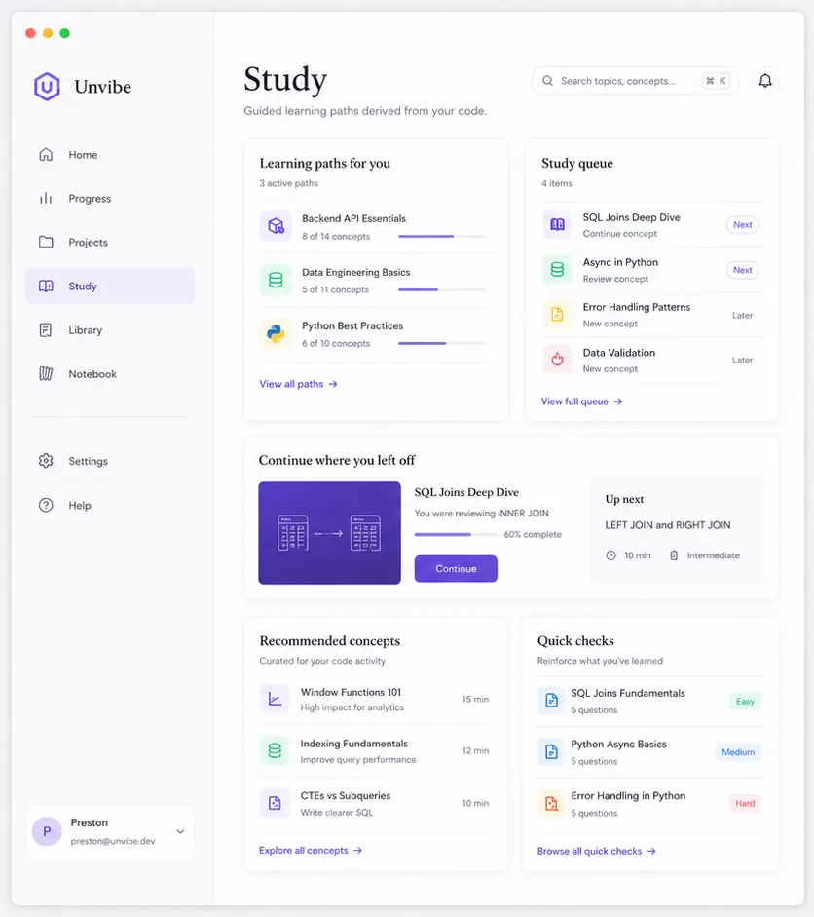
unvibe
Don’t feel guilty
about vibe coding.
Make the code yours.
A learning layer for AI-generated code.
PRIVATE BETA
AI writes the code. Unvibe helps you understand it.

Slide 2
unvibe
01 / THE PROBLEM
02
Your agent finished the feature.
Could you explain it tomorrow?
Using AI is not the problem. Losing the thread of your own project is.
BEFORE
AFTER UNVIBE
It works. You think.
Context found.
→
Unfamiliar abstractions
Unexplained dependencies
Possible failure points
What changed
Why it changed
Files and concepts involved

Slide 3
unvibe
02 / ONE QUIET LOOP
03
From generated to
genuinely understood.
Three steps. Then you keep building.
01
02
03
Select code
Choose your level
Understand. Continue.
Choose the exact lines, file, or git change you want to understand.
Start plain, go deep, or switch level whenever the explanation misses.
Ask a follow-up, test yourself, save the concept, and get back to the project.

Slide 4
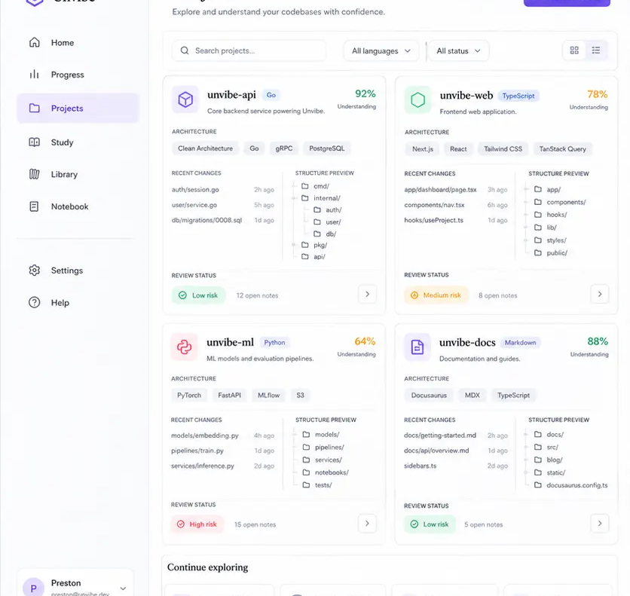
unvibe
03 / YOUR PROJECT IS THE CURRICULUM
04
A line rarely makes sense
by itself.
Unvibe moves outward from expression to architecture, then turns the missing context into something learnable.
LINE → FUNCTION → FILE → PROJECT
No generic tutorial can know the decisions inside your repository.

Slide 5
unvibe
04 / PRIVATE BY DESIGN
05
Your code deserves
a careful boundary.
Unvibe filters likely secrets locally before approved context can be sent for an explanation.
01
02
03
Your selected context
→
Local secret filter
→
Approved request
On your Mac
.env · keys · tokens · builds
Filtered context only
Privacy policy · Terms of service · Data controls

Slide 6
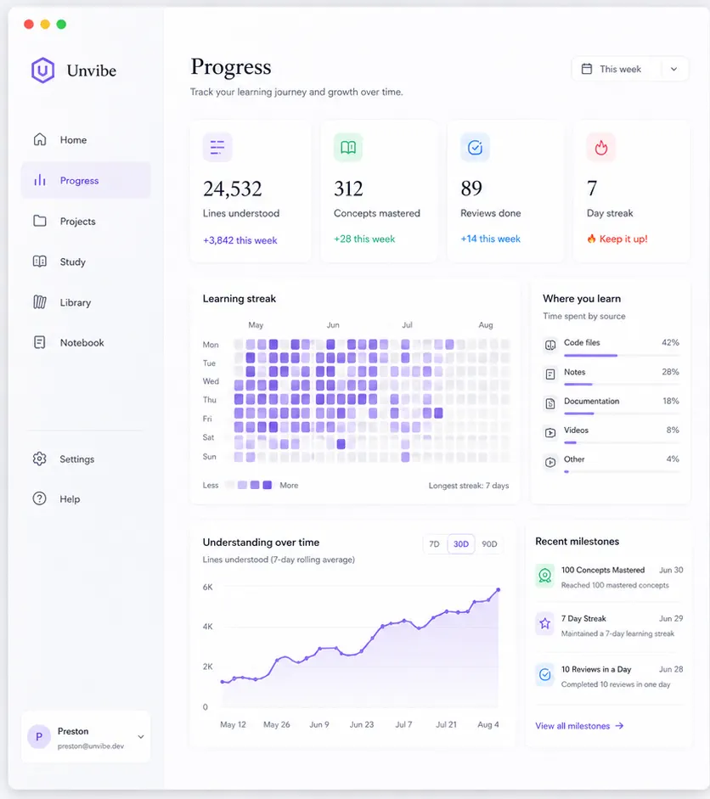
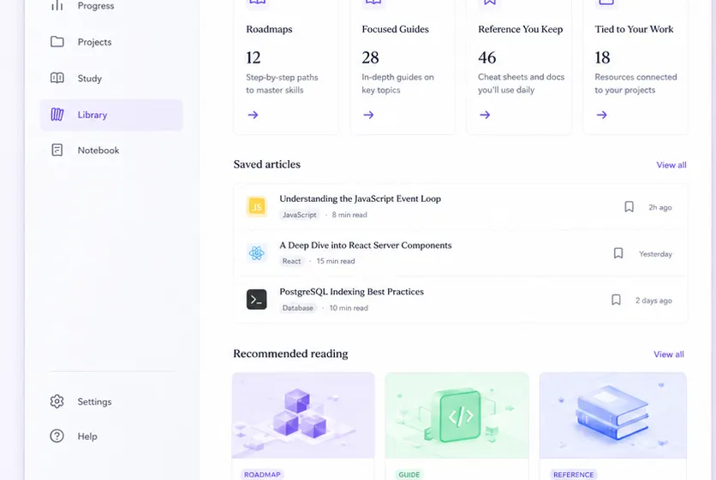
unvibe
05 / KEEP THE THREAD
06
Five places to keep
learning moving.
Every screen connects to real code reviews, explanations, and progress—not an invented course.
STUDY HISTORY QUIZ PROGRESS PLAN
PLAN
The sixth destination is Plan: clear usage, reset dates, and only the space your work needs.
Start free.
Upgrade later.

Slide 7
unvibe
06 / PRICING
07
Start free.
Upgrade when your projects
grow.
No API key. No card required to start.
FREE
PRO
TEAMS
$0
$8 / month
$8 / member / month
30 explanations / month
One active project
Saved learning history
Higher limits
Advanced learning
Personal workspace
Two-seat minimum
Shared workspace
Centralized billing
Team annual billing: $6/member/month, billed annually.

Slide 8
unvibe
AI can write the code.
Make sure it becomes yours.
JOIN THE PRIVATE BETA
Mac first · Free to join · Privacy and terms always available
unvibe.site

