Slide 1

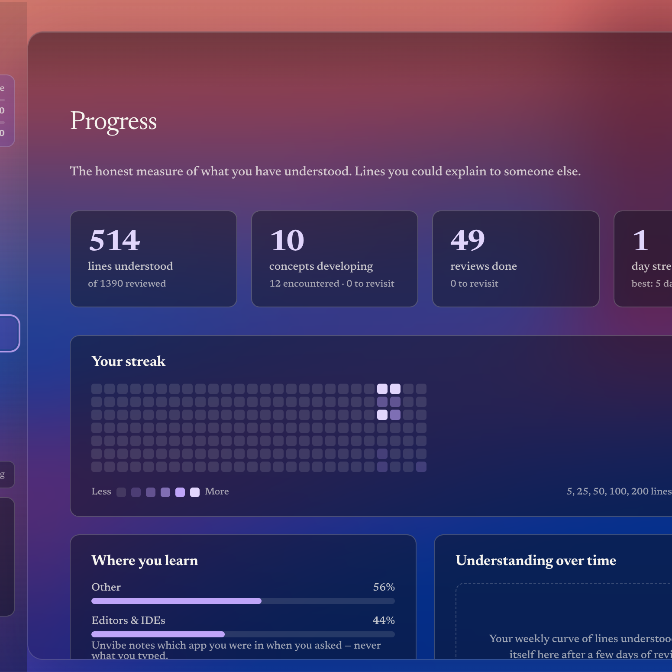
UNVIBE
THE COMPREHENSION LAYER FOR AI-WRITTEN CODE
Unvibe makes AI-written
code understandable.
A Mac-first product that turns every AI-generated change into understanding, verification, and retained project knowledge.
SELECT → EXPLAIN → ASK → TEST → SAVE
Preston Susanto · Founder
Private beta · August 2026
UNVIBE · PRIVATE MAC BETA
01
Notes:
Open with the category: AI code generation is abundant; code ownership is becoming scarce.
[Sources]
- User-provided product screenshot: /Users/prestonjaysusanto/Desktop/Unvibe Resources/new app/Screenshot 2026-08-17 at 6.50.24 PM.png
- Brand asset: /Users/prestonjaysusanto/Unvibe/marketing/public/brand/icon-1024.png
- Prior pitch source: /Users/prestonjaysusanto/Desktop/Unvibe Resources/Unvibe_Pitch_Deck.pdf
- https://sequoiacap.com/article/writing-a-business-plan
- https://www.ycombinator.com/blog/guide-to-demo-day-pitches/
[/Sources]

Slide 2
WHY NOW
02
The faster AI ships code,
the harder ownership becomes.
The bottleneck moved from generating code to verifying, explaining, and remembering what shipped.
84%
66%
45%
3%
use or plan to use AI in development
say AI answers are almost right
spend longer debugging AI code
highly trust AI output
That gap becomes a learning, reliability, and governance problem.
Generation is solved. Ownership is not.
UNVIBE · INVESTOR DECK
02
Notes:
Establish a structural market shift, not a temporary feature gap.
[Sources]
- https://survey.stackoverflow.co/2025/ai
- https://www.ycombinator.com/blog/this-brief-guide-is-a-summary-of-what-startup-founders-need-to-know-about-raising-the-seed-funds-critical-to-getting-their-company-off-the-ground
- https://email.docsend.com/hubfs/The%20Pre-Seed%20Round%20Defined.pdf
[/Sources]

Slide 3
PRODUCT
03
Review the change.
Learn it before it ships.
Highlight code in Cursor or VS Code, press ⌘U, and get a contextual explanation without leaving the project.
01
02
03
04
05
SELECT
→
EXPLAIN
→
ASK
→
TEST
→
SAVE
Exact code, file, or change
Five depth levels
Context-aware follow-up
One comprehension check
Learning becomes history
LOCAL SECRET FILTER BEFORE EVERY REMOTE REQUEST
UNVIBE · INVESTOR DECK
03
Notes:
Explain the full loop in under 30 seconds. Emphasize that Unvibe is not another generator.
[Sources]
- /Users/prestonjaysusanto/Unvibe/AGENTS.md
- /Users/prestonjaysusanto/Unvibe/docs/architecture.md
- /Users/prestonjaysusanto/Unvibe/docs/privacy.md
[/Sources]

Slide 4
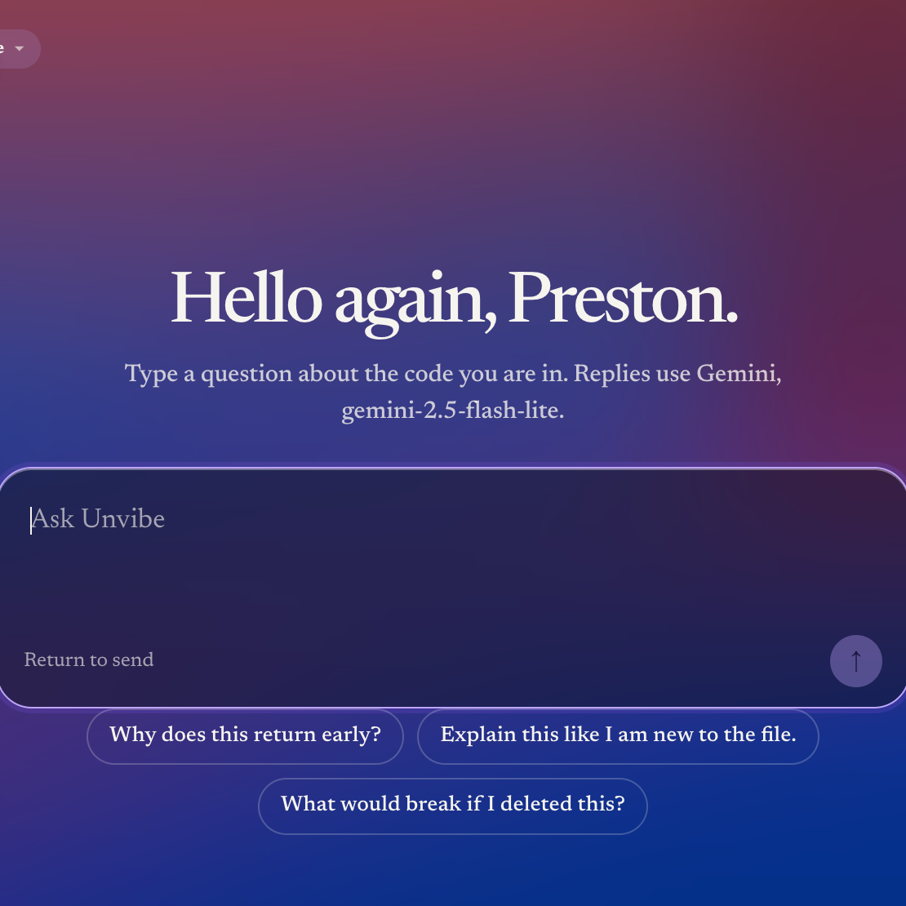
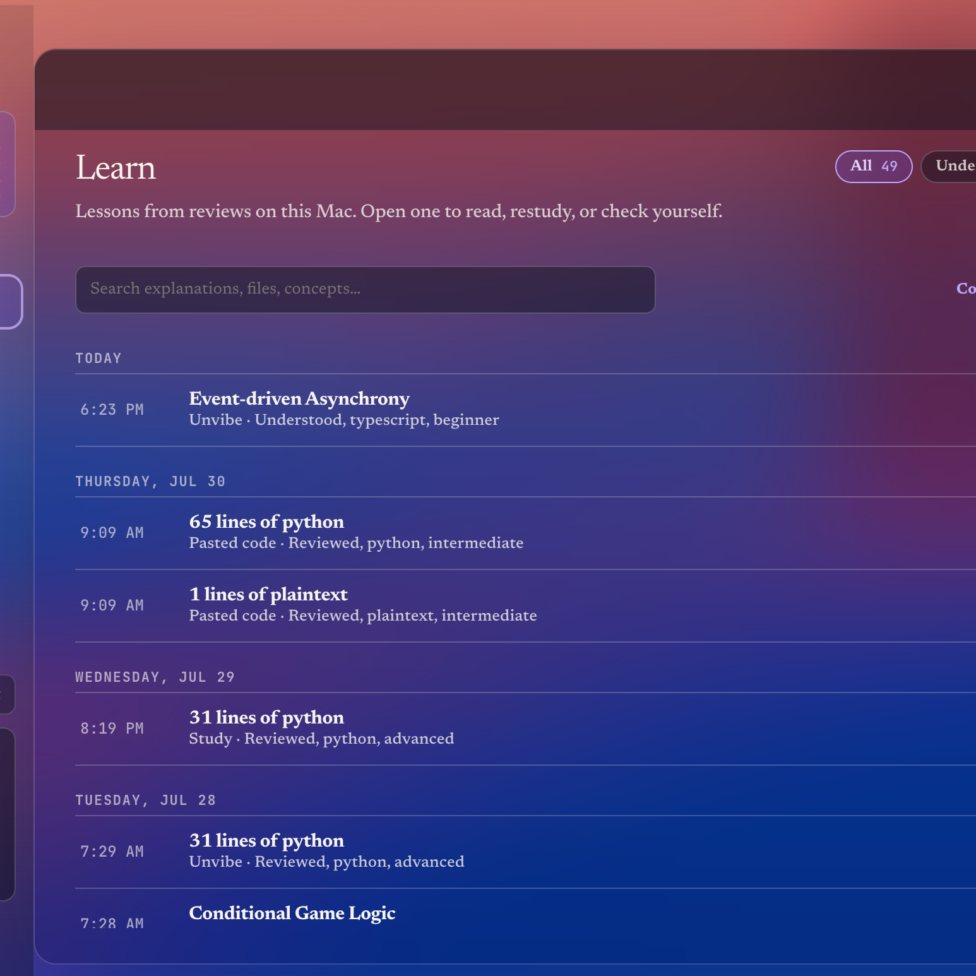
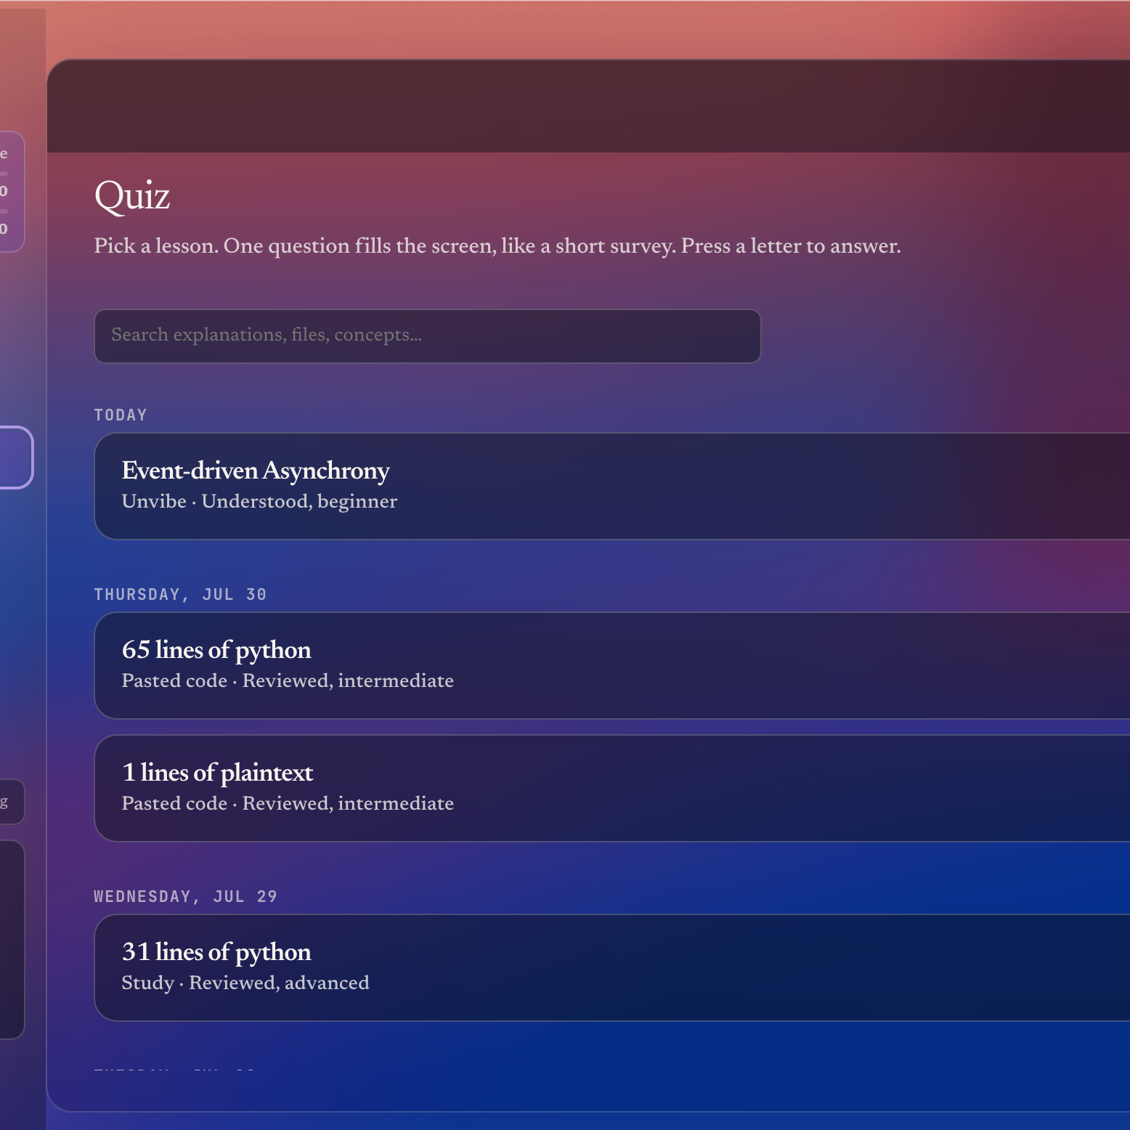
PRODUCT IN HANDS
04
One layer. Three moments of value.
Review the change now. Revisit it later. Prove you retained it.
UNDERSTAND
RETAIN
PROVE
UNVIBE · INVESTOR DECK
04
Notes:
These are current product screenshots, not mockups. Walk left to right.
[Sources]
- User-provided screenshot: /Users/prestonjaysusanto/Desktop/Unvibe Resources/new app/Screenshot 2026-08-17 at 6.50.21 PM.png
- User-provided screenshot: /Users/prestonjaysusanto/Desktop/Unvibe Resources/new app/Screenshot 2026-08-17 at 6.50.10 PM.png
- User-provided screenshot: /Users/prestonjaysusanto/Desktop/Unvibe Resources/new app/Screenshot 2026-08-17 at 6.50.17 PM.png
[/Sources]

Slide 5
POSITIONING
05
Generation creates output.
Unvibe creates ownership.
Coding agents
Generate and edit code
Do not build learning memory
Generic chat
Explain pasted snippets
Misses workflow and project context
Course platforms
Teach fixed curricula
Disconnected from what shipped
Unvibe
Explains your selected change
Tests, saves, and tracks ownership
WORKFLOW CONTEXT + ACTIVE RECALL + RETENTION
UNVIBE · INVESTOR DECK
05
Notes:
Position Unvibe against adjacent categories without claiming feature-for-feature parity.
[Sources]
- Prior competition framing: /Users/prestonjaysusanto/Desktop/Unvibe Resources/Unvibe_Pitch_Deck.pdf
- /Users/prestonjaysusanto/Unvibe/AGENTS.md
- https://sequoiacap.com/article/writing-a-business-plan
[/Sources]

Slide 6
EARLY PROOF
06
Small launch. Real signal.
30+
62
#1
136
historical early-access signups*
Smol Startup upvotes
Smol Startup Daily Winner
unique site visitors
“The test option is very useful to recap what was learnt.”
“The explanation depth and customization felt genuinely creative.”
Sharice Gustian · private beta · 9/10
Om Anand Khaunte · private beta · 7/10
*Founder-reported across the pre-reset waitlist and early beta intake; current live store is tracked separately.
UNVIBE · INVESTOR DECK
06
Notes:
Lead with external proof, then show qualitative retention signals. Do not present credits as traction.
[Sources]
- https://smolstartup.com/projects/unvibe
- https://unvibe.site/api/stats?include=waitlist
- User-provided beta feedback: Sharice Gustian, 29 Jul 2026
- User-provided beta feedback: Om Anand Khaunte, 25 Jul 2026
- Founder-reported historical early-access total supplied in this request; live store count checked 31 Aug 2026
- https://www.docsend.com/blog/data-driven-answers-to-frequently-asked-questions-on-startup-fundraising/
[/Sources]

Slide 7
MARKET WEDGE
07
Start where AI speed
creates the sharpest pain.
01
02
03
04
AI-first students
Solo builders
Developer teams
Regulated teams
Ship quickly, learn unevenly
Own every line they deploy
Need shared comprehension
Need evidence and review
The recurring unit is a review, not a course. The expansion path follows code responsibility from individual learning to team assurance.
UNVIBE · INVESTOR DECK
07
Notes:
Describe a credible beachhead before discussing enterprise expansion.
[Sources]
- https://survey.stackoverflow.co/2025/ai
- Market framing adapted from /Users/prestonjaysusanto/Desktop/Unvibe Resources/Unvibe_Pitch_Deck.pdf
- https://sequoiacap.com/article/writing-a-business-plan
[/Sources]

Slide 8
BUSINESS MODEL
08
Free to build the habit.
Paid when the project grows.
FREE
PRO
TEAM
ENTERPRISE
$0
$8/mo
$8/seat
Custom
Core selected-code review
Saved learning + study
More reviews + AI questions
Personal learning history
Shared workspace
2-seat minimum
Annual contract
Integrations + support
COMING SOON
CONTACT SALES
Annual plans discount 25%. Model access is included—no provider API key required.
UNVIBE · INVESTOR DECK
08
Notes:
Show monetization clarity while separating currently available tiers from planned tiers.
[Sources]
- /Users/prestonjaysusanto/Unvibe/marketing/src/components/redesign/PricingPlans.tsx
- /Users/prestonjaysusanto/Unvibe/marketing/src/data/faq.ts
- https://www.ycombinator.com/blog/this-brief-guide-is-a-summary-of-what-startup-founders-need-to-know-about-raising-the-seed-funds-critical-to-getting-their-company-off-the-ground
[/Sources]

Slide 9
DISTRIBUTION
09
Go where AI-first builders
already share what they ship.
A founder-led motion that turns public building, directories, hackathons, and student communities into beta conversations.
NEXT
500
SMOL STARTUP
PRODUCT HUNT
DEV COMMUNITY
beta builders
LAUNCHKIWI
TOOL INDEX
DEVROVE
Measure activation:
select → understand → save → return.
AI TOOL DISCOVERY
VIBERANK
SIDEPROJECTORS
UNVIBE · INVESTOR DECK
09
Notes:
The go-to-market strategy is community-led and measurable, not paid acquisition dependent.
[Sources]
- /Users/prestonjaysusanto/Unvibe/marketing/src/data/listings.ts
- https://smolstartup.com/projects/unvibe
- https://www.producthunt.com/products/unvibe?launch=unvibe
- https://dev.to/preston_jaysusanto_22498/how-to-review-ai-generated-code-without-losing-ownership-of-your-project-ndl
[/Sources]

Slide 10
EXECUTION
10
Seven weeks from pivot
to working private beta.
11 JUL
14 JUL
24 JUL
27 JUL
17 AUG
26 AUG
Desktop pivot
unvibe.site live
Private Mac beta
⌘U auto review
Pricing + gifting
#1 daily winner
Selection bridge · secret filtering · streaming AI · study loop · usage meters · Google sign-in · durable waitlist
UNVIBE · INVESTOR DECK
10
Notes:
This is the strongest founder signal: speed with a functioning product and reliability work, not a prototype-only sprint.
[Sources]
- /Users/prestonjaysusanto/Unvibe/marketing/src/data/milestones.ts
- Repository git history in /Users/prestonjaysusanto/Unvibe
- https://www.docsend.com/blog/seed-round-fundraising-tips-to-make-your-pitch-deck-a-hit-with-vc-investors/
[/Sources]

Slide 11
CAPITAL EFFICIENCY
11
$232.7K in startup support.
Built without a priced round.
$231.9K is program and platform credit; $800 is founder-reported cash support. Credits are not cash and not investment proceeds.
Mixpanel
$144K
PostHog
$50K
GitLab
$23.7K
WHAT THIS BUYS
AWS
$5K
Linear
$4.5K
Google
$2K
Runway for analytics, infra, AI evaluation, and secure developer operations.
OpenAI
$1.2K
Deepgram
$1K
MongoDB
$500
UNVIBE · INVESTOR DECK
11
Notes:
Be explicit that credits are operating leverage, not fundraising traction.
[Sources]
- /Users/prestonjaysusanto/Unvibe/marketing/src/data/compensation.ts
- /Users/prestonjaysusanto/Unvibe/marketing/src/data/milestones.ts
[/Sources]

Slide 12
NEXT 12 MONTHS
12
Turn a working loop
into a repeatable habit.
NOW
NEXT
THEN
Reliability
Retention
Distribution
Notarize the Mac app. Harden capture, streaming, and offline recovery.
Weekly review rhythm, stronger concepts, personal notes, visual learning aids.
Open VSX extension, beta communities, referrals, and first paid teams.
$50K–$100K PRE-SEED / ACCELERATOR SUPPORT
Also seeking introductions to AI-first builders, student developer communities, and design partners.
UNVIBE · INVESTOR DECK
12
Notes:
The ask preserves the range from the original deck while tying it to concrete milestones.
[Sources]
- Prior ask and roadmap: /Users/prestonjaysusanto/Desktop/Unvibe Resources/Unvibe_Pitch_Deck.pdf
- /Users/prestonjaysusanto/Unvibe/AGENTS.md
- https://a16z.com/raising-capital-this-is-the-advice-we-give-our-founders/
- https://a16z.com/the-insiders-guide-to-data-rooms-what-to-know-before-you-raise/
[/Sources]

Slide 13
FOUNDER
13
Built by someone
inside the problem.
Preston Susanto is a solo technical founder building Unvibe while using AI coding tools every day—and feeling the ownership gap firsthand.
Make AI development
understandable.
◆
Product, desktop, backend, and launch motion built end-to-end
◆
Rapid user-feedback loop with public build records
◆
Google Developers Group DVC founder and hackathon organizer
unvibe.site
◆
Mission: make AI development understandable, verifiable, and retainable
preston@unvibe.site
UNVIBE · PRESTON@UNVIBE.SITE
13
Notes:
Close on founder-market fit and the category ambition.
[Sources]
- Founder biography adapted from /Users/prestonjaysusanto/Desktop/Unvibe Resources/Unvibe_Pitch_Deck.pdf
- Brand asset: /Users/prestonjaysusanto/Unvibe/marketing/public/brand/icon-1024.png
- https://unvibe.site
- https://www.ycombinator.com/blog/aaron-harris-on-fundraising-and-meeting-with-investors
[/Sources]

