Slide 1
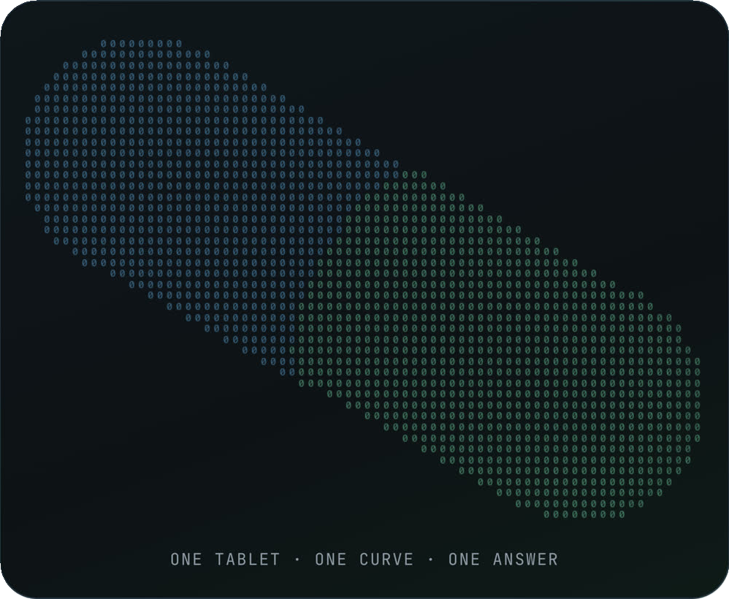
Pill
CAL HACKS 13.0 · IDEA TO DEMO · FIGMA
The box measures.
Pill explains.
A box of hobby parts around an Arduino UNO Q. One whole tablet in a small cup, a 60-second quick run, one of three answers. In a clinic, that answer decides whether the supplier gets paid.
PASS
NEEDS LAB
UNABLE TO VERIFY
Art · the site’s binary pill (pill.js), captured from pill-site.vercel.app
Notes:
Pill is a box of hobby parts around an Arduino UNO Q. One whole tablet in a small cup, a sixty-second quick run, two light sensors. It says three things only: PASS, NEEDS LAB, UNABLE TO VERIFY.

Slide 2
Pill
THE MOMENT · DELIVERY D-1042 · REPLAY TM-02
02 / 21
Same label. Chalk inside.
Clinic app replay of its simulated two-channel design. The bottle says vitamin B2. The blue line drops into the reference band, so a one-sensor tester would call it a pass. The 90° channel never moves.
RULE N2 · INLINE MOVED, 90° DID NOT RISE
NEEDS LAB
reference band 0.36–0.47
A one-sensor tester would have passed it.
blue inline: in the band
POLICY P2 · HOLD, DRAFT THE LAB REFERRAL
$480.00 held
90° channel: flat
0 s
180 s
SANDBOX · REPLAY
Illustration · the shape of replay TM-02, redrawn; not live sensor data.
Pill · Cal Hacks 13.0 · pill-site.vercel.app
Notes:
This is the clinic app replaying its simulated two-channel design. The bottle says vitamin B2; inside is chalk. The blue line drops right into the reference band, so a one-sensor tester would call that a pass, but the 90-degree channel never moves. Pill says NEEDS LAB and the supplier's four hundred and eighty dollars stays held, lab referral drafted. Sandbox money; this is a replay, and we say so.

Slide 3
Pill
THE PROBLEM
03 / 21
One in ten.
WHO estimates 1 in 10 medical products in low- and middle-income countries is substandard or falsified. The lab instrument that catches one costs $20,000 to $100,000.
Illustration · one tablet in ten. WHO, 2017: substandard and falsified products counted together.
116,000
>300
$30.5B
extra malaria deaths a year in sub-Saharan Africa, modelled central estimate, from substandard and falsified antimalarials (range 64,000–158,000)
children's deaths linked to contaminated cough syrups in three countries, 2022–23, most under five
spent each year on substandard and falsified medical products, by WHO's estimate
LSHTM model, cited by WHO, 2017
WHO, Jan 2023
WHO fact sheet, 2024
Pill · Cal Hacks 13.0 · pill-site.vercel.app
Notes:
WHO estimates 1 in 10 medical products in low- and middle-income countries is substandard or falsified. A new lab dissolution tester costs twenty to a hundred thousand dollars, and lab results take seven to ten business days. A clinic pharmacist has neither; what they have is an invoice to pay this afternoon.

Slide 4
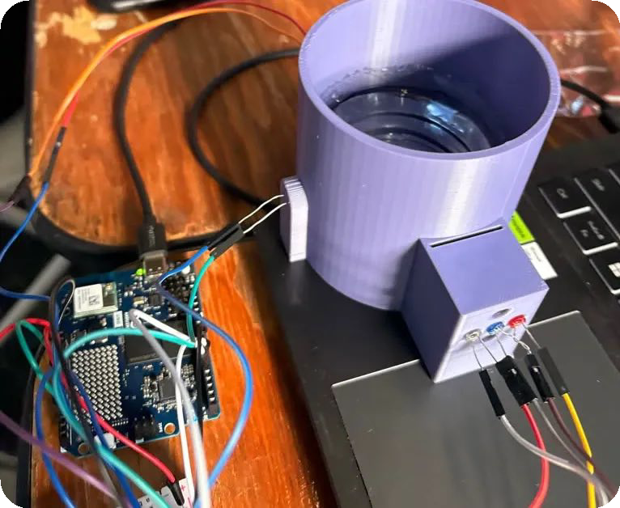
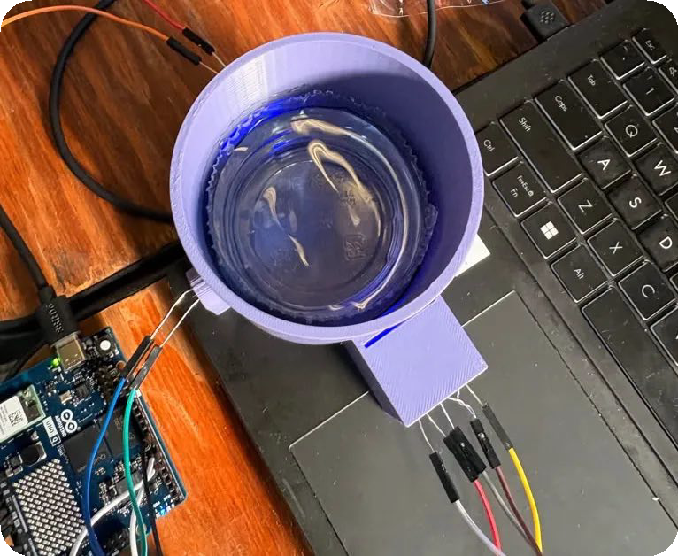
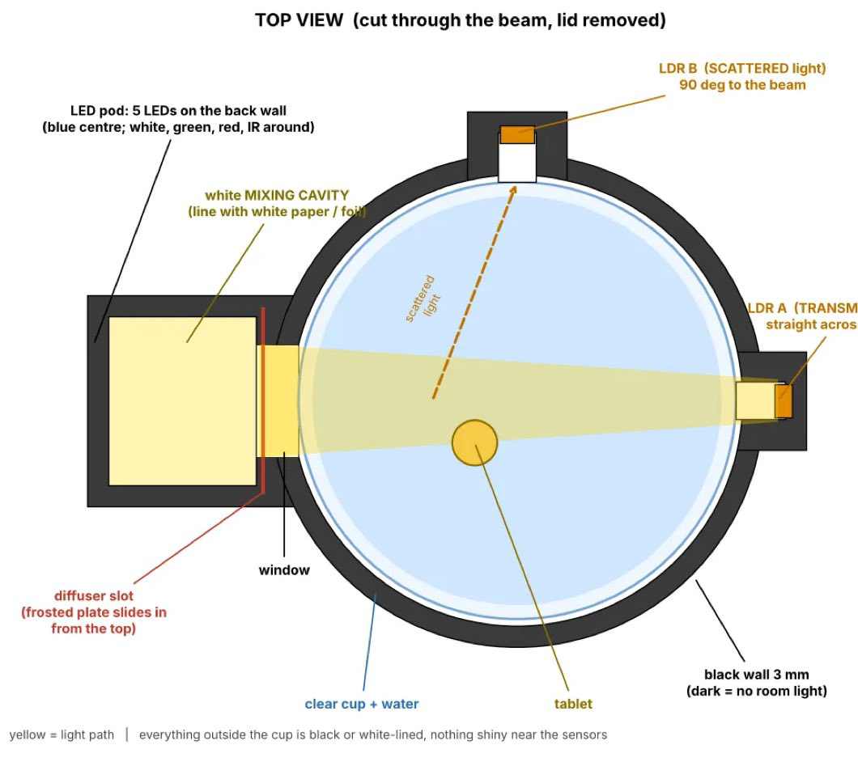
Pill
THE STATION
04 / 21
Lot numbers can be copied. Dissolution cannot.
A recall lookup trusts the label. Pill measures the tablet itself: one tablet in a cup of water inside a dark chamber, two light sensors watching it dissolve.
Photo · purple 3D-printed chamber, clear cup of water; side box with white, blue and red LEDs; the UNO Q at left.
Photo · from above: blue light inside the cup, the LED box below it, the UNO Q at lower left.
Arduino UNO Q · 3.3 V · 12-bit
Two photoresistors in 10 kΩ dividers from the 3V3 pin: A0 across the cup, A1 at 90° to the beam.
Drawing · the chamber design, top view (pillgate/diagrams): the LED pod on one side, one photoresistor straight across the cup, one at 90° to the beam.
A dark reading every second
All LEDs off, both sensors read. Room light cancels out of the signal instead of leaking into it.
Blue, white, red in turn
Each LED lights alone and both sensors read again: light that gets through, light that scatters sideways.
One CSV line a second
ms, dark, blue, white, red for each sensor, at 115200 baud. The firmware decides nothing.
Pill · Cal Hacks 13.0 · pill-site.vercel.app
Notes:
The station is an Arduino UNO Q, a 3.3-volt board with a 12-bit ADC. These are photos of it from Saturday: a purple 3D-printed chamber holding a clear cup of water, a side box with white, blue and red LEDs, and the UNO Q next to it. The drawing shows where the two photoresistors sit, one in line with the beam and one at ninety degrees. Once a second it turns every LED off and reads both, the dark reading that cancels room light, then lights blue, white and red in turn and reads again. It sends one CSV line a second. The firmware decides nothing; the laptop does the maths.

Slide 5
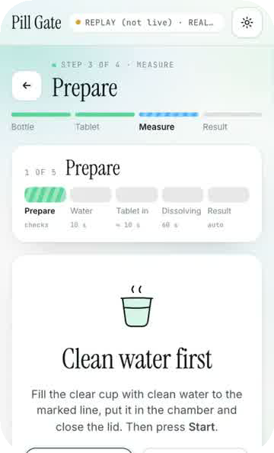
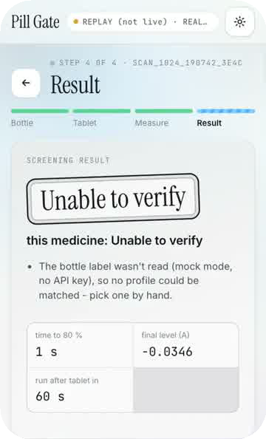
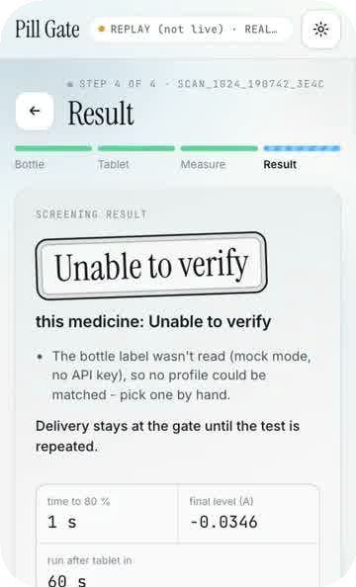
Pill
THE STATION APP · PILL GATE
05 / 21
The station app.
Pill Gate runs on the laptop next to the box (Python, FastAPI). It guides the check and compares the run with a reference profile built from three or more runs of a known-good tablet.
01
02
03
04
05
Prepare
Clean water
Tablet in
Dissolving
Result
checks
10 s
lid opens
60 s
auto
Lid closed, the LED reaches the sensor.
The blank must hold steady for 10 s.
The lid opening on both sensors marks the start.
Absorbance and cloudiness curves, live.
Compared with the reference profile.
THREE ANSWERS, WRITTEN THIS WAY IN THE STATION APP
Passed the screen
Time-to-80 % and final colour inside the spread of the reference runs.
Needs lab testing
Outside it: slower, weaker, cloudier or clearer than the reference.
Unable to verify
No reference for this product, lid open too long, a noisy blank, or the curve never settled.
Measure · the phase rail
Guided flow · step 6
Result · the answer
Pill · Cal Hacks 13.0 · pill-site.vercel.app
Notes:
The station has its own app, Pill Gate, on the laptop beside the box. Prepare checks the lid and the light path, ten seconds of clean water make the blank, the lid opening marks the tablet going in, sixty seconds of dissolving, then the result. It compares the run with a reference profile from three or more runs of a known-good tablet, and it says one of three things: Passed the screen, Needs lab testing, or Unable to verify.

Slide 6
Pill
HOW A RUN WORKS
06 / 21
60 seconds, start to answer.
Quick mode stops 60 s after the tablet goes in; full mode runs 2–10 min until the curve is flat. The station app compares the run with a reference profile (three or more good runs); the clinic app draws it as a pill filling to its reference plateau.
0%
22%
53%
86%
100%
blank
dissolving
dissolving
settling
done
0:00 · dark, then 10 s of clean water. Lid open? No run.
One whole tablet in; stirred by hand.
The light through the cup changes as it dissolves.
The curve starts to flatten.
1:00 · compared with the reference.
Illustration · example levels; the app draws them live from the sensor stream.
Pill · Cal Hacks 13.0 · pill-site.vercel.app
Notes:
One whole tablet in a small cup, stirred by hand. Quick mode is sixty seconds after the tablet goes in; full mode runs two to ten minutes until the curve is flat. The run is compared with a reference, and the answer is one of three. A model explains the result in plain English but never sets it.

Slide 7
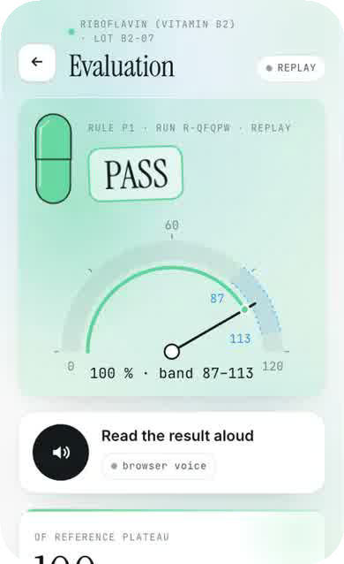
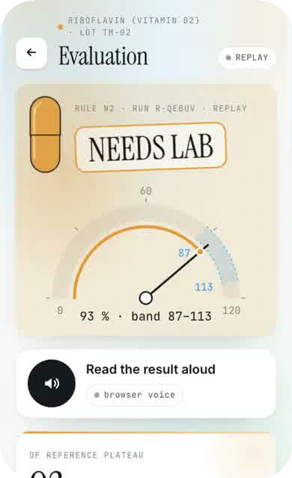
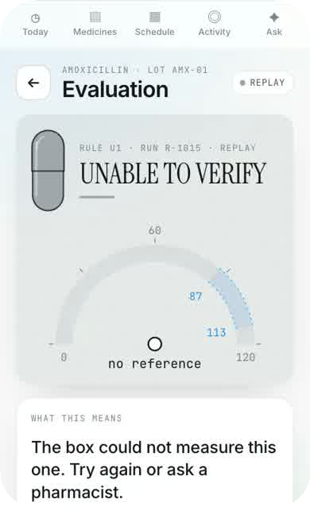
Pill
THREE ANSWERS
07 / 21
Three answers. Never a guess.
Seven rules, checked in order. A model writes the plain-English “why”; it never sets the verdict.
PASS
NEEDS LAB
UNABLE TO VERIFY
Plateau in the reference band and the 90° channel rose with it (P1).
Light dropped with no rise at 90°, no plateau, or a plateau outside the band (N1–N3).
No reference for this drug, a fault, or too little data (U1–U3).
Pill · Cal Hacks 13.0 · pill-site.vercel.app
Notes:
It says three things only: PASS, NEEDS LAB, UNABLE TO VERIFY. Never a fourth. In the clinic app PASS means this tablet's curve matched the reference band; it does not mean right drug, right dose or contaminant-free.

Slide 8
Pill
HOW THE MONEY MOVES
08 / 21
How the money moves, and who decides.
MEASURE
THREE ANSWERS
THE POLICY AGENT · PILL/PAY
THE MONEY · COINBASE
One tablet
Six clauses P1–P6, in code → a ceiling.
pill-clinic
Passed the screen
Claude may only return the ceiling or escalate.
CDP server wallet
hold · delivery logged
refund
Station · Arduino UNO Q
in: the verdict · recall lookup (openFDA) · bottle label (Gemini → editable fields; unreadable = null) · invoice amount vs cap · pharmacist’s tap
pill-escrow
Blue · white · red LEDs, 2 photoresistors, 1 CSV line/s. The firmware decides nothing.
Needs lab testing
CDP server wallet
release
Capital One Nessie mirror, sandbox dollars (SANDBOX; not yet run)
Unable to verify
Release · passed + no recall + within cap + tap
pill-supplier
CDP server wallet
analysis.py
Three answers, never four. No model sets a verdict.
Hold · needs lab; lab referral drafted
USDC on Base Sepolia (TESTNET) · Coinbase CDP SDK server wallets
Deterministic: curve maths, quality gates.
Escalate · unable to verify → a person; nothing moves
ESCROW · MODE: SIMULATED UNTIL A CDP KEY
SELLING A VERDICT · COINBASE X402
Buyer agent · another clinic, or an agent with no local reference
POST /verify with a curve
402 Payment Required · 0.05 USDC (TESTNET); the price travels in the 402
Buyer reads the price, checks its 1 USDC / 24 h cap, signs
Facilitator verifies the signature
200 + verdict JSON · pending a CDP key / 0.05 test USDC
Real 402 today; the facilitator’s verify step answered (insufficient_balance on our unfunded test wallet). @x402/express · @x402/evm · CDP SDK. Service modes cdp · public-facilitator · simulated, each named in every response.
MODEL
DOES
NEVER
Claude
Station: reads the bottle label + imprint, writes the report, answers Ask, behind the guardrail. Clinic: the two-sentence “why”; the escrow clerk (returns the ceiling computed in code, or escalate).
Sets a verdict; moves money
Gemini
Clinic: reads the bottle label into editable fields (unreadable → null); runs the agentic checker (label, up to three cup frames, code tools for the recall lookup).
Sets a verdict; invents a field
Deterministic code
analysis.py and rules.ts (U1 U2 U3 N1 N2 N3 P1) set every verdict; the policy computes the ceiling; the clause filter drops any model sentence with a banned claim word (over half dropped → rule text).
Calls a model to decide
Notes:
How the money moves, and who decides. One tablet goes into the station; deterministic code turns the curve into one of three answers. The policy agent runs six clauses in code to get a ceiling; Claude may only return that ceiling or escalate. Passed, no recall, within the cap and a pharmacist’s tap releases the escrow to the supplier; Needs lab holds it and drafts a lab referral; Unable to verify escalates to a person. The money column is three Coinbase CDP server wallets, USDC on Base Sepolia, testnet, and escrow moves are simulated until we have a CDP key. Underneath, another clinic can buy a verdict over x402: the 402 is real today, the paid 200 is still pending. Claude and Gemini explain and read; code sets every verdict.

Slide 9
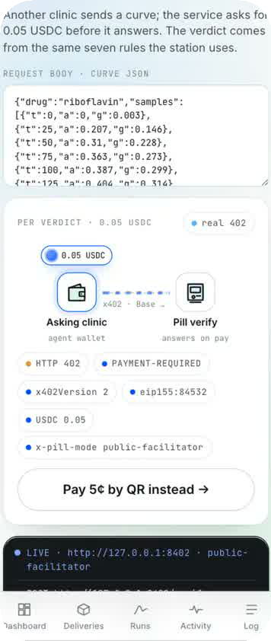
Pill
COINBASE · X402 · PAYMENT AGENTS
09 / 21
The verdict is the invoice.
TESTNET · BASE SEPOLIA
0.05 USDC PER VERDICT
402
sign
settle
200
The server answers “Payment Required”: 0.05 USDC on Base Sepolia.
The buyer’s wallet signs that exact payment; over its spend cap, it refuses.
PENDING · the facilitator settles it on Base Sepolia (needs 0.05 test USDC or a CDP key).
PENDING · the server answers with the verdict and the rule id that fired.
01
02
03
Pay
Buy
Earn
Escrow → supplier in USDC, only after PASS and a pharmacist’s tap.
No local reference? Buy a verdict from another station over x402, capped per day.
Every station can sell /verify to other clinics.
app · /verify over x402
Pill · Cal Hacks 13.0 · pill-site.vercel.app
Notes:
Other clinics can buy a verdict for five cents over x402. The server really answers 402 and the facilitator checks the signed payment; settle and the paid 200 are still pending, waiting on 0.05 test USDC or a CDP key. Testnet USDC on Base Sepolia; nothing here is real money.

Slide 10
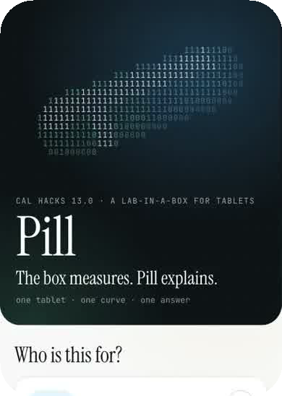
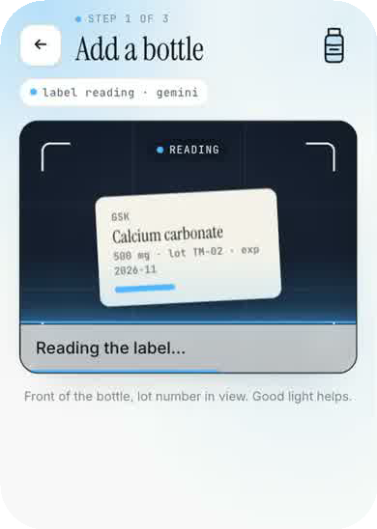
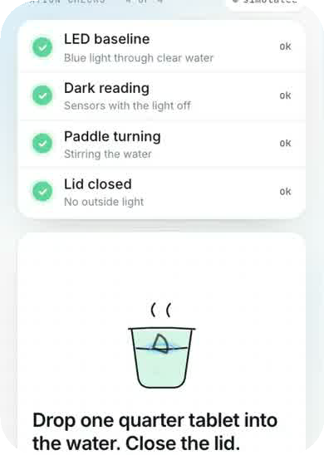
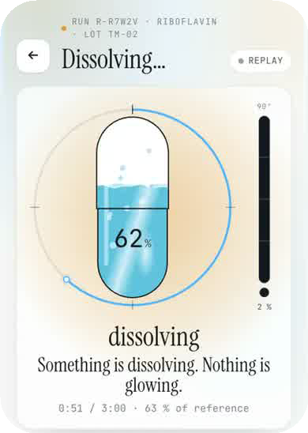
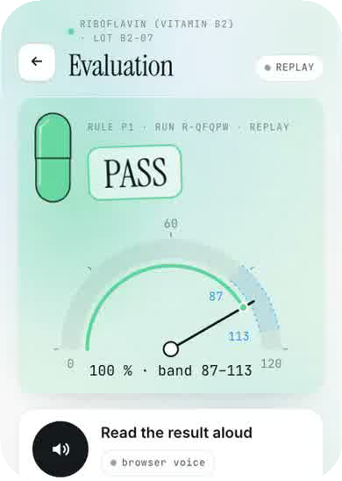
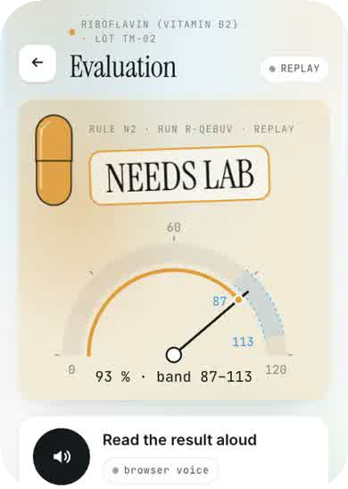
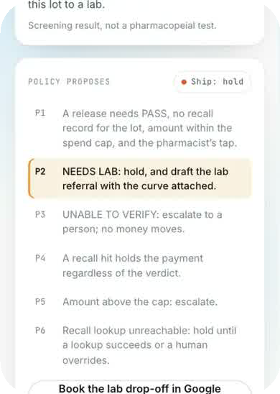
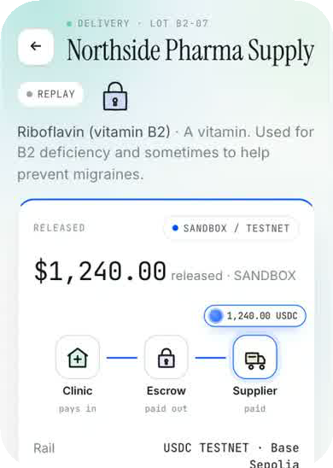
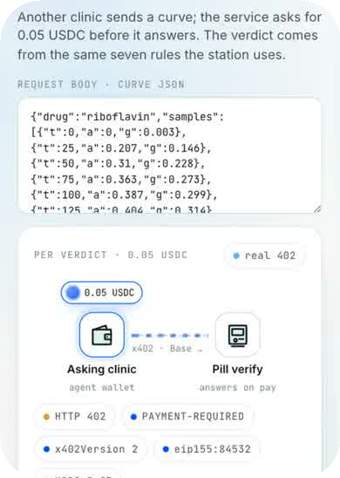
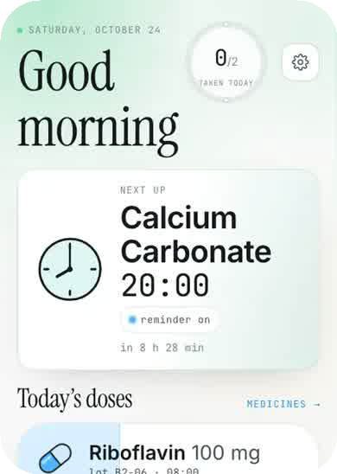
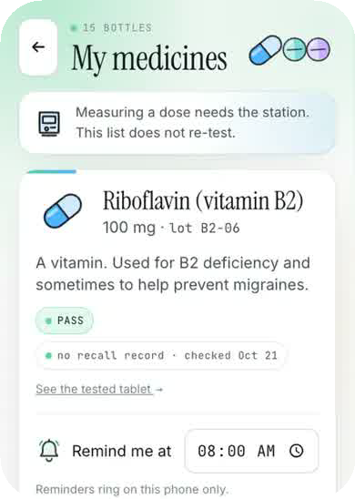
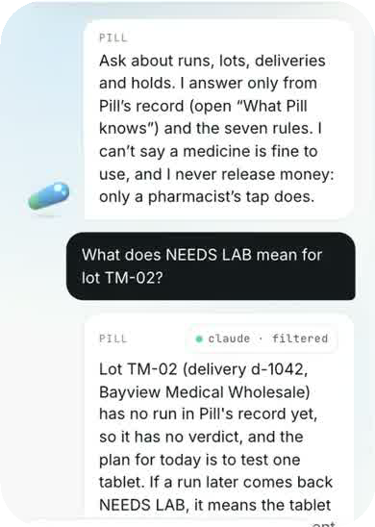
Pill
THE APP
10 / 21
The clinic app: on a laptop and a phone.
25 routes in React. All 364 app screenshots go into the Design file, one frame each, labelled with their route. These twelve are the newest pass.
welcome
bottle
place
run
PASS
NEEDS LAB
held · P2
released
/verify · x402
home
medicines
ask
Notes:
The clinic app is one web app on a laptop and on any phone. These are the newest build pass; the Design file has every screenshot, grouped by pass and linked to its route.

Slide 11
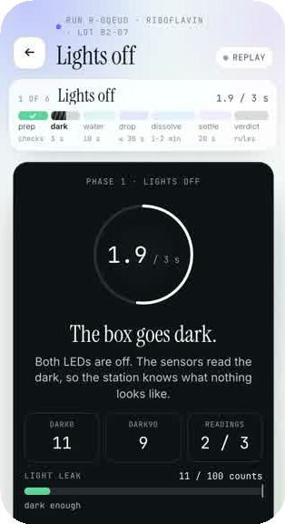
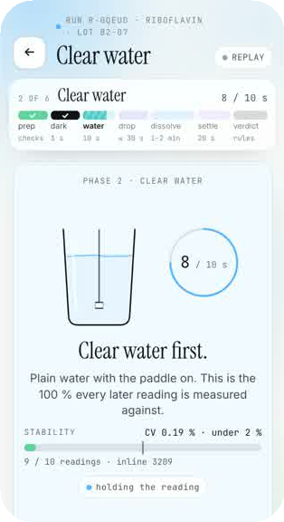
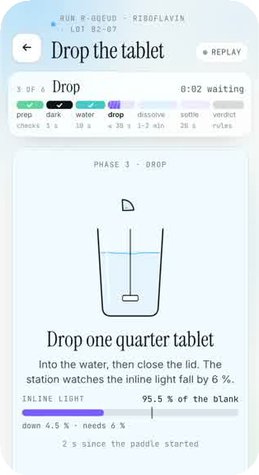
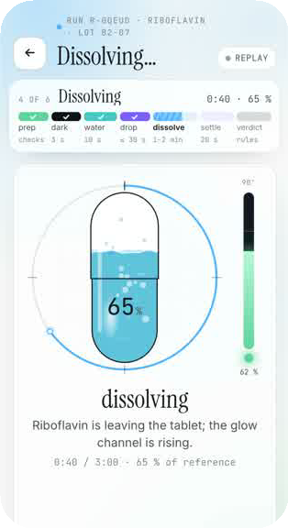
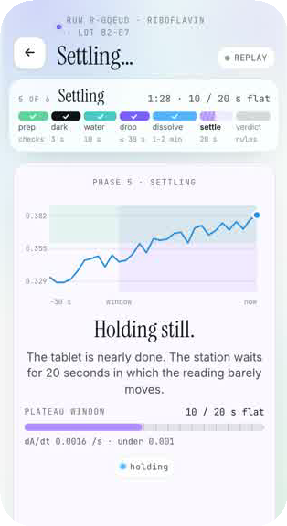
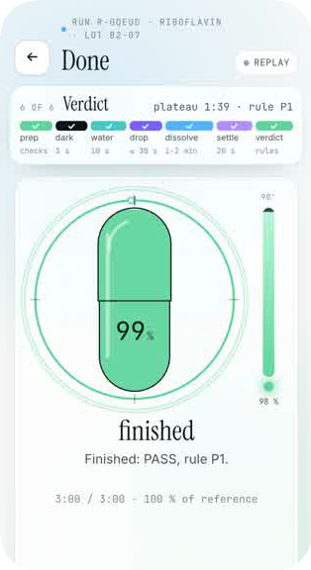
Pill
THE CLINIC APP, PHASE BY PHASE
11 / 21
Six phases, one run.
The clinic app’s run, live against its simulated station. Each phase has its own time, its own look and its own check; a failed check stops the run and says why.
01
02
03
04
05
06
Lights off
Clear water
Drop the tablet
Dissolving
Settling
Verdict
3 s
10 s
≤ 30 s
1–2 min
20 s window
7 rules
LEDs off. The box must read dark; a light leak means the lid is open, and the run stops.
Plain water. The blank must hold steady (CV under 2 %) or it retries, up to 3 times.
It waits for the inline reading to fall 6 %. After 30 s the screen prompts.
The pill fills, the curve falls, the 90° channel rises. Flat at 90° while blue falls: the amber moment.
Flat for 20 s (|dA/dt| < ε) means plateau. No plateau by 180 s: timeout.
Seven rules, in order. The rule that fired is printed with the word.
Pill · Cal Hacks 13.0 · pill-site.vercel.app
Notes:
The clinic app shows a run as six phases, played here against its simulated station. Lights off for three seconds: the box must be dark, or the lid is open and nothing runs. Ten seconds of clear water as the blank; it must be steady. Drop the tablet; it waits for the reading to fall six percent. Dissolving: the pill fills and the 90-degree channel should rise with it. Settling: twenty flat seconds is a plateau. Then the seven rules give the word.

Slide 12
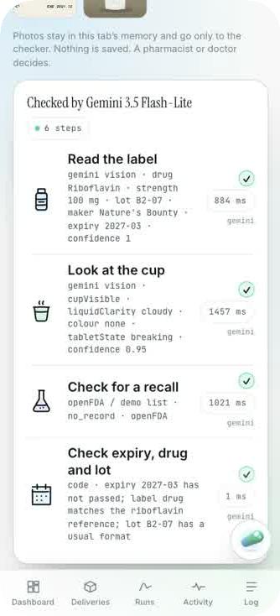
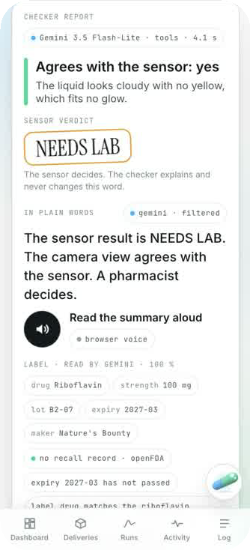
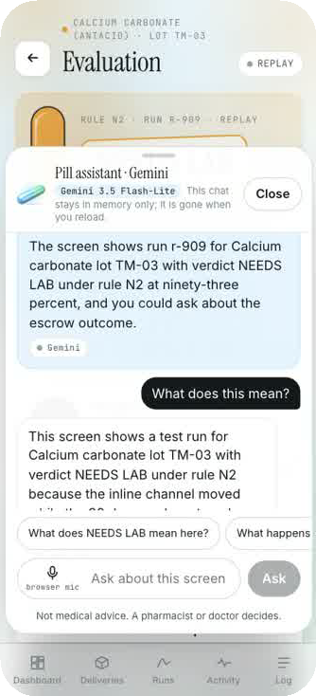
Pill
GEMINI CHECKS THE SENSOR
12 / 21
Gemini checks what the sensor says.
After the run, Gemini reads the label, looks at the cup and checks for a recall, then compares that with the sensor. Six steps, each logged with its own time.
1
Read the label
gemini vision
2
Look at the cup
gemini vision
3
Check for a recall
openFDA
4
Check expiry, drug and lot
code
5
Compare with the sensor
code
6
Say it in plain words
gemini · filtered
The sensor decides. The checker explains and never changes the word. A pharmacist or doctor decides.
Checker · the step log
Checker · the report
Follower · on every screen
Pill · Cal Hacks 13.0 · pill-site.vercel.app
Notes:
After the run, a Gemini agent checks what the sensor says: it reads the label, looks at photos of the cup, checks openFDA for a recall, cross-checks expiry, drug and lot, and compares what the camera saw with the sensor numbers. Every step is logged with its own time. The verdict word comes from the sensor and is never changed. The follower is the same Gemini, docked on every screen, answering questions about what is on it.

Slide 13
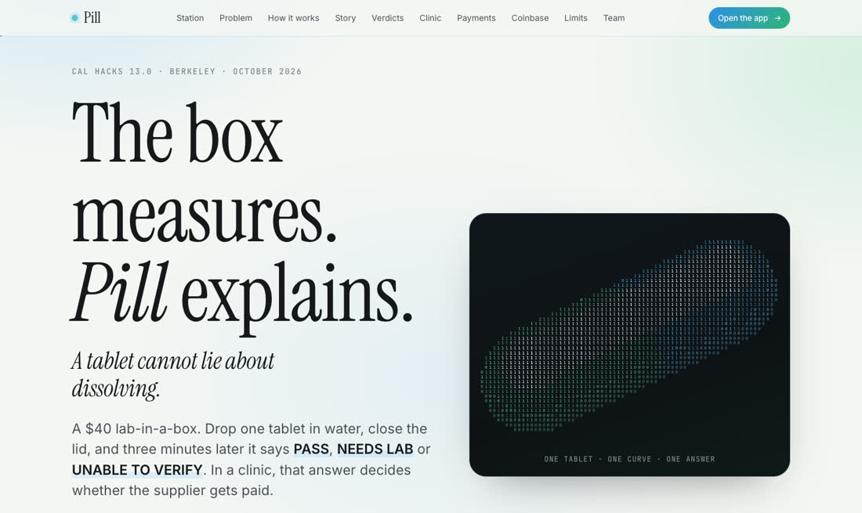
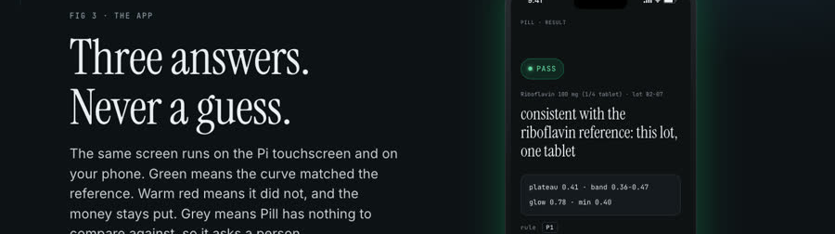
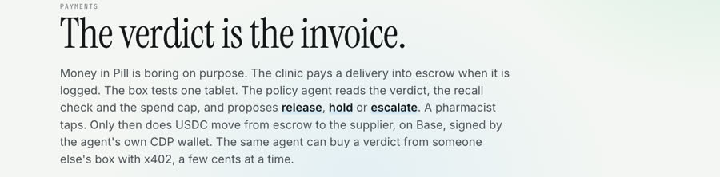
Pill
THE WEBSITE
13 / 21
pill-site.vercel.app
Built code-first (Vite + anime.js) after a 16-persona panel scored a plain, honest page 8.0 against a copied storytelling site at 3.7. Words stay ink; colour lives in backgrounds and lines.
Fig 3 · three answers, the same screen as the app
Hero · the binary pill, drawn in characters by pill.js
Payments · the verdict is the invoice
Pill · Cal Hacks 13.0 · pill-site.vercel.app
Notes:
The website came first and set the tokens the app inherited. A 16-persona panel picked a plain, honest page over a copied storytelling site. All three crops are the live site today, captured headless.

Slide 14
Pill
WORKFLOW · IDEA TO DEMO
14 / 21
Code first, then Figma from the code.
demo
01
02
03
04
Ideation
Prototyping
Handoff
Code generation
CODE
CODE
CODE
CODE
AI persona panels
binary-pill.html
CSS :root, by hand
Claude Code + 3 builders
Web research
Phone mock (Vite)
FIGMA
FIGMA
FIGMA
FIGMA
Styles + variables
Pill → Figma plugin
FigJam board
Figma Make prompt
Composio → CSS
≈92 min · 4/5
≈255 min · 4/5
≈65 min · 3/5
≈7 min · 2/5
FIGMA STEP PENDING
FIGMA STEP PENDING
FIGMA STEP PENDING
FIGMA STEP PENDING
Honest order: no Figma was used Friday or Saturday morning. The Figma files are generated from the repo, and the log says so.
Pill · Cal Hacks 13.0 · pill-site.vercel.app
Notes:
We are a code-first team. Ideation and prototyping happened in markdown, AI panels and HTML. Figma enters as the place the repo is published to: slides, screens, tokens and the ideation board.

Slide 15
Pill
THE FIGMA STEP
15 / 21
This deck was generated from the repo.
Slides
deck + speaker notes
repo
build-deck.mjs
deck.json
Pill → Figma
Composio
screenshots · CSS :root · debate JSON · stage log
Node, no npm deps; ffmpeg for images
slides, pages and board in one file
one-file plugin that draws deck.json
Design
comments, thumbnails, tokens
pages + styles
FigJam
the ideation board
CSS
the loop: Figma styles and variables → Composio → CSS back in the repo
tokens-from-figma.mjs
Recipe for code-first teams: keep the repo as the source of truth, emit one JSON, let a plugin draw it. One run gives designers editable layers, every screen, the tokens as styles, and a board of how you decided.
Why a plugin: the Figma REST API and our Composio connector can read, comment and set variables, but cannot create layers or slides. The Plugin API can.
Pill · Cal Hacks 13.0 · pill-site.vercel.app
Notes:
The REST API cannot draw, so the repo emits deck.json and a one-file plugin draws it in Slides, Design or FigJam. Composio closes the loop: comments, dev resources back to the code, thumbnails, and tokens back to CSS. Nobody has run it in real Figma yet; that step is marked pending.

Slide 16
Pill
STAGE LOG
16 / 21
Four stages, timed from git.
STAGE
TOOLS
MINUTES
RATING
WHAT BROKE
INTO THE PROJECT
Ideation
16 AI personas per panel, reference study; FigJam board generated after
≈255 min
4/5
One model played all 16: agreement inflated (SD 0)
PLAN.md decisions, scope, site outline
PENDING
Prototyping
binary-pill.html, phone mock in the site’s JS; Figma Make prompt written
≈65 min
3/5
Nobody could click it without a code editor
APP-PLAN’s 12 screens, the pill fill
PENDING
Handoff
CSS :root copied site → app; Figma styles + variables; Composio → CSS
≈7 min
2/5
8 of 27 tokens arrived identical; no record of intent
App :root, Tokens page, tokens-from-figma.mjs
PENDING
Code generation
Claude Code + 3 parallel builders; Pill → Figma plugin
≈92 min
4/5
P6 hold rule bug; double deploy; REST API can’t draw
App, payment service, this deck
PENDING
PENDING = the Figma step is written but not yet run; its minutes and rating stay blank in the log, not estimated.
Pill · Cal Hacks 13.0 · pill-site.vercel.app
Notes:
Four stages, timed from git commit times. Steps not yet run in real Figma say pending; we do not estimate them. The full log, with the Figma Make prompt and a ten-minute reproduce box, is STAGE-LOG.md.

Slide 17
Pill
WHAT BROKE
17 / 21
What broke, and what it changed.
The P6 hold rule
A double deploy
The scaffold held money only when the recall lookup was unreachable, so a delivery with no bottle attached could be proposed for release.
A `tail -6` cut off Vercel’s output, the deploy looked unfinished and was re-run: two identical production deploys.
Caught by a builder’s end-to-end test.
Read the whole log before re-running.
The REST API can’t draw
8 of 27 tokens survived the hand copy
The Figma REST API and our Composio connector read, comment and set variables. Neither can create a layer or a slide.
Site → app by hand: 8 identical, 7 changed value, 12 renamed or dropped. Nothing recorded which changes were meant.
So the repo emits deck.json and a plugin draws it.
Tokens now go to Figma as variables and back as CSS.
Pill · Cal Hacks 13.0 · pill-site.vercel.app
Notes:
What broke, honestly. A rule bug the tests caught, a deploy we ran twice because the output was cut off, an API that cannot draw, and a hand-copied palette where most tokens drifted. Each one changed how we work.

Slide 18
Pill
BEFORE AND AFTER
18 / 21
From hours to one click.
BEFORE · BY HAND
ESTIMATE
≈ 18 h
21 slides × 20 min + 618 screenshots × 1 min + 43 tokens × 1 min = 1081 min
Per-unit minutes are our assumption, not a measurement.
AFTER · THE PLUGIN
MEASURED
17.3 s
repo → deck.json + deck.html, cold build on this machine (1.3 s this run). Plugin logic on a stub Figma API: 11 ms Slides · 28 ms Design · 1 ms FigJam.
Plugin run in real Figma: [fill after running]
bars to scale · after = cold build time
Every run places 618 screenshots (364 app, 254 site) and turns 43 CSS variables into Figma styles and variables, with no hand work. By hand, 8 of 27 site tokens reached the app unchanged.
Pill · Cal Hacks 13.0 · pill-site.vercel.app
Notes:
Before numbers are estimates and say so. After numbers are measured on this machine; the real Figma run time is printed by the plugin and goes into LINKS.md.

Slide 19
Pill
LIMITS · REAL VS SIMULATED
19 / 21
Pill screens tablets. It does not grade them.
PASS MEANS
PASS DOES NOT MEAN
The dissolution curve of this one tablet, on this box, was consistent with the reference runs. No red flags found.
That the tablet is the right drug, the right dose, or free of contaminants. Anything Pill cannot compare goes to a lab, by design.
REAL VS SIMULATED, RIGHT NOW
Station hardware
REAL
Arduino UNO Q, 2 photoresistors, blue/white/red LEDs; one CSV line a second. One real aspirin run recorded Saturday. Reference profile not yet recorded; water-only control not yet run.
Station app
REAL
Analysis, guided run, lid detection, guardrail; 14 tests pass. Live Claude scan ran Sat 19:19 on scan_1024_191752_f0c2 (replay of the real aspirin run): Unable to verify, no reference profile yet.
Clinic app curves
REPLAY
Synthetic curves (B2-07, TM-02, B2-LID, AMX-01), labelled REPLAY on screen; the week of history is fixture data.
Money
SIMULATED
USDC escrow simulated until a CDP key. x402: real 402 and signature check; paid 200 pending. Nessie mirror built, not run. SANDBOX / TESTNET only.
Pill · Cal Hacks 13.0 · pill-site.vercel.app
Notes:
Say the limits before a judge asks. PASS, or Passed the screen in the station app, means this tablet dissolved like the reference runs; it never calls a medicine good or bad. Then what is real today: the UNO Q station and its app are real, and a live Claude scan ran Saturday at 19:19 on a replay of our real aspirin run; there is no reference profile yet, so it said Unable to verify, and the water-only control has not run. The clinic app replays labelled synthetic curves, escrow is simulated until a CDP key, and the paid x402 200 is pending. All money is SANDBOX or TESTNET.

Slide 20
Pill
TRACKS
20 / 21
One build, many judges.
Figma · Idea to Demo
Hardware Hack
Hyphenate · finance agents
this deck, the plugin, the stage log
the station, on the table
policy agent: proposes, holds, escalates
Coinbase · x402 payment agents
Capital One · Nessie
Microsoft · Built for the Real World
/verify over x402, USDC escrow (TESTNET)
sandbox mirror only if the key lands
a clinic pharmacist’s delivery check
Anthropic · Claude
People-First
Most Technically Complex
the plain-English why; can only downgrade
personal mode, read aloud
two-sensor optics + rules + payments
MLH · Gemini API
MLH · Gen AI
reads the bottle label
models explain; rules decide
Pill · Cal Hacks 13.0 · pill-site.vercel.app
Notes:
One build, many judges; only the emphasis changes. Money is SANDBOX or TESTNET on every track.

Slide 21
Pill
NEXT
21 / 21
Next: real runs, one clinic.
1
A reference profile on the real box
Three or more runs of a known-good aspirin tablet, then the water-only control against it.
2
A second reference drug
Each new drug needs its own profile. Until then it is UNABLE TO VERIFY, on purpose.
3
One pharmacy, one week
A procurement officer samples one tablet per delivery; we log every decision and every override.
Ask: try to make it say PASS on the chalk. Then tell us which tablet to calibrate next, and introduce us to one clinic pharmacist.
Pill · Cal Hacks 13.0 · pill-site.vercel.app
Notes:
Our ask: try to make it say PASS on the chalk. Then tell us which tablet to calibrate next, and introduce us to one clinic pharmacist. Everything still pending is marked pending in the repo.

