Slide 1
HACKFEST
Jabalpur2019
Sparsh Ahuja | Rakshak | Saumya Mishra

Slide 2
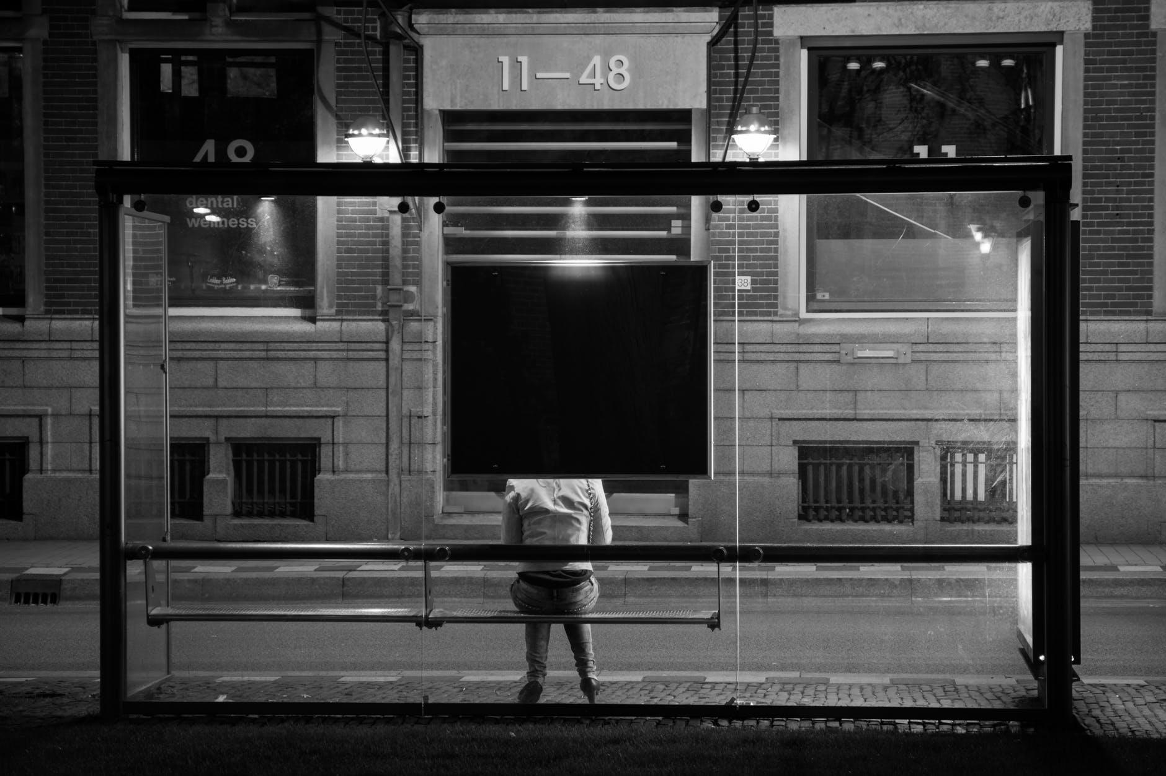
Abstract

Slide 3
Low Frequency (LF) RFID | High Frequency (HF) RFID | Ultrahigh Frequency (UHF) RFID
Covers frequencies from 30 to 300 KHz | Ranges from 3 to 30 MHz | Ranges from 300 MHz to 3 GHz
Provides a short read range of 10cm | Read range is between 10cm and 1m | Read range of passive UHF system can be as long as 35m
Has slower read speed | Has moderate read speed | Has a very good read speed

Slide 4

Abstract
This project aims to develop a bus detection system using Radio Frequency Identification (RFID) for the visually impaired.
Here, the device utilizes the RFID communication technology to provide information of the incoming buses to the visually impaired and help them in boarding the bus

Slide 5
₹ 300,000
Item | Cost
Mercury (M6e) UHF Reader Module | 3 x ₹60000 = ₹180,000
OMNI Dura 3000 RFID Tags | 10 x ₹2000 = ₹20,0000
Antenna Apparatus and Development | ₹ 30,000
Bluetooth Communication Modules | ₹ 30,000
Microprocessors and Miscellaneous Prototyping Material | ₹ 40,000

Slide 6
Thank You!
Sparsh Ahuja | Rakshak | Saumya Mishra

