Slide 1
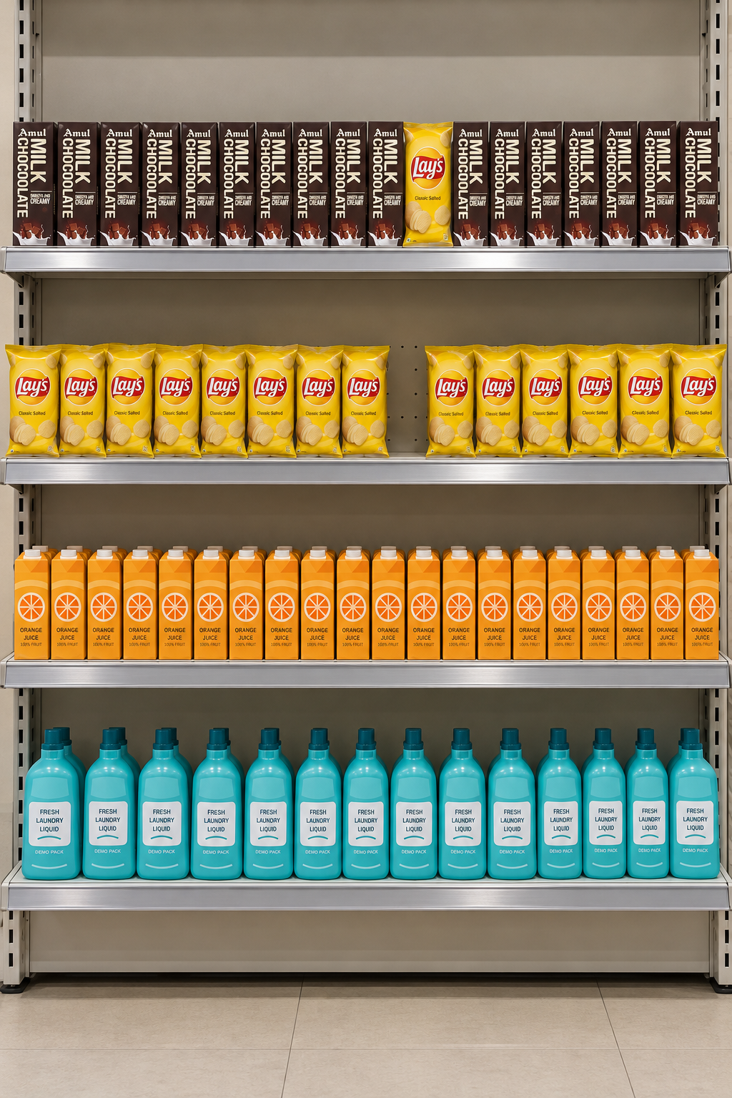
ShelfSense AI
AI-Powered Supermarket Shelf &
Planogram Compliance
From physical planogram design to evidence-backed shelf-photo auditing
Prepared for mentor review
Dhruv | October 2026
Working prototype + controlled fixture evidence
Notes:
Evidence / sources:
Repository fixture: image-parsing/tests/fixtures/compliance/pipeline-verification/shelf_photo.png
Product and implementation evidence: docs/shared/ARCHITECTURE.md; docs/shared/COMPLIANCE_ROADMAP.md

Slide 2
02
Executive summary
What has been built, and what the evidence supports
ShelfSense converts a planogram into a frozen audit reference, processes a shelf photograph, and produces an explainable compliance report.
Verified fixture result
54
Planogram designer stores shelf geometry in centimetres and prevents overlap or out-of-bounds placement.
correct facings
Image pipeline detects shelf elements, extracts product crops, maps rows and positions, then matches only the shelf-scoped catalogue.
1
misplaced Yellow Lays
Compliance report preserves evidence, locations, confidence gates, and operator dispositions.
1
empty facing detected
10 low-confidence boxes withheld from identity and quantity decisions
Status: implemented, thresholds provisional
ShelfSense AI | Mentor review
02 / 16
Notes:
Evidence / sources:
backend/uploads/image_processing/outputs/7/analysis.json
backend/uploads/image_processing/outputs/7/compliance_audit.json
docs/shared/COMPLIANCE_ROADMAP.md

Slide 3
03
Problem statement and motivation
A shelf photo contains visual evidence. A planogram contains physical expectations. Compliance requires a defensible comparison.
Why this is difficult
A detector can locate packaging without proving the exact catalogue identity.
Rows and x-positions in pixels must align with an expected physical shelf layout.
Lookalike packaging, occlusion, perspective, and low-confidence detections must remain reviewable rather than turn into false alerts.
Decision rule
Claim “missing” or “misplaced” only when identity and calibrated position support it.
Observed shelf
ShelfSense AI | Mentor review
03 / 16
Notes:
Evidence / sources:
Fixture image: image-parsing/tests/fixtures/compliance/pipeline-verification/shelf_photo.png
Compliance decision behavior: backend/app/services/compliance_service.py

Slide 4
04
Feature-status inventory
The presentation separates production code, controlled-fixture evidence, and open validation work
Capability
Status
Evidence / caveat
Planogram designer and cm-based placement rules
Implemented
FastAPI, SQLite, Next.js
YOLO product, empty-space and row parsing
Implemented
Weights and inference pipeline present
Cutouts, shelf-scoped CLIP matching, cluster consensus
Implemented
Thresholds remain provisional
Row/x-coordinate mapping and audit report
Implemented
Controlled fixture covered
OCR price-label flow
Implemented adapter
Runtime smoke check, accuracy unevaluated
YOLO product training / mAP evaluation
Not evidenced
No training result claimed
Variant-level accuracy calibration
Open
Needs labelled crops and shelf fixtures
ShelfSense AI | Mentor review
04 / 16
Notes:
Evidence / sources:
docs/shared/COMPLIANCE_ROADMAP.md
image-parsing/README.md
backend/PRICE_TAG_DETECTION_SETUP.md
image-parsing/MODEL_SETUP.md

Slide 5
05
End-to-end workflow
Actual source modules appear below each stage. Orange labels identify evidence gates or provisional thresholds.
Planogram
+ shelf
Shelf photo
YOLO parse
Cutouts + match
Map to cm
Audit report
›
›
›
›
›
Designer + snapshot
Input image job
Rows, products, empty
Color gate + CLIP
Rows + x-span
Findings + evidence
planogram_service.py
image_processing_service.py
pipeline.py
cutout_service.py
position_calibration.py
compliance_reporting_service.py
Evidence gates
Detection ≥ 0.60 for product crops. Catalogue decisions require shelf-scoped candidates. Missing-stock claims require calibrated positions.
ShelfSense AI | Mentor review
05 / 16
Notes:
Evidence / sources:
backend/app/services/image_processing_service.py
image-parsing/src/shelf_image_parsing/pipeline.py
backend/app/services/cutout_service.py
backend/app/services/position_calibration.py
backend/app/services/compliance_reporting_service.py

Slide 6
06
System architecture
A modular monolith with local persistence and a separate image-parsing package
Frontend
Backend
Persistence
Next.js + TypeScript
Dashboard, Planogram Designer
Analysis and compliance report
FastAPI + SQLAlchemy
REST routes, audit snapshots
Compliance and reporting services
SQLite database
Local uploads and derived crops
Versioned JSON / ZIP exports
REST / multipart
paths + JSON
Client API
api.ts
image-parsing package
YOLO + OpenCV + CV utilities
Packshots + embeddings
Audit evidence
Invariant: physical centimetres govern shelf layout. Frontend pixels only project that geometry for interaction and display.
ShelfSense AI | Mentor review
06 / 16
Notes:
Evidence / sources:
docs/shared/ARCHITECTURE.md
backend/app/main.py
frontend/src/lib/api.ts
backend/app/db/models.py

Slide 7
07
Inputs and frozen audit reference
Each processing job captures the planogram state and the relevant shelf catalogue before analysis begins
Planogram
Shelf width, rows, product placements, facings
Expected physical arrangement
Why shelf-scoped candidates matter
Shelf photograph
Original uploaded image
The matcher excludes unrelated catalogue products captured outside the selected shelf.
Observed visual evidence
It preserves the actual candidate set that existed when the audit started.
Audit snapshot
Expected facing slots + shelf-specific catalogue
Immutable comparison frame
It makes a weak visual match an explicit review state rather than a confident global-catalogue guess.
Packshots + metadata
Name, SKU, category, price, embeddings
Snapshot-bound analysis cache
Candidate identity evidence
ShelfSense AI | Mentor review
07 / 16
Notes:
Evidence / sources:
docs/shared/ARCHITECTURE.md
docs/shared/COMPLIANCE_ROADMAP.md
backend/app/services/image_processing_service.py
backend/app/services/cutout_service.py

Slide 8
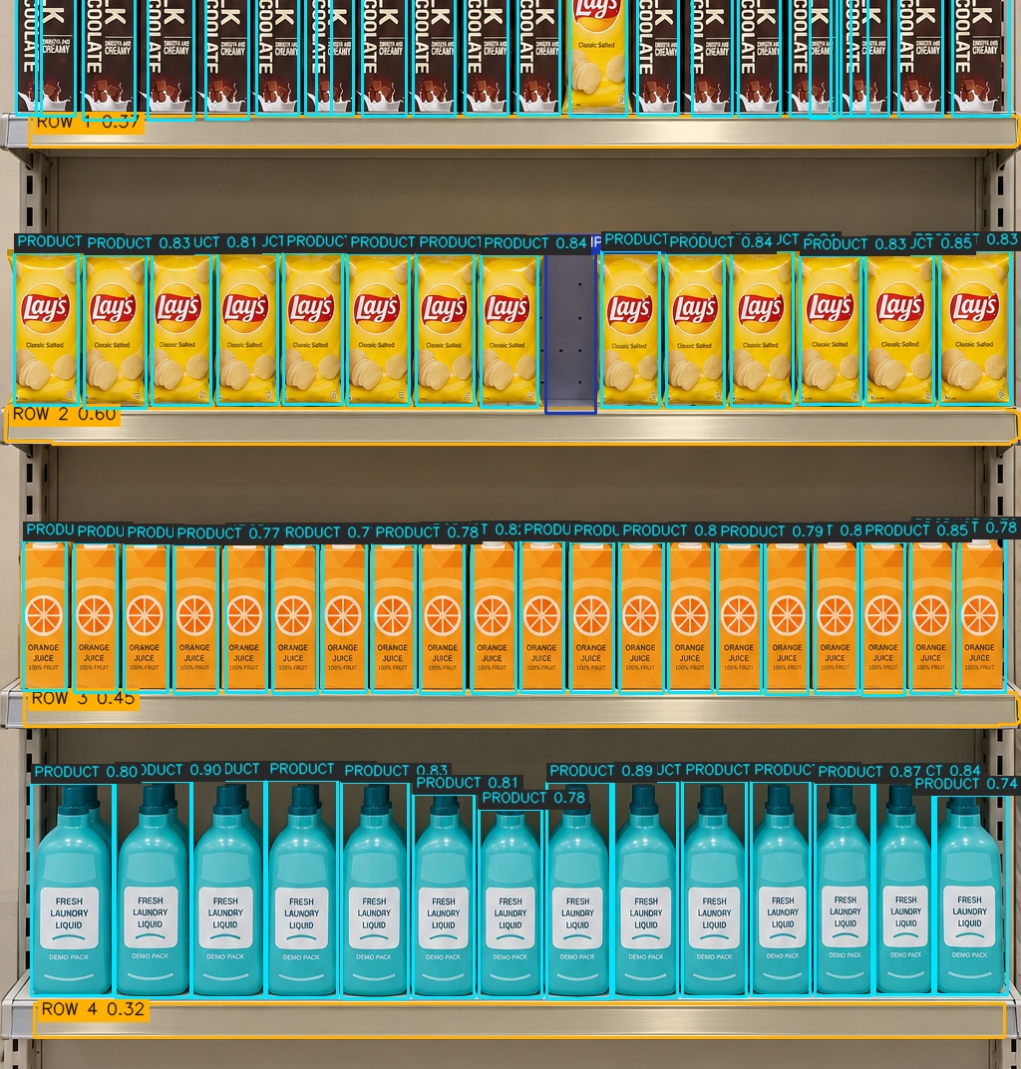




08
Shelf parsing, row understanding, and cutout extraction
YOLO weights detect product / empty-space and shelf-row evidence. Product detection and exact identity remain separate tasks.
Current parsing behavior
Segments shelf rows, detects product and empty-space proposals, filters product crops below 0.60 confidence, and retains excluded boxes as uncertainty geometry.
Detection → Crop → Identity evidence
example crop
example crop
example crop
example crop
Important boundary: a bounding box proves location, not the exact SKU or variant.
Stored annotated output
ShelfSense AI | Mentor review
08 / 16
Notes:
Evidence / sources:
Annotated output: backend/uploads/image_processing/outputs/7/3a6f2153432e4bc7986eab152f10d97c_annotated.jpg
image-parsing/src/shelf_image_parsing/detector.py
image-parsing/src/shelf_image_parsing/row_segmenter.py
backend/app/services/cutout_service.py

Slide 9
09
Catalogue matching and variant identification
Exact catalogue matching uses crop-level evidence. Cluster consensus helps repeated shelf items but does not replace per-crop identity.
1. Candidate gate
2. Visual ranking
3. Decision state
4. Cluster consensus
Use the frozen shelf catalogue only.
Color compatibility filters candidates first.
›
Compare crop embedding with packshot embeddings using CLIP cosine similarity.
›
Accept only when score and margin clear provisional thresholds. Otherwise keep reviewable.
›
Consolidate only a clear same-row catalogue majority. Preserve individual matches.
Current state
CLIP score 0.90 and ambiguity margin 0.03 are present in code but require controlled crop-level calibration. No trained YOLO SKU-classifier or variant accuracy metric is claimed.
ShelfSense AI | Mentor review
09 / 16
Notes:
Evidence / sources:
backend/app/services/cutout_service.py
backend/app/services/product_matching/candidate_filtering.py
backend/app/services/product_matching/cluster_consensus.py
docs/shared/COMPLIANCE_ROADMAP.md

Slide 10
10
Planogram coordinate mapping and compliance decisions
The audit compares expected facing slots with observed, calibrated crop positions in the same row coordinate system
Expected planogram
Observed shelf
Row 1
Row 1
Row 2
Row 2
Row 3
Row 3
Row 4
Row 4
15 expected facings per row | width 120 cm | top-to-bottom row index
red = misplaced Lays
orange outline = empty facing
Conservative rule: when calibration is unavailable, the audit reports “needs review” instead of inferring a definitive missing-stock result.
ShelfSense AI | Mentor review
10 / 16
Notes:
Evidence / sources:
image-parsing/tests/fixtures/compliance/pipeline-verification/manifest.json
backend/app/services/position_calibration.py
backend/app/services/compliance_service.py

Slide 11
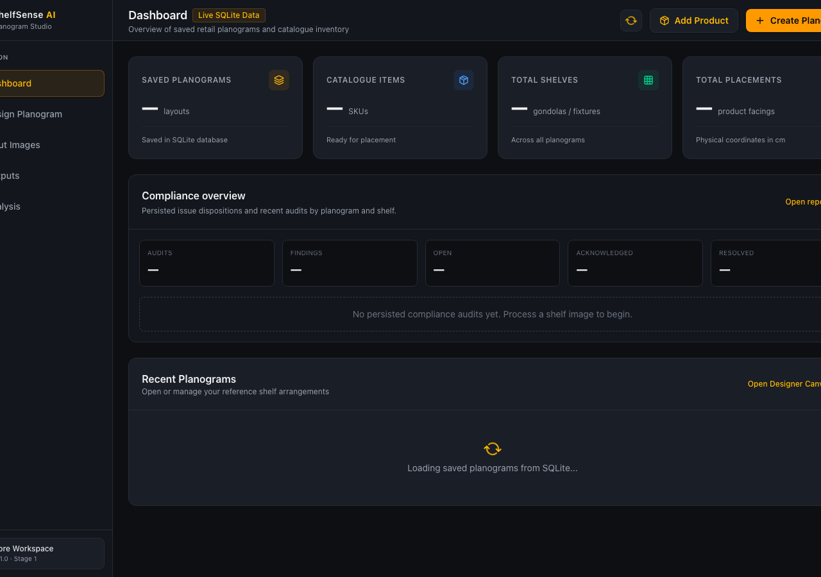
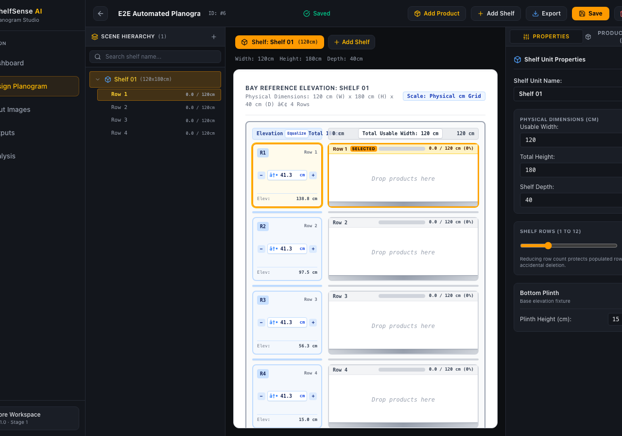
11
Working product interface
The frontend persists planograms and image-processing outputs through the FastAPI backend
Dashboard
Planogram Designer
The designer uses a dark SaaS shell, hierarchy outliner, physical shelf canvas, and direct API synchronization. The analysis flow renders cutout and compliance evidence in the same application.
ShelfSense AI | Mentor review
11 / 16
Notes:
Evidence / sources:
UI screenshots: /Users/dhruv/.gemini/antigravity-ide/brain/a392ed68-b77d-43a0-9d68-3ae758d8881a/dashboard_desktop.png and designer_desktop.png
frontend/src/app/page.tsx
frontend/src/app/designer/page.tsx
frontend/src/app/analysis/page.tsx

Slide 12
12
Controlled four-row fixture evidence
The fixture provides scenario-level acceptance rules. It does not establish detector precision, recall, or calibrated measurement accuracy.
Fixture planogram
Row 1
Amul Milk Chocolate
1 Yellow Lays interleaved
15 expected
Row 2
Yellow Lays
14 reported, one empty facing
15 expected
Row 3
Orange Juice
Full, ±2 facings tolerated
15 expected
Row 4
Fresh Laundry Liquid
Full and correctly arranged
15 expected
Regression target: report one misplaced Lays on Row 1 and one empty Lays facing on Row 2 without false low-stock alerts.
ShelfSense AI | Mentor review
12 / 16
Notes:
Evidence / sources:
image-parsing/tests/fixtures/compliance/pipeline-verification/manifest.json
backend/uploads/image_processing/outputs/7/compliance_audit.json

Slide 13
13
Verification evidence and engineering quality
Tests exercise the isolated backend, image parser, frontend behavior, and critical browser journeys
Backend
pytest
93 passed
Temporary SQLite database and uploads
Image parsing
pytest
40 passed
Pipeline, geometry, row assignment
Frontend
Vitest + TypeScript
22 passed
UI states and report calculations
End-to-end
Playwright
2 passed
Analysis product-match journey
What these results do not prove
They confirm implemented behavior and regressions, not field accuracy, mAP, precision/recall, retail generalization, or OCR accuracy.
ShelfSense AI | Mentor review
13 / 16
Notes:
Evidence / sources:
docs/shared/CONTRIBUTIONS.md entries dated 2026-10-22 and 2026-10-23
backend/tests/
image-parsing/tests/
frontend/tests/
e2e/tests/analysis_product_match.spec.ts

Slide 14
14
Key technical decisions and lessons
The project moved from layout design toward an evidence-conservative photo-to-planogram audit
1
Physical centimetres instead of pixels
Allows layout rules, exports, and compliance positions to use a common real-world coordinate system.
2
Immutable audit snapshot
Prevents a later planogram edit from rewriting the expected state of an already processed shelf photo.
3
Shelf-scoped candidates before CLIP matching
Reduces irrelevant lookalike candidates and preserves the job’s relevant product catalogue.
4
Conservative compliance outcomes
Uncalibrated position or weak identity evidence becomes review-needed, not a fabricated shortage or exact-SKU claim.
ShelfSense AI | Mentor review
14 / 16
Notes:
Evidence / sources:
docs/shared/ARCHITECTURE.md
docs/shared/COMPLIANCE_ROADMAP.md
docs/shared/CONTRIBUTIONS.md

Slide 15
15
Current limitations and risks
The prototype intentionally keeps uncertain evidence visible instead of overstating capability
Model quality
Catalogue variants
No labelled real-shelf benchmark provides precision, recall, mAP, or SKU accuracy.
Packshot embeddings and color gates can confuse visually similar packs and seasonal changes.
Matching thresholds
OCR
CLIP threshold and ambiguity margin are fixture-informed but not calibrated across product categories.
Live smoke test exists, but no labelled price-tag data supports accuracy claims.
Geometry
Operational readiness
Perspective handling supports optional ArUco calibration; physical repeatability remains unmeasured.
Local SQLite, disk storage, and model dependencies suit prototype use rather than production scale.
ShelfSense AI | Mentor review
15 / 16
Notes:
Evidence / sources:
docs/shared/COMPLIANCE_ROADMAP.md
backend/PRICE_TAG_DETECTION_SETUP.md
image-parsing/tests/fixtures/compliance/pipeline-verification/manifest.json

Slide 16
16
Future work and mentor discussion
The highest-value next step is measurable validation on a controlled physical shelf
1
2
3
4
1. Build labelled fixture
2. Calibrate decisions
3. Strengthen recognition
4. Productize
Measured shelf rows, pixel boxes, exact SKU/variant identities, price labels, and multiple controlled error scenarios.
Measure detector quality, matching accuracy, position tolerance, empty-space recall, and OCR correctness.
Expand catalogue packshots, add variant-specific data, hard-negative examples, and human review feedback.
Move beyond local storage, define monitoring, access controls, deployment, and retailer workflow integration.
Mentor prompt: validate the controlled fixture design and success metrics before expanding model complexity.
ShelfSense AI | Mentor review
16 / 16
Notes:
Evidence / sources:
docs/shared/COMPLIANCE_ROADMAP.md controlled test fixture checklist
docs/shared/PRODUCT_SPEC.md

