Slide 1
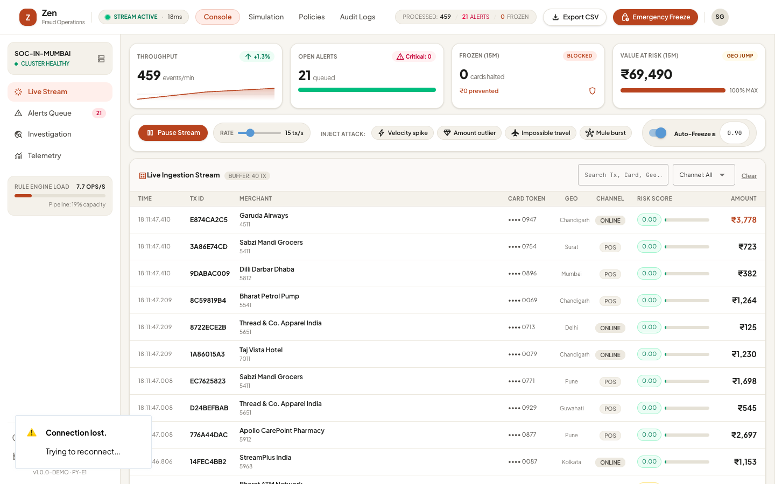
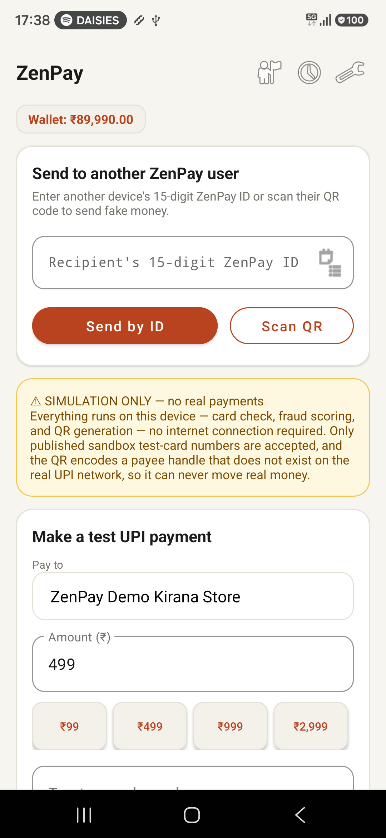
● AI/ML FRAUD INTELLIGENCE · REAL-TIME
Zen & ZenPay
Autonomous Fraud Defense & Real-Time Payment Security
• Sub-Millisecond Scoring: Evaluates velocity, amount outliers, impossible travel, and mule patterns live.
• Synchronized Native Ecosystem: Standalone ZenPay Android client (P2P + UPI) connected to SOC web console.
• Autonomous Enforcement: Zero-latency auto-freeze engine halting compromised instruments in < 40ms.
• Audit-Ready Observability: Complete trace telemetry, case dossiers, and analyst review workflow.
PRODUCTION-READY HYBRID STACK
Python (NiceGUI + FastAPI + Asyncio) | Kotlin Native Android | Cloudflare Tunnel | Supabase Auth
Live Console & Mobile Simulator

Slide 2
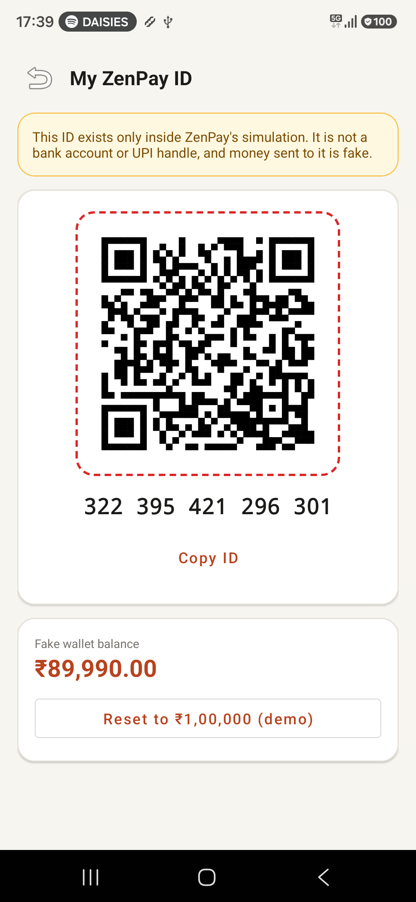
MOBILE CLIENT
02 / 06
ZenPay Android: User-to-User P2P & UPI Simulation
Native Kotlin client supporting wallet management, direct ID transfers, and camera QR scanning.
1. Device-Generated ZenPay Wallet ID
Generates a persistent 15-digit wallet identity on first launch. Users can share their formatted ID or display a dynamic QR code for immediate peer transfers.
2. Offline-First & Cloud Sync Architecture
Functions completely local with standalone device-side Luhn checks and fallback scoring, but connects to the Cloudflare tunnel for live telemetry sync to the fraud ops desk.
3. Sandbox Safety Guarantee
Only accepts verified sandbox test PANs (Stripe/Razorpay test-sets) and stamps payee handles with non-resolvable '@fakebank' domains, guaranteeing no real money can ever move.

Slide 3
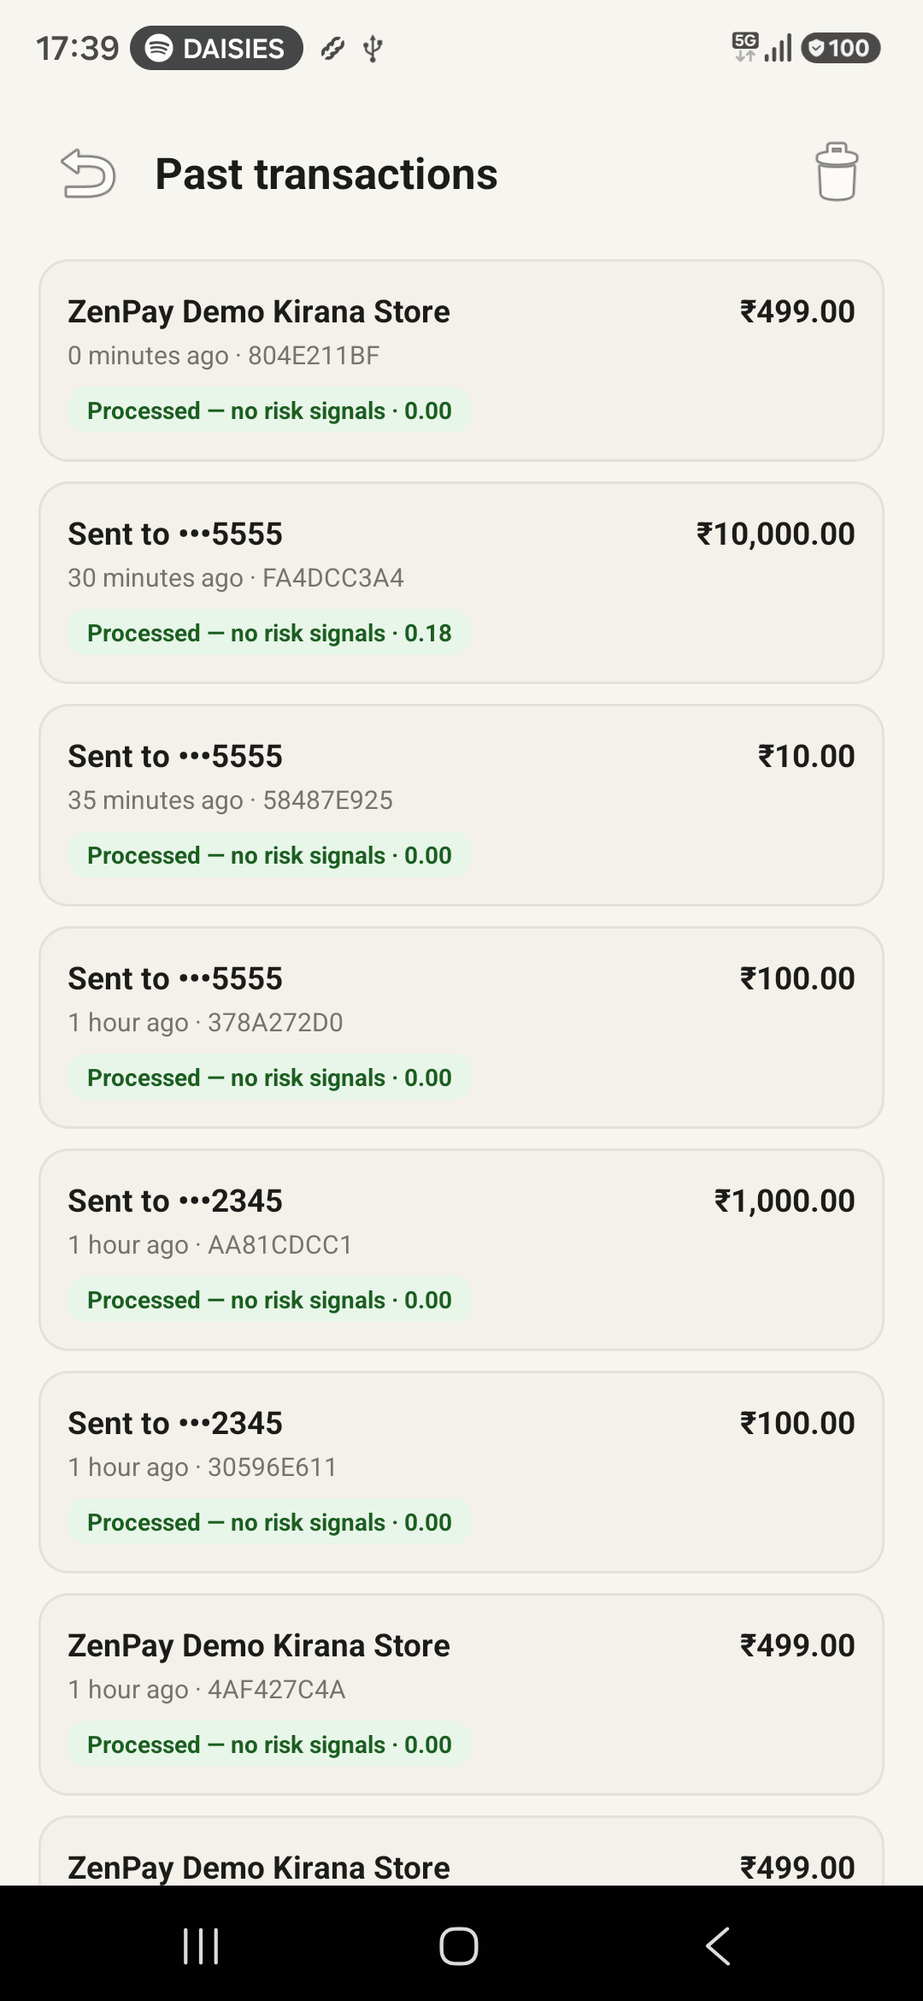
TRANSACTION INTELLIGENCE
03 / 06
Mobile Audit Trail & Real-Time Risk Feedback
Every transaction is scored and badged with instant explanation chips before analyst review.
Real-Time Scoring Flow
• Step 1: Input & Sanitization
Validates 16-digit PAN via Luhn algorithm, checks expiry & CVV formatting.
• Step 2: Local Rule Evaluation
Matches against local device velocity windows and abnormal transfer amounts.
• Step 3: Portal Cloud Dispatch
Dispatches transaction asynchronously to /api/portal/pay via HTTP/2 tunnel.
• Step 4: Composite Risk Scoring
Receives unified 0.00-1.00 risk score and detector firing rationales.
• Step 5: Audit Trail Archival
Stores timestamped receipt in Room/JSON local history store with color badges.
Observed Transaction Logs
ZenPay Demo Kirana Store — ₹499.00
Status: Processed — no risk signals · 0.00
Sent to •••5555 (Rapid Transfer) — ₹10,000.00
Status: Risk score flagged · 0.18
Sent to •••5555 (Micro-probe) — ₹10.00
Status: Processed — no risk signals · 0.00
Sent to •••2345 (P2P Wallet) — ₹1,000.00
Status: Processed — no risk signals · 0.00
Immediate Analyst Sync:
Every transaction triggered on mobile reflects within 50ms across the SOC dashboard feed and alerts queue.

Slide 4
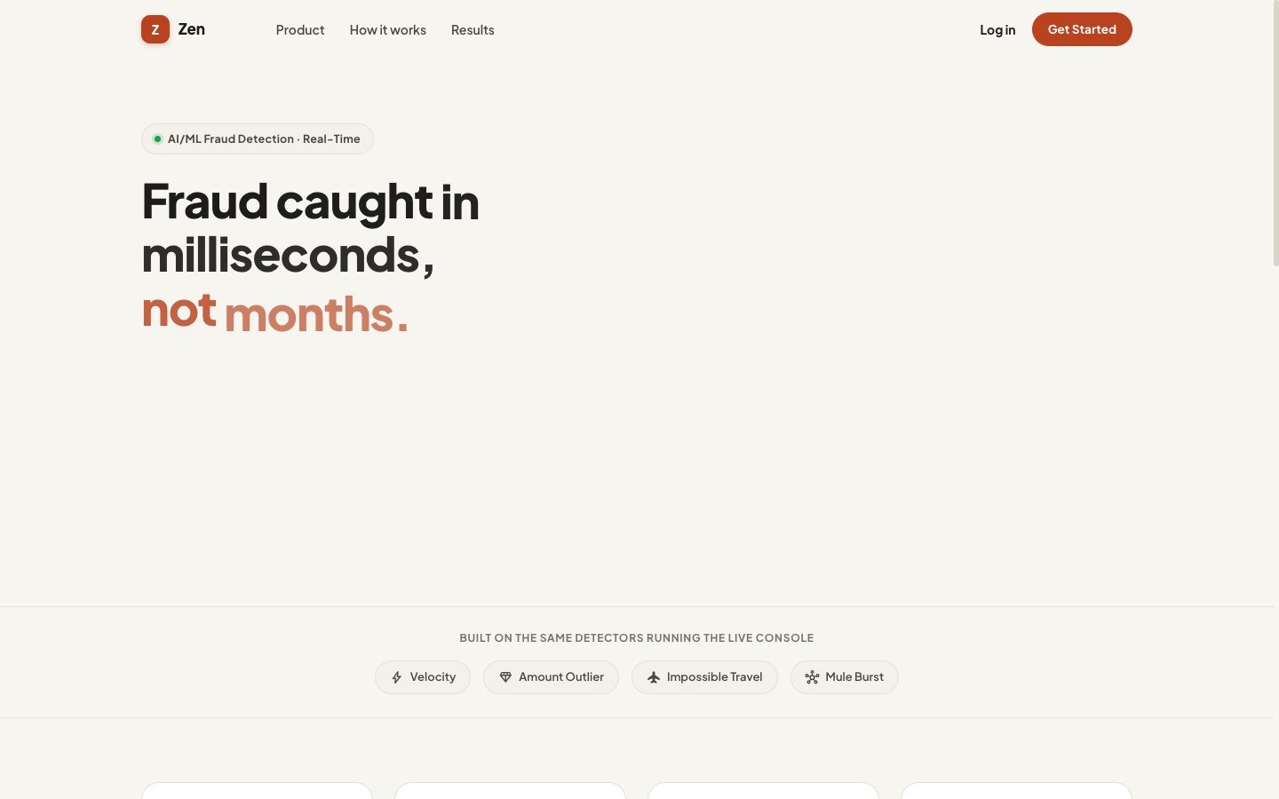
WEB PLATFORM
04 / 06
Zen Public Portal: High-Conversion Marketing & Auth
Designed with Warm Civic Minimal aesthetics, lightweight typography, and PKCE OAuth.
Warm Civic Minimal Visual System
Tailwind arbitrary values over Quasar base, Plus Jakarta Sans typography, and subtle terracotta accents replacing generic dark-ops dashboards.
Enterprise PKCE Google OAuth
Supabase Auth with custom public.zen_analysts routing trigger, hand-rolled PKCE code-exchange handshake, and mobile deep-link redirection.
Zero Leak Responsive Geometry
Flex-1 stretch architecture and max-w-[100vw] bounds preventing right-side gutters on desktop monitors while scaling seamlessly down to 360px phones.

Slide 5
SOC CONSOLE
05 / 06
Live Ingestion Stream & Real-Time Attack Simulation
High-throughput WebSocket feed processing 450+ events/min with instant manual scenario injection.
Real-Time Telemetry & Throughput
Monitors 450+ transactions/min with 18ms server latency, live rule engine capacity utilization, and rolling 15-minute value-at-risk indicators.
One-Click Attack Injection
Allows analysts to stress-test detection pipelines by injecting pre-timed fraud patterns: Velocity Spikes, Amount Outliers, Impossible Travel, and Mule Bursts.
Emergency Freeze Circuit Breaker
Global emergency action instantly halts transactions scoring >= 0.80 across all channels (Online CNP, In-Store POS, UPI, P2P) to contain active outbreaks.

Slide 6
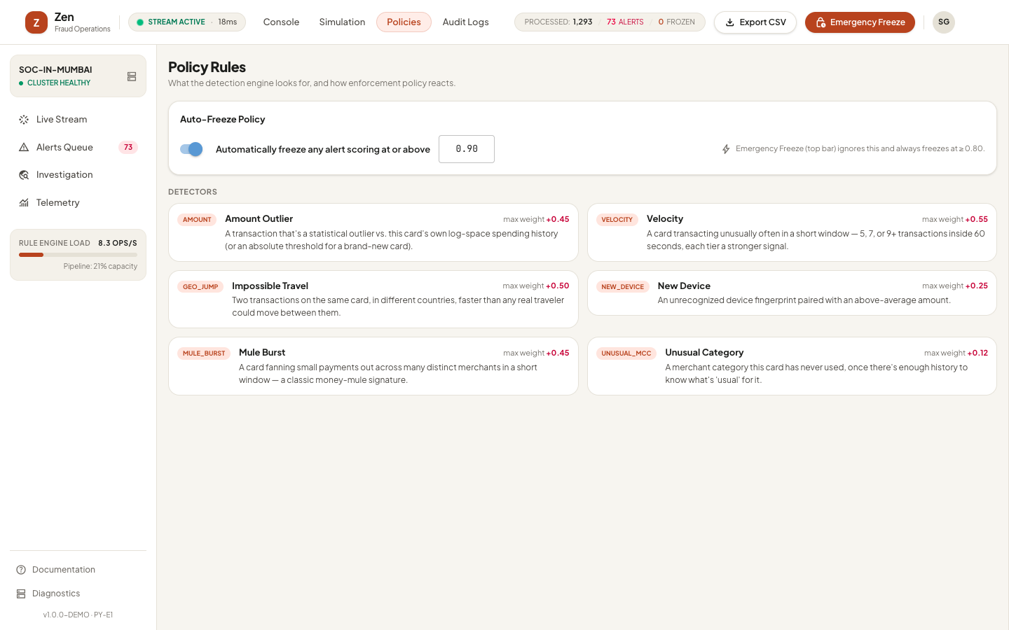
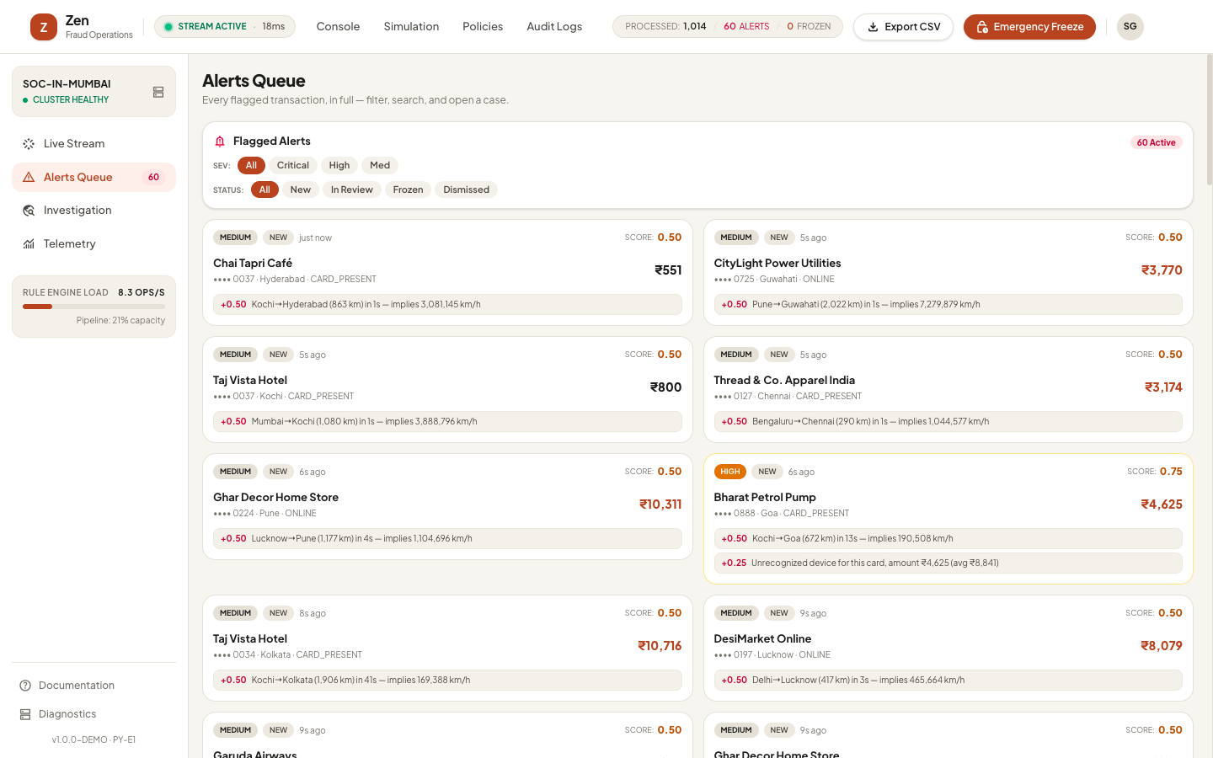
POLICY & DEFENSE
06 / 06
Automated Detection Rules & Flagged Alerts Queue
Multi-engine scoring architecture, configurable auto-freeze thresholds, and full analyst dossier review.
The 6 Core Detection Engines
• Velocity Spike (Max Weight +0.55)
Flags rapid card reuse (5-9+ transactions within 60s), catching credential stuffing and automated bot script attacks.
• Impossible Travel (Max Weight +0.50)
Haversine geodesic distance calculation between sequential transactions, flagging supersonic location hops (e.g. 3,000,000 km/h).
• Mule Burst Ring (Max Weight +0.45)
Identifies card fanning small rapid sums across multiple distinct merchants/payees, a classic money-mule laundering signature.
• Amount Outlier (Max Weight +0.45)
Online Welford's algorithm tracking running mean and variance in log-space, robust to natural right-skewed spending behaviors.
• New Device Fingerprint (Max Weight +0.25)
Detects novel client fingerprints paired with above-average transaction sums.
• Unusual Category / MCC (Max Weight +0.12)
Flags merchant category codes never before encountered in cardholder history.

