Slide 1


ARTIFICIAL NEURAL NETWORKS PROJECT
Movie Recommendation System

Slide 2


CONTENTS
Problem Statement
Motivation
Possible Applications
Model
Accuracies & Losses
Conclusions

Slide 3

PROBLEM STATEMENT
“Develop a movie recommendation system that provides personalized movie recommendations based on user preferences, leveraging the content of movies such as genres, keywords, cast, and crew, using natural language processing and machine learning techniques.”

Slide 4

MOTIVATION
The entertainment industry relies heavily on user engagement, and recommendations can enhance user experience and retention.
Personalized recommendations can help users discover new movies tailored to their preferences.
Building recommendation systems is a popular and practical application of machine learning.

Slide 5
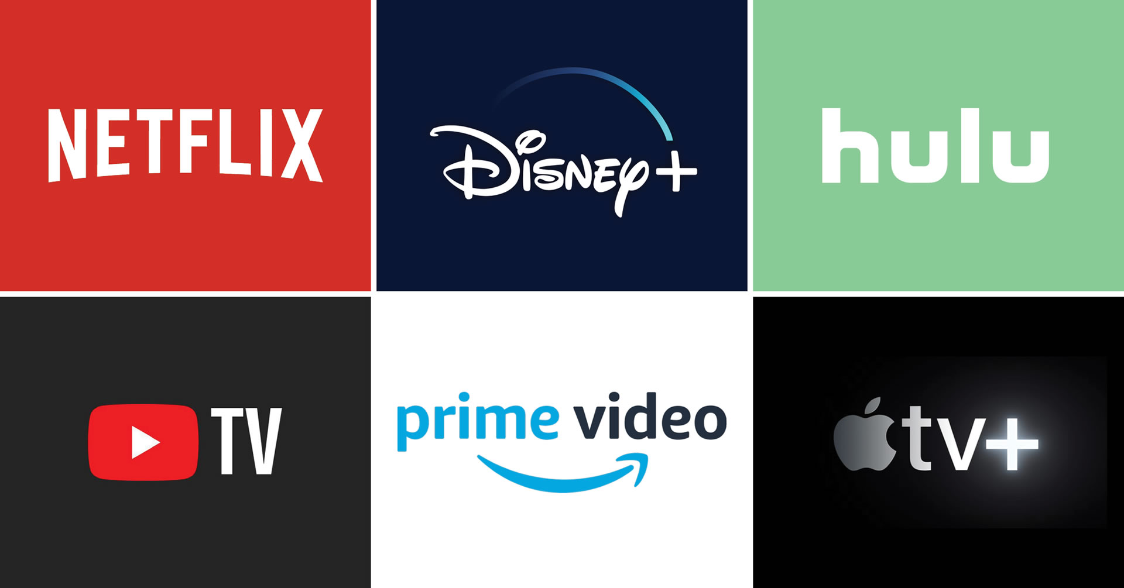
POSSIBLE APPLICATIONS
Streaming Services: Enhance user experience on platforms like Netflix, Hulu, or Amazon Prime.
E-commerce: Provide recommendations for products or services based on user behavior.
Music Streaming: Recommend songs or artists based on listening history.
News: Suggest relevant articles or news topics to readers.

Slide 6
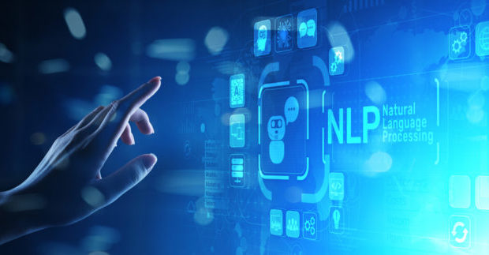
MODEL
“The recommendation system employs a content-based filtering approach, which uses natural language processing (NLP) and cosine similarity to compare the content of movies.”

Slide 7
MODEL
DATA PREPROCESSING:
Extracted and processed information from 'movies' and 'credits' datasets.
Cleaned and transformed text data, removed missing values, and applied stemming.
FEATURE EXTRACTION:
Utilized CountVectorizer to convert text data into a document-term matrix (DTM).
Captured keywords and content from movie descriptions, genres, cast, crew, and keywords.
SIMILARITY CALCULATION:
Calculated cosine similarity between movie vectors in the DTM.
Measured the similarity between movies based on their content.
RECOMMENDATION:
Provided movie recommendations by identifying movies with the highest cosine similarity to the user's selected movie.

Slide 8

ACCURACIES AND LOSES
“The content-based filtering approach doesn't have traditional accuracy or loss metrics, as it doesn't involve training or validation. It relies on cosine similarity scores to find similar movies, where a higher score indicates a stronger recommendation.”

Slide 9

CONCLUSIONS
The recommendation system successfully provides movie recommendations based on user preferences and movie content.
Personalized recommendations can enhance user engagement and satisfaction.
This project demonstrates the application of natural language processing and machine learning techniques in building recommendation systems for various industries.

Slide 10

THANK YOU
Project By:
Ch Niranjan Rao
HU21CSEN0300431
K Vinay
HU21CSEN0300505

