Slide 1
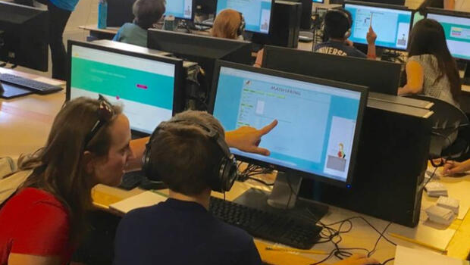
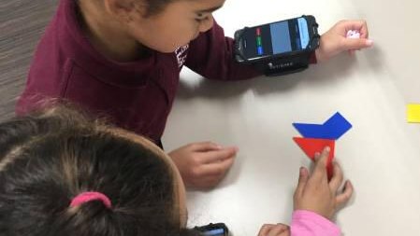

Group 6: The Wearable Learning Platform
Julia Epshtein, Anh Pham, Minh Vu

Slide 2
Games For Learning
Game-based learning is great way to learn a new subject, collaborate in groups, and increase participation among students
But what about having students design their own games?
Students can build on and challenge their existing knowledge
Make connections between their ideas and the real world
Problem posing
Practice Computational Thinking (CT)

Slide 3
The Wearable Learning Platform

Slide 4
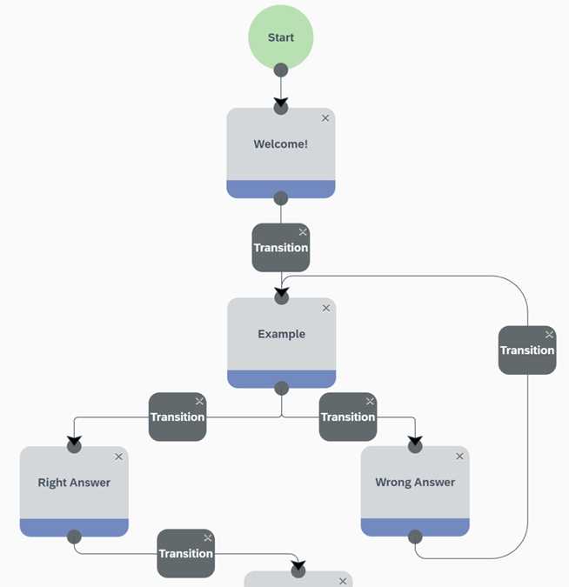
Wearable Learning Platform: What is it?
Web-based app for game creation
Teaches math and CT skills
Game creation: Finite State Machines (FSMs)
Create, manage, and play physically active and social multiplayer games
Do not need any programming experience

Slide 5
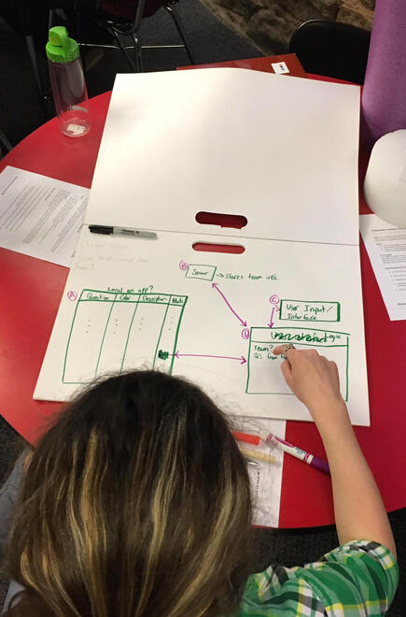
The Game Design Process
First play games on WL, then design their own
Express their game design ideas as drawings and narrations on booklets
“state” boxes represent game screens on a phone
Arrows or “transitions” represent inputs to transition from one state to another

Slide 6
The Game Design Process (cont.)
Game Editors
Program the games using WL’s drag-and-drop, FSM-based programming language
Run and debug the games
Game Players
Play the games and reinforce their subject knowledge
Game Managers
Browse the platform to find any open-access games complete with instructions and materials
Choose and start games from any device with WiFi access
Generate a PIN that can be used by the entire classroom

Slide 7
Identifying Characteristics in Game Design
Games are stored in JSON representation
Previously, researchers made a coding guide and a coding scheme to analyze booklets
Purpose: to use the qualitative analysis to further understand students’ processes of CT development
We want to see what domains in the coding scheme can be extracted from the JSON data

Slide 8
Research Questions
How can we automate the data analysis process?
What kinds of game-design characteristics can we extract from the FSM database that go in accordance with the coding manual?
How can we extract qualitative information from the FSM database?

Slide 9
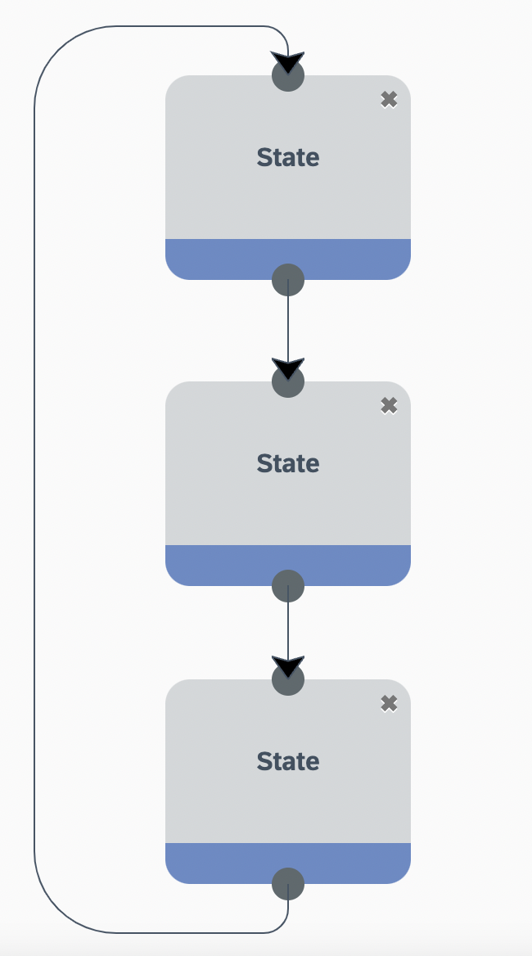
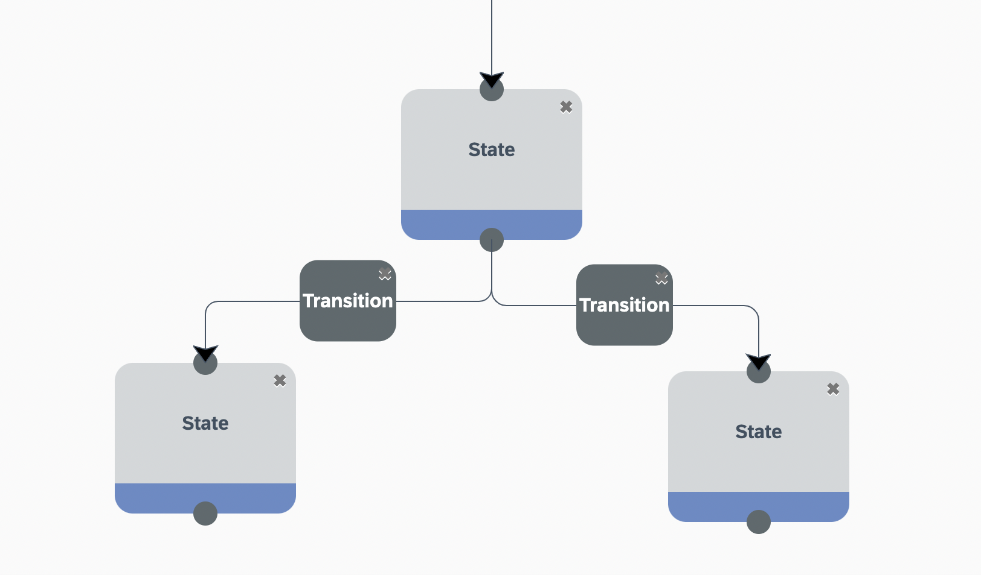
Proposed Solution
Some attributes are names, state count, state ID, computational concepts (loops, conditionals)
Those attributes can be analyzed using a program… (counting, finding)
Notes:
The JSON data (text) contains various attributes like names, ID of state, team number, and text description of the games
We plan to automate the process by using computer program to analyze computational concepts such as loops and conditionals
As we can see from the images, loops and conditional can be found by states IDs

Slide 10
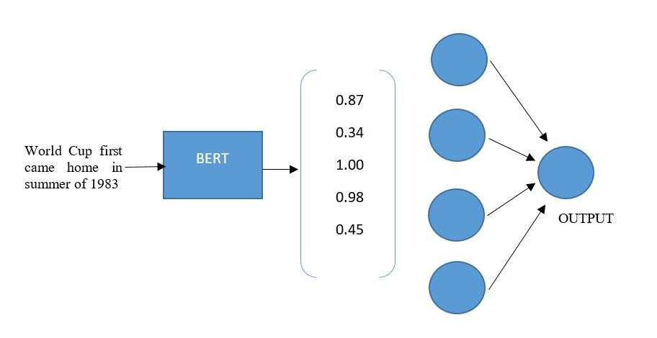
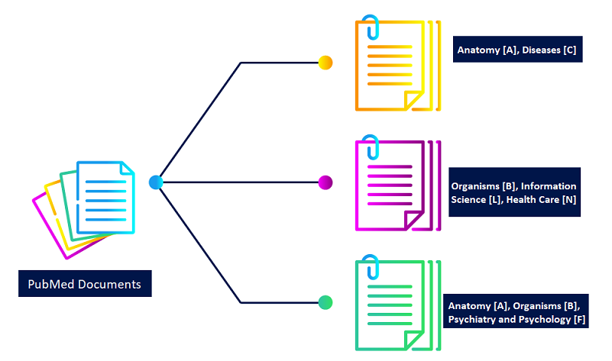
Proposed Solution
Using BERT, a machine learning model, to extract special keywords from the description text
Using a multi-label text classification model to determine the features of the games
Notes:
Overall script:
BERT is a machine learning model that can extract vector semantics from text (turning words into vectors i.e numerical data) and then analyze the vectors. What we intend to do is to extract meaningful keywords from BERT (i.e the main idea of the description text). Our idea is that the keywords would represent the context of the game, and analyzing keywords we can know the context and feature of the game.
From then on, we can run a multi-label text classification model. Multilabel is when there are various features/classes that the text can fall into, and we want to explore all of the possible features that can occur in the description.
For NLP, there are various models that can be used (like CNN, RNN, Naives Bayes) so ideally we can test on different models to find the most efficient one. So currently, we do not have a specific model in mind.
To better illustrate, we predict that text with keywords such as “square” or “rectangle” may result in a game of Geometry feature, or description with many occurrences of fraction may result in a Fraction feature.
That’s all for analyzing the text description of the games

Slide 11
Evaluation Plan
Manual Analysis
Machine Learning Model
Further Analysis

Slide 12
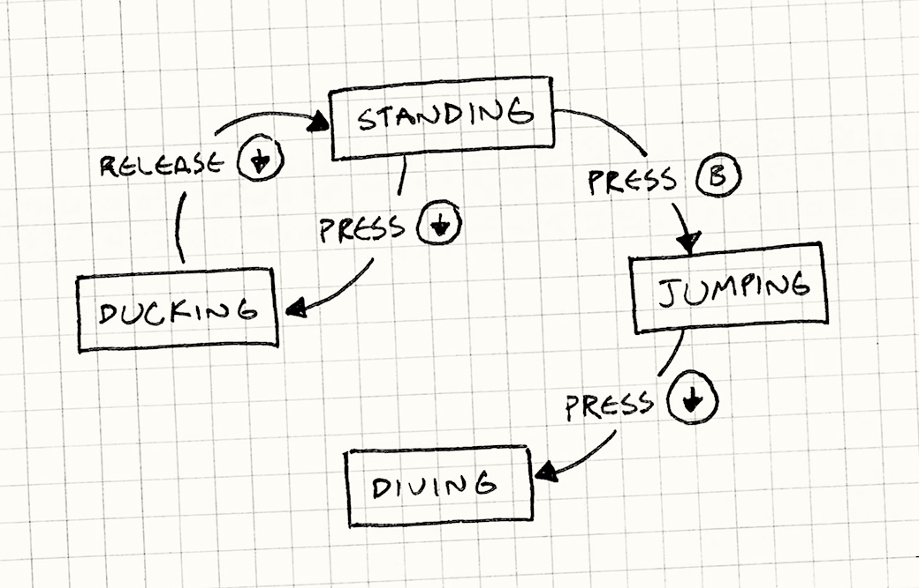
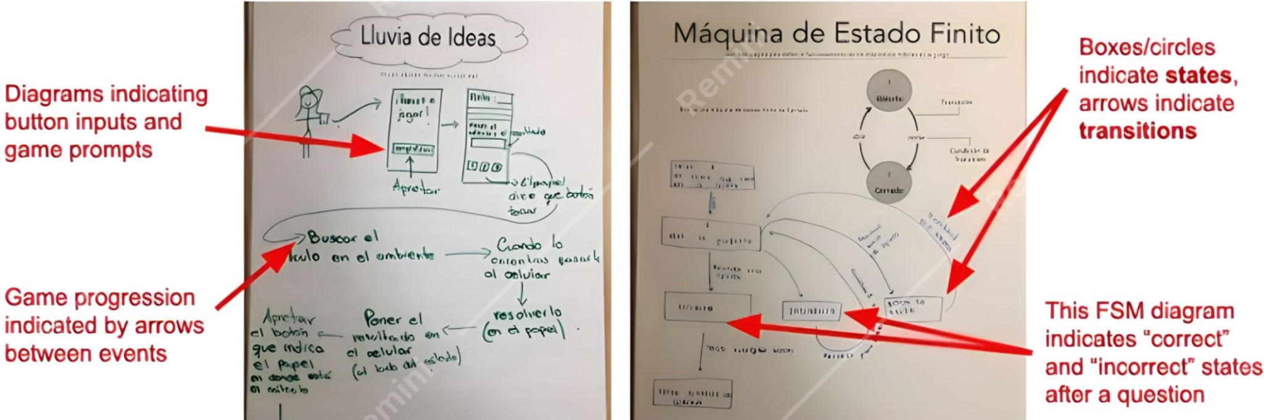
Manual Analysis
Notes:
The first step will be analyzing the game design artifact
- manual analysis means that we gonna work with game design artifact
- So, game design artifact are childrens hand-drawn of the states of the game as you can see here - various rectangular shape like represent the steps of the game
- If you look closely here, you would see inside these steps are keywords. And what manually analyzing does is that we gonna extract
those keywords and put them into categories like Geometry characteristic, or Math Operation, and etc.
- The meaning of doing this is to create a ground truth dataset to cross checking with our classification machine learning model.

Slide 13
Manually Analysis
Extracting keywords from text
Put them into categories: Geometry characteristic, Math operation, etc.
Ground truth dataset for the classification machine learning model
Notes:
The first step will be analyzing the game design artifact
- Just a moment of reminds, game design artifact (Pulling out pictures) can be describe as children hand-drawn on their
thinking process on the how the game should proceed. As you can see here, its like a finite state machine with various of rectangular
shape like represent the steps of the game.
- If you look closely here, you would see inside these steps are keywords. And what manually analyzing does is that we gonna extract
those keywords and put them into categories like Geometry characteristic, or Math Operation, and etc.
- The meaning of doing this is to create a ground truth dataset to cross checking with our classification machine learning model.

Slide 14
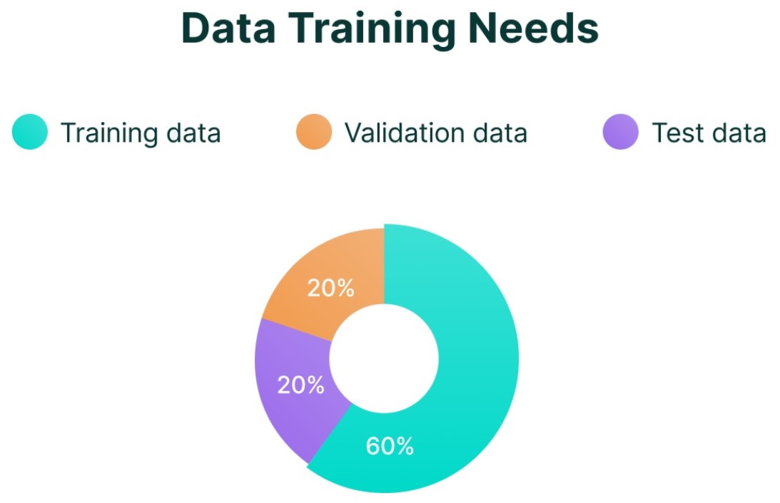
Machine Learning Model
Notes:
Okay, And for the next part, we gonna looking into the machine learning model.
- So in this part, we will working on the JSON file, rather than with the game design artifact.
- After utilize BERT, natural language processing machine learning model, to extract the keywords from the jSON file, we will divides our dataset into 3 parts: 60% for training data,
20% for testing set, and 20% for validation set.
- After a process of training model, the most important part here is that we gonna cross checking the accuracy of the model with the
manually extracted data that we have created before.
- The higher the accuracy, the better the classification model.

Slide 15
Machine Learning model
Validate the accuracy by cross checking with manually extracted data
The higher the accuracy - the better the classification model
Notes:
Okay, And for the next part, we gonna looking into the machine learning model.
- So in this part, we will working on the JSON file, rather than with the game design artifact.
- After utilize BERT, natural language processing machine learning model, to extract the keywords from the jSON file, we will divides our dataset into 3 parts: 60% for training data,
20% for testing set, and 20% for validation set.
- After a process of training model, the most important part here is that we gonna cross checking the accuracy of the model with the
manually extracted data that we have created before.
- The higher the accuracy, the better the classification model.

Slide 16
Further Analysis
Automate the process of classifying children’s game design!
Shared aspects in children’s computational thinking: Process Difficulty, Mathematics Utilization, Pictorial Representation, etc.
Understand human even more!
Notes:
For the last part, we will look through the further analysis - like what we gonna do after create such model
- So the purpose of doing this is to automate the process of classifying childrens game design in the future.
- Moreover, this could help us find the shared aspects in childrens' computational thinking: such as Progressive Difficulty, Mathematic
Utilization, Pictorial Representation, etc.
- In the end, creating such model have ease our process of understanding the human even more. So that is the purpose of further analyzing.

Slide 17
Thank you for listening!

