Slide 1
File Handling in C
Chapter 8

Slide 2
File in c
A file refers to a source in which a program stores the information/data in the form of bytes of sequence on a disk (permanently).
The content available on a file isn’t volatile like the compiler memory in C.
2 types of file handling in c:
Text File
Binary File

Slide 3
File Operations
Creation of a new file
Opening an existing file
Reading from file
Writing to a file
Moving to a specific location in a file
Closing a file

Slide 4
Functions in File Operations:
fopen () Creating a file or opening an existing file
fclose () Closing a file
fprintf () Writing a block of data to a file
fscanf () Reading a block data from a file
getc () Reads a single character from a file
putc () Writes a single character to a file
getw () Reads an integer from a file
putw () Writing an integer to a file

Slide 5
Opening a file
FILE *fp;
fp = fopen ("file_name", "mode");
If the file is not present on the system, then it is created and then opened.
If a file is already present on the system, then it is directly opened using this function.

Slide 6
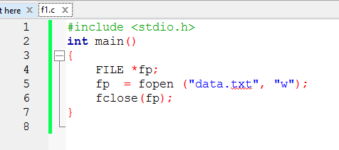
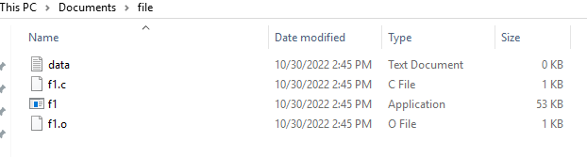
FILE *fp;
fp = fopen ("data.txt", "r");
fclose (fp);

Slide 7
Some File opening modes in C
r —> Open a file for reading the content.
w —> Open a file for writing the content.
a —> Open a file for appending the content.
Meaning, the data of the program is added to the file’s end in a program.
r+ —> Open a file for both writing and reading the content.
a+ —> Open a file for both appending and reading the content.

Slide 8
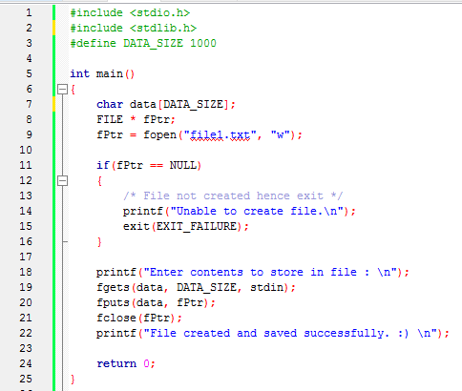

Slide 9
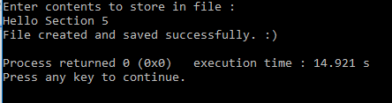
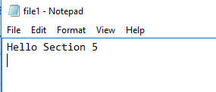
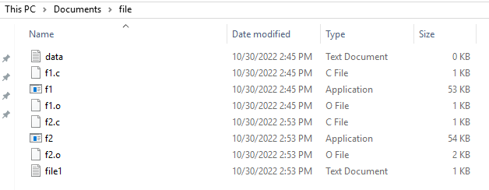

Slide 10
Structure
A collection of data having same or different data type.
But in array are able to store collections of data of same data type.
For example, in array we can store only 1 type of information of students of your class.
But using structure we can define our own collection of data allowing different data types.

Slide 11
struct student{
int S_ID;
char S_Name[100];
char S_EMail[100];
char S_Address[100];
};
struct structure_name
{
Data_member_type data_member_defination;
Data_member_type data_member_defination;
Data_member_type data_member_defination;
...
...
}(structure_variables);

Slide 12
