Slide 1
Recursion
Chapter 11

Slide 2
Objectives
become familiar with the idea of recursion
learn to use recursion as a programming tool
become familiar with the binary search algorithm as an example of recursion
become familiar with the merge sort algorithm as an example of recursion

Slide 3
How do you look up a name in the phone book?

Slide 4
One Possible Way
Search:
  middle page = (first page + last page)/2
  Go to middle page;
  If (name is on middle page)
  done; //this is the base case
  else if (name is alphabetically before middle page)
  last page = middle page //redefine search area to front half
  Search //same process on reduced number of pages
  else //name must be after middle page
  first page = middle page //redefine search area to back half
  Search //same process on reduced number of pages

Slide 5
Overview
Recursion: a definition in terms of itself.
Recursion in algorithms:
Natural approach to some (not all) problems
A recursive algorithm uses itself to solve one or more smaller identical problems
Recursion in Java:
Recursive methods implement recursive algorithms
A recursive method includes a call to itself

Slide 6
Recursive Methods
Must Eventually Terminate
A recursive method must have
at least one base, or stopping, case.
A base case does not execute a recursive call
  stops the recursion
Each successive call to itself must be a "smaller version of itself”
  an argument that describes a smaller problem
  a base case is eventually reached

Slide 7
Key Components of a Recursive Algorithm Design
What is a smaller identical problem(s)?
  Decomposition
How are the answers to smaller problems combined to form the answer to the larger problem?
  Composition
Which is the smallest problem that can be solved easily (without further decomposition)?
  Base/stopping case

Slide 8
Examples in Recursion
Usually quite confusing the first time
Start with some simple examples
  recursive algorithms might not be best
Later with inherently recursive algorithms
  harder to implement otherwise

Slide 9
Factorial (N!)
N! = (N-1)! * N [for N > 1]
1! = 1
3!
  = 2! * 3
  = (1! * 2) * 3
  = 1 * 2 * 3
Recursive design:
  Decomposition: (N-1)!
  Composition: * N
  Base case: 1!

Slide 10
factorial Method
public static int factorial(int n)
{
int fact;
if (n > 1) // recursive case (decomposition)
fact = factorial(n – 1) * n; // composition
else // base case
fact = 1;
return fact;
}

Slide 11
public static int factorial(int 3)
{
int fact;
if (n > 1)
fact = factorial(2) * 3;
else
fact = 1;
return fact;
}

Slide 12
public static int factorial(int 3)
{
int fact;
if (n > 1)
fact = factorial(2) * 3;
else
fact = 1;
return fact;
}
public static int factorial(int 2)
{
int fact;
if (n > 1)
fact = factorial(1) * 2;
else
fact = 1;
return fact;
}

Slide 13
public static int factorial(int 3)
{
int fact;
if (n > 1)
fact = factorial(2) * 3;
else
fact = 1;
return fact;
}
public static int factorial(int 2)
{
int fact;
if (n > 1)
fact = factorial(1) * 2;
else
fact = 1;
return fact;
}
public static int factorial(int 1)
{
int fact;
if (n > 1)
fact = factorial(n - 1) * n;
else
fact = 1;
return fact;
}

Slide 14
public static int factorial(int 3)
{
int fact;
if (n > 1)
fact = factorial(2) * 3;
else
fact = 1;
return fact;
}
public static int factorial(int 2)
{
int fact;
if (n > 1)
fact = factorial(1) * 2;
else
fact = 1;
return fact;
}
public static int factorial(int 1)
{
int fact;
if (n > 1)
fact = factorial(n - 1) * n;
else
fact = 1;
return 1;
}

Slide 15
public static int factorial(int 3)
{
int fact;
if (n > 1)
fact = factorial(2) * 3;
else
fact = 1;
return fact;
}
public static int factorial(int 2)
{
int fact;
if (n > 1)
fact = 1 * 2;
else
fact = 1;
return fact;
}
public static int factorial(int 1)
{
int fact;
if (n > 1)
fact = factorial(n - 1) * n;
else
fact = 1;
return 1;
}

Slide 16
public static int factorial(int 3)
{
int fact;
if (n > 1)
fact = factorial(2) * 3;
else
fact = 1;
return fact;
}
public static int factorial(int 2)
{
int fact;
if (n > 1)
fact = 1 * 2;
else
fact = 1;
return 2;
}

Slide 17
public static int factorial(int 3)
{
int fact;
if (n > 1)
fact = 2 * 3;
else
fact = 1;
return fact;
}
public static int factorial(int 2)
{
int fact;
if (n > 1)
fact = 1 * 2;
else
fact = 1;
return 2;
}

Slide 18
public static int factorial(int 3)
{
int fact;
if (n > 1)
fact = 2 * 3;
else
fact = 1;
return 6;
}

Slide 19
Execution Trace (decomposition)
public static int factorial(int n)
{
int fact;
if (n > 1) // recursive case (decomposition)
fact = factorial(n – 1) * n; (composition)
else // base case
fact = 1;
return fact;
}
factorial(4)
factorial(3) 4

Slide 20
Execution Trace (decomposition)
public static int factorial(int n)
{
int fact;
if (n > 1) // recursive case (decomposition)
fact = factorial(n – 1) * n; (composition)
else // base case
fact = 1;
return fact;
}
factorial(4)
factorial(3) 4
factorial(2) 3

Slide 21
Execution Trace (decomposition)
public static int factorial(int n)
{
int fact;
if (n > 1) // recursive case (decomposition)
fact = factorial(n – 1) * n; (composition)
else // base case
fact = 1;
return fact;
}
factorial(4)
factorial(3) 4
factorial(2) 3
factorial(1) 2

Slide 22
Execution Trace (composition)
public static int factorial(int n)
{
int fact;
if (n > 1) // recursive case (decomposition)
fact = factorial(n – 1) * n; (composition)
else // base case
fact = 1;
return fact;
}
factorial(4)
*
factorial(3) 4
*
factorial(2) 3
*
factorial(1)->1 2

Slide 23
Execution Trace (composition)
public static int factorial(int n)
{
int fact;
if (n > 1) // recursive case (decomposition)
fact = factorial(n – 1) * n; (composition)
else // base case
fact = 1;
return fact;
}
factorial(4)
*
factorial(3) 4
*
factorial(2)->2 3

Slide 24
Execution Trace (composition)
public static int factorial(int n)
{
int fact;
if (n > 1) // recursive case (decomposition)
fact = factorial(n – 1) * n; (composition)
else // base case
fact = 1;
return fact;
}
factorial(4)
*
factorial(3)->6 4

Slide 25
Execution Trace (composition)
public static int factorial(int n)
{
int fact;
if (n > 1) // recursive case (decomposition)
fact = factorial(n – 1) * n; (composition)
else // base case
fact = 1;
return fact;
}
factorial(4)->24

Slide 26
Improved factorial Method
public static int factorial(int n)
{
int fact=1; // base case value
if (n > 1) // recursive case (decomposition)
fact = factorial(n – 1) * n; // composition
// else do nothing; base case
return fact;
}

Slide 27
Fibonacci Numbers
The Nth Fibonacci number is the sum of the previous two Fibonacci numbers
0, 1, 1, 2, 3, 5, 8, 13, …
Recursive Design:
  Decomposition & Composition
    fibonacci(n) = fibonacci(n-1) + fibonacci(n-2)
  Base case:
    fibonacci(1) = 0
    fibonacci(2) = 1

Slide 28
fibonacci Method
public static int fibonacci(int n)
{
int fib;
if (n > 2)
fib = fibonacci(n-1) + fibonacci(n-2);
else if (n == 2)
fib = 1;
else
fib = 0;
return fib;
}

Slide 29
Execution Trace (decomposition)
fibonacci(4)
fibonacci(3)
fibonacci(2)

Slide 30
Execution Trace (decomposition)
fibonacci(4)
fibonacci(3)
fibonacci(2)
fibonacci(2)
fibonacci(1)

Slide 31
Execution Trace (composition)
fibonacci(4)
+
fibonacci(3)
fibonacci(2)
+
fibonacci(2)->1
fibonacci(1)->0

Slide 32
Execution Trace (composition)
fibonacci(4)
+
fibonacci(3)->1
fibonacci(2)->1

Slide 33
Execution Trace (composition)
fibonacci(4)->2

Slide 34
Remember:
Key to Successful Recursion
if-else statement (or some other branching statement)
Some branches: recursive call
  "smaller" arguments or solve "smaller" versions of the same task (decomposition)
  Combine the results (composition) [if necessary]
Other branches: no recursive calls
  stopping cases or base cases

Slide 35
Template
… method(…)
{
if ( … )// base case
{
}
else // decomposition & composition
{
}
return … ; // if not void method
}

Slide 36
Template (only one base case)
… method(…)
{
… result = … ;//base case
if ( … ) // not base case
{ //decomposition & composition
result = …
}
return result;
}

Slide 37
What Happens Here?
public static int factorial(int n)
{
int fact=1;
if (n > 1)
fact = factorial(n) * n;
return fact;
}

Slide 38
What Happens Here?
public static int factorial(int n)
{
return factorial(n – 1) * n;
}

Slide 39
Warning: Infinite Recursion May Cause a Stack Overflow Error
Infinite Recursion
  Problem not getting smaller (no/bad decomposition)
  Base case exists, but not reachable (bad base case and/or decomposition)
  No base case
Stack: keeps track of recursive calls by JVM (OS)
  Method begins: add data onto the stack
  Method ends: remove data from the stack
Recursion never stops; stack eventually runs out of space
  Stack overflow error

Slide 40
"Name in the Phone Book" Revisited
  Search:
    middle page = (first page + last page)/2
    Go to middle page;
    If (name is on middle page)
    done;//this is the base case
    else if (name is alphabetically before middle page)
    last page = middle page//redefine to front half
    Search//recursive call
    else //name must be after middle page
    first page = middle page//redefine to back half
    Search//recursive call

Slide 41
Binary Search Algorithm
Searching a list for a particular value
  sequential and binary are two common algorithms
Sequential search (aka linear search):
  Not very efficient
  Easy to understand and program
Binary search:
  more efficient than sequential
  but the list must be sorted first!

Slide 42
Why Is It Called "Binary" Search?
Compare sequential and binary search algorithms:
How many elements are eliminated from the list each time a value is read from the list and it is not the "target" value?
Sequential search: only one item
Binary search: half the list!
That is why it is called binary -
each unsuccessful test for the target value
reduces the remaining search list by 1/2.

Slide 43
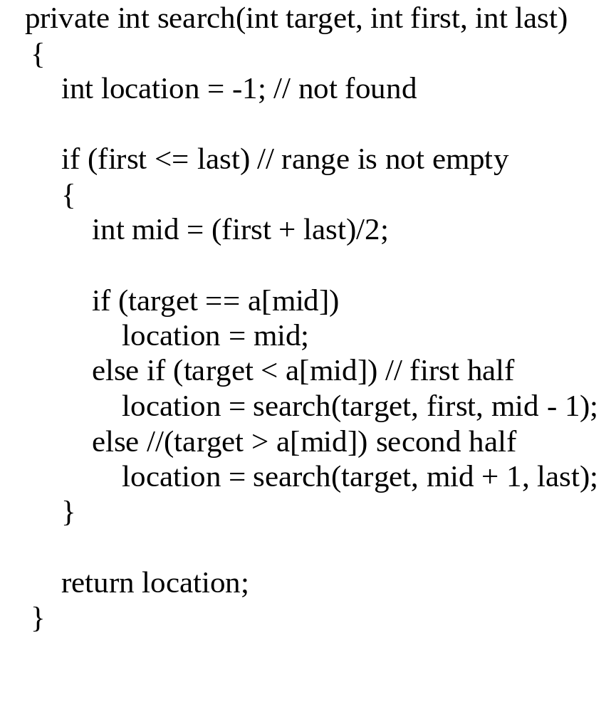
Binary Search Method
public find(target) calls private search(target, first, last)
returns the index of the entry if the target value is found or -1 if it is not found
Compare it to the pseudocode for the "name in the phone book" problem

Slide 44
Where is the composition?
If no items
  not found (-1)
Else if target is in the middle
  middle location
Else
  location found by search(first half) or search(second half)

Slide 45
Binary Search Example
target is 33
The array a looks like this:
Indices
Contents
0 1 2 3 4 5 6 7 8 9
5 7 9 13 32 33 42 54 56 88
mid = (0 + 9) / 2 (which is 4)
33 > a[mid] (that is, 33 > a[4])
So, if 33 is in the array, then 33 is one of:
5 6 7 8 9
33 42 54 56 88
Eliminated half of the remaining elements from consideration because array elements are sorted.

Slide 46
Binary Search Example
target is 33
The array a looks like this:
Indexes
Contents
0 1 2 3 4 5 6 7 8 9
5 7 9 13 32 33 42 54 56 88
mid = (5 + 9) / 2 (which is 7)
33 < a[mid] (that is, 33 < a[7])
So, if 33 is in the array, then 33 is one of:
Eliminate half of the remaining elements
5 6
33 42
mid = (5 + 6) / 2 (which is 5)
33 == a[mid]
So we found 33 at index 5:
5
33

Slide 47
Binary vs. Sequential Search
Binary Search
  log₂N + 1 comparisons (worst case)
Sequential/Linear Search
  N comparisons (worst case)
Binary Search is faster but
  array is assumed to be sorted beforehand
Faster searching algorithms for “non-sorted arrays”
  More sophisticated data structures than arrays
  Later courses

Slide 48
Recursive Versus Iterative Methods
All recursive algorithms/methods
can be rewritten without recursion.
Iterative methods use loops instead of recursion
Iterative methods generally run faster and use less memory--less overhead in keeping track of method calls

Slide 49
So When Should You Use Recursion?
Solutions/algorithms for some problems are inherently recursive
  iterative implementation could be more complicated
When efficiency is less important
  it might make the code easier to understand
Bottom line is about:
  Algorithm design
  Tradeoff between readability and efficiency

Slide 50
Pages 807 NOT a good tip [Programming Tip: Ask Until the User Gets It Right]
Recursion continues until user enters valid input.
public void getCount()
{
System.out.println("Enter a positive number:");
count = SavitchIn.readLineInt();
if (count <= 0)
{
System.out.println("Input must be positive.
System.out.println("Try again.");
getCount(); //start over
}
}
read a number
Use a recursive call to get another number.
No notion of a smaller problem for recursive design
Easily implemented using iteration without loss
of readability

Slide 51
Summary
Recursive call: a method that calls itself
Powerful for algorithm design at times
Recursive algorithm design:
    Decomposition (smaller identical problems)
    Composition (combine results)
    Base case(s) (smallest problem, no recursive calls)
Implementation
  Conditional (e.g. if) statements to separate different cases
  Avoid infinite recursion
    Problem is getting smaller (decomposition)
    Base case exists and reachable
  Composition could be tricky

