Slide 1
Pointer

Slide 2
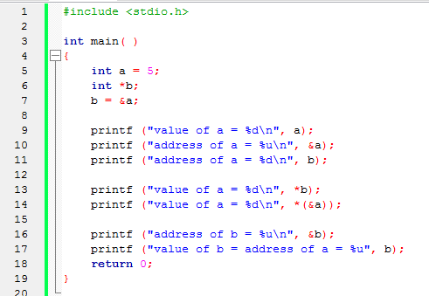
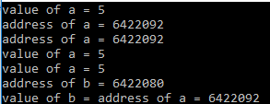

Slide 3
Pointer to Pointer
– A pointer can point to another pointer (which means it can store the address of another pointer), such pointers are known as double pointer OR pointer to pointer.

Slide 4
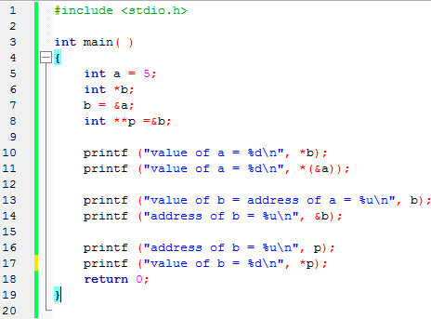


Slide 5
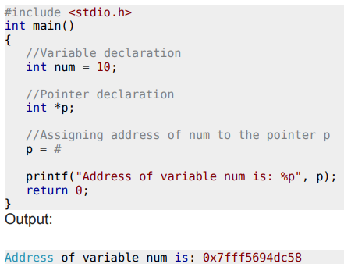
Important point to note is:
The data type of pointer and the variable must match,
an int pointer can hold the address of int variable, similarly a pointer declared with float data type can hold the address of a float variable.
Here, the pointer and the variable both are of int type
%p is a format specifier which is used for displaying the address in hexadecimal format.

Slide 6
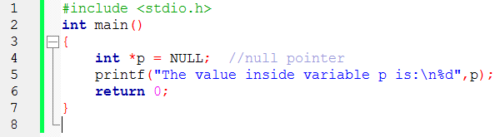

Null Pointer
We can create a null pointer by assigning null value during the pointer declaration.
This method is useful when you do not have any address assigned to the pointer.
A null pointer always contains value 0.

Slide 7
Pointers and Array

Slide 8
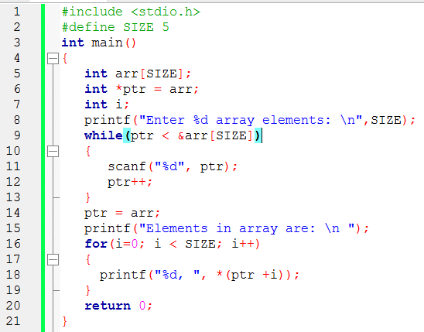


Slide 9
Passing pointers to function
Pointers can also be passed as an argument to a function,
Using this feature a function can be called by reference
And an array can be passed to a function while calling.
Call by value
Call by reference

Slide 10
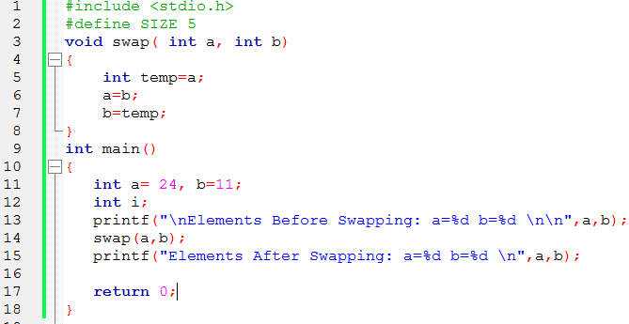


Slide 11
