Slide 1
String
Chapter 5

Slide 2
String
Strings are used for storing text/characters.
"Hello World" is a string of characters.
one-dimensional array of characters terminated by a null character '\0'.
Strings are defined as an array of characters
difference between a character array and a string is the string is terminated with a unique character ‘\0’.
an extra terminating character which is the Null character (‘\0’) used to indicate the termination of a string
When a Sequence of characters enclosed in the double quotation marks is encountered by the compiler, a null character ‘\0’ is appended at the end of the string by default.

Slide 3
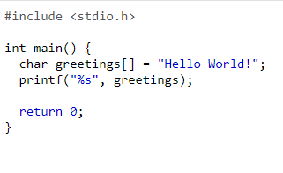


Slide 4

Declaration of Strings
Declaring a string is as simple as declaring a one-dimensional array.
char str_name[size];
Example:
char s[5];

Slide 5

Initializing a String
1. Assigning a string literal without size: char c[] = "abcd";
2. Assigning a string literal with a predefined size: char c[50] = "abcd";
3. Assigning character by character without size:
char c[] = {'a', 'b', 'c', 'd', '\0'};
4. Assigning character by character with size:
char c[5] = {'a', 'b', 'c', 'd', '\0'};

Slide 6
Assigning Values to Strings
Arrays and strings do not support the assignment operator once it is declared. For example,
char c[100];
c = "C programming"; // Error! array type is not assignable.

Slide 7
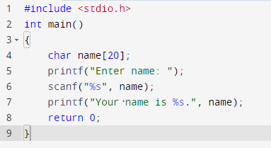


Read String from the user
scanf() function
The scanf() function reads the sequence of characters until it encounters whitespace (space, newline, tab, etc.).

Slide 8
The scanf() function reads the sequence of characters until it encounters whitespace (space, newline, tab, etc.).
the name in scanf() already points to the address of the first element in the string, which is why we don't need to use &.

Slide 9
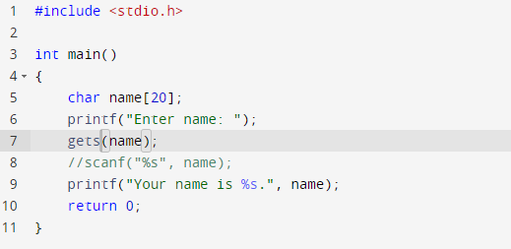

Read a line of text
gets() gets( variable name );

Slide 10
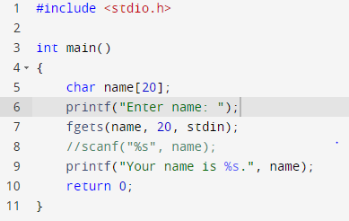
Read a line of text
fgets() char* fgets(char* str, int n, FILE* stream);

Slide 11
fgets() char* fgets(char* str, int n, FILE* stream);
Arguments
char* str: pointer to an initialized string in which characters are copied.
int n: number of characters to copy.
FILE* stream: pointer to the file stream, this can be replaced by stdin when reading from standard input.
Return Type: On successful read, the pointer to str is returned. If there was an error or the end of file character is encountered before any content could be read, a NULL pointer is returned.

Slide 12
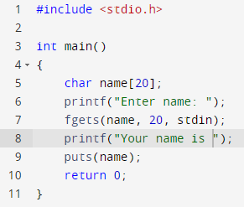
Print a line of text
puts() puts( variable name );

Slide 13
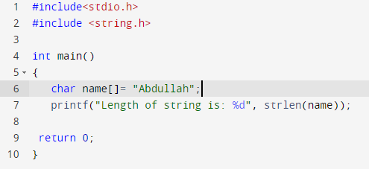

Most Used Functions in C Strings:
C supports a wide range of functions that manipulate null-terminated strings −
strlen() function in c
The strlen() function calculates the length of a given string.
strlen() function is defined in string.h header file.
It doesn’t count null character ‘\0’.

Slide 14
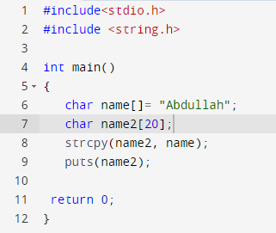
strcpy() function in c
strcpy() is a standard library function in C/C++
is used to copy one string to another.
In C it is present in string.h header file

Slide 15
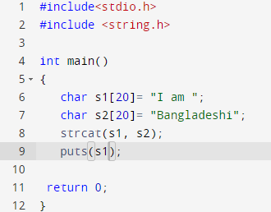
strcat() function in c
The strcat() function will append a copy of the source string to the end of destination string.

Slide 16
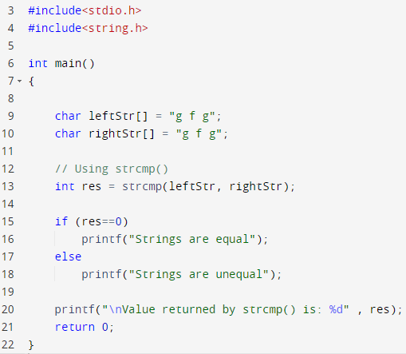
strcmp() function in c
Compares the first string with the second string. If strings are the same it returns 0.
strcmp() is a built-in library function and is declared in <string.h> header file.
This function takes two strings as arguments and compare these two strings lexicographically.

Slide 17


Slide 18

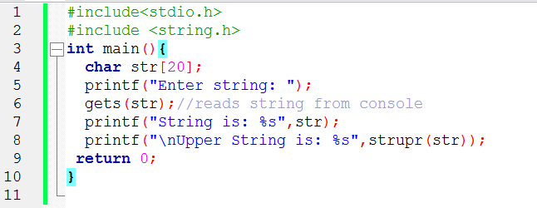
strupr() | Converts string to uppercase.
The strupr( ) function is used to converts a given string to uppercase.

Slide 19
strstr() in C
Find the first occurrence of s2 in s1.
a predefined function used for string handling.
string.h is the header file required for string functions.
This function takes two strings s1 and s2 as an argument and finds the first occurrence of the sub-string s2 in the string s1.
The process of matching does not include the terminating null-characters(‘\0’), but function stops there

Slide 20
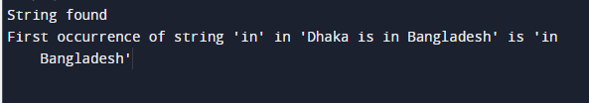
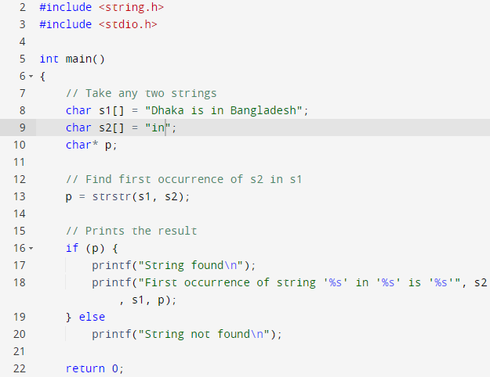

Slide 21
Strings - Special Characters

