Slide 1
Array in structured Programming
1D and 2D array
Chapter 5 (Teach Yourself C Book)

Slide 2
Array
An array is a group (or collection) of same data types.
Arrays a kind of data structure
can store a fixed-size sequential collection of elements of the same type.
Instead of declaring individual variables, such as
N0, N1, ..., and N99,
We declare one array variable such as
N and use N[0], N[1], and ..., N[99] to represent individual variables
Specific element in an array is accessed by an index.
a=3
b=5

Slide 3
Array
An Array is a collection of variables of a similar type that are referenced by a common name.
Each data item in an array is called an element.
The array elements are stored in contiguous memory locations.
Elements can be accessed randomly using indices(subscripts) of an array.
dataType arrayName[size];
int A[5]
A=
2 | 8 | 4 | 1 | 5
0 1 2 3 4

Slide 4
Declaring an Array in C
dataType arrayName[size];
1D Arrays: int arr[n];
2D Arrays: int arr[m][n];
3D Arrays: int arr[m][n][o];

Slide 5
Initialization
Declare an array by specifying size in [].
int arr[5] ={2,4,5,6,8};
Initialize an array at the time of declaration.
int arr[] ={2,4,5,6,8};
Declare an array by specifying user defined size
int n;
scanf(“%d”,&n);
int arr[n];
for(int i=0;i<5;i++)
{
scanf(“%d”,&arr[i]);
}
4. int arr[5];
int arr[0]=2;
int arr[1]=4;
:
:
int arr[4]=8;
Size = 5
2
4
5
6
8

Slide 6
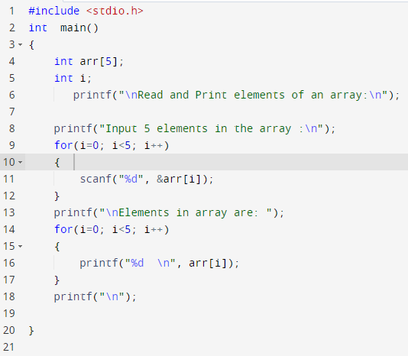
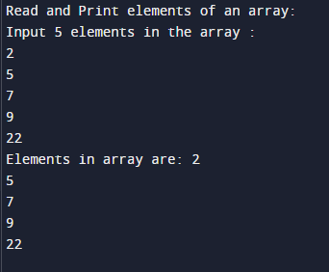

Slide 7
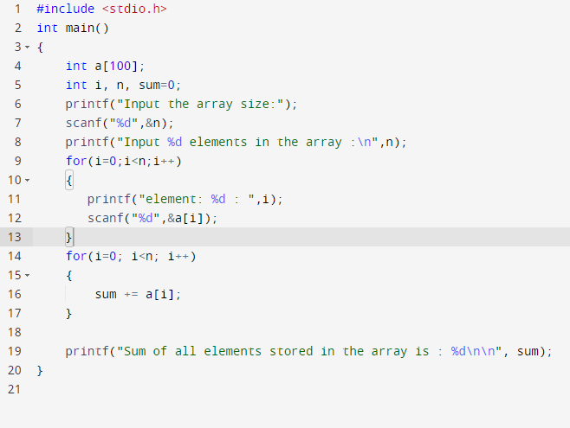
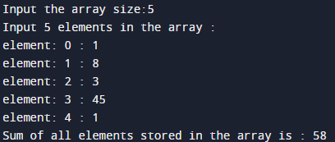

Slide 8
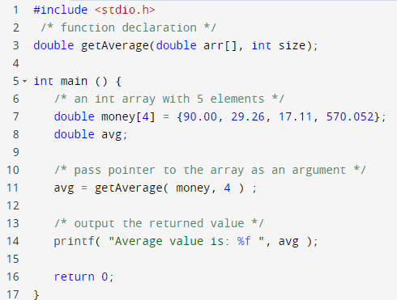
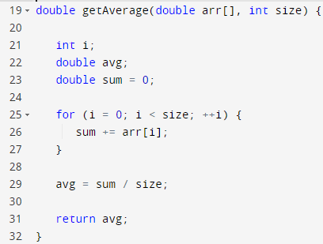

Slide 9
Examples of some problems using Array:
Find Minimum and Maximum number in Array
Number search in array
Delete an element from the array
Find sum of all elements in the array
Count total number of duplicate elements in the array
Count total number of unique elements in the array
Sort the elements in array in ascending or descending order
Copy elements of one array into another array
And many more…

Slide 10
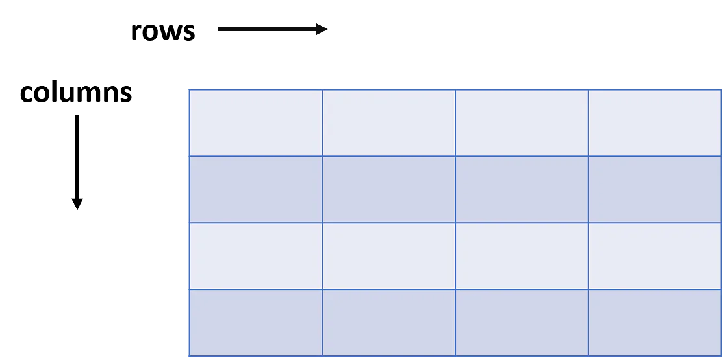
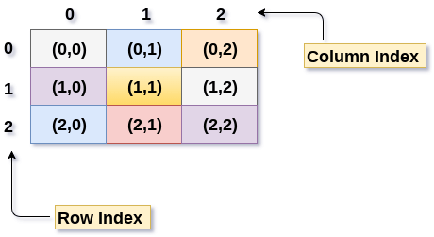
2D Array
Two-dimensional arrays can be defined as arrays within an array.
Like metrics, it is a collection of rows and columns

Slide 11
Declare and Initialise 2D Array
int arr[max_rows][max_columns];
The number of elements that can be present in a 2D array =
(number of rows * number of columns).
for ( int i=0; i<n ; i++)
{
for (int j=0; j<n; j++)
{
arr[i][j] = 0;
}
}
int x[3][4] = {0, 1 ,2 ,3 ,4 , 5 , 6 , 7 , 8 , 9 , 10 , 11}

Slide 12
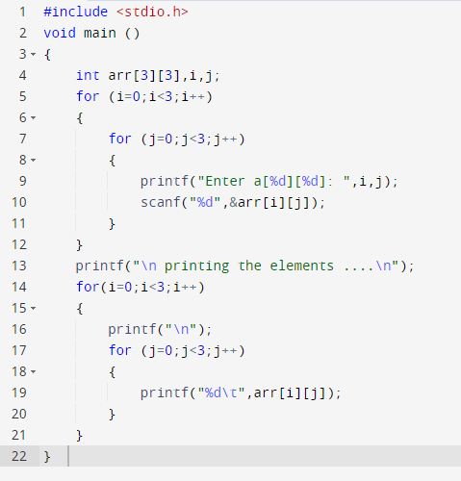
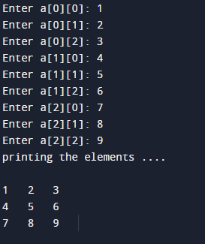

Slide 13
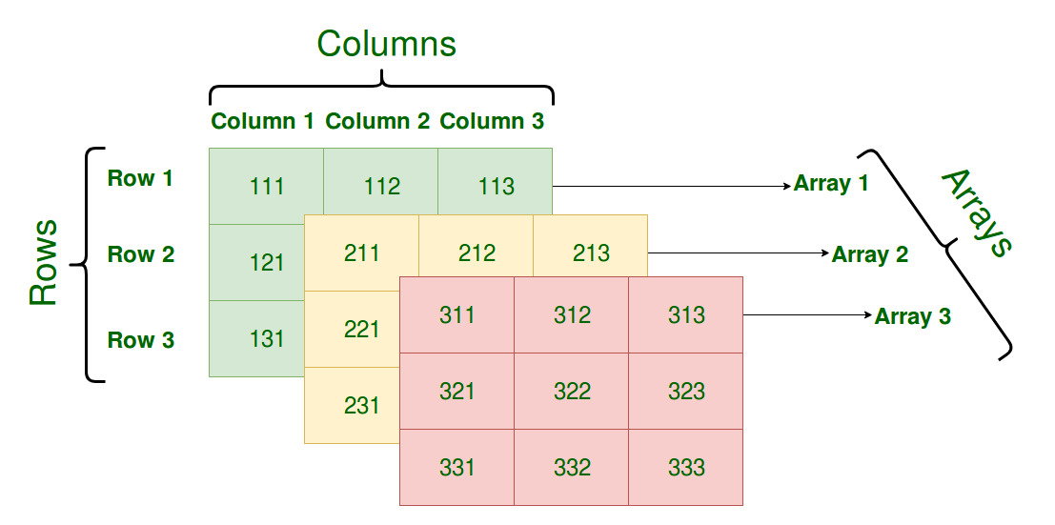
3D Array

