Slide 1
Module 15: Transactions

Slide 2
Outline
Transaction Concept
Transaction State
Concurrent Executions
Serializability
Recoverability
Implementation of Isolation
Transaction Definition in SQL
Testing for Serializability.

Slide 3
Transaction Concept
A transaction is a unit of program execution that accesses and possibly updates various data items.
E.g. transaction to transfer $50 from account A to account B:
  1. read(A)
  2. A := A – 50
  3. write(A)
  4. read(B)
  5. B := B + 50
  6. write(B)
Two main issues to deal with:
  Failures of various kinds, such as hardware failures and system crashes
  Concurrent execution of multiple transactions

Slide 4
ACID Properties
A transaction is a unit of program execution that accesses and possibly updates various data items.To preserve the integrity of data the database system must ensure:
Atomicity. Either all operations of the transaction are properly reflected in the database or none are.
Consistency. Execution of a transaction in isolation preserves the consistency of the database.
Isolation. Although multiple transactions may execute concurrently, each transaction must be unaware of other concurrently executing transactions. Intermediate transaction results must be hidden from other concurrently executed transactions.
  That is, for every pair of transactions T_{i} and T_{j}, it appears to T_{i} that either T_{j}, finished execution before T_{i} started, or T_{j} started execution after T_{i} finished.
Durability. After a transaction completes successfully, the changes it has made to the database persist, even if there are system failures.

Slide 5
Transaction State
Active – the initial state; the transaction stays in this state while it is executing
Partially committed – after the final statement has been executed.
Failed -- after the discovery that normal execution can no longer proceed.
Aborted – after the transaction has been rolled back and the database restored to its state prior to the start of the transaction. Two options after it has been aborted:
  restart the transaction
    can be done only if no internal logical error
  kill the transaction
Committed – after successful completion.

Slide 6
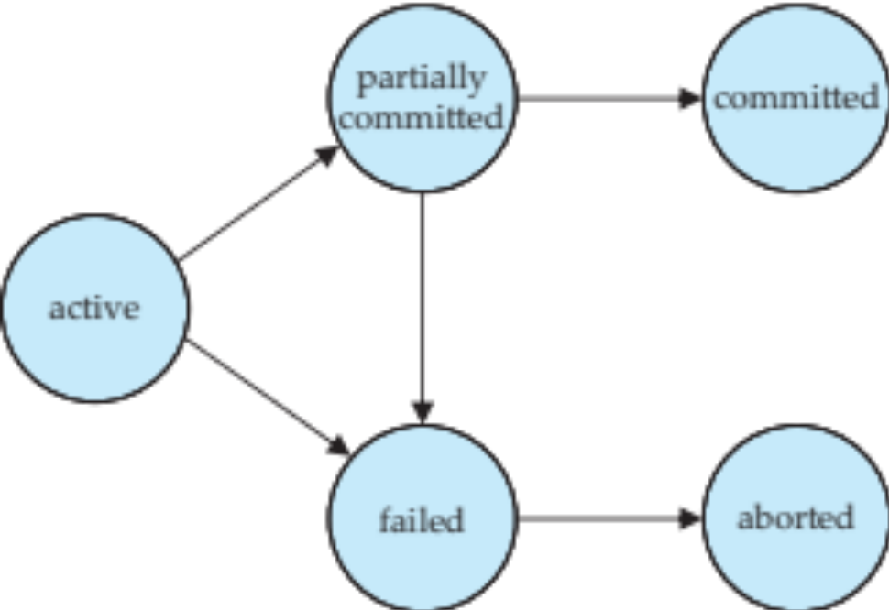
Transaction State (Cont.)

Slide 7
Concurrent Executions
Multiple transactions are allowed to run concurrently in the system. Advantages are:
  Increased processor and disk utilization, leading to better transaction throughput
    e.g., one transaction can be using the CPU while another is reading from or writing to the disk
  Reduced average response time for transactions: short transactions need not wait behind long ones.
Concurrency control schemes – mechanisms to achieve isolation
  That is, to control the interaction among the concurrent transactions in order to prevent them from destroying the consistency of the database
    Will study in Chapter 15, after studying notion of correctness of concurrent executions.

Slide 8
Schedules
Schedule – a sequences of instructions that specify the chronological order in which instructions of concurrent transactions are executed
  A schedule for a set of transactions must consist of all instructions of those transactions
  Must preserve the order in which the instructions appear in each individual transaction.
A transaction that successfully completes its execution will have a commit instructions as the last statement
  By default transaction assumed to execute commit instruction as its last step
A transaction that fails to successfully complete its execution will have an abort instruction as the last statement

Slide 9
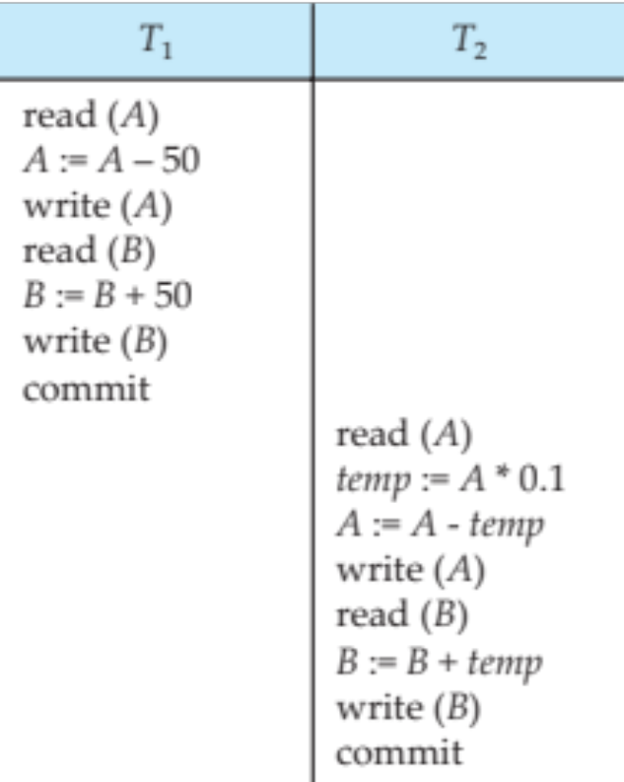
Schedule 1
Let T₁ transfer $50 from A to B, and T₂ transfer 10% of the balance from A to B.
A serial schedule in which T₁ is followed by T₂ :
A=100
A=50
DB: A=50
B=200
B=250
DB: B=250
A=100, B=200 A+B=300
A=50
Temp=5
A=45
DB: A=45
B=250
B=255
DB: B=255
A=45, B=255 A+B=300

Slide 10
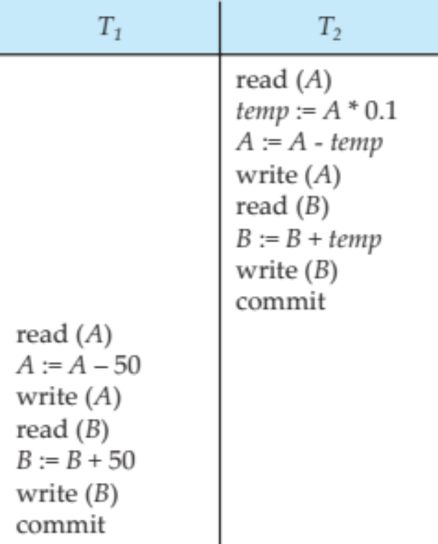
Schedule 2
A=100, B=200
A serial schedule where T₂ is followed by T₁
A=100
Temp=10
A=90
DB:A=90
B=200
B=210
DB:B=210
A=90
A=40
DB:A=40
B=210
B=260
DB:B=260

Slide 11
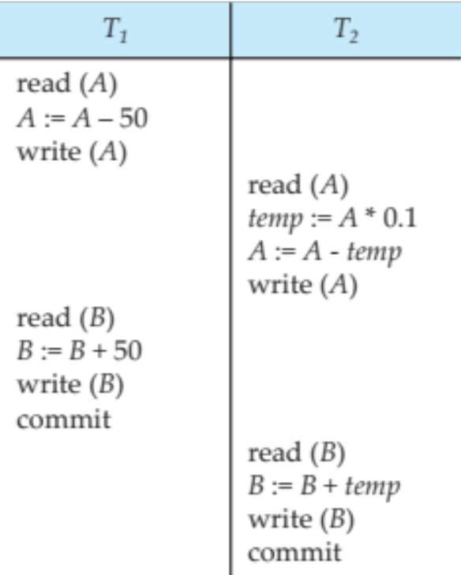
Schedule 3
Let T₁ and T₂ be the transactions defined previously. The following schedule is not a serial schedule, but it is equivalent to Schedule 1.
A=100
A=50
DB:A=50
B=200
B=250
DB:B=250
A=50
Temp=5
A=45
DB:A=45
B=250
B=255
DB:B=255
In Schedules 1, 2 and 3, the sum A + B is preserved.

Slide 12
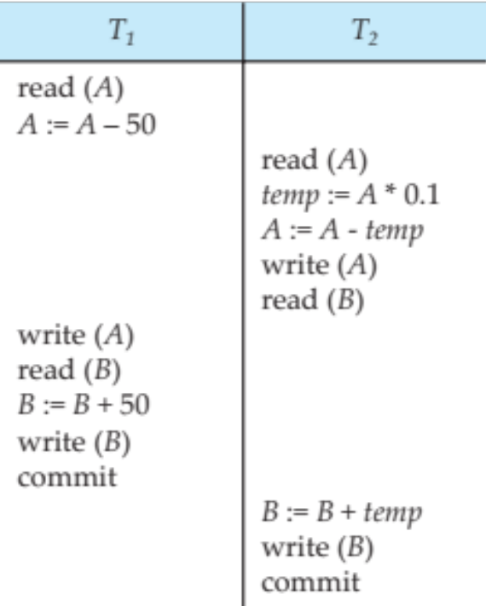
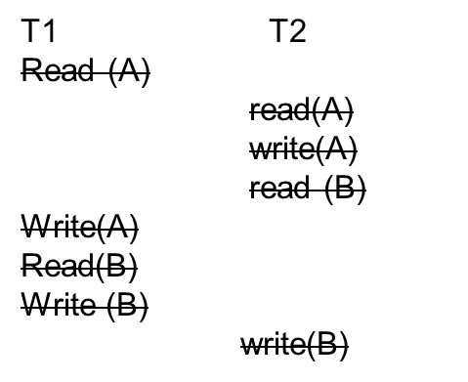
Schedule 4
The following concurrent schedule does not preserve the value of (A + B ).
A=100
Temp=10
A=90
DB:A=90
B=200
B=260
DB:B=260

