Slide 1
Chapter 1: Introduction

Slide 2
Chapter 1: Introduction
What Operating Systems Do
Computer-System Organization
Computer-System Architecture
Operating-System Operations
Resource Management
Security and Protection
Virtualization
Distributed Systems
Kernel Data Structures
Computing Environments
Free/Libre and Open-Source Operating Systems

Slide 3
Objectives
Describe the general organization of a computer system and the role of interrupts
Describe the components in a modern, multiprocessor computer system
Illustrate the transition from user mode to kernel mode
Discuss how operating systems are used in various computing environments
Provide examples of free and open-source operating systems

Slide 4
What is an Operating System?
A program that acts as an intermediary between a user of a computer and the computer hardware
Operating system goals:
Execute user programs and make solving user problems easier
Make the computer system convenient to use
Use the computer hardware in an efficient manner

Slide 5
Computer System Structure
Computer system can be divided into four components:
Hardware – provides basic computing resources
CPU, memory, I/O devices
Operating system
Controls and coordinates use of hardware among various applications and users
Application programs – define the ways in which the system resources are used to solve the computing problems of the users
Word processors, compilers, web browsers, database systems, video games
Users
People, machines, other computers

Slide 6
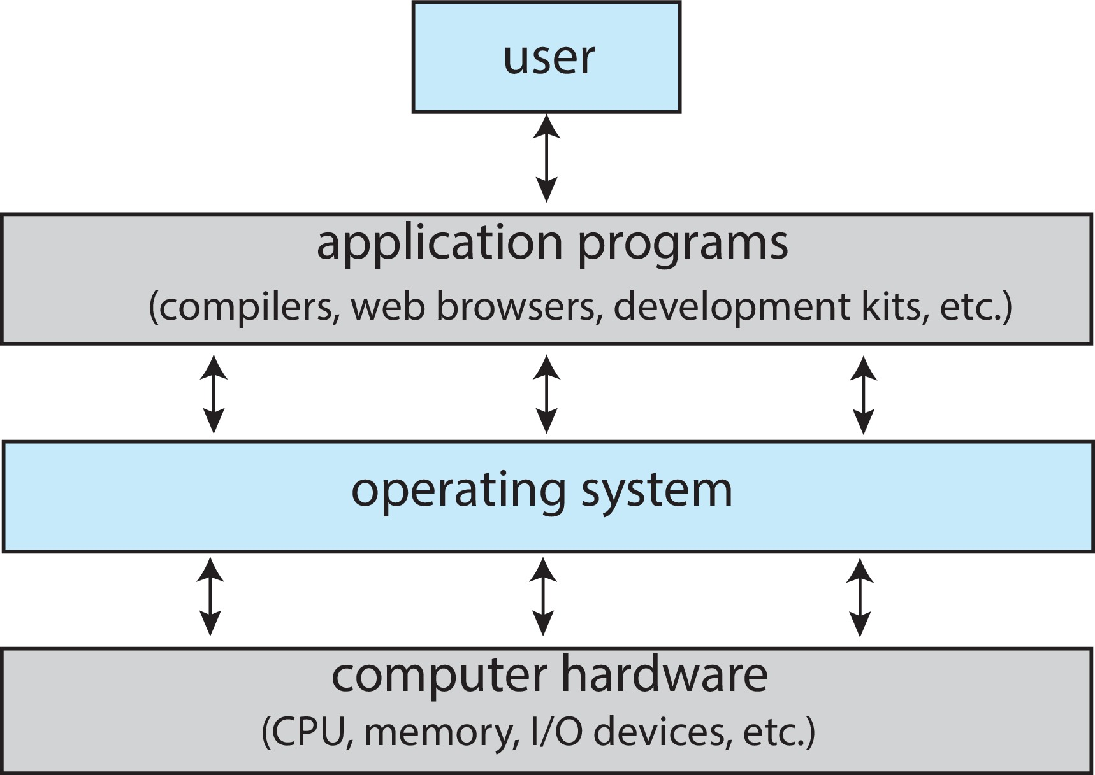
Abstract View of Components of Computer

Slide 7
What Operating Systems Do
Depends on the point of view
Users want convenience, ease of use and good performance
Don’t care about resource utilization
But shared computer such as mainframe or minicomputer must keep all users happy
Operating system is a resource allocator and control program making efficient use of HW and managing execution of user programs
Users of dedicate systems such as workstations have dedicated resources but frequently use shared resources from servers
Mobile devices like smartphones and tables are resource poor, optimized for usability and battery life
Mobile user interfaces such as touch screens, voice recognition
Some computers have little or no user interface, such as embedded computers in devices and automobiles
Run primarily without user intervention

Slide 8
Operating System Definition
No universally accepted definition
“Everything a vendor ships when you order an operating system” is a good approximation
But varies wildly
“The one program running at all times on the computer” is the kernel, part of the operating system
Everything else is either
A system program (ships with the operating system, but not part of the kernel) , or
An application program, all programs not associated with the operating system
Today’s OSes for general purpose and mobile computing also include middleware – a set of software frameworks that provide additional services to application developers such as databases, multimedia, graphics

Slide 9
Overview of Computer System Structure

Slide 10
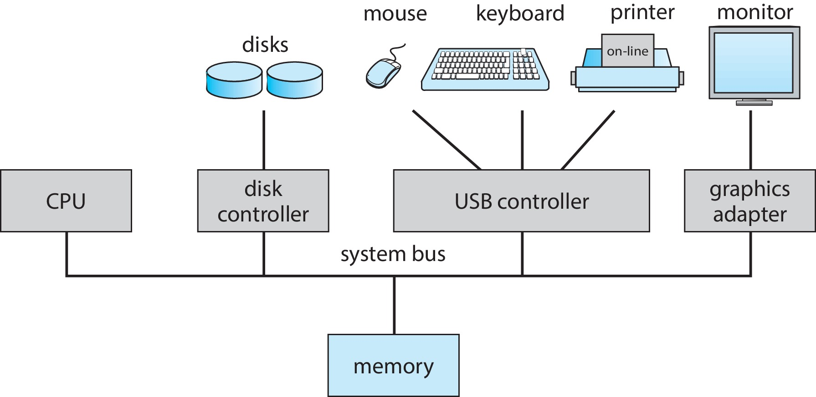
Computer System Organization
Computer-system operation
One or more CPUs, device controllers connect through common bus providing access to shared memory
Concurrent execution of CPUs and devices competing for memory cycles

Slide 11
Computer-System Operation
I/O devices and the CPU can execute concurrently
Each device controller is in charge of a particular device type
Each device controller has a local buffer
Each device controller type has an operating system device driver to manage it
CPU moves data from/to main memory to/from local buffers
I/O is from the device to local buffer of controller
Device controller informs CPU that it has finished its operation by causing an interrupt

Slide 12
Common Functions of Interrupts
Interrupt transfers control to the interrupt service routine generally, through the interrupt vector, which contains the addresses of all the service routines
Interrupt architecture must save the address of the interrupted instruction
A trap or exception is a software-generated interrupt caused either by an error or a user request
An operating system is interrupt driven

Slide 13
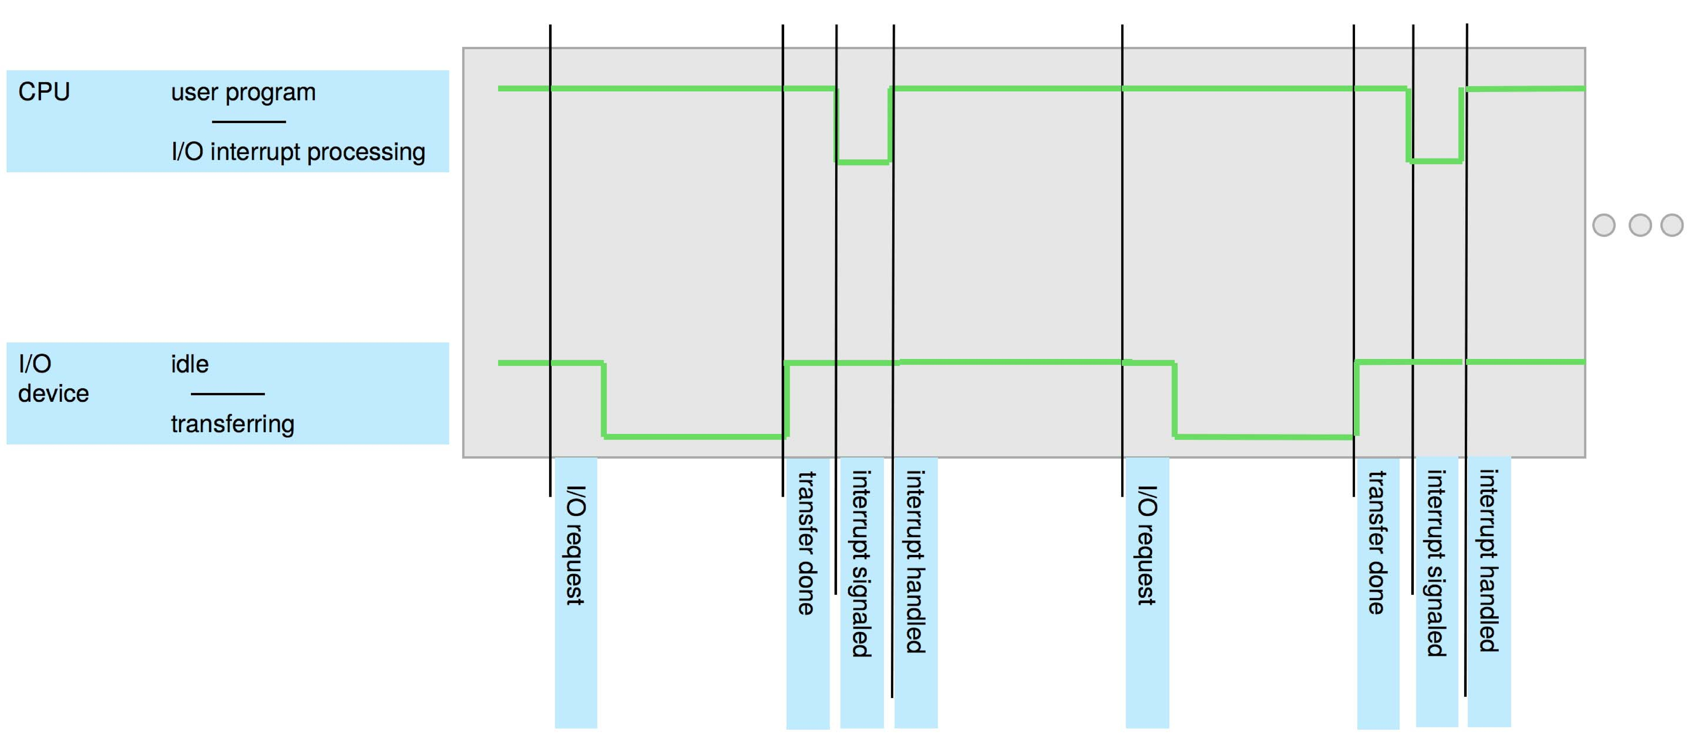
Interrupt Timeline

Slide 14
Interrupt Handling
The operating system preserves the state of the CPU by storing the registers and the program counter
Determines which type of interrupt has occurred:
Separate segments of code determine what action should be taken for each type of interrupt

Slide 15
Interrupt-drive I/O Cycle

Slide 16
Computer Startup
Bootstrap program is loaded at power-up or reboot
Typically stored in ROM or EPROM, generally known as firmware
Initializes all aspects of system
Loads operating system kernel and starts execution

Slide 17
Storage Structure

Slide 18
Storage Hierarchy
Storage systems organized in hierarchy
Speed
Cost
Volatility
Caching – copying information into faster storage system; main memory can be viewed as a cache for secondary storage
Device Driver for each device controller to manage I/O
Provides uniform interface between controller and kernel

Slide 19
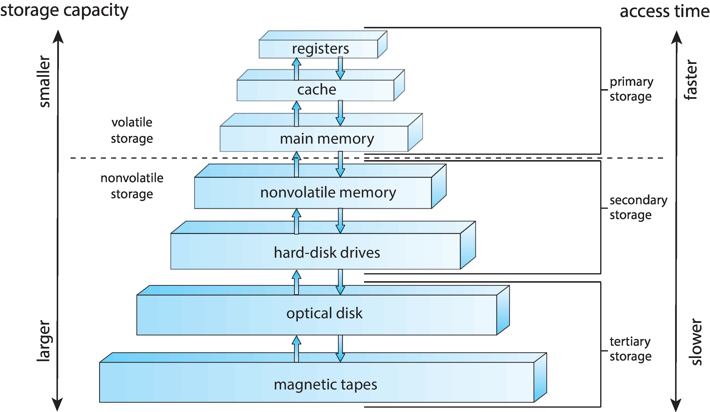
Storage-Device Hierarchy

Slide 20
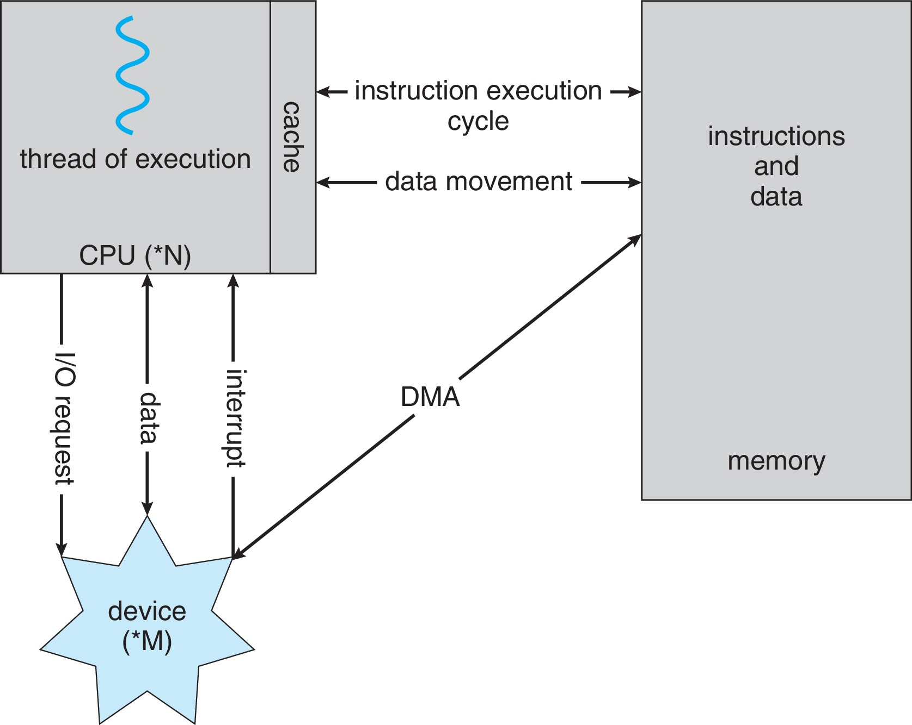
How a Modern Computer Works
A von Neumann architecture

Slide 21
Direct Memory Access Structure
Used for high-speed I/O devices able to transmit information at close to memory speeds
Device controller transfers blocks of data from buffer storage directly to main memory without CPU intervention
Only one interrupt is generated per block, rather than the one interrupt per byte

Slide 22
Operating-System Operations
Bootstrap program – simple code to initialize the system, load the kernel
Kernel loads
Starts system daemons (services provided outside of the kernel)
Kernel interrupt driven (hardware and software)
Hardware interrupt by one of the devices
Software interrupt (exception or trap):
Software error (e.g., division by zero)
Request for operating system service – system call
Other process problems include infinite loop, processes modifying each other or the operating system

Slide 23
Multiprogramming (Batch system)
Single user cannot always keep CPU and I/O devices busy
Multiprogramming organizes jobs (code and data) so CPU always has one to execute
A subset of total jobs in system is kept in memory
One job selected and run via job scheduling
When job has to wait (for I/O for example), OS switches to another job

Slide 24
Multitasking (Timesharing)
A logical extension of Batch systems– the CPU switches jobs so frequently that users can interact with each job while it is running, creating interactive computing
Response time should be < 1 second
Each user has at least one program executing in memory  process
If several jobs ready to run at the same time  CPU scheduling
If processes don’t fit in memory, swapping moves them in and out to run
Virtual memory allows execution of processes not completely in memory

Slide 25
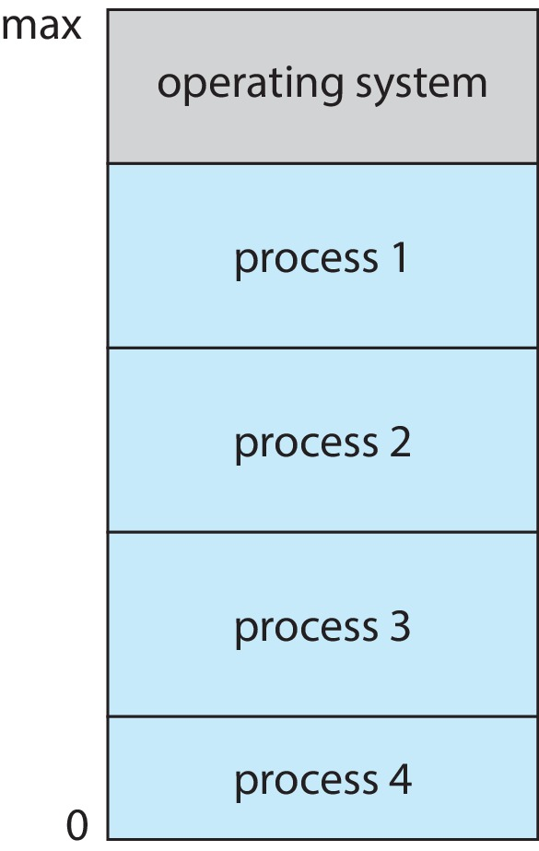
Memory Layout for Multiprogrammed System

Slide 26
Dual-mode Operation
Dual-mode operation allows OS to protect itself and other system components
User mode and kernel mode
Mode bit provided by hardware
Provides ability to distinguish when system is running user code or kernel code.
When a user is running  mode bit is “user”
When kernel code is executing  mode bit is “kernel”
How do we guarantee that user does not explicitly set the mode bit to “kernel”?
System call changes mode to kernel, return from call resets it to user
Some instructions designated as privileged, only executable in kernel mode

Slide 27
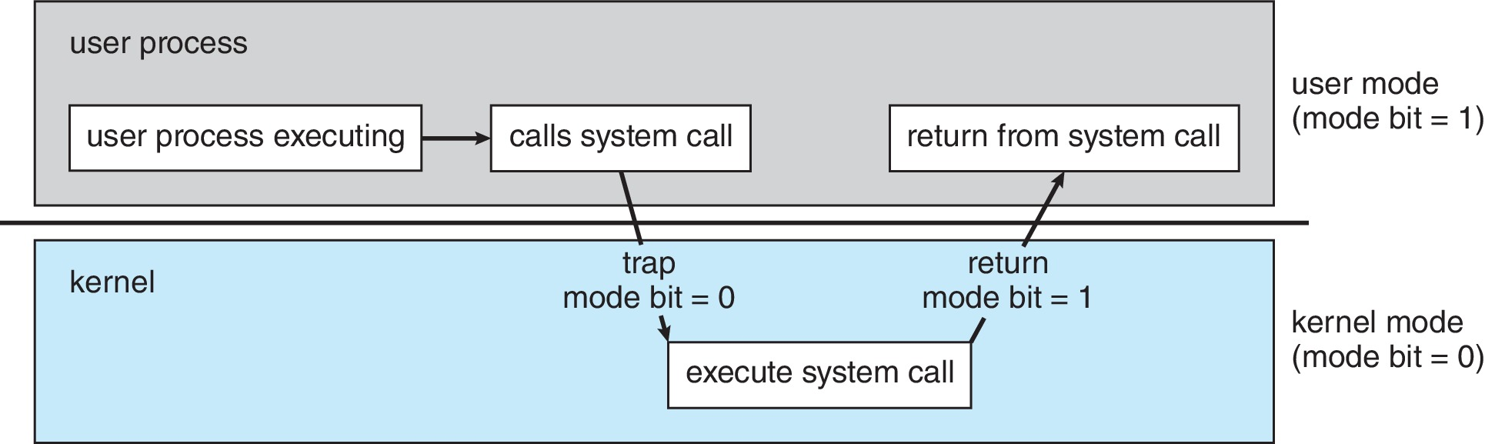
Transition from User to Kernel Mode

Slide 28
Timer
Timer to prevent infinite loop (or process hogging resources)
Timer is set to interrupt the computer after some time period
Keep a counter that is decremented by the physical clock
Operating system set the counter (privileged instruction)
When counter zero generate an interrupt
Set up before scheduling process to regain control or terminate program that exceeds allotted time

Slide 29
Computer System Architecture

Slide 30
Computer-System Architecture
Most systems use a single general-purpose processor
Most systems have special-purpose processors as well
Multiprocessors systems growing in use and importance
Also known as parallel systems, tightly-coupled systems
Advantages include:
Increased throughput
Economy of scale
Increased reliability – graceful degradation or fault tolerance
Two types:
Asymmetric Multiprocessing – each processor is assigned a specie task.
Symmetric Multiprocessing – each processor performs all tasks

Slide 31
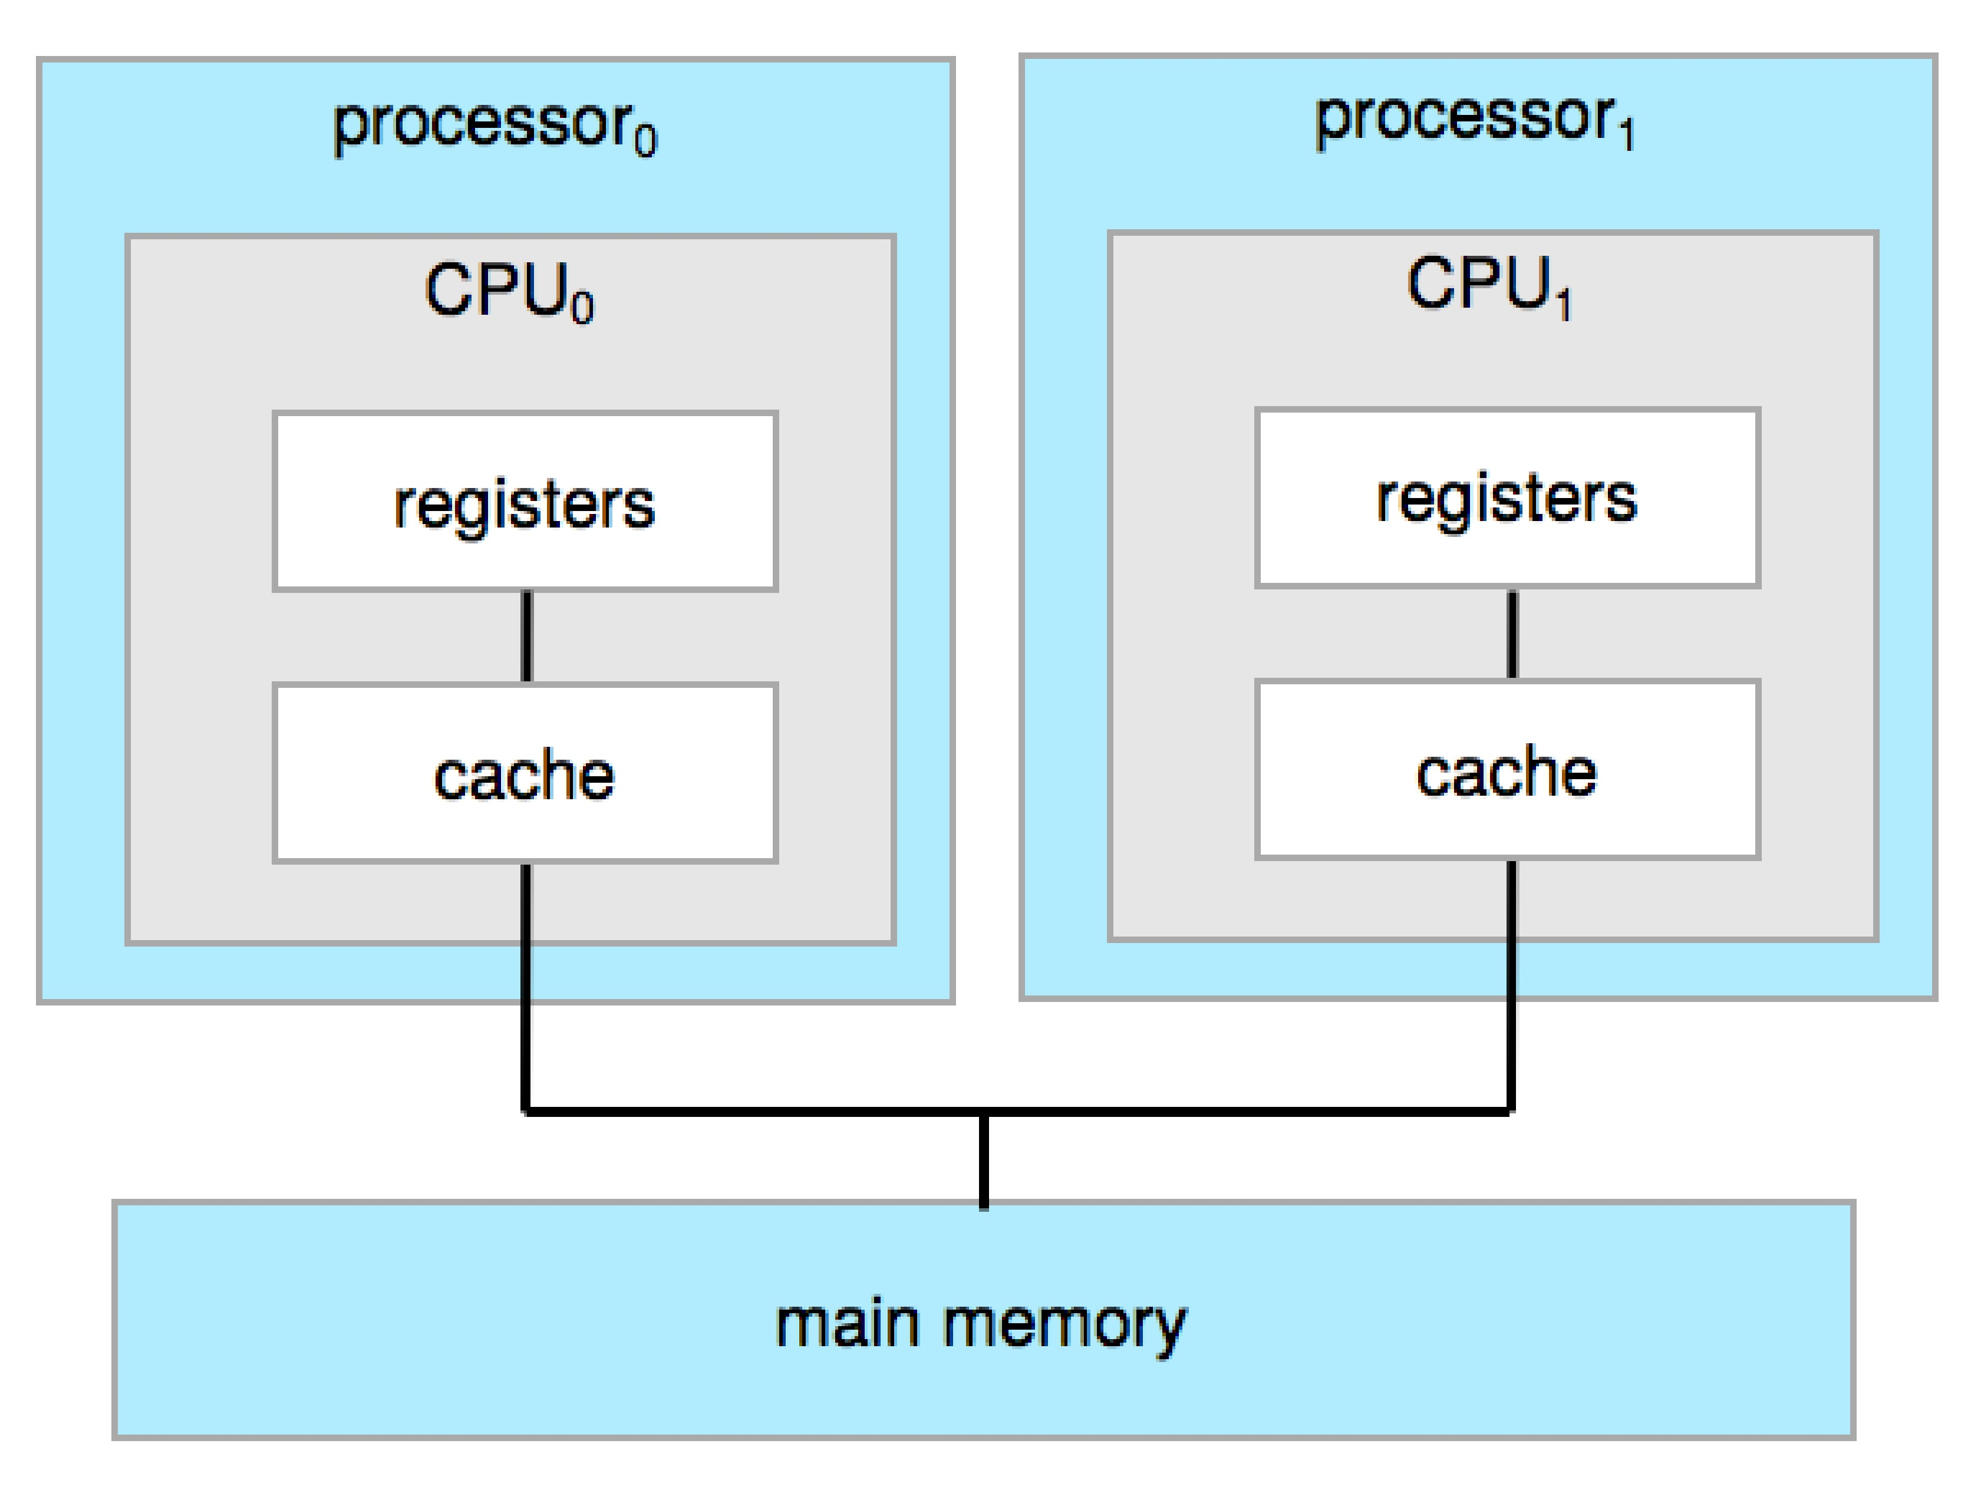
Symmetric Multiprocessing Architecture

Slide 32
Computer System Environments

Slide 33
Computing Environments
Traditional
Mobile
Client Server
Peer-to-Peer
Cloud computing
Real-time Embedded

Slide 34
Traditional
Stand-alone general-purpose machines
But blurred as most systems interconnect with others (i.e., the Internet)
Portals provide web access to internal systems
Network computers (thin clients) are like Web terminals
Mobile computers interconnect via wireless networks
Networking becoming ubiquitous – even home systems use firewalls to protect home computers from Internet attacks

Slide 35
Mobile
Handheld smartphones, tablets, etc.
What is the functional difference between them and a “traditional” laptop?
Extra feature – more OS features (GPS, gyroscope)
Allows new types of apps like augmented reality
Use IEEE 802.11 wireless, or cellular data networks for connectivity
Leaders are Apple iOS and Google Android

Slide 36
Client Server
Client-Server Computing
Dumb terminals supplanted by smart PCs
Many systems now servers, responding to requests generated by clients
Compute-server system provides an interface to client to request services (i.e., database)
File-server system provides interface for clients to store and retrieve files

Slide 37
Peer-to-Peer
Another model of distributed system
P2P does not distinguish clients and servers
Instead all nodes are considered peers
May each act as client, server or both
Node must join P2P network
Registers its service with central lookup service on network, or
Broadcast request for service and respond to requests for service via discovery protocol
Examples include Napster and Gnutella, Voice over IP (VoIP) such as Skype

Slide 38
Cloud Computing
Delivers computing, storage, even apps as a service across a network
Logical extension of virtualization because it uses virtualization as the base for it functionality.
Amazon EC2 has thousands of servers, millions of virtual machines, petabytes of storage available across the Internet, pay based on usage

Slide 39
Cloud Computing (Cont.)
Many types
Public cloud – available via Internet to anyone willing to pay
Private cloud – run by a company for the company’s own use
Hybrid cloud – includes both public and private cloud components
Software as a Service (SaaS) – one or more applications available via the Internet (i.e., word processor)
Platform as a Service (PaaS) – software stack ready for application use via the Internet (i.e., a database server)
Infrastructure as a Service (IaaS) – servers or storage available over Internet (i.e., storage available for backup use)

Slide 40
Cloud Computing (cont.)
Cloud computing environments composed of traditional OSes, plus VMMs, plus cloud management tools
Internet connectivity requires security like firewalls
Load balancers spread traffic across multiple applications

Slide 41
End of Chapter 1

