Slide 1
Chapter 9: Virtual Memory
Notes:
‹#›

Slide 2
Chapter 9: Virtual Memory
Background
Demand Paging
Copy-on-Write
Page Replacement
Allocation of Frames
Thrashing
Memory-Mapped Files
Allocating Kernel Memory
Other Considerations
Operating-System Examples
Notes:
‹#›

Slide 3
Objectives
To describe the benefits of a virtual memory system
To explain the concepts of demand paging, page-replacement algorithms, and allocation of page frames
To discuss the principle of the working-set model
To examine the relationship between shared memory and memory-mapped files
To explore how kernel memory is managed
Notes:
‹#›

Slide 4
Background
Code needs to be in memory to execute, but entire program rarely used
Error code, unusual routines, large data structures
Entire program code not needed at same time
Consider ability to execute partially-loaded program
Program no longer constrained by limits of physical memory
Each program takes less memory while running -> more programs run at the same time
Increased CPU utilization and throughput with no increase in response time or turnaround time
Less I/O needed to load or swap programs into memory -> each user program runs faster
Notes:
‹#›

Slide 5
Background (Cont.)
Virtual memory – separation of user logical memory from physical memory
Only part of the program needs to be in memory for execution
Logical address space can therefore be much larger than physical address space
Allows address spaces to be shared by several processes
Allows for more efficient process creation
More programs running concurrently
Less I/O needed to load or swap processes
Notes:
‹#›

Slide 6
Background (Cont.)
Virtual address space – logical view of how process is stored in memory
Usually start at address 0, contiguous addresses until end of space
Meanwhile, physical memory organized in page frames
MMU must map logical to physical
Virtual memory can be implemented via:
Demand paging
Demand segmentation
Notes:
‹#›

Slide 7
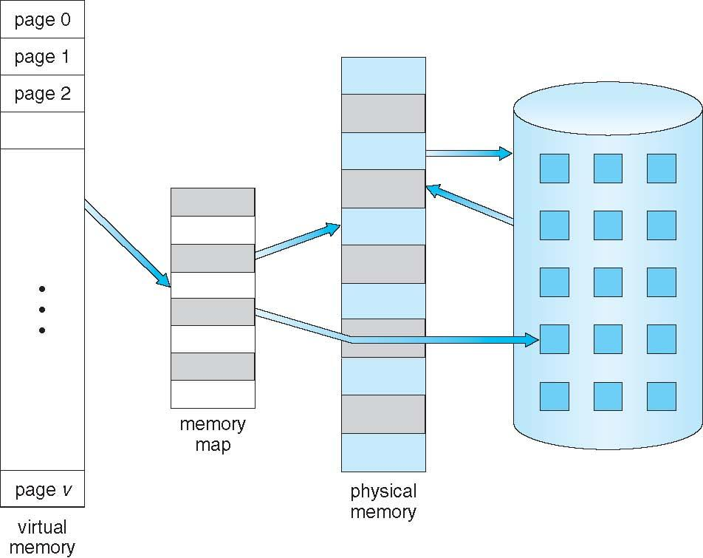
Virtual Memory That is Larger Than Physical Memory
Notes:
‹#›

Slide 8

Demand Paging
Could bring entire process into memory at load time
Or bring a page into memory only when it is needed
Less I/O needed, no unnecessary I/O
Less memory needed
Faster response
More users
Similar to paging system with swapping (diagram on right)
Page is needed ⇒ reference to it
invalid reference ⇒ abort
not-in-memory ⇒ bring to memory
Lazy swapper – never swaps a page into memory unless page will be needed
Swapper that deals with pages is a pager
Notes:
‹#›

Slide 9
Basic Concepts
With swapping, pager guesses which pages will be used before swapping out again
Instead, pager brings in only those pages into memory
How to determine that set of pages?
Need new MMU functionality to implement demand paging
If pages needed are already memory resident
No difference from non demand-paging
If page needed and not memory resident
Need to detect and load the page into memory from storage
Without changing program behavior
Without programmer needing to change code

Slide 10
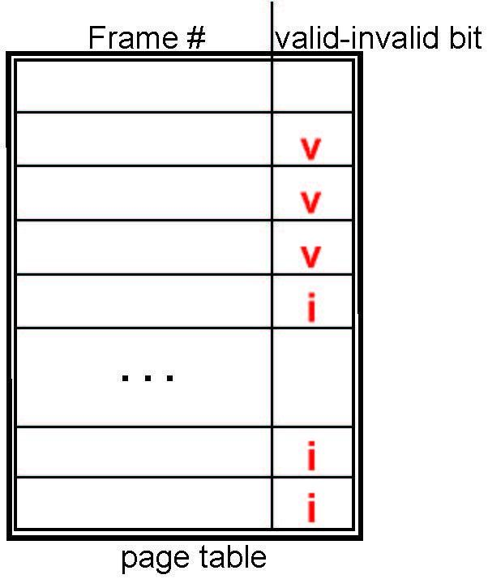
Valid-Invalid Bit
With each page table entry a valid–invalid bit is associated (v ⇒ in-memory – memory resident, i ⇒ not-in-memory)
Initially valid–invalid bit is set to i on all entries
Example of a page table snapshot:
During MMU address translation, if valid–invalid bit in page table entry is i ⇒ page fault
Notes:
‹#›

Slide 11
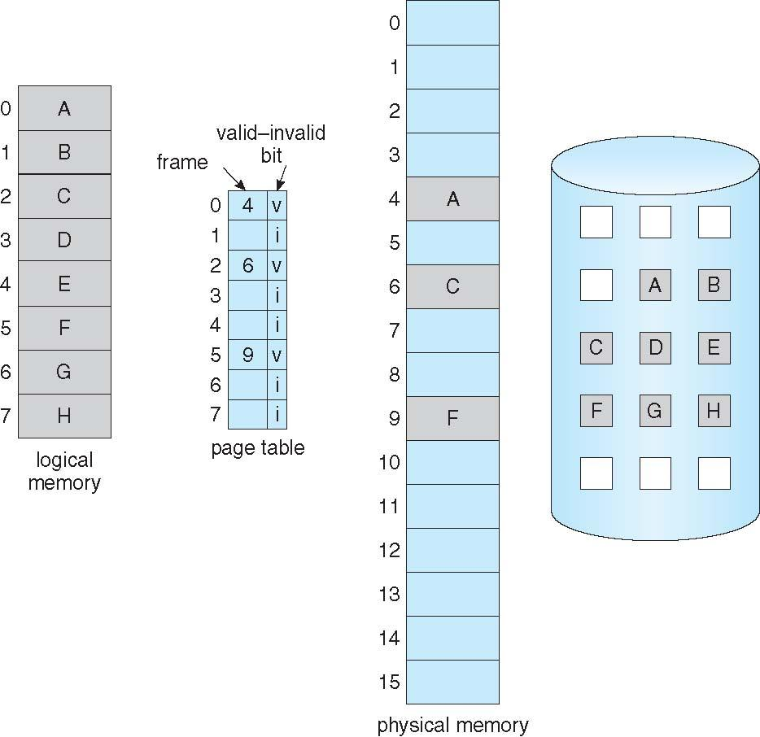
Page Table When Some Pages Are Not in Main Memory
Notes:
‹#›

Slide 12
Page Fault
If there is a reference to a page, first reference to that page will trap to operating system:
page fault
Operating system looks at another table to decide:
Invalid reference ⇒ abort
Just not in memory
Find free frame
Swap page into frame via scheduled disk operation
Reset tables to indicate page now in memory Set validation bit = v
Restart the instruction that caused the page fault
Notes:
‹#›

Slide 13

Steps in Handling a Page Fault
Notes:
‹#›

Slide 14
Page Replacement
Prevent over-allocation of memory by modifying page-fault service routine to include page replacement
Use modify (dirty) bit to reduce overhead of page transfers – only modified pages are written to disk
Page replacement completes separation between logical memory and physical memory – large virtual memory can be provided on a smaller physical memory
Notes:
‹#›

Slide 15
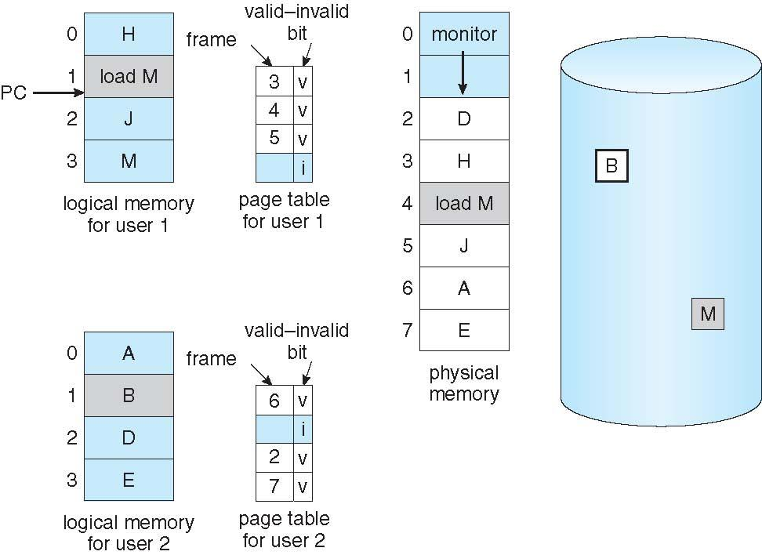
Need For Page Replacement
Notes:
‹#›

Slide 16
Basic Page Replacement
Find the location of the desired page on disk
Find a free frame: - If there is a free frame, use it - If there is no free frame, use a page replacement algorithm to select a victim frame - Write victim frame to disk if dirty
Bring the desired page into the (newly) free frame; update the page and frame tables
Continue the process by restarting the instruction that caused the trap
Note now potentially 2 page transfers for page fault – increasing EAT
Notes:
‹#›

Slide 17
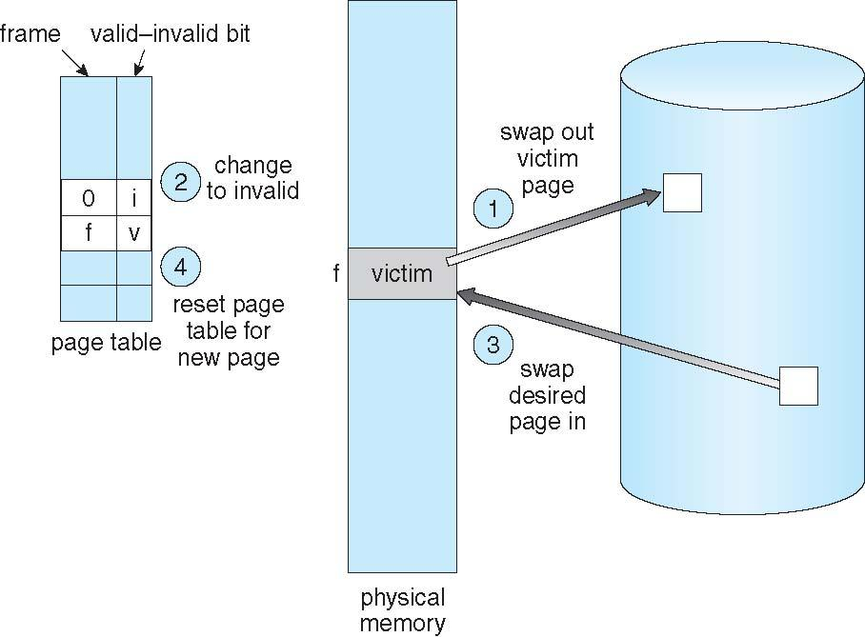
Page Replacement
Notes:
‹#›

Slide 18
Page and Frame Replacement Algorithms
Frame-allocation algorithm determines
How many frames to give each process
Which frames to replace
Page-replacement algorithm
Want lowest page-fault rate on both first access and re-access
Evaluate algorithm by running it on a particular string of memory references (reference string) and computing the number of page faults on that string
String is just page numbers, not full addresses
Repeated access to the same page does not cause a page fault
Results depend on number of frames available
In all our examples, the reference string of referenced page numbers is
7,0,1,2,0,3,0,4,2,3,0,3,0,3,2,1,2,0,1,7,0,1
Notes:
‹#›

Slide 19
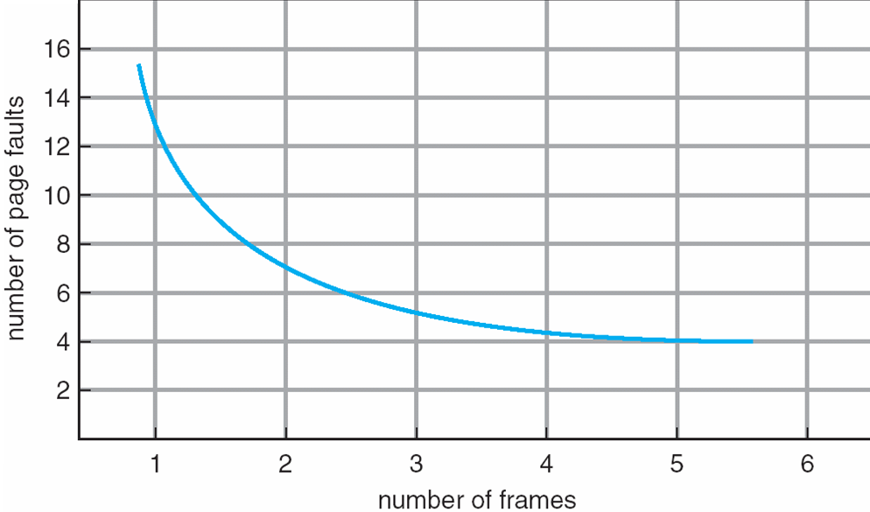
Graph of Page Faults Versus The Number of Frames
Notes:
‹#›

Slide 20
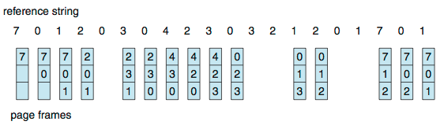
First-In-First-Out (FIFO) Algorithm
Reference string: 7,0,1,2,0,3,0,4,2,3,0,3,0,3,2,1,2,0,1,7,0,1
3 frames (3 pages can be in memory at a time per process)
Can vary by reference string: consider 1,2,3,4,1,2,5,1,2,3,4,5
Adding more frames can cause more page faults!
Belady’s Anomaly
How to track ages of pages?
Just use a FIFO queue
15 page faults
Notes:
‹#›

Slide 21
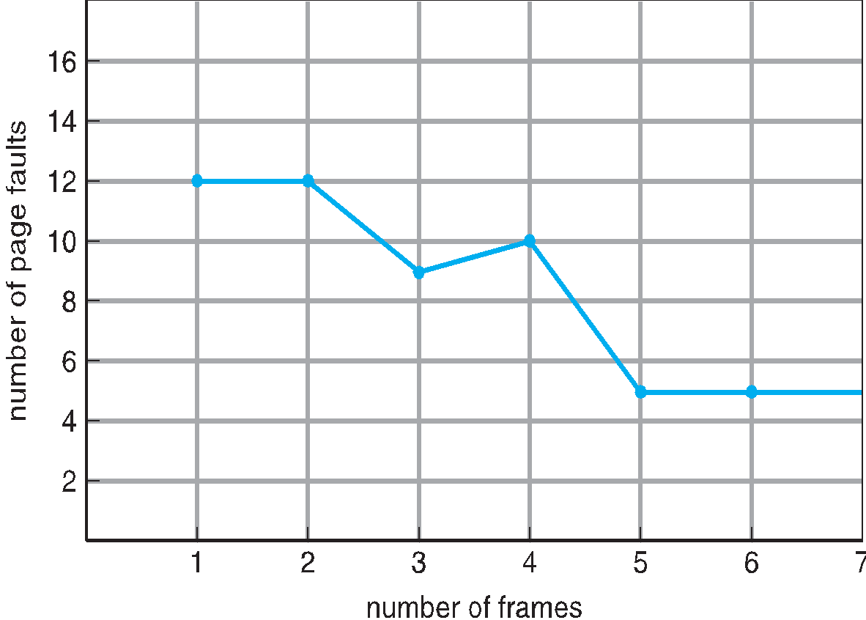
FIFO Illustrating Belady’s Anomaly
Notes:
‹#›

Slide 22
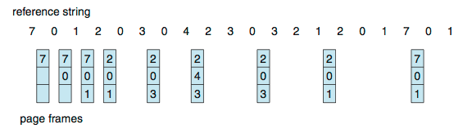
Optimal Algorithm
Replace page that will not be used for longest period of time
9 is optimal for the example
How do you know this?
Can’t read the future
Used for measuring how well your algorithm performs
Notes:
‹#›

Slide 23
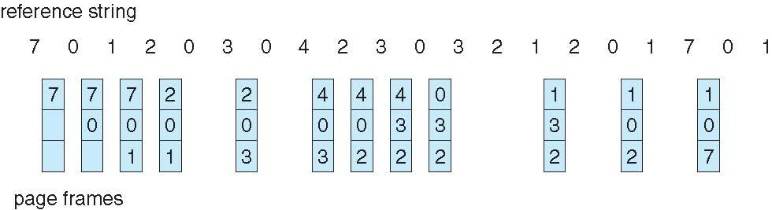
Least Recently Used (LRU) Algorithm
Use past knowledge rather than future
Replace page that has not been used in the most amount of time
Associate time of last use with each page
12 faults – better than FIFO but worse than OPT
Generally good algorithm and frequently used
Notes:
‹#›

Slide 24
End of Chapter 9
Notes:
‹#›

