Slide 1
Throughput Latency and RTT

Slide 2
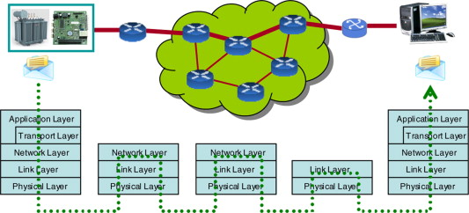
E2E Throughput and Delay

Slide 3
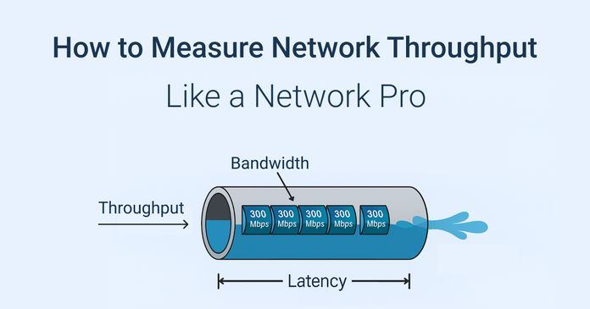
Throughput

Slide 4
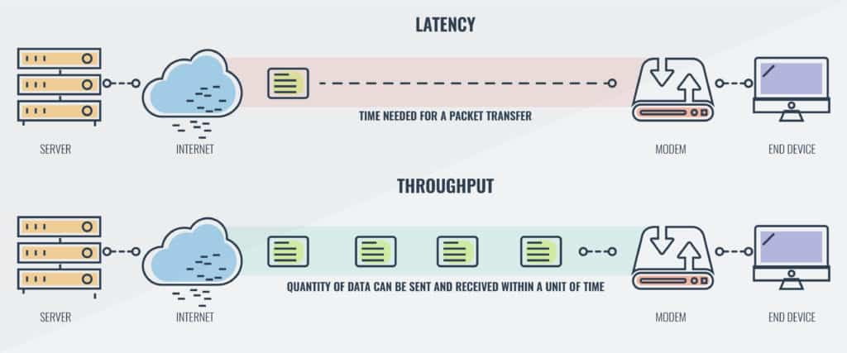
Throughput and Latency

Slide 5
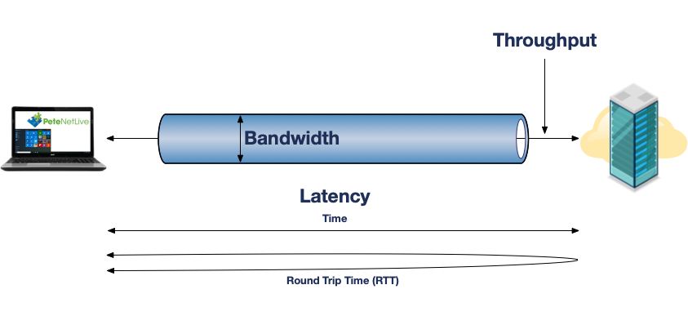
Bandwidth Throughput and Latency

Slide 6
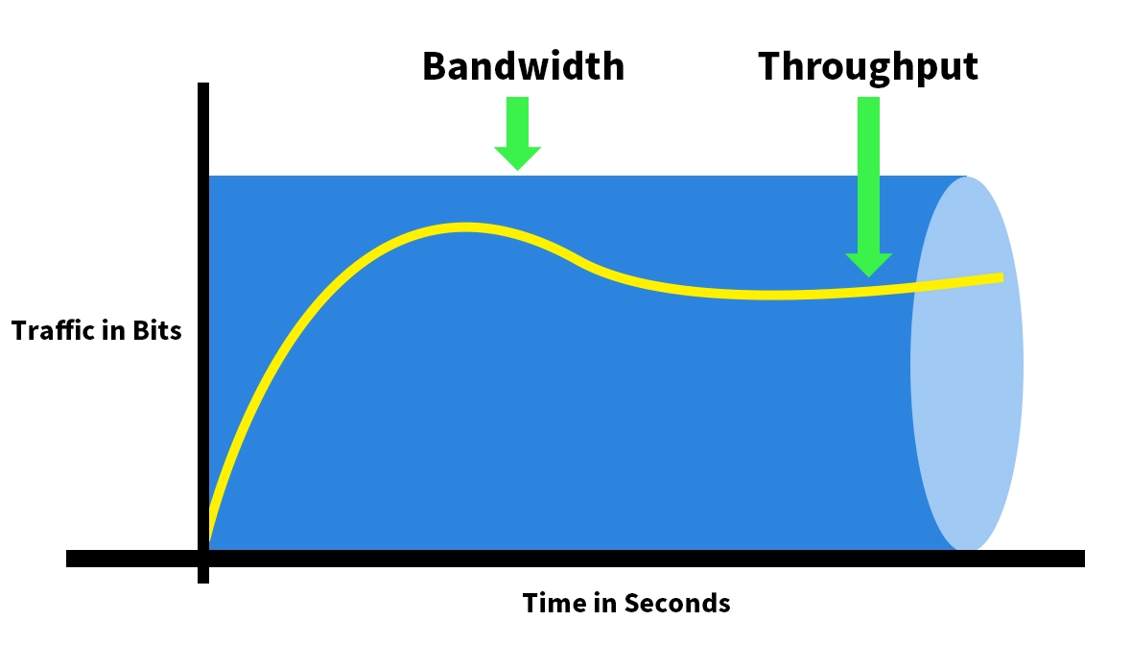
Bandwidth vs Throughput

Slide 7
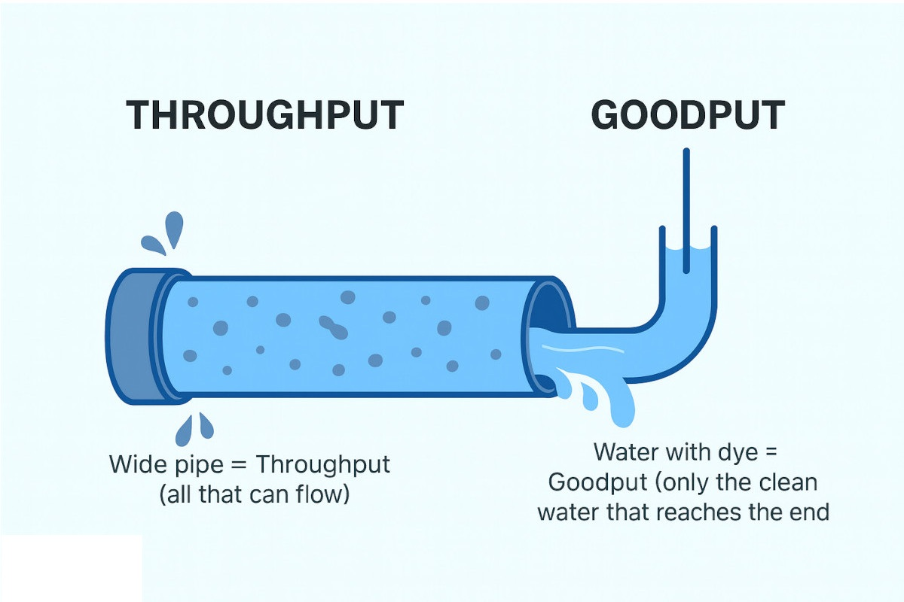
Throughput and Goodput and Badput

Slide 8
Definition
Latency is the one-way delay for data to travel from source to destination.
Round Trip Time (RTT) is the total time for a packet to go from source to destination and a response to come back. RTT is a common way to measure network latency, but it's often slightly more than double the one-way latency.
Goodput measures useful data delivered (application data only).
Throughput measures total data (useful + overhead + retransmissions) over a network link, making goodput a truer indicator of application performance, as it excludes protocol junk like headers and lost packets. In essence, throughput is the entire pipe's flow, but goodput is the actual product getting through the factory efficiently, representing the real user experience for things like file downloads or streaming.

Slide 9
Question
Compare Bandwidth and Latency
Difference between Throughput and Goodput
Illustrate Goodput and Badput
Classification of Bandwidth
Components of RTT
E2E Delay and E2E Throughput
E2E Goodput

