Slide 1
REFERENCE MODEL TCP/IP and ISO/OSI

Slide 2
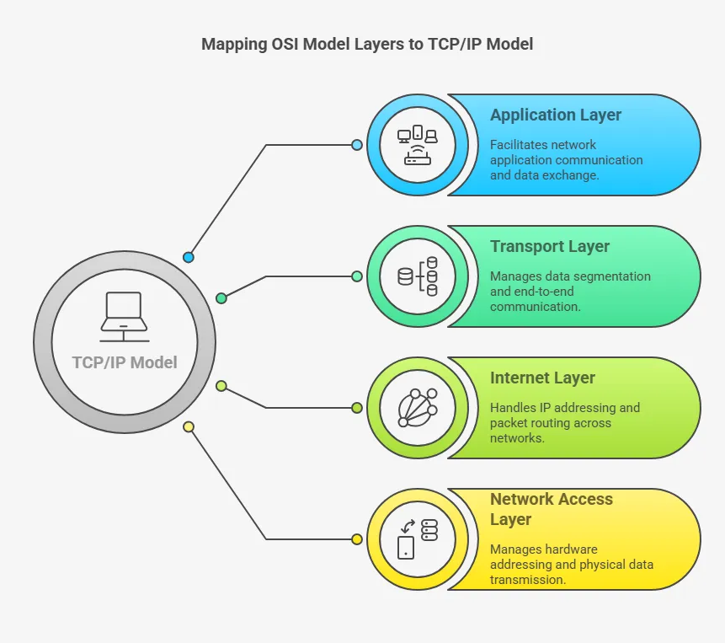
REFERENCE MODEL (OSI and TCP/IP)

Slide 3
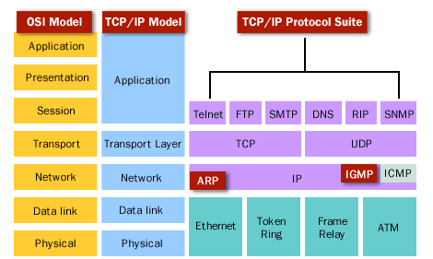
TCP/IP Protocol Suite

Slide 4
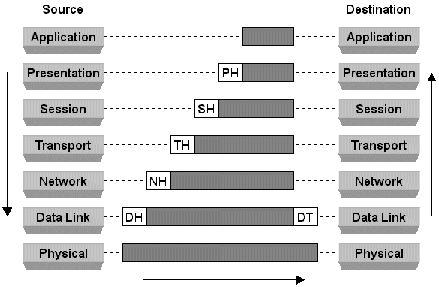
Reference Model (Horizontal Communication)

Slide 5
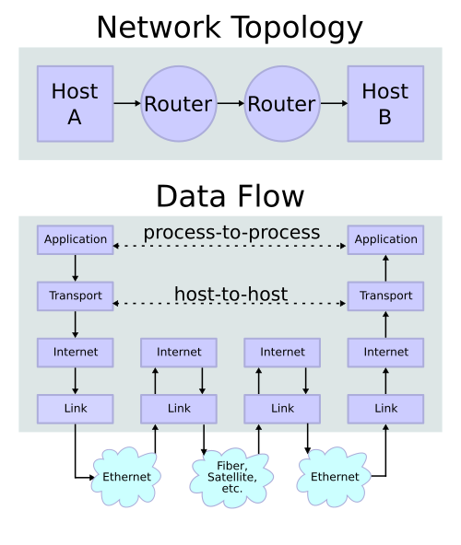
End to End Communication

Slide 6
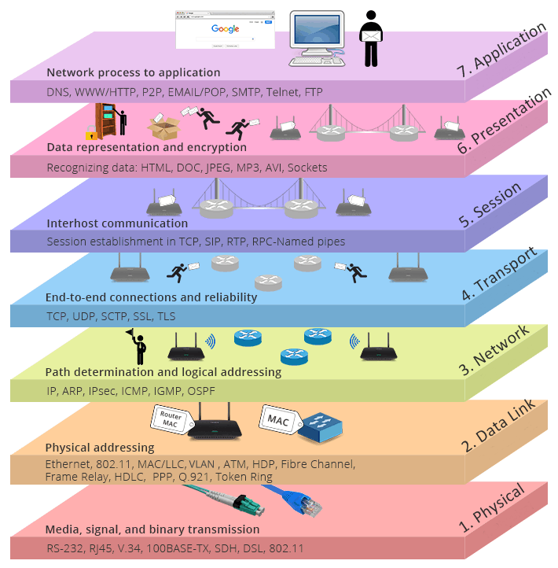
QUESTION?

