Slide 1
Firebase
Basic Understanding

Slide 2
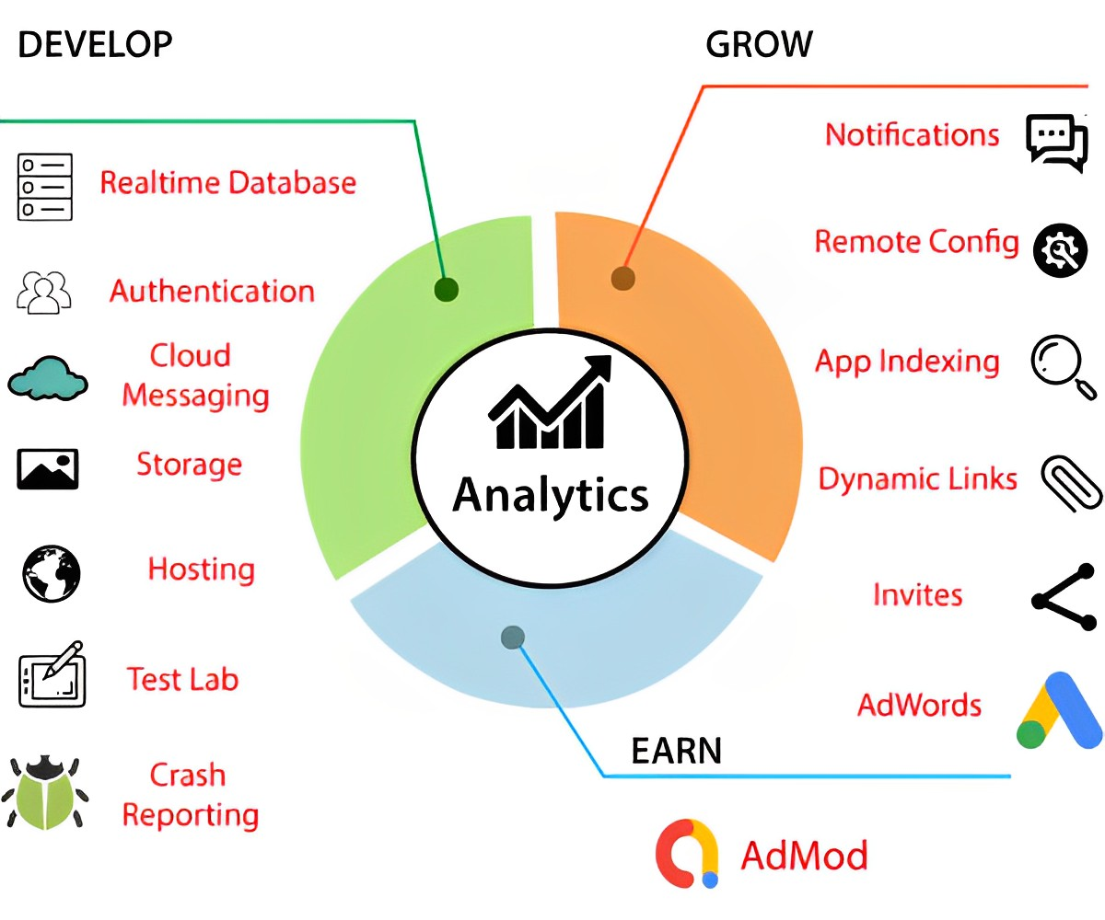
Firebase Structure
Google
Backend as a Service

Slide 3



Add Firebase to Flutter Application
Install Firebase CLI
$ firebase login
$ dart pub global activateflutterfire_cli
$ flutter pub add firebase_core
$ flutterfire configure
$ flutterfire configure --project= <project-123>
Flutter -> flutterfire_cli
Android -> google-services.json
Web -> firebase node module
iOS -> GoogleService-Info.plist
import 'package:firebase_core/firebase_core.dart’; import 'firebase_options.dart’;
await Firebase.initializeApp( options: DefaultFirebaseOptions.currentPlatform, );

Slide 4
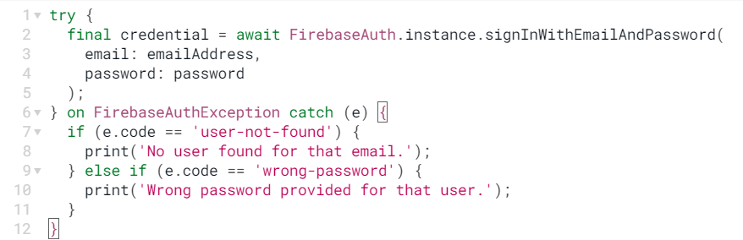
Authentication
Auth ways :
Passsword
LinkWithCredentials
GoogleAuthProvider / FacebookAuth / AppleAuthProvider
PhoneAuthCredentials
FirebaseAuth.instatnce.signInWithCustomToken
FirebaseAuth.instatnce.signInAnonimously
Test server:
useAuthEmulator(`localhost`, 9099)
- authStateChanges()
- idTokenChanges()
- userChanges()
-- reload()
-- unlink()
-- updateEmail()

Slide 5
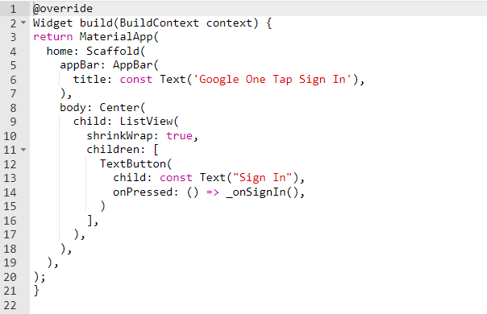
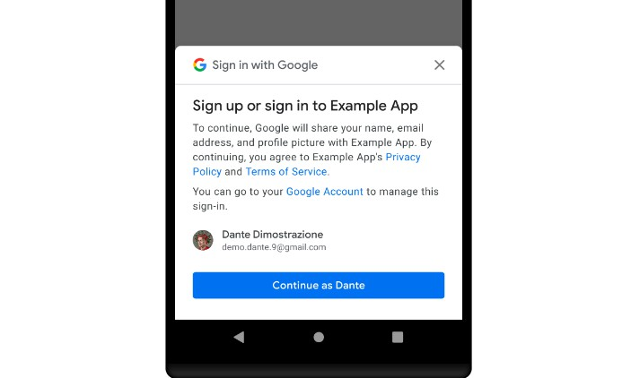
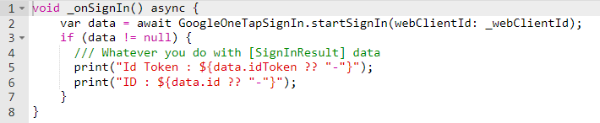
Flutter Google One Tap Sign In

Slide 6
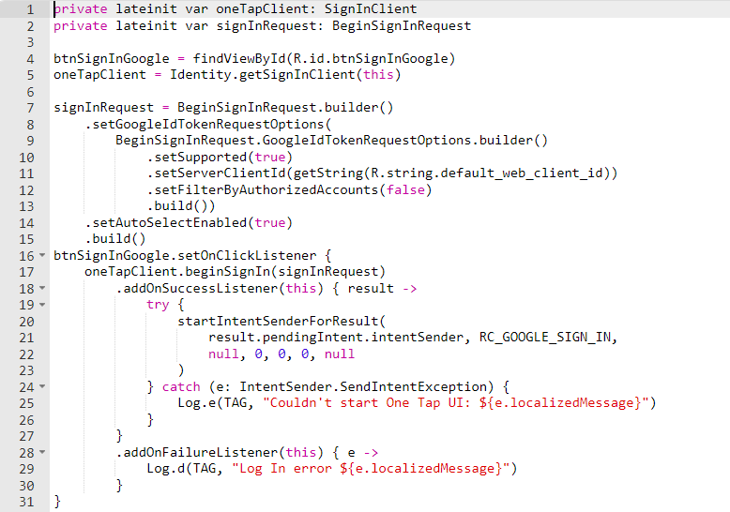
Android Google One Tap Sign In

Slide 7
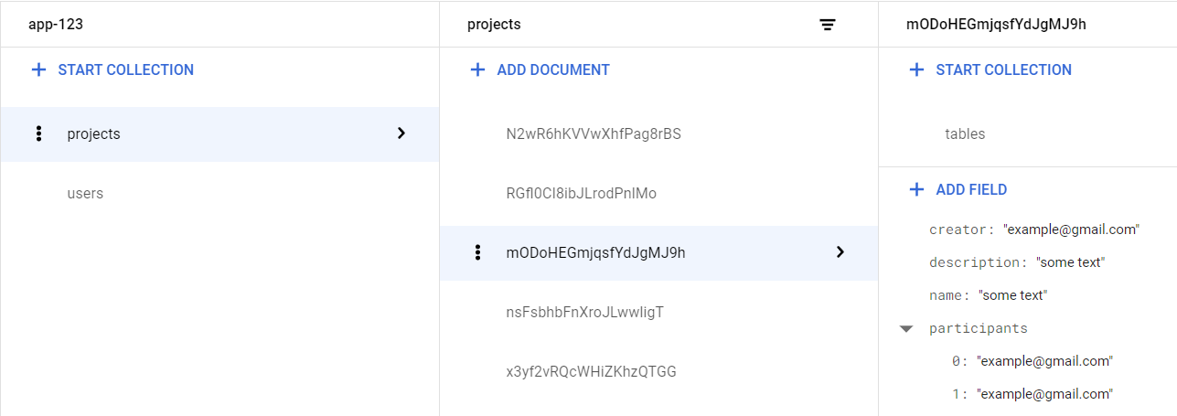
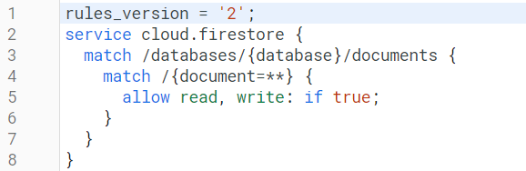
Firebase Realtime Database
Document Oriented
JSON
Synchronization

Slide 8
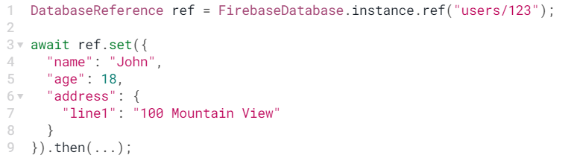
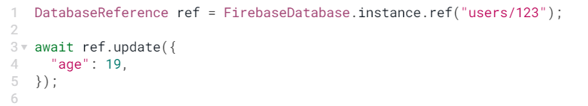
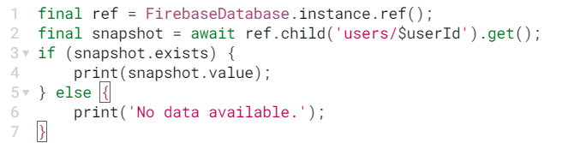
Firebase Realtime Database
Firebase emulators:start
DatabaseReference
Transactions

Slide 9
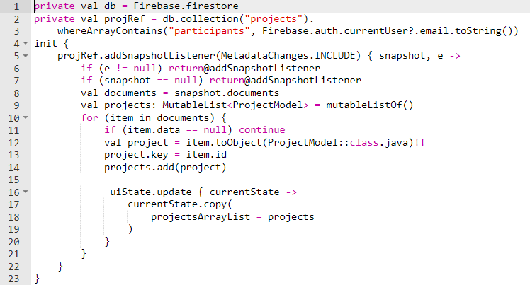
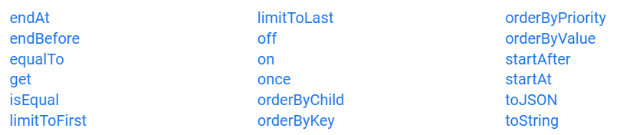
Firebase Realtime Database
Sinchronization
SnapshotListener

Slide 10
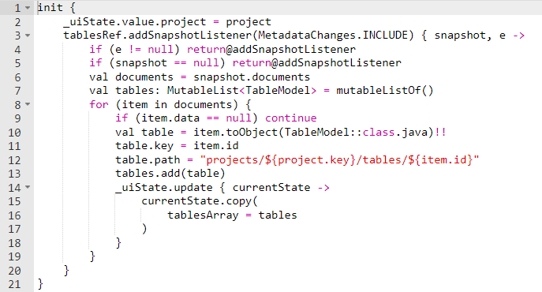
Firebase Realtime Database
Path with Parameters
Handle change of tablesRef

Slide 11
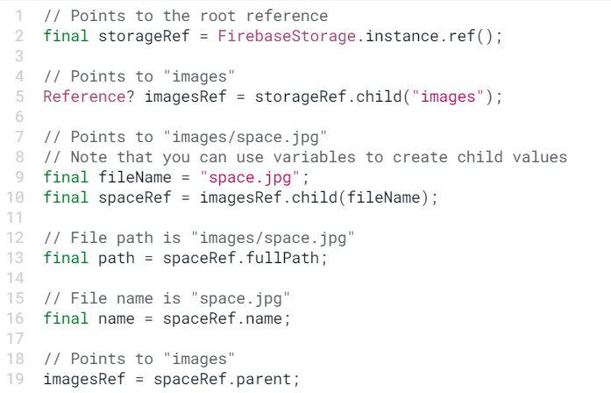
Cloud Storage
flutter pub add firebase_storage
import 'package:firebase_storage/firebase_storage.dart';
References
Properties
References

Slide 12
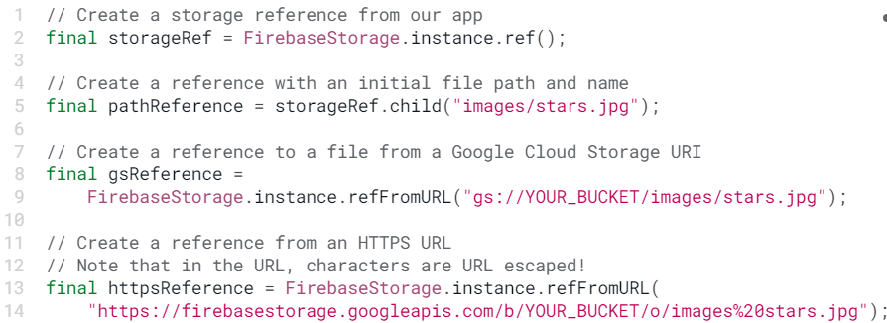
Cloud Storage
flutter pub add firebase_storage
import 'package:firebase_storage/firebase_storage.dart';
Buckets

Slide 13
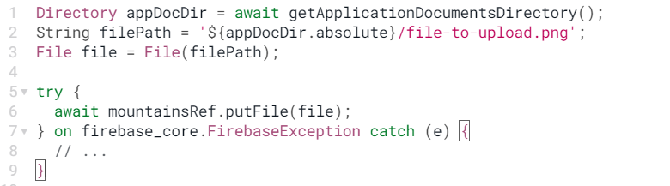
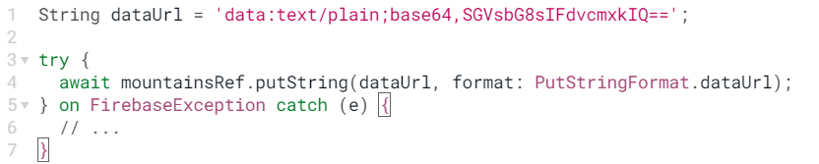
Upload to Storage
Data types
Path

Slide 14
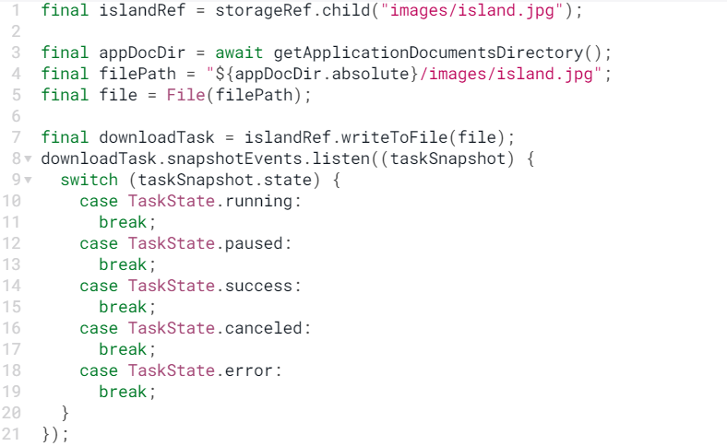
Download from Storage
Save to local storage
State handlers

