Slide 1

pyallConditioner
A simple user guide

Slide 6
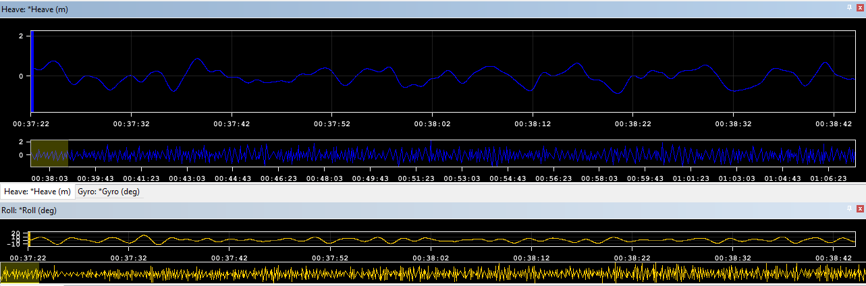
Sample.all – original file

Slide 7
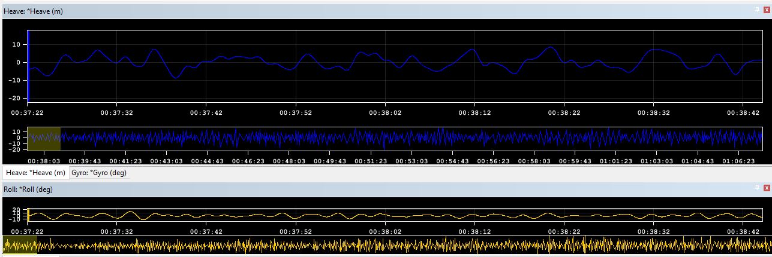
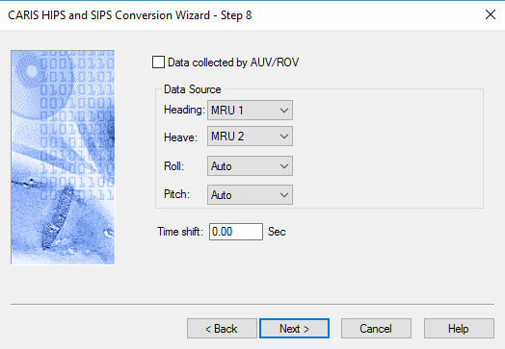
Notes:
Heave is intentionally ten times too large

