Slide 1

pyAllHillShadedWaterfall
Development Notes, August 2016

Slide 2

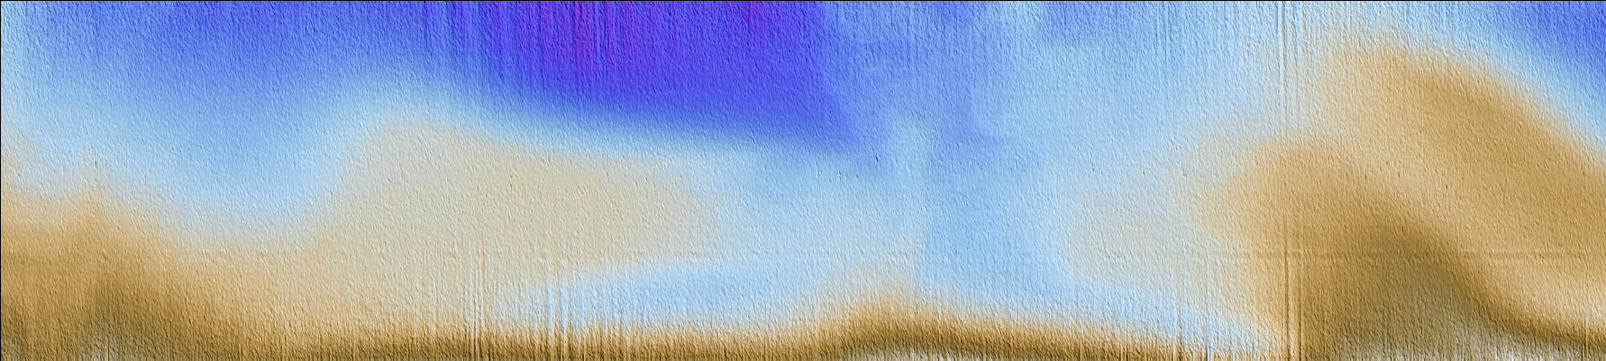
EM710 Sample: 0003_20110822_092831_Vector.all
Conventional processed file with lastools hillshading
Python waterfall hillshading with jeca depth palette
Confirm the –r (rotate) option runs left to right
Auto stretch in across track axis to approximate real world pixel isometry

Slide 3
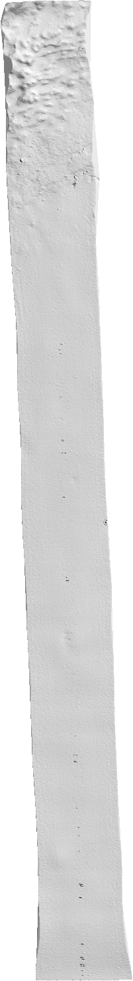
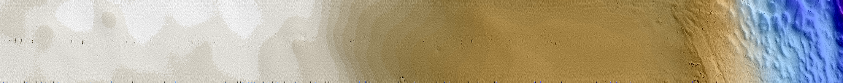
em2000-0005-vsm3_15-20151123-023334.all

Slide 4
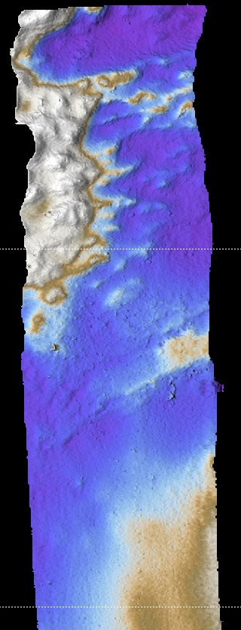
em2000-0005-vsm3_15-20151123-023334.all

