Slide 1
Chapter 13:
Overloading and Templates

Slide 2
Objectives
In this chapter, you will
  Learn about overloading
  Become familiar with the restrictions on operator overloading
  Examine the pointer this
  Learn about friend functions
  Learn how to overload operators as members and nonmembers of a class
C++ Programming: Program Design Including Data Structures, Seventh Edition

Slide 3
Objectives (cont’d.)
In this chapter, you will (cont’d.)
  Discover how to overload various operators
  Become familiar with the requirements for classes with pointer member variables
  Learn about templates
  Explore how to construct function templates and class templates
C++ Programming: Program Design Including Data Structures, Seventh Edition

Slide 4
Introduction
Templates: enable you to write generic code for related functions and classes
Function templates: used to simplify function overloading
C++ Programming: Program Design Including Data Structures, Seventh Edition

Slide 5

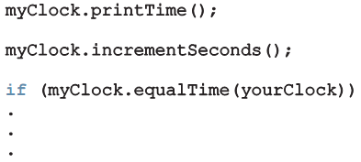
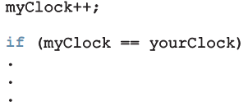
Why Operator Overloading Is Needed
Consider the following statements:
Which of the following would you prefer?
C++ Programming: Program Design Including Data Structures, Seventh Edition

Slide 6
Why Operator Overloading Is Needed (cont’d.)
Assignment and member selection are the only built-in operations on classes
  Other operators cannot be applied directly to class objects
Operator overloading: extends definition of an operator to work with a user-defined data type
  C++ allows you to extend the definitions of most of the operators to work with classes
C++ Programming: Program Design Including Data Structures, Seventh Edition

Slide 7
Operator Overloading
Most existing C++ operators can be overloaded to manipulate class objects
Cannot create new operators
Operator function: overloads an operator
  Use reserved word operator as the function name
C++ Programming: Program Design Including Data Structures, Seventh Edition

Slide 8
Syntax for Operator Functions
Syntax of an operator function heading:
  It is a value-returning function
  operator is a reserved word
To overload an operator for a class:
  Include operator function declaration in the class definition
  Write the definition of the operator function
C++ Programming: Program Design Including Data Structures, Seventh Edition

Slide 9
Overloading an Operator: Some Restrictions
Cannot change precedence or associativity
Default parameters cannot be used
Cannot change number of parameters
Cannot create new operators
Cannot overload: . .* :: ?: sizeof
How the operator works with built-in types remains the same
  Can overload for user-defined objects or for a combination of user-defined and built-in objects
C++ Programming: Program Design Including Data Structures, Seventh Edition

Slide 10
Pointer this
Every object of a class maintains a (hidden) pointer to itself called this
When an object invokes a member function
  this is referenced by the member function
C++ Programming: Program Design Including Data Structures, Seventh Edition

Slide 11
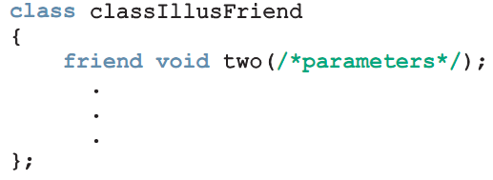
Friend Functions of Classes
Friend function (of a class): a nonmember function of the class that has access to all the members of the class
Use the reserved word friend in the function prototype in the class definition
C++ Programming: Program Design Including Data Structures, Seventh Edition

Slide 12
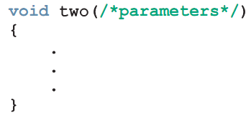
Definition of a friend Function
Ex 8, p982
"friend" doesn’t appear in function definition
When writing the friend function definition
  The name of the class and the scope resolution operator are not used
C++ Programming: Program Design Including Data Structures, Seventh Edition

Slide 13
Operator Functions as Member Functions and Nonmember Functions
To overload (), [], ->, or = for a class, the function must be a member of the class
If op is overloaded for opOverClass:
  If the leftmost operand of op is an object of a different type, the overloading function must be a nonmember (friend) of the class
  If the overloading function for op is a member of opOverClass, then when applying op on objects of type opOverClass, the leftmost operand must be of type opOverClass
C++ Programming: Program Design Including Data Structures, Seventh Edition

Slide 14
Overloading Binary Operators
If # represents a binary operator (e.g., + or ==) that is to be overloaded for rectangleType
  It can be overloaded as either a member function of the class or as a friend function
C++ Programming: Program Design Including Data Structures, Seventh Edition

Slide 15
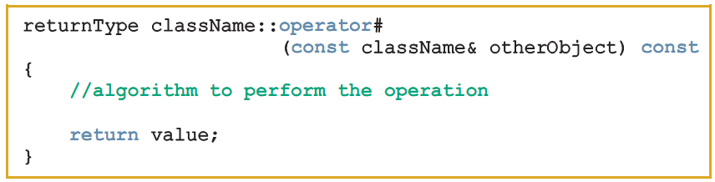
Overloading the Binary Operators as Member Functions
Function prototype (included in the class definition):
Function definition:
C++ Programming: Program Design Including Data Structures, Seventh Edition

Slide 16

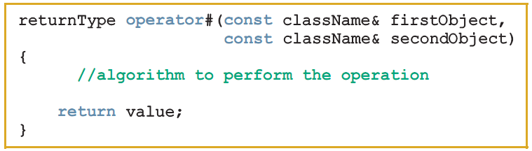
Overloading the Arithmetic or Relational Operators as Nonmember Functions
Function prototype (included in class definition):
Function definition:
C++ Programming: Program Design Including Data Structures, Seventh Edition

Slide 17
Overloading the Stream Insertion (<<) and Extraction (>>) Operators
Consider the expression:
  cout << myRectangle;
  Leftmost operand is an ostream object, not a rectangleType object
Thus, the operator function that overloads << for rectangleType must be a nonmember function of the class
  Same applies to the function that overloads >>
C++ Programming: Program Design Including Data Structures, Seventh Edition

Slide 18
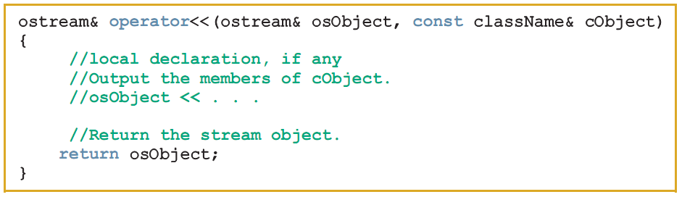
Overloading the
Stream Insertion Operator (<<)
Function prototype:
Function definition:
C++ Programming: Program Design Including Data Structures, Seventh Edition

Slide 19
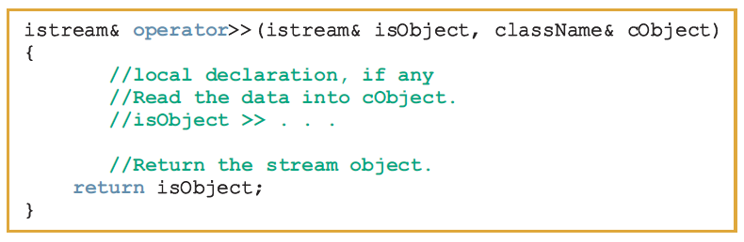
Overloading the Stream Extraction Operator (>>)
Function prototype:
Function definition:
C++ Programming: Program Design Including Data Structures, Seventh Edition

Slide 20
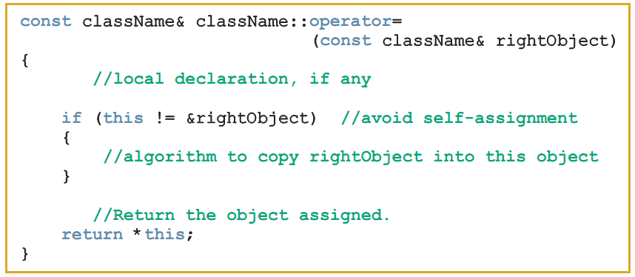
Overloading the Assignment Operator (=)
Function prototype:
Function definition:
C++ Programming: Program Design Including Data Structures, Seventh Edition

Slide 21
Overloading Unary Operators
To overload a unary operator for a class:
  If the operator function is a member of the class, it has no parameters
  If the operator function is a nonmember (i.e., a friend function), it has one parameter
C++ Programming: Program Design Including Data Structures, Seventh Edition

Slide 22

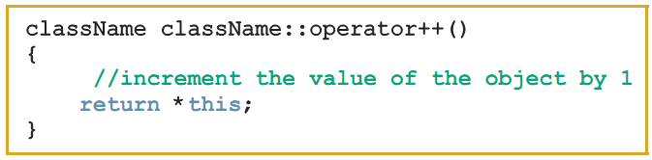
Overloading the Increment (++) and Decrement (--) Operators
General syntax to overload the pre-increment operator ++ as a member function
  Function prototype:
  Function definition:
C++ Programming: Program Design Including Data Structures, Seventh Edition

Slide 23

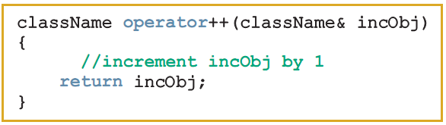
Overloading the Increment (++) and Decrement (--) Operators (cont’d.)
General syntax to overload the pre-increment operator ++ as a nonmember function:
  Function prototype:
  Function definition:
C++ Programming: Program Design Including Data Structures, Seventh Edition

Slide 24

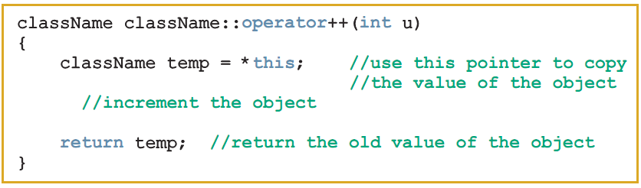
Overloading the Increment (++) and Decrement (--) Operators (cont’d.)
General syntax to overload the post-increment operator ++ as a member function:
  Function prototype:
  Function definition:
C++ Programming: Program Design Including Data Structures, Seventh Edition

Slide 25
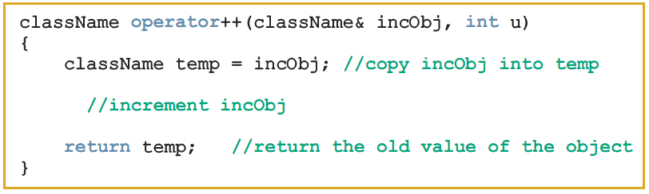
Overloading the Increment (++) and Decrement (--) Operators (cont’d.)
Syntax to overload the post-increment operator ++ as a nonmember function:
  Function prototype:
  Function definition:
Lecture 1 end
C++ Programming: Program Design Including Data Structures, Seventh Edition

Slide 26
Operator Overloading:
Member Versus Nonmember
Some operators must be overloaded as member functions and some must be overloaded as nonmember (friend) functions
Binary arithmetic operator + can be overloaded either way
  As a member function, operator + has direct access to data members of one of the objects
  Need to pass only one object as a parameter
C++ Programming: Program Design Including Data Structures, Seventh Edition

Slide 27
Operator Overloading:
Member Versus Nonmember (cont’d.)
Ex 12 p982
Ex 13 p982
Overload + as a nonmember function
  Must pass both objects as parameters
  Code may be somewhat clearer this way
C++ Programming: Program Design Including Data Structures, Seventh Edition

Slide 28
Classes and Pointer Member Variables (Revisited)
Recall that assignment operator copies member variables from one object to another of the same type
  Does not work well with pointer member variables
Classes with pointer member variables must:
  Explicitly overload the assignment operator
  Include the copy constructor
  Include the destructor
C++ Programming: Program Design Including Data Structures, Seventh Edition

Slide 29
Operator Overloading:
One Final Word
If an operator op is overloaded for a class, e.g., rectangleType
  When you use op on objects of type rectangleType, the body of the function that overloads the operator op for the class rectangleType executes
  Therefore, whatever code you put in the body of the function executes
C++ Programming: Program Design Including Data Structures, Seventh Edition

Slide 30

Overloading the Array Index (Subscript) Operator ([])
Syntax to declare operator[] as a member of a class for nonconstant arrays:
Syntax to declare operator[] as a member of a class for constant arrays:
C++ Programming: Program Design Including Data Structures, Seventh Edition

Slide 31
Function Overloading
Overloading a function: several functions with the same name, but different parameters
  Parameter list determines which function will execute
  Must provide the definition of each function
C++ Programming: Program Design Including Data Structures, Seventh Edition

Slide 32

Templates
Template: a single code body for a set of related functions (function template) and related classes (class template)
Syntax:
  Type is the data type
  Declaration is either a function declaration or a class declaration
C++ Programming: Program Design Including Data Structures, Seventh Edition

Slide 33
Templates (cont’d.)
class in the heading refers to any user-defined type or built-in type
Type: a formal parameter to the template
Just as variables are parameters to functions, data types are parameters to templates
C++ Programming: Program Design Including Data Structures, Seventh Edition

Slide 34

Function Templates
Syntax of the function template:
Type is a formal parameter of the template used to:
  Specify type of parameters to the function
  Specify return type of the function
  Declare variables within the function
C++ Programming: Program Design Including Data Structures, Seventh Edition

Slide 35

Class Templates
Class template: a single code segment for a set of related classes
  Called parameterized types
Syntax:
A template instantiation can be created with either a built-in or user-defined type
The function members of a class template are considered to be function templates
C++ Programming: Program Design Including Data Structures, Seventh Edition

Slide 36
Header File and Implementation File of a Class Template
Passing a parameter to a function takes effect at run time
Passing a parameter to a class template takes effect at compile time
Cannot compile the implementation file independently of the client code
  Can put class definition and definitions of the function templates directly in the client code
  Can put class definition and the definitions of the function templates in the same header file
C++ Programming: Program Design Including Data Structures, Seventh Edition

Slide 37
Header File and Implementation File of a Class Template (cont’d.)
Ex 34, p985
Ex 35, p986
Ex 37, p986
Ex 38, p987
Another alternative: put class definition and function definitions in separate files
  Include directive to implementation file at the end of header file
In either case, function definitions and client code are compiled together
C++ Programming: Program Design Including Data Structures, Seventh Edition

Slide 38
Array-Based Lists (Revisited)
Can implement the arrayListType using generic (templated) code
Can derive the class template unorderedArrayListType from the abstract class template arrayListType
Same for orderedArrayListType
C++ Programming: Program Design Including Data Structures, Seventh Edition

Slide 39
Summary
An operator that has different meanings with different data types is said to be overloaded
Operator function: a function that overloads an operator
  operator is a reserved word
  Operator functions are value-returning
Operator overloading provides the same concise notation for user-defined data types as for built-in data types
C++ Programming: Program Design Including Data Structures, Seventh Edition

Slide 40
Summary (cont’d.)
Only existing operators can be overloaded
The pointer this refers to the object
A friend function is a nonmember of a class
If an operator function is a member of a class
  The leftmost operand of the operator must be a class object (or a reference to a class object) of that operator’s class
C++ Programming: Program Design Including Data Structures, Seventh Edition

Slide 41
Summary (cont’d.)
Classes with pointer variables must overload the assignment operator, and include both a copy constructor and deconstructor
Templates:
  Function template: a single code segment for a set of related functions
  Class template: a single code segment for a set of related classes
    Are called parameterized types
C++ Programming: Program Design Including Data Structures, Seventh Edition

