Slide 1
AfriLearning

Slide 2
Problem
During the epidemic period students found it difficult to continue traditional education, which results in educational gap and hinders development.
The lack of accessible and unify education scheme affects students learning process drastically.

Slide 3
Solution
The quest of accessible free education have long been a major topic, with AfriLearning we plan to simplify students education experience by developing a online application where teachers and student can interact and perform educational task.
Our main focus is to alleviate the literacy problem and improve standard of living through education.

Slide 4

Target Markets
AfriLearning is developed primarily for all levels of student inclusive.
The platform is also tailored made for teachers to interact effectively with students.
Proprietor/proprietress, School principles, Dean of faculties are some of those will use the Admin panel to manage the educational process.

Slide 5
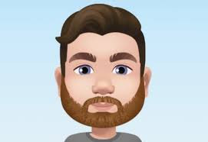


Meet our Team
CEO
CFO
COO

Slide 6
Thanks for your Attention!!

