Slide 1
Wireshark and Tshark

Slide 2
What is Wireshark?
Wireshark is a free and open-source packet analyzer. It is used for network troubleshooting, analysis, software and communications protocol testing and debugging, and education.
There is also a terminal-based (non-GUI) version called TShark. Wireshark, and the other programs distributed with it such as TShark, are free software, released under the terms of the GNU General Public License version 2 or any later version.

Slide 3
How to install Wireshark?
For Linux-
Open Terminal
Write these commands -
sudo add-apt-repository universe
sudo apt-get install wireshark
sudo wireshark
For Windows-
Go to https://www.wireshark.org/download.html
Download according to your respective windows configuration

Slide 4
Visualization
Setting up Wireshark to capture packets for the first time, here are few common point that you need to keep in mind-
You need to have root / Administrator privileges to start a live capture.
You need to choose the right network interface to capture packet data from.
You need to capture at the right place in the network to see the traffic
you want to see

Slide 5
Promiscuous Mode
Promiscuous mode is a mode for a wired network interface controller (NIC) or wireless network interface controller (WNIC) that causes the controller to pass all traffic it receives to the central processing unit (CPU) rather than passing only the frames that the controller is specifically programmed to receive
This mode is normally used for packet sniffing that takes place on a router or on a computer connected to a wired network or one being part of a wireless LAN

Slide 6
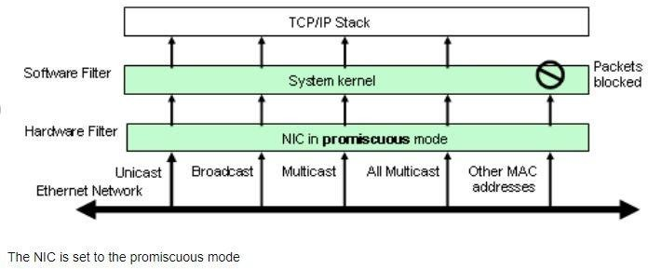
How Tshark/Wireshark Capture Packet from NIC?
*Note: Packets are not blocked at the system kernel level

Slide 7
Start Capturing
To capture packets we can either go to-
Capture interface, Here you can select the interface whose packet you want to capture.
Capture Options
Using command if you already know the interface. For example this
command will capture ethernet0- wireshark -i eth0 -k

Slide 8
Capture frame
Interface- This field specifies the interface you want to capture on. You can only capture on one interface, and you can only capture on interfaces that Wireshark has found on the system.
On some systems, loopback interfaces cannot be used for capturing (loopback interfaces are not available on Windows platforms).

Slide 9
Output file formats
pcap - The pcap format contain information about the capture interface, the interface information is part of the common header and not stored on a per packet basis
pcapng - The above issue is solved by pcapng which allows a capture file to define multiple interfaces

Slide 10
Filtering while capturing
Wireshark uses the libpcap filter language for capture filters.
You enter the capture filter into the Filter field of the Wireshark go to Capture Options dialog box--->Capture filters.
A capture filter takes the form of a series of primitive expressions connected by conjunctions (and/ or) and optionally preceded by not:
[not] primitive [and|or [not] primitive ...]

Slide 11
Display Filters
Display filters allow you to concentrate on the packets you are interested in while hiding the currently uninteresting ones. They allow you to select packets by:
Protocol
The presence of a field
The values of fields
A comparison between fields
For e.g. ip.addr==192.168.0.1

Slide 12
TCP Stream
If you are working with TCP based protocols it can be very helpful to see the data from a TCP stream in the way that the application layer sees it.
You just need a display filter to show only the packets of that TCP stream. If so, Wireshark's ability to follow a TCP stream will be useful to you
How to view the tcp stream: Select the packet -> Go to Follow -> Go to TCP stream

Slide 13
tcpdump
tcpdump is a data-network packet analyzer computer program that runs under a command line interface. It allows the user to display TCP/IP and other packets being transmitted or received over a network to which the computer is attached.
tcpdump -i <interface> -s 1500 -w <somefile>
The -i flag specifies the interface, -s the packet length,-w the file to write to.
You will have to specify the correct interface and the name of a file to save into. In addition, you will have to terminate the capture with ^C when you believe you have captured enough packets. Alternatively the number of packets can be fixed using -c flag.
Warning: This doesn’t work on WSL. You need a virtual machine.

Slide 14
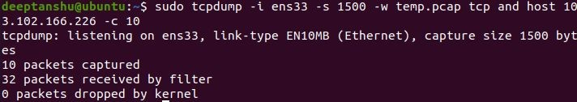
tcp-dump
The command in the previous slide can be combined with filters to get only the required packets. We can even use grep to extract the required data.
example: Get all tcp from wikipedia.com upto 10 packets and store in temp.pcap

Slide 15
tcp-dump+grep
Example:as we can only know that it is a post, get request after the packet has been assembled, we need to keep a buffer using the flag -l on port 80 which with egrep gives us the required output

Slide 16
What is Tshark?
TShark is a command-line based network protocol analyzer.
TShark is a terminal oriented version of Wireshark designed for capturing and displaying packets when an interactive user interface isn't necessary or available. It supports the same options as wireshark. For more information on tshark, see the manual pages (man tshark).

Slide 17
Tshark Installation
It generally comes with wireshark installation but can be installed separately for linux based machines with package name as tshark or wireshark-cli
In windows we need to set the system variable so that it recognized the command tshark as an internal command.

Slide 18
Tshark Commands
tshark [ -i <capture interface> ] [ -f <capture filter> ] [ -r <infile> ] [ -w <outfile>] [ options ] [ <filter>]
here we have added Capture Filters where we are the host and all the packets are tcp
Filters can be Found from :https://wiki.wireshark.org/CaptureFilters andhttps://wiki.wireshark.org/DisplayFilters

Slide 19
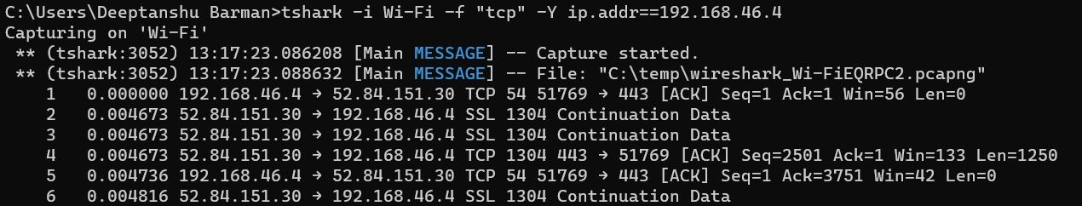
Display + Capture Filters

Slide 20
References
https://web.fe.up.pt/~jruela/DOC/Wireshark-user-guide-a4_v1.0.0.pdf
https://en.wikipedia.org/wiki/Wireshark
https://wiki.wireshark.org/
https://en.wikipedia.org/wiki/Berkeley_Packet_Filter
https://sharkfestus.wireshark.org/sharkfest.11/presentations/McCanne-Sharkfest'11_Keynote_Addre
ss.pdf
https://www.researchgate.net/figure/The-NIC-is-set-to-the-promiscuous-mode_fig1_220905310
https://en.wikipedia.org/wiki/Promiscuous_mode
https://www.tcpdump.org/manpages/tcpdump.1.html
https://www.youtube.com/watch?v=21M1rnbd5xo

