Slide 1

Lec 25B:
DHCP,NAT,STUN,IPv6
Computer Networks (CSE232)
Rinku Shah
These slides are inspired and adapted from:
Computer Networking: A Top-Down Approach
6th edition, Jim Kurose, Keith Ross, Pearson, 2017

Slide 2

Routing by an ISP’s router
Our solution to “Problem 3” had following 4 subnets: 10.129.0.0/24, 10.129.1.0/25, 10.129.1.128/26, 10.129.1.192/26.
Assume a similar subnet with public IP addresses: 11.129.0.0/24, 11.129.1.0/25, 11.129.1.128/26, 11.129.1.192/26
ISP will announce a network with prefix 11.129.0.0/16 and route packets with /24, /25, /26 prefixes to the individual organisation
11.129.0.0/24
ISP
to external network
11.129.1.0/25
11.129.1.128/26
Destination | Distance | Next Hop
11.129.0.0/24 | --- | ---
11.129.1.0/25 | --- | ---
11.129.1.128/26 | --- | ---
11.129.1.192/26 | --- | ---
Destination | Distance | Next Hop
11.129.0.0/16 | --- | ---
11.129.1.192/26

Slide 3
DHCP: Dynamic Host Configuration Protocol
goal: allow host to dynamically obtain its IP address from network server when it joins network
can renew its lease on address in use
allows reuse of addresses (only hold address while connected/“on”)
support for mobile users who want to join network (more shortly)
DHCP overview:
host broadcasts “DHCP discover” msg [optional]
DHCP server responds with “DHCP offer” msg [optional]
host requests IP address: “DHCP request” msg
DHCP server sends address: “DHCP ack” msg
4-‹#›
Notes:
‹#›

Slide 4



DHCP client-server scenario
DHCP
server
223.1.1.0/24
223.1.1.1
223.1.2.1
223.1.1.2
arriving DHCP
client needs
address in this
network
223.1.1.4
223.1.2.9
223.1.3.27
223.1.2.2
223.1.1.3
223.1.2.0/24
223.1.3.1
223.1.3.2
223.1.3.0/24
4-‹#›
Notes:
‹#›

Slide 5
DHCP client-server scenario
DHCP server: 223.1.2.5
DHCP discover
arriving
client
src : 0.0.0.0, 68
dest.: 255.255.255.255,67
yiaddr: 0.0.0.0
transaction ID: 654
Broadcast: is there a DHCP server out there?
DHCP offer
src: 223.1.2.5, 67
dest: 255.255.255.255, 68
yiaddrr: 223.1.2.4
transaction ID: 654
lifetime: 3600 secs
Broadcast: I’m a DHCP server! Here’s an IP address you can use
DHCP request
src: 0.0.0.0, 68
dest:: 255.255.255.255, 67
yiaddrr: 223.1.2.4
transaction ID: 655
lifetime: 3600 secs
Broadcast: OK. I’ll take that IP address!
DHCP ACK
src: 223.1.2.5, 67
dest: 255.255.255.255, 68
yiaddrr: 223.1.2.4
transaction ID: 655
lifetime: 3600 secs
Broadcast: OK. You’ve got that IP address!
4-‹#›
Notes:
‹#›

Slide 6
DHCP: more than IP addresses
DHCP can return more than just allocated IP address on subnet:
address of first-hop router for client
name and IP address of DNS sever
network mask
indicating network versus host portion of address
4-‹#›

Slide 7


DHCP: example
DHCP
DHCP
UDP
IP
Eth
Phy
connecting laptop needs its IP address, addr of first-hop router, addr of DNS server: use DHCP
DHCP
DHCP
DHCP
DHCP
DHCP request encapsulated in UDP, encapsulated in IP, encapsulated in 802.1 Ethernet
DHCP
DHCP
UDP
IP
Eth
Phy
168.1.1.1
DHCP
DHCP
DHCP
Ethernet frame broadcast (dest: FFFFFFFFFFFF) on LAN, received at router running DHCP server
DHCP
router with DHCP
server built into
router
Ethernet demuxed to IP demuxed, UDP demuxed to DHCP
4-‹#›

Slide 8
DHCP: example
DCHP server formulates DHCP ACK containing client’s IP address, IP address of first-hop router for client, name & IP address of DNS server
DHCP
DHCP
UDP
IP
Eth
Phy
DHCP
DHCP
DHCP
encapsulation of DHCP server, frame forwarded to client, demuxing up to DHCP at client
DHCP
DHCP
UDP
IP
Eth
Phy
DHCP
DHCP
DHCP
router with DHCP
server built into
router
client now knows its IP address, name and IP address of DNS server, IP address of its first-hop router
DHCP
4-‹#›

Slide 9
DHCP: Wireshark output (home LAN)
reply
Message type: Boot Reply (2)
Hardware type: Ethernet
Hardware address length: 6
Hops: 0
Transaction ID: 0x6b3a11b7
Seconds elapsed: 0
Bootp flags: 0x0000 (Unicast)
Client IP address: 192.168.1.101 (192.168.1.101)
Your (client) IP address: 0.0.0.0 (0.0.0.0)
Next server IP address: 192.168.1.1 (192.168.1.1)
Relay agent IP address: 0.0.0.0 (0.0.0.0)
Client MAC address: Wistron_23:68:8a (00:16:d3:23:68:8a)
Server host name not given
Boot file name not given
Magic cookie: (OK)
Option: (t=53,l=1) DHCP Message Type = DHCP ACK
Option: (t=54,l=4) Server Identifier = 192.168.1.1
Option: (t=1,l=4) Subnet Mask = 255.255.255.0
Option: (t=3,l=4) Router = 192.168.1.1
Option: (6) Domain Name Server
Length: 12; Value: 445747E2445749F244574092;
IP Address: 68.87.71.226;
IP Address: 68.87.73.242;
IP Address: 68.87.64.146
Option: (t=15,l=20) Domain Name = "hsd1.ma.comcast.net."
Message type: Boot Request (1)
Hardware type: Ethernet
Hardware address length: 6
Hops: 0
Transaction ID: 0x6b3a11b7
Seconds elapsed: 0
Bootp flags: 0x0000 (Unicast)
Client IP address: 0.0.0.0 (0.0.0.0)
Your (client) IP address: 0.0.0.0 (0.0.0.0)
Next server IP address: 0.0.0.0 (0.0.0.0)
Relay agent IP address: 0.0.0.0 (0.0.0.0)
Client MAC address: Wistron_23:68:8a (00:16:d3:23:68:8a)
Server host name not given
Boot file name not given
Magic cookie: (OK)
Option: (t=53,l=1) DHCP Message Type = DHCP Request
Option: (61) Client identifier
Length: 7; Value: 010016D323688A;
Hardware type: Ethernet
Client MAC address: Wistron_23:68:8a (00:16:d3:23:68:8a)
Option: (t=50,l=4) Requested IP Address = 192.168.1.101
Option: (t=12,l=5) Host Name = "nomad"
Option: (55) Parameter Request List
Length: 11; Value: 010F03062C2E2F1F21F92B
1 = Subnet Mask; 15 = Domain Name
3 = Router; 6 = Domain Name Server
44 = NetBIOS over TCP/IP Name Server
……
request
4-‹#›

Slide 10
NAT: network address translation
rest of
Internet
local network
(e.g., home network)
10.0.0/24
10.0.0.1
10.0.0.4
10.0.0.2
138.76.29.7
10.0.0.3
all datagrams leaving local
network have same single source NAT IP address: 138.76.29.7,different source port numbers
datagrams with source or
destination in this network
have 10.0.0/24 address for
source, destination (as usual)
4-‹#›

Slide 11
NAT: network address translation
motivation: local network uses just one IP address as far as outside world is concerned:
range of addresses not needed from ISP: just one IP address for all devices
can change addresses of devices in local network without notifying outside world
can change ISP without changing addresses of devices in local network
devices inside local net not explicitly addressable, visible by outside world (a security plus)
4-‹#›

Slide 12
NAT: network address translation
implementation: NAT router must:
outgoing datagrams: replace (source IP address, port #) of every outgoing datagram to (NAT IP address, new port #)
. . . remote clients/servers will respond using (NAT IP address, new port #) as destination addr
remember (in NAT translation table) every (source IP address, port #) to (NAT IP address, new port #) translation pair
incoming datagrams: replace (NAT IP address, new port #) in dest fields of every incoming datagram with corresponding (source IP address, port #) stored in NAT table
4-‹#›

Slide 13
NAT: network address translation
NAT translation table
WAN side addr LAN side addr
2: NAT router
changes datagram
source addr from
10.0.0.1, 3345 to
138.76.29.7, 5001,
updates table
1: host 10.0.0.1
sends datagram to
128.119.40.186, 80
138.76.29.7, 5001 10.0.0.1, 3345
…… ……
S: 10.0.0.1, 3345
D: 128.119.40.186, 80
10.0.0.1
1
2
S: 138.76.29.7, 5001
D: 128.119.40.186, 80
10.0.0.4
10.0.0.2
138.76.29.7
S: 128.119.40.186, 80
D: 10.0.0.1, 3345
4
S: 128.119.40.186, 80
D: 138.76.29.7, 5001
3
10.0.0.3
4: NAT router
changes datagram
dest addr from
138.76.29.7, 5001 to 10.0.0.1, 3345
3: reply arrives
dest. address:
138.76.29.7, 5001
* Check out the online interactive exercises for more examples: http://gaia.cs.umass.edu/kurose_ross/interactive/
4-‹#›

Slide 14
NAT: network address translation
16-bit port-number field:
60,000 simultaneous connections with a single LAN-side address!
NAT is controversial:
routers should only process up to layer 3
address shortage should be solved by IPv6
violates end-to-end argument
NAT possibility must be taken into account by app designers, e.g., P2P applications
NAT traversal: what if client wants to connect to server behind NAT?
4-‹#›

Slide 15
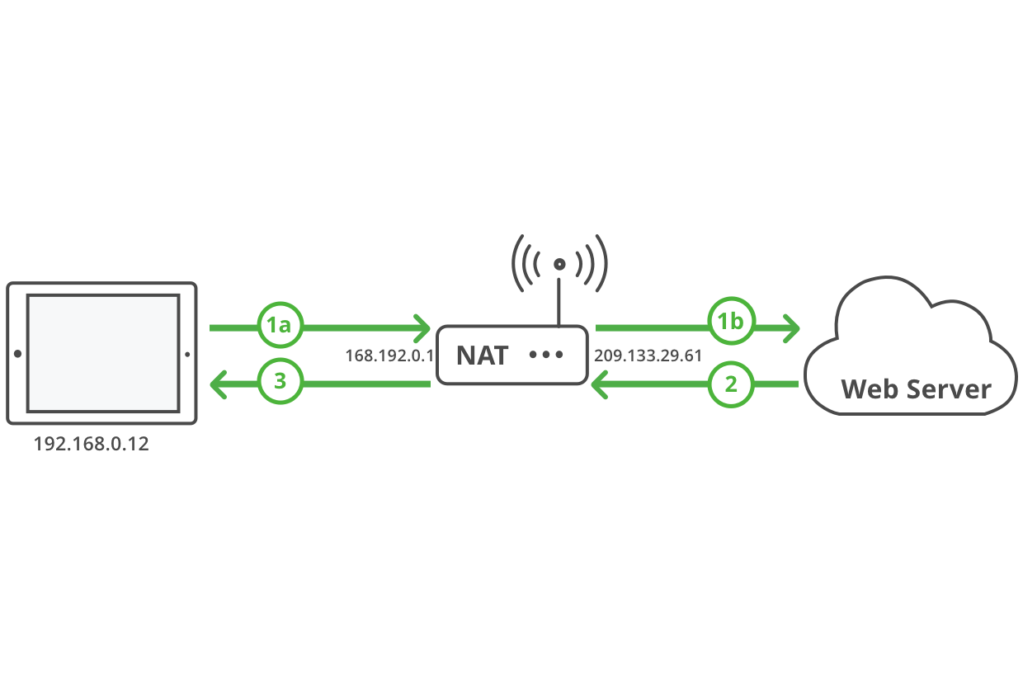
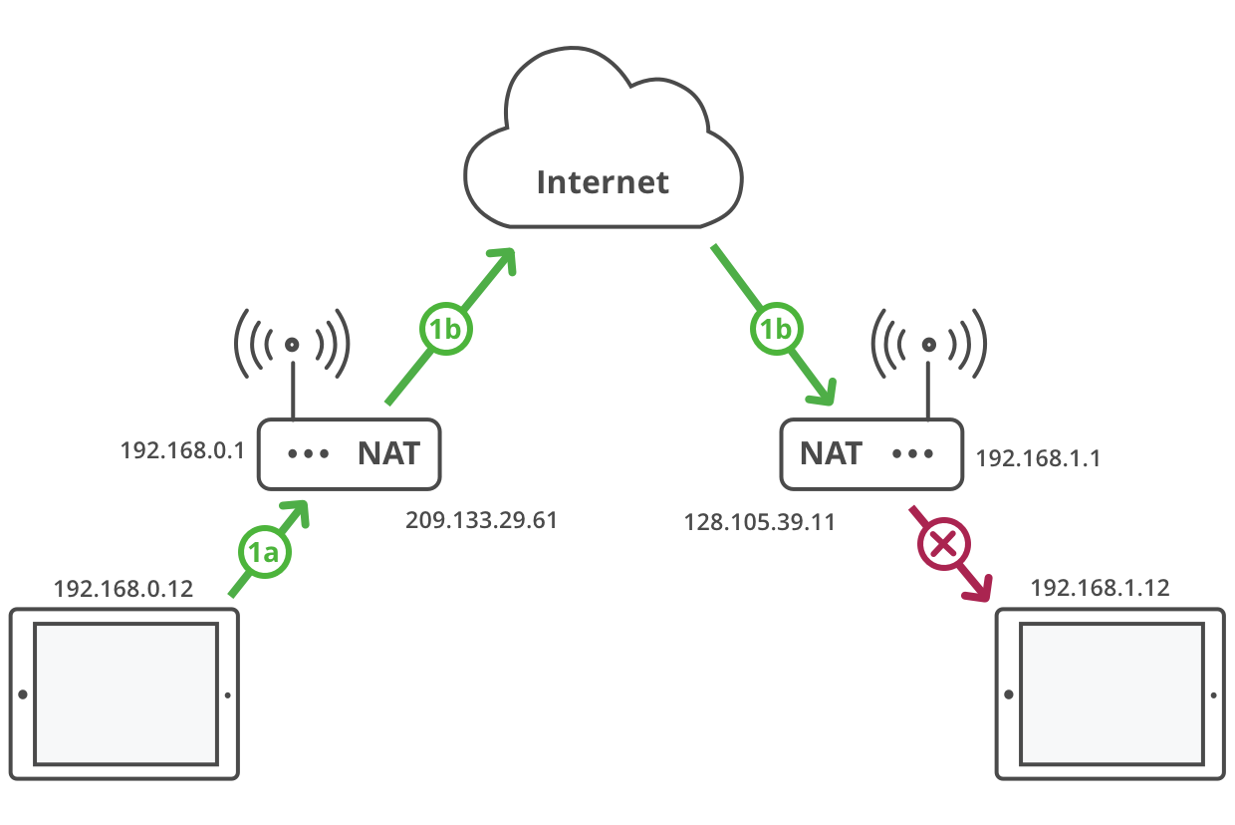
Motivation for STUN (Session Traversal Utilities for NAT)
NOT IN SYLLABUS
Reference: https://anyconnect.com/stun-turn-ice/

Slide 16
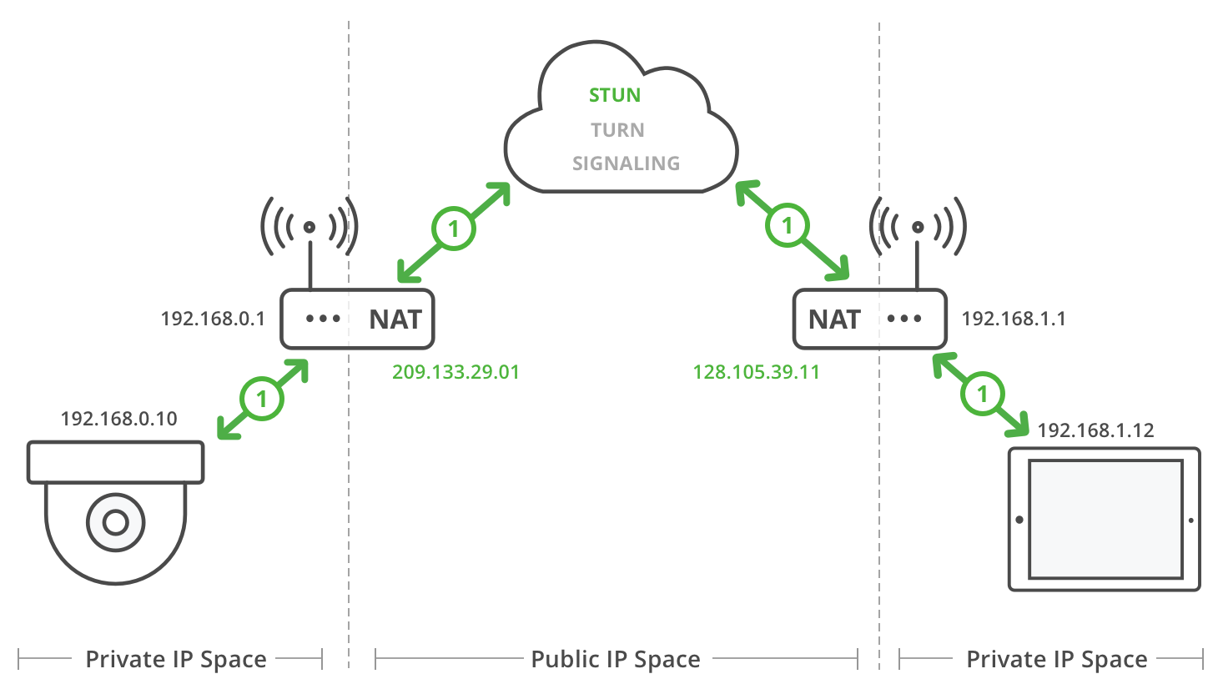
Motivation for STUN (Session Traversal Utilities for NAT)
NOT IN SYLLABUS
Client->STUN server
STUN binding
STUN server->Client
Success response
contains Client IP, Client Port address
obfuscated (XOR) to avoid packet translation by app gateways
Typically, STUN messages sent over UDP
Client uses DNS to determine STUN server’s IP
Limitation:
Not self-contained NAT traversal tool
Does not work for all NAT types, for example, symmetric NAT
More about NAT types here: https://en.wikipedia.org/wiki/Network_address_translation

Slide 17
IPv6: motivation
initial motivation: 32-bit address space soon to be completely allocated.
additional motivation:
header format helps speed processing/forwarding
header changes to facilitate QoS
IPv6 datagram format:
fixed-length 40 byte header
no fragmentation allowed
4-‹#›

Slide 18
IPv6 datagram format
priority: identify priority among datagrams in flow
flow Label: identify datagrams in same “flow.”
(concept of“flow” not well defined).
next header: identify upper layer protocol for data
ver
pri
flow label
payload len
next hdr
hop limit
source address
(128 bits)
destination address
(128 bits)
data
32 bits
4-‹#›

Slide 19
Other changes from IPv4
checksum: removed entirely to reduce processing time at each hop
options: allowed, but outside of header, indicated by “Next Header” field
ICMPv6: new version of ICMP
additional message types, e.g. “Packet Too Big”
multicast group management functions
4-‹#›

Slide 20
Transition from IPv4 to IPv6
not all routers can be upgraded simultaneously
no “flag days”
how will network operate with mixed IPv4 and IPv6 routers?
tunneling: IPv6 datagram carried as payload in IPv4 datagram among IPv4 routers
IPv4 header fields
IPv6 header fields
IPv4 payload
IPv4 source, dest addr
IPv6 source dest addr
UDP/TCP payload
IPv6 datagram
IPv4 datagram
4-‹#›

Slide 21
Tunneling
A
B
IPv4 tunnel
connecting IPv6 routers
E
F
logical view:
IPv6
IPv6
IPv6
IPv6
A
B
C
D
E
F
physical view:
IPv6
IPv6
IPv4
IPv4
IPv6
IPv6
4-‹#›

Slide 22
Tunneling
A
B
IPv4 tunnel
connecting IPv6 routers
E
F
logical view:
IPv6
IPv6
IPv6
IPv6
A
B
C
D
E
F
physical view:
IPv6
IPv6
IPv4
IPv4
IPv6
IPv6
flow: X
src: A
dest: F
data
src:B
dest: E
src:B
dest: E
flow: X
src: A
dest: F
data
Flow: X
Src: A
Dest: F
data
Flow: X
Src: A
Dest: F
data
A-to-B:
IPv6
B-to-C:
IPv6 inside
IPv4
B-to-C:
IPv6 inside
IPv4
E-to-F:
IPv6
4-‹#›

Slide 23
IPv6: adoption
Google: 8% of clients access services via IPv6
NIST: 1/3 of all US government domains are IPv6 capable
Long (long!) time for deployment, use
20 years and counting!
think of application-level changes in last 20 years: WWW, Facebook, streaming media, Skype, …
Why?
4-‹#›

