Slide 1
Chapter 19: Recovery System

Slide 2
Failure Classification
Transaction failure :
Logical errors: transaction cannot complete due to some internal error condition
System errors: the database system must terminate an active transaction due to an error condition (e.g., deadlock)
System crash: a power failure or other hardware or software failure causes the system to crash.
Disk failure: a head crash or similar disk failure destroys all or part of disk storage
Destruction is assumed to be detectable: disk drives use checksums to detect failures

Slide 3
Recovery Algorithms
Suppose transaction T_{i} transfers Rs50 from account A to account B
Two updates: subtract 50 from A and add 50 to B
Transaction T_{i} requires updates to A and B to be output to the database.
A failure may occur after one of these modifications have been made but before both of them are made.
Modifying the database without ensuring that the transaction will commit may leave the database in an inconsistent state
Not modifying the database may result in lost updates if failure occurs just after transaction commits
Recovery algorithms have two parts
Actions taken during normal transaction processing to ensure enough information exists to recover from failures
Actions taken after a failure to recover the database contents to a state that ensures atomicity, consistency and durability

Slide 4
Data Access
Physical blocks are those blocks residing on the disk.
Buffer blocks are the blocks residing temporarily in main memory.
Block movements between disk and main memory are initiated through the following two operations:
input (B) transfers the physical block B to main memory.
output (B) transfers the buffer block B to the disk, and replaces the appropriate physical block there.
We assume, for simplicity, that each data item fits in, and is stored inside, a single block.

Slide 5
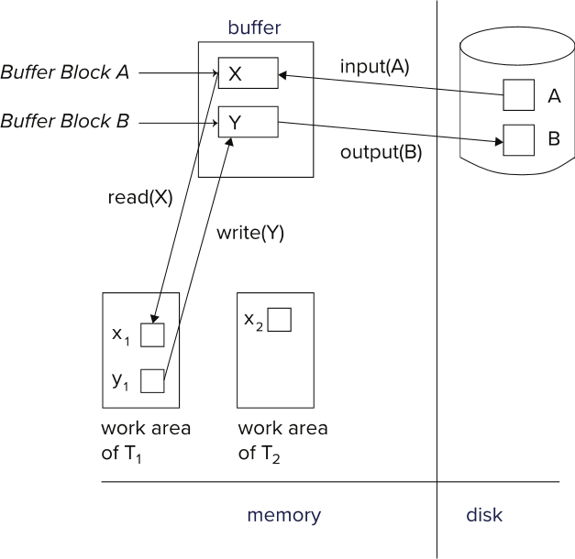
Example of Data Access

Slide 6
Log-Based Recovery
A log is a sequence of log records. The records keep information about update activities on the database.
The log is kept on stable storage
When transaction T_{i} starts, it registers itself by writing a
<T_{i} start> log record
When T_{i} executes write(X), a log record
<T_{i}, X, V₁, V₂>
is written, where V₁ is the value of X before the write (the old
value), and V₂ is the value to be written to X (the new value).
When T_{i} finishes it last statement, the log record <T_{i} commit> is written.
Two approaches using logs
Immediate database modification
Deferred database modification.

Slide 7
Undo and Redo Operations
Undo and Redo of Transactions
undo(T_{i}) -- restores the value of all data items updated by T_{i} to their old values, going backwards from the last log record for T_{i}
Each time a data item X is restored to its old value V a special log record <T_{i} , X, V> is written out
When undo of a transaction is complete, a log record <T_{i} abort> is written out.
redo(T_{i}) -- sets the value of all data items updated by T_{i} to the new values, going forward from the first log record for T_{i}
No logging is done in this case

Slide 8
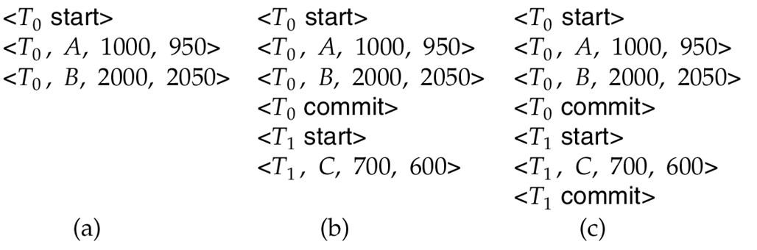
Immediate DB Modification Recovery Example
Below we show the log as it appears at three instances of time.
Recovery actions in each case above are:
(a) undo (T₀): B is restored to 2000 and A to 1000, and log records <T₀, B, 2000>, <T₀, A, 1000>, <T₀, abort> are written out
(b) redo (T₀) and undo (T₁): A and B are set to 950 and 2050 and C is restored to 700. Log records <T₁, C, 700>, <T₁, abort> are written out.
(c) redo (T₀) and redo (T₁): A and B are set to 950 and 2050
respectively. Then C is set to 600

Slide 9
Checkpoints
Redoing/undoing all transactions recorded in the log can be very slow
Processing the entire log is time-consuming if the system has run for a long time
We might unnecessarily redo transactions which have already output their updates to the database.
Streamline recovery procedure by periodically performing checkpointing
1. Output all log records currently residing in main memory onto stable
storage.
2. Output all modified buffer blocks to the disk.
3. Write a log record < checkpoint L> onto stable storage where L is a
list of all transactions active at the time of checkpoint.
4. All updates are stopped while doing checkpointing

Slide 10
Checkpoints (Cont.)
During recovery we need to consider only the most recent transaction T_{i} that started before the checkpoint, and transactions that started after T_{i}.
Scan backwards from end of log to find the most recent <checkpoint L> record
Only transactions that are in L or started after the checkpoint need to be redone or undone
Transactions that committed or aborted before the checkpoint already have all their updates output to stable storage.
Some earlier part of the log may be needed for undo operations
Continue scanning backwards till a record <T_{i} start> is found for every transaction T_{i} in L.
Parts of log prior to earliest <T_{i} start> record above are not needed for recovery, and can be erased whenever desired.

Slide 11
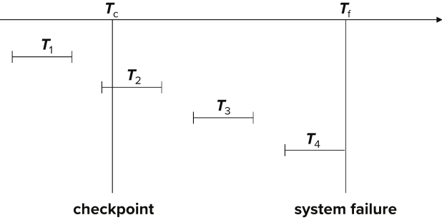
Example of Checkpoints
T₁ can be ignored (updates already output to disk due to checkpoint)
T₂ and T₃ redone.
T₄ undone
T₁ can be ignored (updates already output to disk due to checkpoint)
T₂ and T₃ redone.
T₄ undone

Slide 12
Recovery Algorithm

Slide 13
Recovery Algorithm
Logging (during normal operation):
<T_{i} start> at transaction start
<T_{i}, X_{j}, V₁, V₂> for each update, and
<T_{i} commit> at transaction end
Transaction rollback (during normal operation)
Let T_{i} be the transaction to be rolled back
Scan log backwards from the end, and for each log record of T_{i} of the form <T_{i}, X_{j}, V₁, V₂>
Perform the undo by writing V₁ to X_{j},
Write a log record <T_{i} , X_{j}, V₁>
such log records are called compensation log records
Once the record <T_{i} start> is found stop the scan and write the log record <T_{i} abort>

Slide 14
Recovery Algorithm (Cont.)
Recovery from failure: Two phases
Redo phase: replay updates of all transactions, whether they committed, aborted, or are incomplete
Undo phase: undo all incomplete transactions
Redo phase:
1. Find last <checkpoint L> record, and set undo-list to L.
2. Scan forward from above <checkpoint L> record
Whenever a record <T_{i}, X_{j}, V₁, V₂> or <T_{i}, X_{j}, V₂> is found, redo it by writing V₂ to X_{j}
Whenever a log record <T_{i} start> is found, add T_{i} to undo-list
Whenever a log record <T_{i} commit> or <T_{i} abort> is found, remove T_{i} from undo-list

Slide 15
Recovery Algorithm (Cont.)
Undo phase:
1. Scan log backwards from end
Whenever a log record <T_{i}, X_{j}, V₁, V₂> is found where T_{i} is in undo-list perform same actions as for transaction rollback:
perform undo by writing V₁ to X_{j}.
write a log record <T_{i} , X_{j}, V₁>
Whenever a log record <T_{i} start> is found where T_{i} is in undo-list,
Write a log record <T_{i} abort>
Remove T_{i} from undo-list
Stop when undo-list is empty
1. i.e., <T_{i} start> has been found for every transaction in undo-list
After undo phase completes, normal transaction processing can commence

Slide 16
Log Record Buffering
Log record buffering: log records are buffered in main memory, instead of being output directly to stable storage.
Log records are output to stable storage when a block of log records in the buffer is full, or a log force operation is executed.
Log force is performed to commit a transaction by forcing all its log records (including the commit record) to stable storage.
Several log records can thus be output using a single output operation, reducing the I/O cost.

Slide 17
Log Record Buffering (Cont.)
The rules below must be followed if log records are buffered:
Log records are output to stable storage in the order in which they are created.
Transaction T_{i} enters the commit state only when the log record <T_{i} commit> has been output to stable storage.
Before a block of data in main memory is output to the database, all log records pertaining to data in that block must have been output to stable storage.
This rule is called the write-ahead logging or WAL rule
Strictly speaking, WAL only requires undo information to be output

Slide 18
Database Buffering
Database maintains an in-memory buffer of data blocks
When a new block is needed, if buffer is full an existing block needs to be removed from buffer
If the block chosen for removal has been updated, it must be output to disk
The recovery algorithm supports the no-force policy: i.e., updated blocks need not be written to disk when transaction commits
force policy: requires updated blocks to be written at commit
More expensive commit
The recovery algorithm supports the steal policy: i.e., blocks containing updates of uncommitted transactions can be written to disk, even before the transaction commits

Slide 19
Database Buffering (Cont.)
If a block with uncommitted updates is output to disk, log records with undo information for the updates are output to the log on stable storage first
(Write ahead logging)
No updates should be in progress on a block when it is output to disk. Can be ensured as follows.
Before writing a data item, transaction acquires exclusive lock on block containing the data item
Lock can be released once the write is completed.
Such locks held for short duration are called latches.
To output a block to disk
1. First acquire an exclusive latch on the block
Ensures no update can be in progress on the block
2. Then perform a log flush
3. Then output the block to disk
4. Finally release the latch on the block
Notes:
19

Slide 20
Buffer Management (Cont.)
Database buffer can be implemented either
In an area of real main-memory reserved for the database, or
In virtual memory
Implementing buffer in reserved main-memory has drawbacks:
Memory is partitioned before-hand between database buffer and applications, limiting flexibility.
Needs may change, and although operating system knows best how memory should be divided up at any time, it cannot change the partitioning of memory.

Slide 21
Buffer Management (Cont.)
Database buffers are generally implemented in virtual memory in spite of some drawbacks:
When operating system needs to evict a page that has been modified, the page is written to swap space on disk.
When database decides to write buffer page to disk, buffer page may be in swap space, and may have to be read from swap space on disk and output to the database on disk, resulting in extra I/O!
Known as dual paging problem.
Ideally when OS needs to evict a page from the buffer, it should pass control to database, which in turn should
Output the page to database instead of to swap space (making sure to output log records first), if it is modified
Release the page from the buffer, for the OS to use
Dual paging can thus be avoided, but common operating systems do not support such functionality.

Slide 22
ARIES Recovery Algorithm

Slide 23
ARIES
ARIES is a state of the art recovery method
Incorporates numerous optimizations to reduce overheads during normal processing and to speed up recovery
The recovery algorithm we studied earlier is modeled after ARIES, but greatly simplified by removing optimizations
Unlike the recovery algorithm described earlier, ARIES
1. Uses log sequence number (LSN) to identify log records
Stores LSNs in pages to identify what updates have already been applied to a database page
2. Physiological redo
3. Dirty page table to avoid unnecessary redos during recovery
4. Fuzzy checkpointing that only records information about dirty pages,
and does not require dirty pages to be written out at checkpoint time
More coming up on each of the above …

Slide 24
ARIES Optimizations
Physiological redo
Affected page is physically identified, action within page can be logical
Used to reduce logging overheads
e.g. when a record is deleted and all other records have to be moved to fill hole
Physiological redo can log just the record deletion
Physical redo would require logging of old and new values for much of the page
Requires page to be output to disk atomically
Easy to achieve with hardware RAID, also supported by some disk systems
Incomplete page output can be detected by checksum techniques,
But extra actions are required for recovery
Treated as a media failure

Slide 25
ARIES Data Structures
ARIES uses several data structures
Log sequence number (LSN) identifies each log record
Must be sequentially increasing
Typically an offset from beginning of log file to allow fast access
Easily extended to handle multiple log files
Page LSN
Log records of several different types
Dirty page table

Slide 26
ARIES Data Structures: Page LSN
Each page contains a PageLSN which is the LSN of the last log record whose effects are reflected on the page
To update a page:
X-latch the page, and write the log record
Update the page
Record the LSN of the log record in PageLSN
Unlock page
To flush page to disk, must first S-latch page
Thus page state on disk is operation consistent
Required to support physiological redo
PageLSN is used during recovery to prevent repeated redo
Thus ensuring idempotence

Slide 27
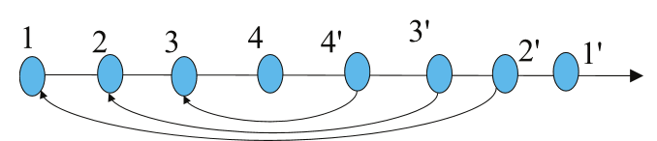
ARIES Data Structures: Log Record
Each log record contains LSN of previous log record of the same transaction
LSN in log record may be implicit
Special redo-only log record called compensation log record (CLR) used to log actions taken during recovery that never need to be undone
Serves the role of operation-abort log records used in earlier recovery algorithm
Has a field UndoNextLSN to note next (earlier) record to be undone
Records in between would have already been undone
Required to avoid repeated undo of already undone actions
LSN TransID PrevLSN RedoInfo UndoInfo
LSN TransID UndoNextLSN RedoInfo

Slide 28
ARIES Data Structures: DirtyPage Table
DirtyPageTable
List of pages in the buffer that have been updated
Contains, for each such page
PageLSN of the page
RecLSN is an LSN such that log records before this LSN have already been applied to the page version on disk
Set to current end of log when a page is inserted into dirty page table (just before being updated)
Recorded in checkpoints, helps to minimize redo work

Slide 29
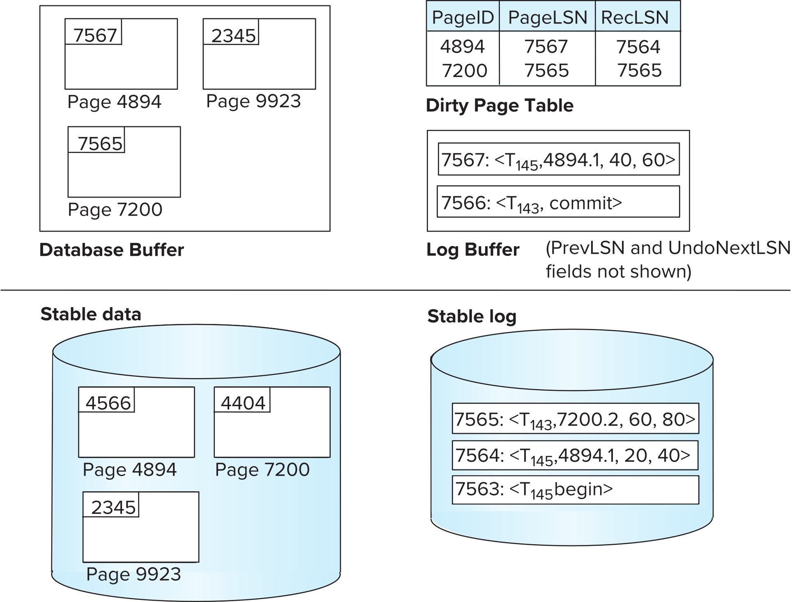
ARIES Data Structures

Slide 30
ARIES Data Structures: Checkpoint Log
Checkpoint log record
Contains:
DirtyPageTable and list of active transactions
For each active transaction, LastLSN, the LSN of the last log record written by the transaction
Fixed position on disk notes LSN of last completed checkpoint log record
Dirty pages are not written out at checkpoint time
Instead, they are flushed out continuously, in the background
Checkpoint is thus very low overhead
can be done frequently

Slide 31
ARIES Recovery Algorithm
ARIES recovery involves three passes
Analysis pass: Determines
Which transactions to undo
Which pages were dirty (disk version not up to date) at time of crash
RedoLSN: LSN from which redo should start
Redo pass:
Repeats history, redoing all actions from RedoLSN
RecLSN and PageLSNs are used to avoid redoing actions already reflected on page
Undo pass:
Rolls back all incomplete transactions
Transactions whose abort was complete earlier are not undone
Key idea: no need to undo these transactions: earlier undo actions were logged, and are redone as required

Slide 32
Aries Recovery: 3 Passes
Analysis, redo and undo passes
Analysis determines where redo should start
Undo has to go back till start of earliest incomplete transaction
Last checkpoint
End of Log
Time
Log
Analysis pass
Redo pass
Undo pass

Slide 33
ARIES Recovery: Analysis
Analysis pass
Starts from last complete checkpoint log record
Reads DirtyPageTable from log record
Sets RedoLSN = min of RecLSNs of all pages in DirtyPageTable
In case no pages are dirty, RedoLSN = checkpoint record’s LSN
Sets undo-list = list of transactions in checkpoint log record
Reads LSN of last log record for each transaction in undo-list from checkpoint log record
Scans forward from checkpoint
.. Cont. on next page …

Slide 34
ARIES Recovery: Analysis (Cont.)
Analysis pass (cont.)
Scans forward from checkpoint
If any log record found for transaction not in undo-list, adds transaction to undo-list
Whenever an update log record is found
If page is not in DirtyPageTable, it is added with RecLSN set to LSN of the update log record
If transaction end log record found, delete transaction from undo-list
Keeps track of last log record for each transaction in undo-list
May be needed for later undo
At end of analysis pass:
RedoLSN determines where to start redo pass
RecLSN for each page in DirtyPageTable used to minimize redo work
All transactions in undo-list need to be rolled back

Slide 35
ARIES Redo Pass
Redo Pass: Repeats history by replaying every action not already reflected in the page on disk, as follows:
Scans forward from RedoLSN. Whenever an update log record is found:
1. If the page is not in DirtyPageTable or the LSN of the log record is
less than the RecLSN of the page in DirtyPageTable, then skip the
log record
2. Otherwise fetch the page from disk. If the PageLSN of the page
fetched from disk is less than the LSN of the log record, redo the log
record
NOTE: if either test is negative the effects of the log record have already appeared on the page. First test avoids even fetching the page from disk!

Slide 36
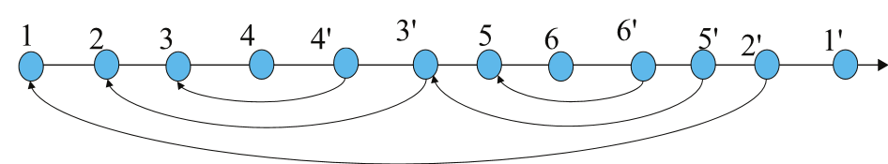
ARIES Undo Actions
When an undo is performed for an update log record
Generate a CLR containing the undo action performed (actions performed during undo are logged physicaly or physiologically).
CLR for record n noted as n’ in figure below
Set UndoNextLSN of the CLR to the PrevLSN value of the update log record
Arrows indicate UndoNextLSN value
ARIES supports partial rollback
Used e.g. to handle deadlocks by rolling back just enough to release reqd. locks
Figure indicates forward actions after partial rollbacks
records 3 and 4 initially, later 5 and 6, then full rollback

Slide 37
ARIES: Undo Pass
Undo pass:
Performs backward scan on log undoing all transaction in undo-list
Backward scan optimized by skipping unneeded log records as follows:
Next LSN to be undone for each transaction set to LSN of last log record for transaction found by analysis pass.
At each step pick largest of these LSNs to undo, skip back to it and undo it
After undoing a log record
For ordinary log records, set next LSN to be undone for transaction to PrevLSN noted in the log record
For compensation log records (CLRs) set next LSN to be undo to UndoNextLSN noted in the log record
All intervening records are skipped since they would have been undone already
Undos performed as described earlier

Slide 38
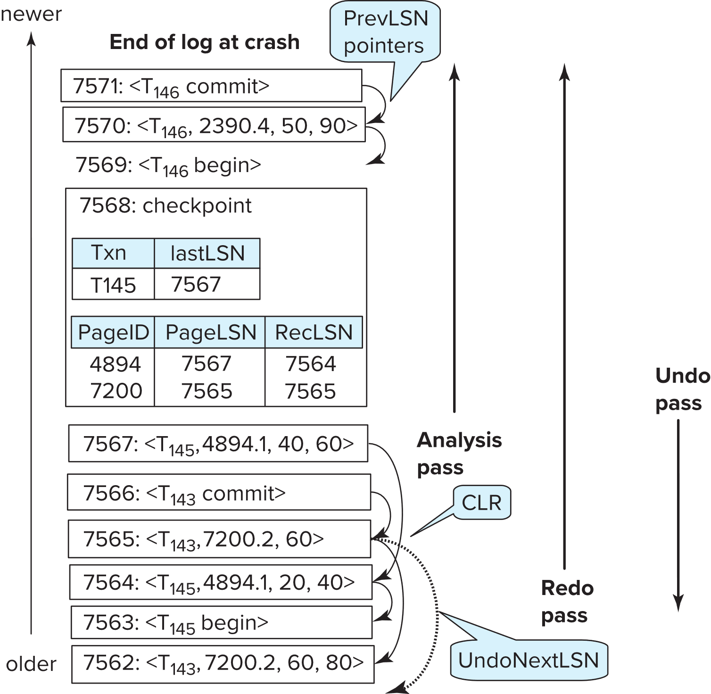
Recovery Actions in ARIES

Slide 39
Other ARIES Features
Recovery Independence
Pages can be recovered independently of others
E.g. if some disk pages fail they can be recovered from a backup while other pages are being used
Savepoints:
Transactions can record savepoints and roll back to a savepoint
Useful for complex transactions
Also used to rollback just enough to release locks on deadlock

Slide 40
Other ARIES Features (Cont.)
Fine-grained locking:
Index concurrency algorithms that permit tuple level locking on indices can be used
These require logical undo, rather than physical undo, as in earlier recovery algorithm
Recovery optimizations: For example:
Dirty page table can be used to prefetch pages during redo
Out of order redo is possible:
redo can be postponed on a page being fetched from disk, and performed when page is fetched.
Meanwhile other log records can continue to be processed

Slide 41
Recovery in Main Memory Databases
Normal recovery algorithms can be used with main-memory databases
But optimizations are possible
No redo-logging for indices: indices can be rebuilt quickly in-memory on recovery
No undo logging if only committed data is written to disk
Parallel recovery is important to load large amounts of data in-memory and perform recover with minimum delay

Slide 42
End of Chapter 19

