Slide 1
Functions - and Program Structuring

Slide 2
Recap
We have seen program as a monolith sequence of statements
Main types of statements
Assignment - var = expression
Conditional - if-then-else, if-then, if-elifs
Iteration - for loop, while loop
These statements are sufficient to compute anything computable
For a large program, or a complex problem
One monolith seq of statements is hard to construct or debug
Having only the above statements makes it harder
Functions provide an answer to both of these
Allows us to build new and more powerful "constructs" from the basic language constructs, which we can use in our code
Allows code to be broken into pieces

Slide 3
Recap
You learn programming by practice
Always remember that
The more you practice, the better you will get
There is no shortcut

Slide 4
Functions
In math, we have functions like:
Z = f(x,y)
After defining a function, we can use it in other functions
In python, we can define very general functions, and use them
Like in math, functions may have parameters, and to compute a function, values of parameters have to be provided
Function is a unit of computation – which can be invoked from different places, i.e. used wherever we want
With functions, a python program is a set of function declarations, and a “main program” which calls / uses these functions
Let's show it by example

Slide 5
Python Functions: Example
# defining a fn sq
def square(x):
return x*x
# defining a fn cube
def cube(y):
return y*y*y
# Main program
a, b = 2, 4
c = square(a) + cube(b)
print("Val of c: ", c)
Two functions defined - each has one parameter
Code of function definition specifies the computation the fn does
Function can return some value
To use the function – it is called, value of parameter is provided
On call – parameter gets value, body of function executed; value returned (and can be used)

Slide 6
Defining and Calling a function
We need two basic capabilities - defining a function and calling a defined function
Defining a function is done by def
def fn_name(parm-list):
<fn-body>
Parameters are optional; parameters are available for use in body
The function execution terminates when it executes a return statement, or its body completes

Slide 7
Defining and Calling a function…
Defining a function just defines it, to execute we must call it
Statement to call a function: just the function name with parameters:
fn_name(arguments)
If function does not have any arguments, it must be called with () - this tells the interpreter that this is not a variable but a function call
fn_name()
If function has parameters, arguments need to be provided for all the parameters - provide value of the parameter for fn execution

Slide 8
Defining and Calling: flow of control
Program is a sequence of statements being executed by interpreter
Function definition is a definition - not an executable statement
Function call is an executable statement
On encountering a function call statement, to execute it:
Interpreter jumps to function definition
Parameters are assigned values that corresponding arguments in the calling statement have
Body of the function (a sequence of statements) is executed
Upon completion of the function, the control returns to the calling stmt
Return value, if any, is used where the function was called

Slide 9
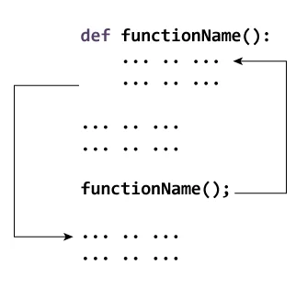
Flow of control - diagram (programiz)

Slide 10
Executing a Program with Functions
A general program structure:
def fn1():
body
def fn2():
body
def fn3(params):
body
# Main program
Stmt-block
# includes some call stmts
When interpreter gets this program
On function definitions, it records some information; body is not executed
Starts execution from the first stmt in the stmt block of the main program
On a call statement, control is transferred to the function; function starts executing
On return statement in the function, goes back to the call stmt (in the main program)
Execution continues in the main program
Note: Function definition must be before the function call stmt is executed. Otherwise results in error.

Slide 11
Return statement
A function can use in its body a special statement:
return <expression> # expression is optional
Return statement serves two purposes
Terminates the execution of the function and returns the control back to where the function was called
Returns a value to the caller
A function execution can also terminate when its body finishes
Like having a return statement as the last statement
If some value specified in return - that is provided at calling point
Otherwise the return value is treated as None (a special value)
Note: In Python, functions can return multiple values. Just write each value/expression after return, separated by commas.

Slide 12
Quiz - Single Correct
Order in which names of colors are printed when the program is executed?
Red, Yellow, Blue, Green
Red, Green, Yellow, Blue
Yellow, Green, Blue, Red
Red, Yellow, Green, Blue
print("Red")
def f(a, b):
s = a*b
print("Green")
return s
print("Yellow")
num1 = 10
num2 = 5
ans = f(10, 5)
print("Blue")

Slide 13
Quiz - Single Correct
Order in which names of colors are printed when the program is executed?
Red, Yellow, Blue, Green
Red, Green, Yellow, Blue
Yellow, Green, Blue, Red
Red, Yellow, Green, Blue
print("Red")#1
def f(a, b): #6
s = a*b #7
print("Green") #8
return s #9
print("Yellow")#2
num1 = 10 #3
num2 = 5 #4
ans = f(10, 5) #5
print("Blue") #10

Slide 14
Argument Passing
A function definition may have parameters (or not) - these are available inside the function for use
Call to a function has arguments (or not)
When a function is called, argument values are assigned to the parameters
Positional arguments (also called required arguments) - arguments are assigned to parameters in order
Must have same number of arguments for calling
i-th argument value is assigned to i-th parameter
When a function is called, interpreter checks if the # of args is same as # of parms
If number of arguments is not same, error

Slide 15
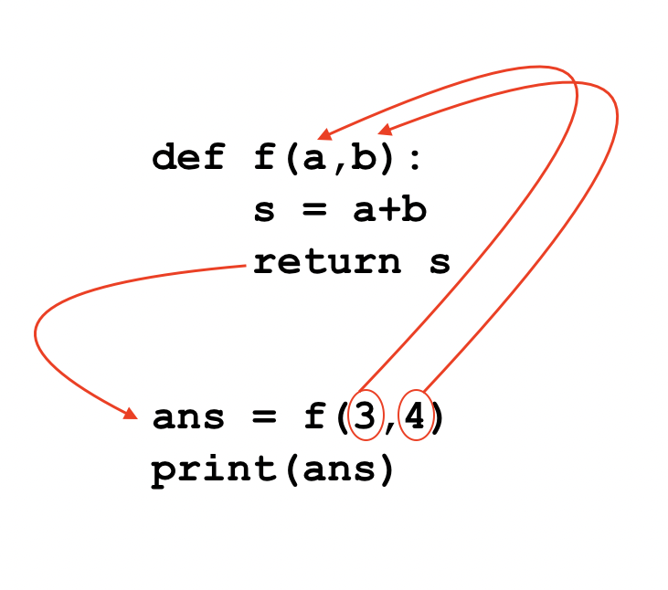
Argument passing example
The values 3 and 4 are passed as arguments for function f.
The arguments values are copied to function parameters a and b.
a and b are used for computing value of s.
s is returned by the function and assigned to variable ans.
The variable ans now holds the value 7 and is printed.
Notes:
+

Slide 16
Argument Passing …
Arguments can be pass by value or pass by reference
Pass by value - the value of arg is assigned to the parm
Pass by reference - a reference to the arg is assigned to the parm - in this case changes made by function can be reflected in the caller
Python uses pass by value, but in some cases, this value is a reference - we will discuss it later
Complex objects can also be passed as arguments

