Slide 1
Lists, List Comprehension, Strings
and Multiple Inputs

Slide 2
Feedback
How comfortable are you with material so far
Green: Very Comfortable
Yellow: Moderately Comfortable
Red: Not comfortable

Slide 3
Structured Data Types
Looked at scalar data types - which have simple values
E.g. integer, real numbers, boolean
These data have no components/parts within them
Python also has data types in which the data object is compound, i.e. a collection of scalar (structured) data items combined into one object
In such data types, you can access the full data object, or its components / items
In python there are some built-in structured types: Lists, Strings, Sets, Tuples, Dictionaries
We will first discuss lists and strings (strings often not considered in the same category)
Will then discuss how to take multiple inputs from user

Slide 4
Lists

Slide 5
Lists
Lists are used to store multiple items in one variable
List items are ordered - there is a notion of ith item
Items can be of any type (incl structured types), and can be mixed - though generally lists of type of items is used
List items are changeable; duplicate values are allowed
Lists are created using square brackets, e.g.
L1 = [1, 4, 5, 2, 9, 5]
L2 = ["apple", "banana"]
L3 = [1, 2.0, "str", 3, 5]
L4 = [] #Empty List
List items are indexed, the first item has index [0], the second item has index [1] etc.
L1[0] is 1; L1[2] is 5, L2[1] is "banana", L3[3] is 3
String objects: those within "" - for now treat them as one object

Slide 6
Accessing a List Item : Indexing
To access an Individual item stored in a list we use indexing
The position of any item in list (with the first item as 0) is known as its index. This index can be used to access an item in the list.
Usage : L[i] returns the i^{th} item in the list where i starts from 0.
Most programming languages use positive index i.e. L[i] accesses the i^{th} item, with indexes starting from 0.
Python also allows for negative index. The items are accessed from the end of the list; -1 means last item, -2 last but one….
Example : L3 = [1, 2.0, "str", 3, 5]
L3[0] is 1
L3[1] is 2.0
L3[2] is "str"
L3[-1] is 5
L3[-2] is 3

Slide 7
Accessing Multiple List Items : Slicing
We can also extract a portion of a list. Operation is known as Slicing.
Syntax : L[i:j] # returns a list which is sub-list of L for index range i:j (i.e. includes i, but not j, no. of items is : j-i )
Omitting i starts the slicing at the beginning of the list i.e L[:j]
Omitting j stops the slicing at the end of the list i.e L[i:]
A third parameter step is available to determine the jump size L[start:stop:step].Similar to range() fn.
Example : L3 = [1, 2.0, "str", 3, 5]
L3[1:3] returns a list [2.0, "str"]
L3[:2] is [1, 2.0]
L3[3:] is [3,5]
L3[-4:-2] is list from 4th item from end to 2nd item;[2.0, "str"] (note: -4 included, -2 is not; no of items is: -2 - (-4) = 2;
L3[1:4:2] returns [2.0,3]

Slide 8
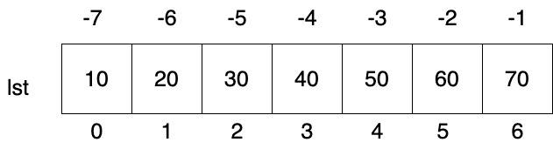
List Slicing Examples
Used to access a particular range of elements in a list
Uses the slicing operator i.e. colon(:)
lst[start : stop : step]
Examples :
print(lst[1:4])
[20, 30, 40]
print(lst[1:5:2])
[20, 40]
print(lst[2:])
[30, 40, 50, 60, 70]

Slide 9
List Slicing Examples
Used to access a particular range of elements in a list
Uses the slicing operator i.e. colon(:)
lst[start : stop : step]
Examples :
print(lst[:4])
[10, 20, 30, 40]
print(lst[:-6:-2])
[70, 50, 30]
print(lst[-5:-2: 2])
[30, 50]

Slide 10
Quiz (ungraded)
Write down your answer
L = [1, 2, 3, 4, 5, 6, 7, 8, 9, 10]
Q1: What is the value of L[3]
Q2: Value of L[2:5]
Q3: L[-2:-5]
Q4: L[-5: -2]
We will do them in python shell

Slide 11
Change List Items
We can use the index to specify an item - assign it a new value
L[i] = new_val # item L[i] will now be new_val
Example :
L = [“physics”, “chemistry”, “maths”, 2021, 2025]
L[2] = “biology”
print(L) #[“physics”, “chemistry”, “biology”, 2021, 2025]
Can also change a range of list items by selecting a slice and assigning it values (we will ignore it)

Slide 12
Some important operations on Lists
The len() function gives the length of the list, i.e. the no. of items
len([1, 2, 5]) is 3
The sum() function gives the sum of items (for int/float - error for str/mixed)
sum([1, 2, 5]) is 8
Checking if an item exists in a list: in operator (membership testing). Only for checking of items, not for sub-list
l3 = [1, 2.0, "str", 3, 5]
4 in l3 is False; "str" in l3 is True; 2.0 in l3 is True
Checking absence using not in
12 not in l3 will return True ; 5 not in l3 is False
Concatenate : Join lists by + operation
l1+l2 returns a new list by adding l2 to end of l1
Can replicate lists by * operation:
Given l1=[1,2], then l1*4 returns [1, 2, 1, 2, 1, 2, 1, 2]

Slide 13
Operations on a List - Adding Data
Multiple operations are provided on a list object
Syntax of an operation on an object: var_name.opname()
If the var L is a list, some operations that can be done are:
L.append(item) # adds an item to the end of L
L.insert(i, item) # insert item at i th location in L - earlier items from i onwards are pushed back (i.e. their index increases)
L.extend(list) # append the list to L, (the argument must be a list)

Slide 14
Operations on a List - Removing Data
Multiple operations provided for removing items from a list L, e.g
L.remove(item) # removes the item if it exists (first occurrence only), else gives ValueError
L.pop(index) # removes L[index] item ; if no i specified, removes last item
L.clear() # clears the list; L becomes an empty list: []
Items can also be removed from the list using the del function:
del L[index] # removes the item at the specified index

Slide 15
Operations on Lists - others
L.index(item) # returns the lowest index where the searched item appears
L.reverse() # reverses the order of list elements, updates the existing list, does not return any value

Slide 16
Example
Given a list as input, write a program to create a new list that has products of frequency of repeating elements (which come together) and value of elements.
Input :
lst = [2, 2, 2, 2, 5, 5, 5, 8, 8, 8, 8, 8, 6, 6, 6, 6, 4, 4, 7, 7, 7, 5, 7,7]
Output :
res = [8, 15, 40, 24, 8, 21, 5, 14]
res = []
count = 1
for i in range(1,len(lst)):
if lst[i]!=lst[i-1]:
res.append(count*lst[i-1])
count = 0
count = count+1
res.append(count*lst[-1])
print(res)

Slide 17
Example : List Operations
Replace 1st occurrence of the given element with new value if found
Input:
l1 = [2, 3, 3, 5, 7, 3, 4, 3]
Element to be replaced: 3
New value = 13
Output:
[2, 11, 3, 5, 7, 3, 4, 3]
l1 = [2, 3, 3, 5, 7, 3, 4, 3]
elt = 3
new_value = 13
index = l1.index(elt) #Index : 1
print("Index : ",index)
l1[index] = new_value
print(l1)
# [2, 11, 3, 5, 7, 3, 4, 3]

Slide 18
Quiz : Single Correct
What would be the output of the code given on the right?
Error
[8, 12]
[1, 2, 3, 4, 1, 2, 3, 4]
[1, 2, 1, 2, 3, 4, 3, 4]
list1 = [1, 2]
list2 = [3, 4]
print ((list1 + list2)*2)

Slide 19
Quiz : Single Correct
What would be the output of the code given on the right?
Error
[8, 12]
[1, 2, 3, 4, 1, 2, 3, 4]
[1, 2, 1, 2, 3, 4, 3, 4]
Explanation: Recall that + is for concatenation and * is for replication
list1 = [1, 2]
list2 = [3, 4]
print ((list1 + list2)*2)

Slide 20
Copying a List
Say, L1 is a list of [1, 2, 3]
L2 = L1 does not create a new list - just creates a new var L2 which also points to the same list
We can make truly another copy of the list by copy() operation
L2=L1.copy()
We can also create a copy of the list using slicing.
L2 = L1[:] # Leaving both start and stop as blank
With L1=L2, if you change L1[i] (or L2[i]) , the change is in the list, and as both L1 and L2 point to same list, both will show
With copy, a new list is created which has same contents as list pointed by L1, and pointer to this is assigned to L2

Slide 21
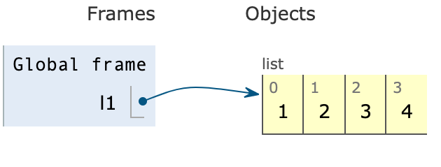
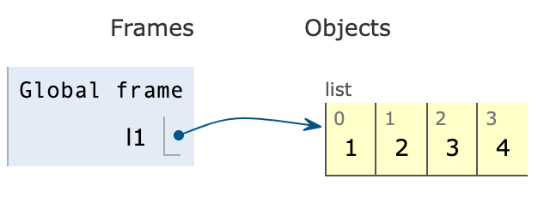
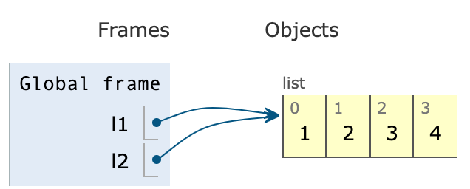
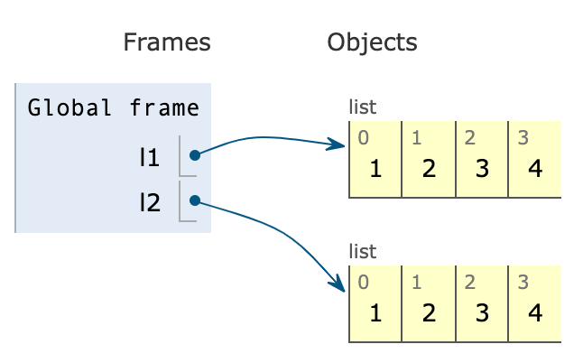
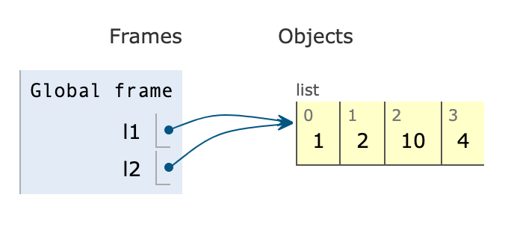
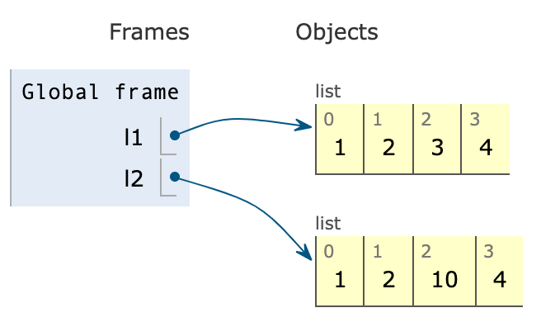
Copying a list - pythontutor.com
l1 = [1,2,3,4]
l2 = l1
l2[2] = 10
print(l1)
print(l2)
l1 = [1,2,3,4]
l2 = l1.copy()
l2[2] = 10
print(l1)
print(l2)

Slide 22
Looping over items in a list
For loop and lists are made for each other - easy to loop
for item in <list>:
Loop_body
====
Looping using index is also easy
N = len(list)
for i in range(N):
use L[i]
Printing items in a list:
for item in list1:
print(item)
====
for i in range(len(list1)):
print(list1[i])

Slide 23
Eg: Sum of squares of items in a list
lst = [1, 3, 2, 5, 9, 4]
total = 0
for item in lst:
total = total + item*item
print(total)
lst = [1, 3, 2, 5, 9, 4]
total = 0
for i in range(len(lst)):
total = total + (lst[i])**2
print(total)

Slide 24
Sorting lists
Lists themselves are any collection of items
Sorting them is a very common need
Python provides a powerful operation, with variations, to sort - treats items as strings and does alphanumeric sorting
lst.sort() # lst changed to have items in ascending order
lst.sort(reverse=True) # lst sorted in descending order
Remember, strings are case sensitive

Slide 25
Special sorting with own key
Can provide own function as "key" for sorting
lst.sort(key=myfn)
Items of list are now arranged based on value of applying myfn on each item
I.e. sorting of items is done as per the value myfn(item) of each item - items do not change
E.g a list of strings
fl = ["orange", "mango", "kiwi", "pineapple", "banana"]
Sorting using fl.sort(key=len) will sort it using the value provided by the len function for each item, i.e. by length
E.g. write a function sq to square the value, use it to sort

Slide 26
Using Lists to Assign Multiple vars
lst = [1,2,3]
How to assign the list elements to variables?
Method 1:
a = lst[0]
b = lst[1]
c = lst[2]
Method 2 (Better way): Sequence unpacking
a,b,c = lst # Now a=1, b=2, c=3
x, y = lst # ValueError: too many values to unpack (expected 2)

