Slide 1

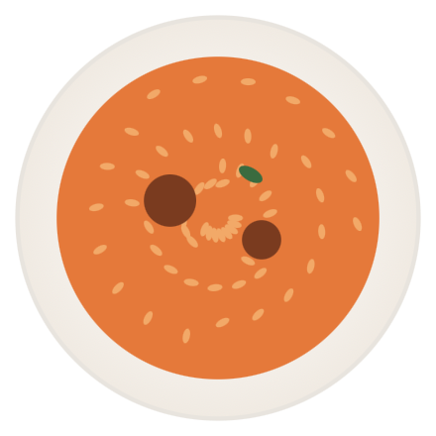
ChopWise
PRE-SEED · 2026
9:41
CALORIE TRACKING, BUILT FOR GHANA
Snap your meal. Get the calories. In your kitchen.
IDENTIFIED · 98% CONFIDENCE
Jollof Rice
612
kcal
The first calorie tracker that recognizes jollof, banku, fufu and waakye — not just burgers and burritos.
CARBS
PROTEIN
FAT
78 g
22 g
24 g
Log to today
Pitch deck · April 2026
01 / 12

Slide 2
THE PROBLEM · CONTEXT
Ghana is in the middle of a nutrition transition.
Urbanization, sedentary work, and a shift toward processed foods have pushed obesity from a rare condition to a population-scale health risk.
50%
18.8%
+6 pts
of Ghanaian women aged 20–49 are overweight or obese
of women now live with obesity
sharper increase in overweight & obesity since 2017
doubled from 9.3% in 2008
up from 40% in 2014
Ghana DHS, pooled 2008–2022
driven by urbanization and diet shifts
Ghana DHS, 2022
PLOS Glob Public Health, 2024
02 / 12

Slide 3

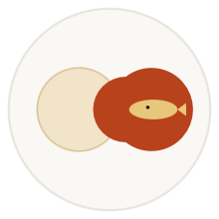
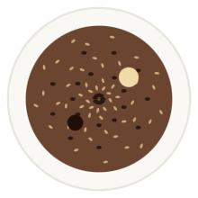


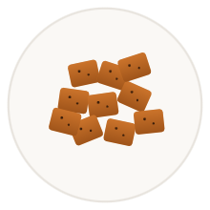


THE PROBLEM · THE GAP
None of these dishes exist in mainstream calorie databases.
Search "banku" in MyFitnessPal: zero verified entries. The FAO West Africa Food Composition Table covers ~1,000 raw ingredients — but no composite dishes. There is no systematic database of prepared Ghanaian food.
Jollof Rice
Banku & Tilapia
Waakye
Fufu & Light Soup
not found
not found
not found
not found
Kenkey & Shito
Kelewele
TZ & Ayoyo
Kontomire Stew
not found
not found
not found
not found
03 / 12

Slide 4
THE PROBLEM · WHY INCUMBENTS CAN'T FIX THIS
Four structural reasons mainstream apps fail Ghanaian users.
01
Western training data
02
Composite dishes have no entries
Computer-vision models for Cal AI and Foodvisor are trained on US/EU food photography. They mistake fufu for mashed potatoes, banku for an egg, and kelewele for sweet-potato fries.
WAFCT 2019 lists raw cassava and raw fish. It does not list "banku & tilapia" with a known portion size — the form Ghanaians actually eat.
03
Wrong portion mental models
04
No local context
A "serving of rice" in MyFitnessPal is 158g. A normal jollof plate in Accra is 350–500g, often with a side. Logging is wrong from the first tap.
No street-food entries (kelewele, koose, bofrot). No regional variants (waakye in Tamale vs Accra). No mapping to local portion vocabulary ("one ball", "half olonka").
04 / 12

Slide 5
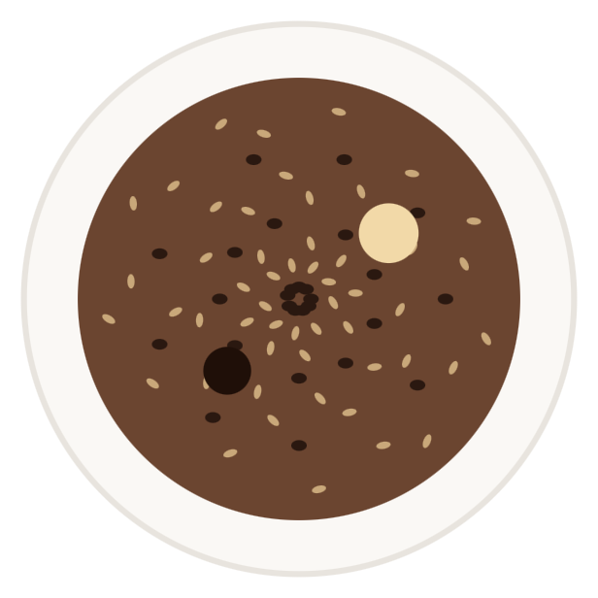
THE SOLUTION
9:41
Point. Snap. Logged.
Identifying dish…
ChopWise recognizes Ghanaian dishes from a single photo and returns calories, macros, and portion size — instantly.
Trained on Ghanaian food
tens of thousands of locally-sourced photos
Built for street and home cooking
kelewele, koose, waakye stands, family pots
Works offline
designed for 3G and intermittent connectivity
05 / 12

Slide 6
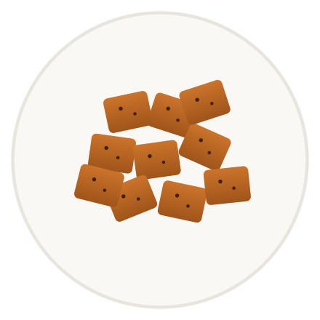




THE PRODUCT · END-TO-END FLOW
Three taps from plate to logged.
9:41
9:41
9:41
Identifying dish…
TODAY · TUE
1340
/ 2100 kcal
BREAKFAST
380
Hausa koko & koose
LUNCH
720
Waakye with shito
IDENTIFIED · 98% CONFIDENCE
Kelewele
SNACK
240
318
Kelewele
kcal
CARBS
PROTEIN
FAT
78 g
22 g
24 g
Snap
Recognize
Track
1
2
Log to today
3
Open ChopWise, point at the plate, tap once. No menu hunting, no manual entry.
On-device model identifies the dish, components, and portion. Two seconds, works offline.
Daily totals, macros, and trends — built around what Ghanaians actually eat all day.
06 / 12

Slide 7
THE DEFENSIBILITY
A four-layer database no one else is building.
Mainstream apps cannot retrofit this. It requires on-the-ground operations in Ghana — exactly what we are.
LAYER 01
LAYER 02
LAYER 03
LAYER 04
Ingredient floor
Composite dish library
Vision dataset
Portion intelligence
500+ prepared Ghanaian dishes, with regional variants. Built with chefs and nutritionists in Accra, Kumasi, Tamale. Proprietary.
Tens of thousands of dish photos across lighting, plates, and portions. Labeled by Ghanaian annotators. Compounds with every user.
WAFCT 2019 — ~1,000 West African raw ingredients. Public, free, scientifically rigorous. Our nutritional bedrock.
Local portion vocabulary mapped to grams: "one ball", "half olonka", "small bowl". The thing nobody else has.
07 / 12

Slide 8
THE MARKET
A 25M-person market with the device in their pocket.
34.5M
BEACHHEAD → EXPANSION
Population of Ghana
~800k SOM
DataReportal, Jan 2024
Health-conscious urban Ghanaians, ages 22–45, with diabetes risk or weight-management goals — willing to pay GHS 30/mo.
24.1M
Internet users · 70% penetration
DataReportal, Jan 2024
~80M SAM
~8M
West Africa expansion: Nigeria, Côte d'Ivoire, Senegal, Togo. Many shared dishes and ingredients — our database compounds.
Urban smartphone users — our beachhead
Statista / GSMA, 2024
Diaspora pull
4.2M
~3M Ghanaians abroad (US, UK, Canada, Germany) with disposable income and the same data gap. Free distribution channel via family.
Ghanaians with type-2 diabetes
Statista / IDF, 2022
08 / 12

Slide 9
THE COMPETITION
Incumbents are global. We are local — by design.
ChopWise
Cal AI
MyFitnessPal
Cronometer
Recognizes Ghanaian dishes
✓
—
—
—
Composite dish database
✓
—
—
—
Local portion vocabulary
✓
—
—
—
Works offline on 3G
✓
—
—
—
Mobile-money payment
✓
—
—
—
Built in Ghana
✓
—
—
—
Cal AI, MyFitnessPal and Cronometer are excellent products — for the markets they were built for. None has a strategic reason to invest in a Ghana-specific database.
09 / 12

Slide 10
THE PLAN
Beachhead in Accra. Expand in compounding waves.
PHASE 1
Months 0–6
PHASE 2
Months 6–12
PHASE 3
Year 2
Accra power-user beta
Public launch · Ghana
West Africa expansion
Recruit 1,000 health-conscious users in Accra and Tema
Freemium with GHS 30/mo Pro tier (mobile-money native)
Nigeria first — shared dishes, 220M population, Naira mobile money
Free during beta — collect labeled data + feedback
Influencer partnerships with Ghanaian fitness & food creators
Côte d’Ivoire and Senegal follow
Diaspora app via App Store and Play Store · USD pricing
Partner with two diabetes clinics for clinical-validation pilot
B2B pilots: corporate wellness, NHIA-affiliated clinics
10 / 12

Slide 11
THE ROADMAP
From research to revenue in 18 months.
Now
Q3 '26
Q1 '27
Q3 '27
Q2 '28
Concept + research
Closed alpha
Public beta · Accra
Paid launch · Ghana
Nigeria
WAFCT mapped · 80 dishes catalogued · founder team formed
iOS-first build · 200 dishes · first clinic partnership
1k users · 500 dishes · vision model v1
Mobile-money billing · Android · 10k MAU target
Naira + Paystack · regional dish library
11 / 12

Slide 12
THE ASK
$500k
USE OF FUNDS
Vision model + dish dataset
45 %
Annotators, compute, dish-cataloguing field work
Pre-seed round · 18 months runway
Engineering team
30 %
Two mobile engineers, one ML engineer, 18 months
To build the world's first calorie-tracking app for Ghanaian cuisine — and the data moat that makes it the default for West Africa.
Beta operations + clinics
15 %
User research, two clinic pilots, support
Runway + reserve
10 %
Legal, infrastructure, working capital
LET'S TALK
hello@chopwise.app
12 / 12

