Slide 1
LoRa PODWave
Thibaud Vegreville / Loris Gentillion / Zheng Jian

Slide 2

Global Structure
POD
POD
LEGENDE :
Protocole LoRa
Protocole WiFi
THE IDEA :
A propagation-based algorithm wich is close in mind to a survey function.
Designed to work as fast-configured / fast-used LAN and result propagation.
POD
Client
Client
Client

Slide 3
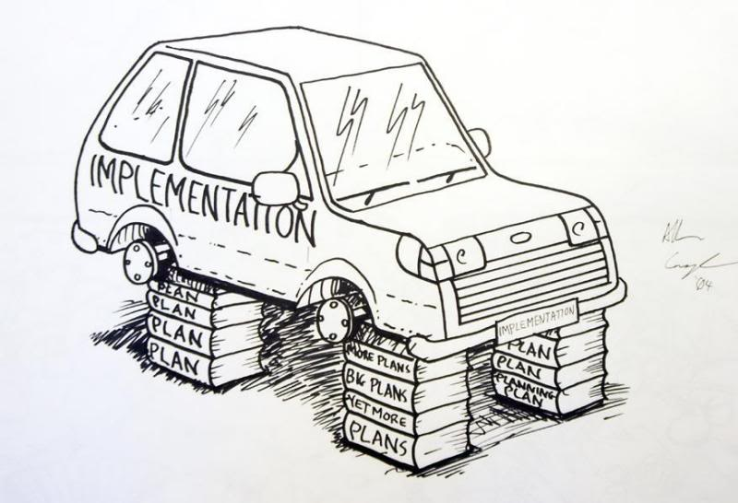
Technical Implementation :
Mobile app side :
General interfaces (WIP)
Test interfaces done (request + response)
POD Side:
Server and WiFi application :
Roads up and formatted response (JSON parser)
OLED and series-port display
Local LAN and website services
LoRa transition :
Packet emitting and receiving “simultaneously”
Callback function implemented

Slide 4
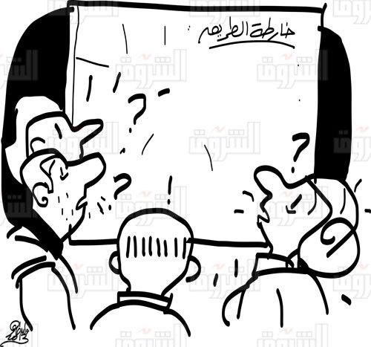
Road Map :
Mobile app side :
General interfaces
Workshop and plugin function for extensibility
POD Side:
Server and WiFi application :
Complete Web fast-configuration
Fully implemented API easy to use
Back-end access and configuration
Implement a Trigger&Survey type library.
LoRa transition :
Complete the LoRa communication.
Implement a LoRa standard for application communication
Handle error and environment variable.

Slide 5

Ideas of Application Fields.
Low-cost humanitarian devices
Long range and reliability in difficult condition
Improvised event in area not connected or poorly
Poor population or nomad ones in no-network-cover area
Sahara’s nomad.
High mountain population (e.g : Kazakhstan, Peru, etc…)

Slide 6
ANY QUESTIONS ?

