Slide 1
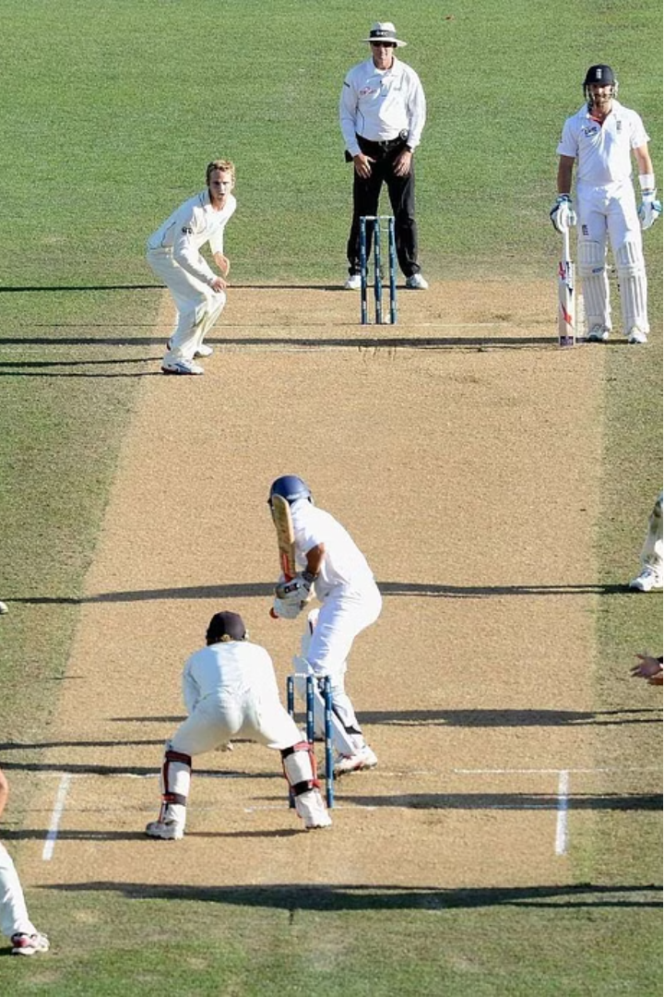

Cricket Analysis: Insights from the T20 World Cup 2022
This presentation offers a comprehensive analysis of the T20 World Cup 2022, delving into key aspects such as team participation, top-performing batsmen, and India's standout performers. Leveraging cricket data, we uncover insightful trends and patterns to fuel strategic decision-making and enhance the understanding of this thrilling tournament.

Slide 2
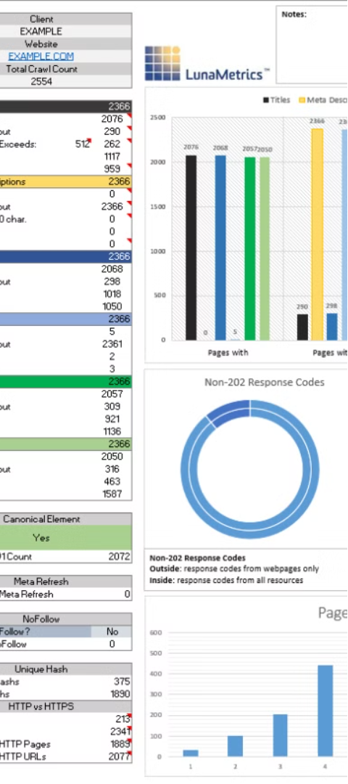
Data Import and Preprocessing
1
Data Source
2
Data Cleaning
The analysis utilizes cricket data from a CSV file, containing match details and player statistics.
The data is preprocessed to remove unnecessary columns and handle any missing values, ensuring a clean and robust dataset for further analysis.
3
Exploratory Analysis
The preprocessed data is subjected to exploratory analysis to gain insights into the participating teams, top-performing players, and other key metrics.

Slide 3
Participating Teams
Team Representation
Dominant Teams
Emerging Contenders
The analysis identifies the participating teams in the T20 World Cup 2022 and visualizes their occurrences in the tournament.
The data reveals the most prominent teams in the tournament, providing insights into the competitive landscape and potential favorites.
The analysis also highlights any surprising or unexpected teams that made a strong showing, indicating potential shifts in the cricketing landscape.

Slide 4
Top 10 Highest Scoring Batsmen
1
Batting Prowess
The analysis delves into the performances of the top 10 highest scoring batsmen, showcasing their exceptional skills and contributions to their respective teams.
2
Consistent Performers
The data highlights the batsmen who consistently delivered high-scoring innings, demonstrating their importance and value to their teams.
3
Emerging Talents
The analysis also identifies any young or lesser-known batsmen who have emerged as rising stars, hinting at the depth and potential of the cricketing talent pool.

Slide 5
India's Top 5 Run Getters
Domestic Dominance
Cumulative Contributions
Emerging Superstars
The analysis focuses on India's top 5 run getters, showcasing the country's cricketing prowess and the depth of talent within the national team.
The analysis identifies any new or rising players within the Indian team, indicating potential future leaders and the team's ability to groom talent.
The data visualizes the cumulative runs scored by these top performers, highlighting their consistent and substantial contributions to India's success in the tournament.

Slide 6
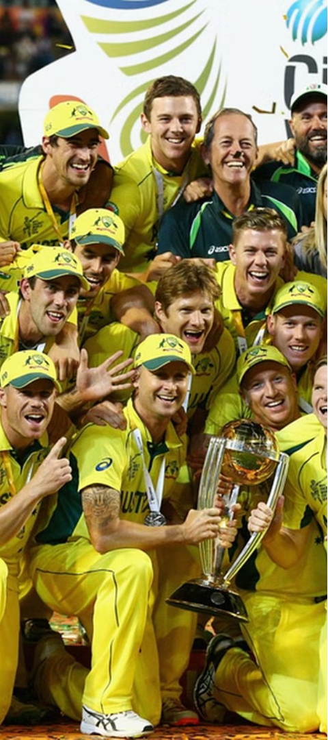



Match-Winning Performances
Standout Batting
The analysis showcases the match-winning batting performances by players, highlighting their ability to deliver when the pressure is on.
Impactful Bowling
The data also examines the key bowling performances that turned the tide in crucial matches, demonstrating the importance of a well-rounded team.
Clutch Moments
The analysis delves into the game-changing moments and highlight-reel plays that captivated fans and sealed victories for the teams.

Slide 7

Emerging Cricketing Talents
Batting Prodigies
Bowling Sensations
Athletic Fielders
Inspiring Leaders
The analysis identifies the young batting talents who showcased their skills and potential to become future superstars of the sport.
The analysis sheds light on the exceptional fielders who displayed agility, athleticism, and game-changing impacts on the field.
The data identifies the young captains or team leaders who showcased their strategic acumen and ability to guide their teams to success.
The data also highlights the up-and-coming bowlers who left a lasting impression, hinting at the depth of bowling talent in the tournament.

Slide 8
Tournament Highlights and Insights
Most Sixes Hit
Highest Individual Score
Highest Team Total
Fastest Fifty
456
101 by Alex Hales (England)
248/3 by India vs. Scotland
12 balls by Lorcan Tucker (Ireland)
The analysis provides a comprehensive overview of the key highlights and notable records set during the T20 World Cup 2022, offering a snapshot of the tournament's most thrilling moments and exceptional performances.

