Slide 1

BLUESTOCK MUTUAL FUND ANALYTICS CAPSTONE PROJECT
End-to-End Financial Analytics using Python, SQLite & Power B
Shady Abdul Nazer P

Slide 2

Objective
The project focuses on building a complete mutual fund analytics solution capable of:
Performing ETL and data cleaning
Analysing fund performance
Evaluating investor behaviour
Computing financial risk metrics
Creating interactive dashboards
Business Goal
To generate actionable investment insights using analytics and business intelligence tools.

Slide 3

Tools & Technologies
Technology | Purpose
Python | Data processing
Pandas & NumPy | Analytics
SQLite | Database
SQLAlchemy | Database integration
Matplotlib & Seaborn | Visualisation
Power BI | Interactive dashboard
Git & GitHub | Version control

Slide 4

DATASETS USED

Slide 5
Datasets
Fund Master
NAV History
Monthly SIP Inflows
Investor Transactions
Scheme Performance
Portfolio Holdings
Benchmark Indices
Industry Folio Count
Category Inflows
Total Schemes Analysed
40 Mutual Fund Schemes

Slide 6
ETL & DATA CLEANING
Data Cleaning Operations
Datetime conversion
Missing value handling
Forward filling NAV values
Duplicate removal
Validation of transaction types
Risk grade standardisation
Output
Cleaned datasets stored in:
data/processed/
SQLite database

Slide 7
DATABASE DESIGN
Dimension Tables
Fact Tables
Features
dim_fund
dim_date
fact_nav
fact_transactions
fact_performance
fact_aum
Optimised analytical queries
Relationship modelling
Power BI integration

Slide 8
EXPLORATORY DATA ANALYSIS
EDA Performed
NAV trend analysis
SIP inflow analysis
Category inflow heatmaps
Investor demographic analysis
Geographic investment analysis
Sector allocation analysis
Key Observation
SIP inflows and folio counts showed strong growth from 2022 to 2025.

Slide 9
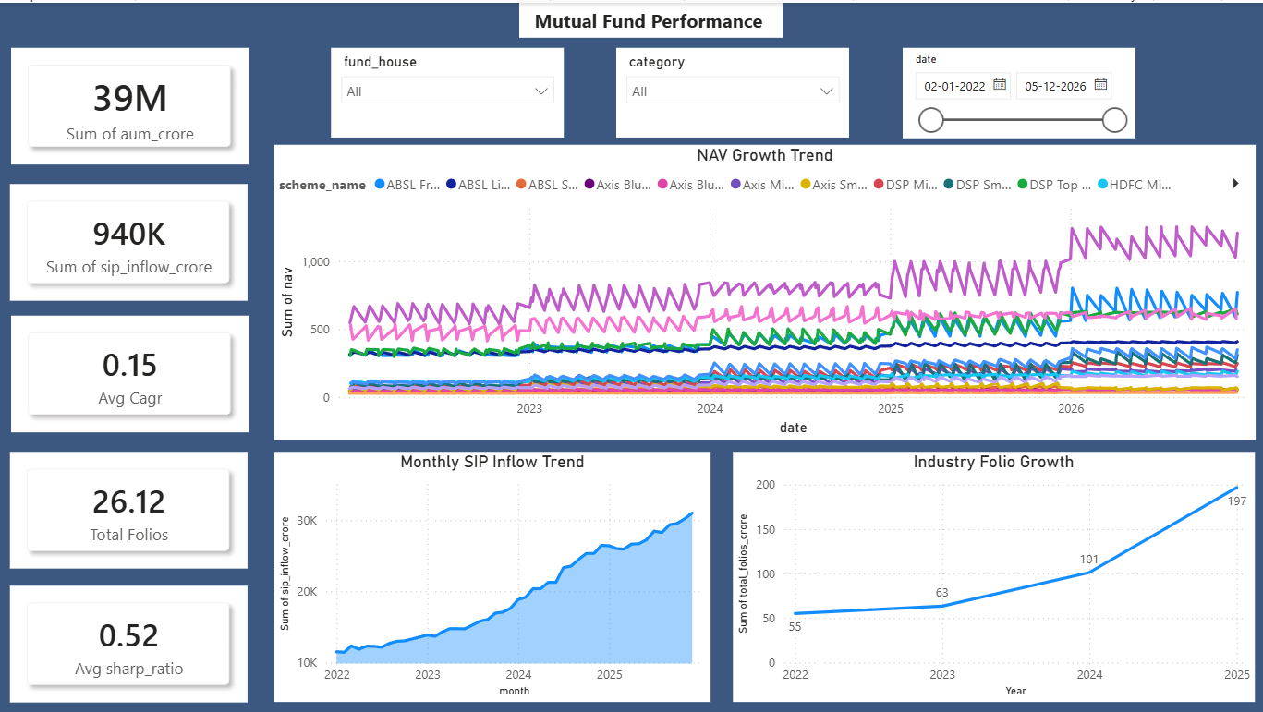
EXECUTIVE DASHBOARD
Jun
Dashboard Features
KPI cards
NAV growth trend
SIP trend analysis
Folio growth analysis
Interactive slicers
Key KPIs
Total AUM
Total SIP Inflow
Average CAGR
Average Sharpe Ratio
Total Folios

Slide 10

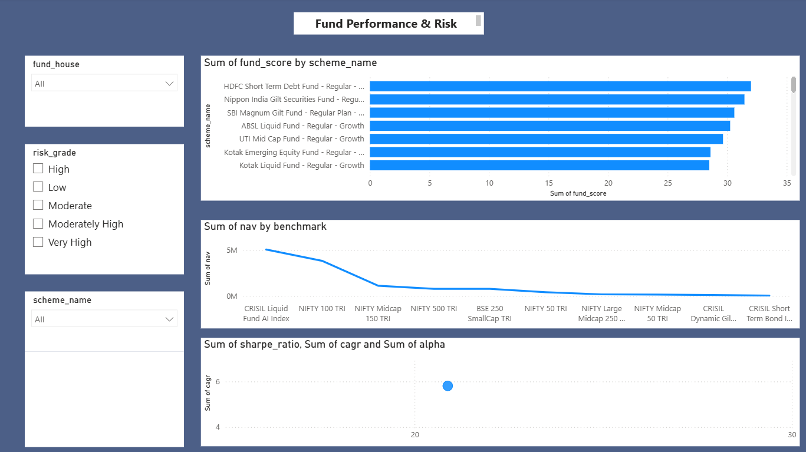
FUND PERFORMANCE ANALYTICS
Metrics Computed
Features
CAGR
Sharpe Ratio
Sortino Ratio
Alpha & Beta
Maximum Drawdown
Risk-adjusted return analysis
Benchmark comparison
Top-performing funds ranking
Key Observation
Funds with higher Sharpe Ratios demonstrated better long-term stability.

Slide 11
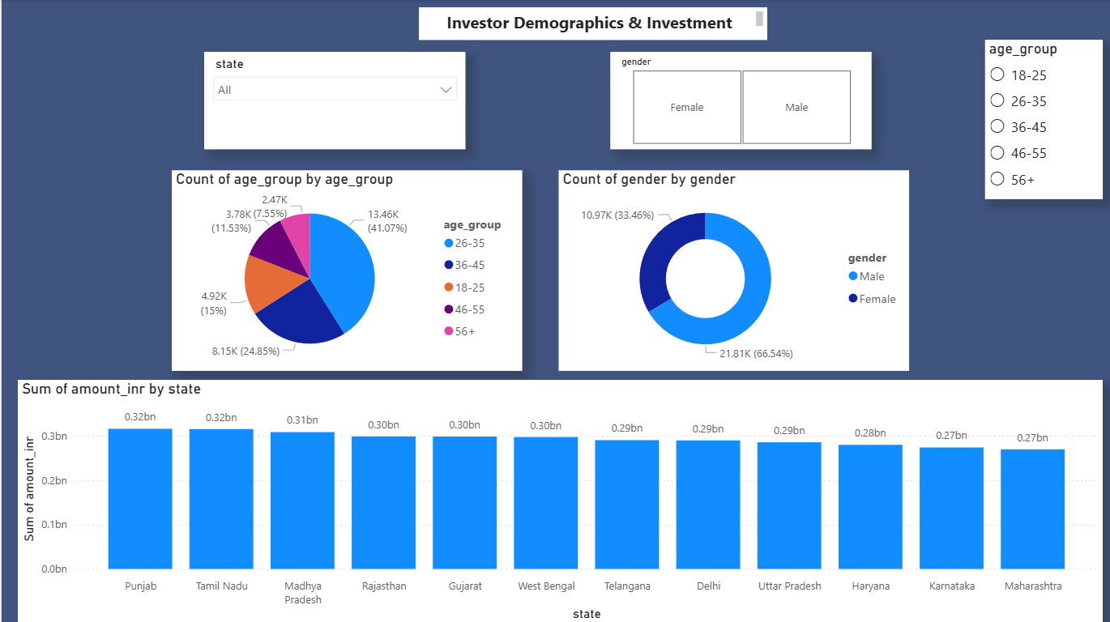
INVESTOR ANALYTICS
Analysis Performed
Age group distribution
Gender-wise investment analysis
State-wise SIP contribution
Investor demographic patterns
Key Observation
Majority of investors belong to the 26–35 age group
Male investors contributed the highest transaction volume

Slide 12
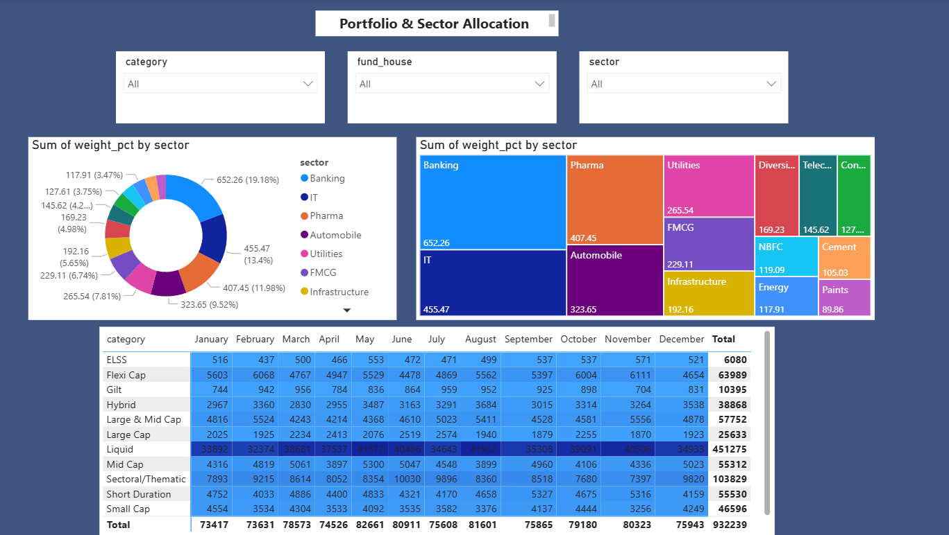
PORTFOLIO & SECTOR ANALYTICS
Analysis Performed
Sector allocation
Portfolio diversification
Category inflow heatmap
Treemap analysis
Key Observation
Banking and IT sectors dominated portfolio allocation
Liquid funds received highest category inflows

Slide 13
ADVANCED ANALYTICS
Advanced Metrics Implemented
Historical VaR (95%)
CVaR
Rolling 90-Day Sharpe Ratio
SIP continuity analysis
Investor cohort analysis
HHI concentration analysis
Fund Recommender System
Developed a simple recommendation engine based on:
Risk appetite
Sharpe Ratio
Risk grade

Slide 14
KEY INSIGHTS
Major Insights
SIP inflows increased continuously from 2022–2025
Equity funds dominated investor preference
High Sharpe Ratio funds delivered better risk-adjusted returns
Retail investor participation increased significantly
Some funds showed concentrated sector exposure

Slide 15
CHALLENGES FACED
Challenges
Handling missing NAV values
Managing date hierarchies
Building Power BI relationships
Computing financial metrics accurately
Handling large datasets efficiently

Slide 16

Conclusion
The project successfully implemented:
ETL pipeline
Financial analytics
Risk metric computation
Dashboard visualisation
Advanced investor analytics
The final solution provides an end-to-end mutual fund analytics platform for investment analysis and business intelligence.

Slide 17
FUTURE SCOPE
Future Enhancements
Live NAV API integration
Machine learning-based recommendations
Streamlit web deployment
Monte Carlo simulation
Portfolio optimisation

Slide 18

THANK YOU

