Slide 1

Angular 5
Shady Boukhary

Slide 2
What is Angular
Front-end framework
Open source
JavaScript
Directives
Services
Components

Slide 3
Modules
Modules are made up of Components and Services
Modules define what to export and package them together
App.module.ts is the main module. It contains all user-defined modules and imported modules

Slide 4
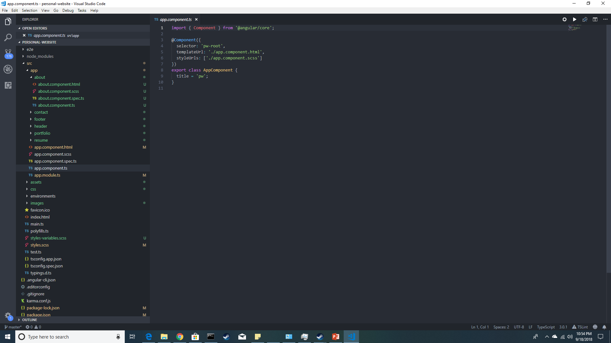
Structure

Slide 5
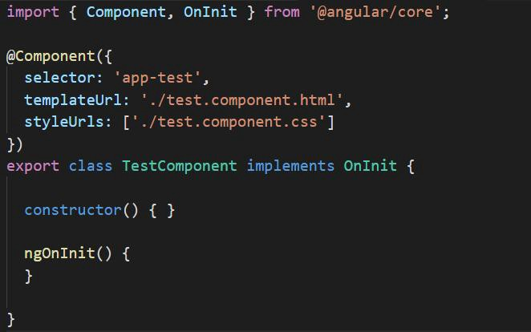
Components
Every component has a selector, a template, and a stylesheet.
Selector: How it is referenced in code
Template: The View (HTML)
Stylesheet: SCSS (CSS on steroids)
Components can be used inside other components

Slide 6
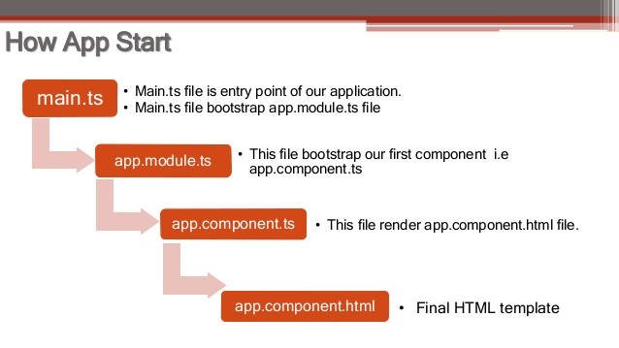
Flow of Angular

Slide 7
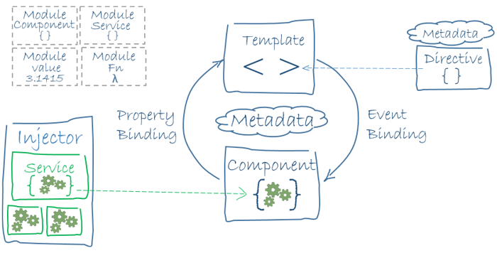
I have a lot of pictures

Slide 8
Services and Dependency Injection
Services are SINGLETON objects
Maintain data
Usually encompass functionality (like data, auth, storage, network)
Can be injected into any component
Defined using @injectable()

Slide 9
Directives
Most Commonly used:
*ngIf provides conditional functionality inside HTML
*ngFor provides for-each loop functionality inside HTML
[(ngModel]) binds an input to a property in its component controller (banana in a box)
ngSwitchCase provides switch-statement functionality
You can create your own but no one ever does that. Google is your friend.

