Slide 1

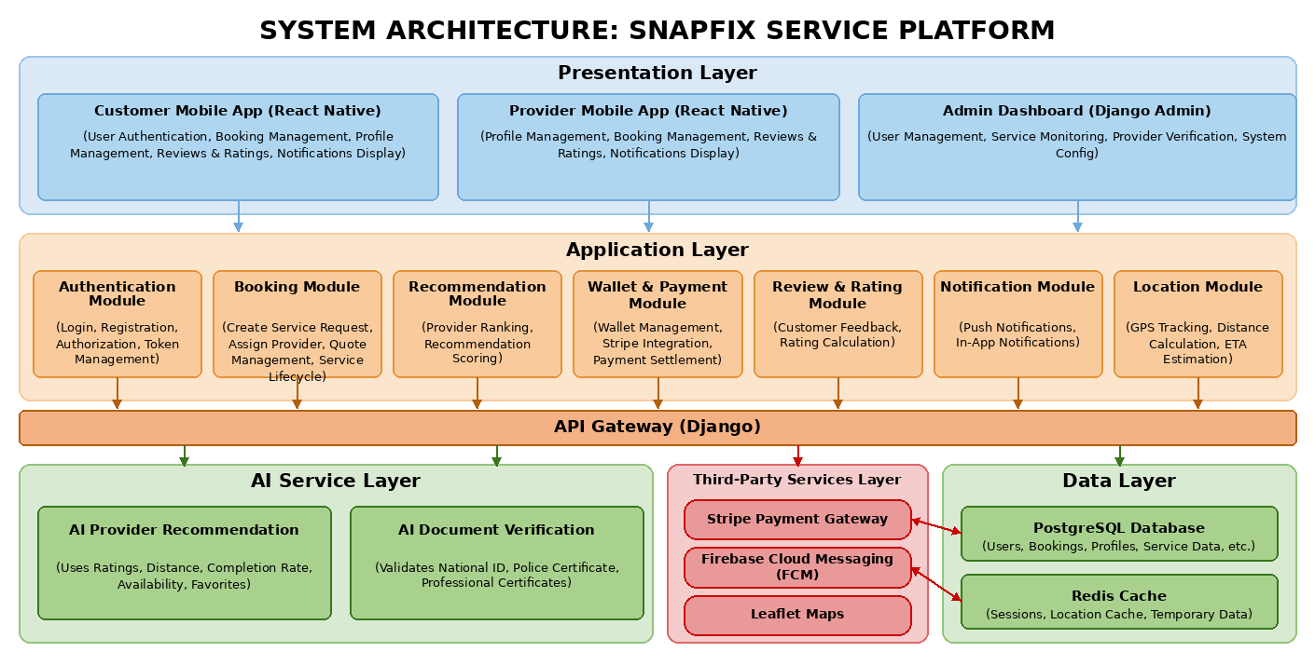
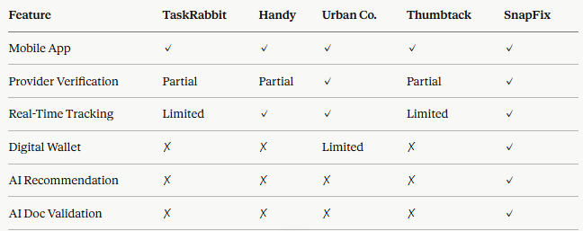
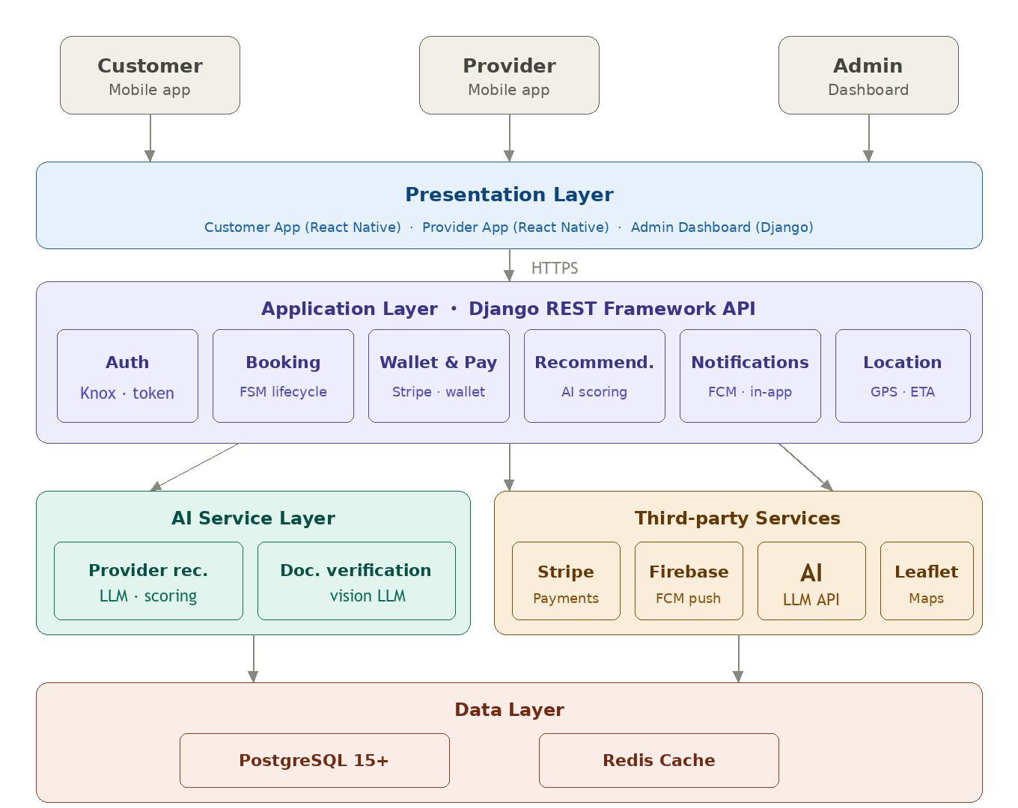
SnapFix
By: Joseph Nader, Kerollos Nagy, Shady Joseph, Youssef Kamal,
Amir Waleed, Fares Ahmed
Supervised by: Dr. Eman Amin, TA. Oliver Ayman
Software Engineering Department
Faculty of Computer and Information Sciences - Ain Shams University
Introduction
Results/Findings
The home services sector faces a critical gap: customers struggle to find trusted, qualified providers, while skilled professionals lack the tools to reach clients efficiently. Traditional methods relying on personal recommendations, social media groups, and informal networks fail to guarantee service quality, transparent pricing, or accountability when problems arise.
On the customer side, the challenges are clear. There is no reliable way to compare providers, no upfront pricing transparency, no formal feedback system, and no mechanism to track whether a booked provider is actually on their way. On the provider side, skilled tradespeople have no professional platform to showcase their credentials, manage their bookings, build a verified reputation, or track their earnings over time.
SnapFix addresses these challenges by providing a centralized, intelligent mobile marketplace that connects customers with verified service providers across Egypt. The platform leverages mobile computing, cloud services, artificial intelligence, real-time GPS tracking, and secure online payments to deliver a seamless and trustworthy experience for all parties.
Key achievements:
AI Recommendation Engine consistently ranked geographically closer, higher-rated providers ahead of less relevant alternatives across all manual test scenarios
AI Document Verification achieved over 90% accuracy for Egyptian National IDs, Professional Certificates, and Police Clearance documents under well-lit conditions
Stripe payment integration successfully handled card, digital wallet, and hybrid (wallet + card) payment flows in the test environment
Firebase FCM push notifications delivered reliably at every booking state transition on both iOS and Android test devices
All 14 functional requirements validated through functional and integration testing
Table 1: Comparative Analysis: SnapFix vs. Existing Platforms
Methodology
Technologies
Frontend: React Native and Expo (iOS and Android).
Backend: Django REST Framework with Knox token authentication.
AI: multi-provider LLM engine (Claude, OpenAI, Gemini, Groq) with automatic failover.
Services: Stripe payments, Firebase push notifications, Leaflet Maps and GPS.
Data: PostgreSQL 15+ and Redis cache.
Key Features
AI provider recommendations and document verification.
Real-time GPS tracking and full booking lifecycle.
Cash, card, and wallet payments with ratings and reviews.
Push notifications, admin dashboard, and Arabic / English support.
SnapFix was developed using a layered client-server architecture:
Presentation Layer: Two React Native mobile apps (Customer & Provider) and a Django Admin dashboard, supporting iOS and Android from a single codebase.
Application Layer: Modules for authentication (Knox token authentication), booking lifecycle (FSM with 6 states), provider recommendation, wallet & payments, reviews, notifications, and GPS tracking.
AI Service Layer: Provider Recommendation Engine using a weighted scoring formula that evaluates rating, distance, completion rate, availability, and customer favorites. A Document Verification microservice uses multimodal vision LLMs, configurable across multiple providers (Claude, OpenAI, Gemini, and Groq) with automatic failover, to read and validate uploaded National IDs, Police Clearance Certificates, and Professional Certificates during provider onboarding, producing a Passed / Flagged / Failed result for admin review.
Third-Party Services: Stripe (payments), Firebase Cloud Messaging (push notifications), multi-provider LLM APIs (AI features), Leaflet Maps (location).
Data Layer: PostgreSQL (primary database), Redis (caching and session management).
Conclusion
SnapFix demonstrates the full feasibility of an AI-enhanced home services marketplace tailored to the Egyptian market. It is the first graduation project at Ain Shams University to combine mobile-first UI, AI document verification, and financial-grade payment infrastructure in a single platform. The system is production-ready pending a final security audit and App Store/Google Play submission.
Future work includes WebSocket-based real-time location updates, OTP phone verification via an Egyptian SMS gateway, advanced document tampering detection, provider video portfolios with AI content moderation, tiered provider subscription plans, and multi-city expansion across Egypt.
Key Algorithms
Simple Additive Weighting (SAW): weighted multi-criteria scoring that ranks eligible providers.
Score = Rating×0.30 + Proximity×0.25 + Completion×0.20 + Favorite×0.15 + Availability×0.10
Haversine + k-Nearest-Neighbor Search: great-circle distance with a PostGIS spatial index to surface the nearest providers.
Finite State Machine: guarded, deterministic booking-lifecycle transitions.
Cumulative Moving Average: incremental, atomic provider-rating aggregation.
Pessimistic Concurrency Control (2PL): row-level locks for race-free job picking and wallet settlement.
Exponential Backoff with Failover: resilient retries across multiple AI and notification providers.
Multimodal Vision-Language Model: reads and validates onboarding identity documents.
Natural Language Generation: produces human-readable recommendation reasons.
References
Ricci, F., Rokach, L., & Shapira, B. (2015). Recommender Systems Handbook (2nd ed.). Springer.
Wang, Y., Tao, L., & Zhang, X. (2025). Recommending for a Multi-Sided Marketplace. Marketing Science, 44(1), 1–29.
Xie, S., et al. (2023). COUPA: An Industrial Recommender System for Online-to-Offline Service Platforms. arXiv.
Django REST Framework Documentation. djangorestframework.org
Firebase Cloud Messaging Documentation. firebase.google.com
Stripe Payments Documentation. stripe.com/docs
June 2026 - Ain Shams University, Faculty of Computer and Information Sciences

