Slide 1
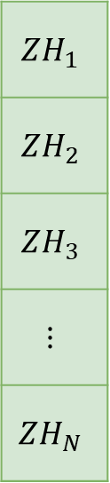
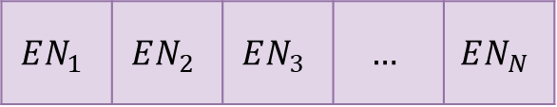
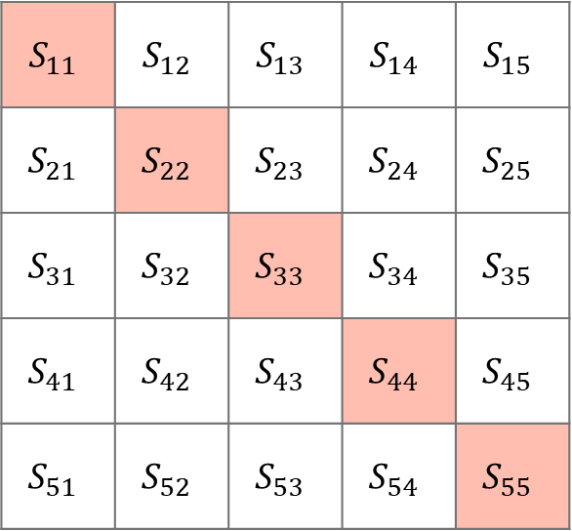


English Aligner
$$…$$
Hello
$$EN_{1}$$ | $$EN_{2}$$ | $$EN_{3}$$ | $$…$$ | $$EN_{N}$$
Text Encoder
$$ZH_{1}$$
$$ZH_{2}$$
$$ZH_{3}$$
$$⋮$$
$$ZH_{N}$$
$$S_{11}$$ | $$S_{12}$$ | $$S_{13}$$ | $$S_{14}$$ | $$S_{15}$$
$$S_{21}$$ | $$S_{22}$$ | $$S_{23}$$ | $$S_{24}$$ | $$S_{25}$$
$$S_{31}$$ | $$S_{32}$$ | $$S_{33}$$ | $$S_{34}$$ | $$S_{35}$$
$$S_{41}$$ | $$S_{42}$$ | $$S_{43}$$ | $$S_{44}$$ | $$S_{45}$$
$$S_{51}$$ | $$S_{52}$$ | $$S_{53}$$ | $$S_{54}$$ | $$S_{55}$$
你好
Chinese Aligner
❄️Frozen
$$⋮$$

