Slide 1

Smart-Home Project
Presented by:
Eng. Shady Aly Soltan
Eng. Mohamed Bakr

Slide 2

Table of Content
Introduction
Project Components
Communication Protocols
System Explanation
Flow Chart

Slide 3
Introduction

Slide 4

Introduction
What is a Smart Home?
Why Smart Home?
Is it Safe?
Objectives of Smart Home.

Slide 5
Project Components

Slide 6
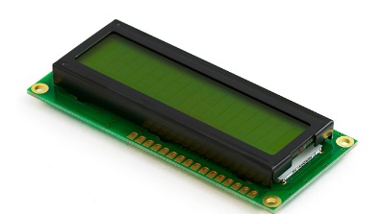
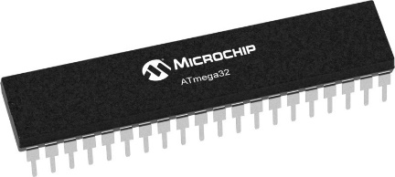

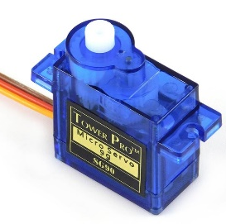
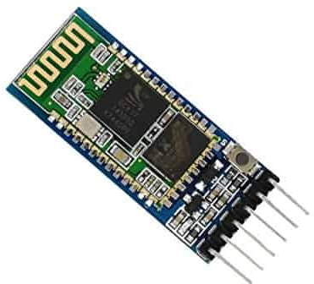
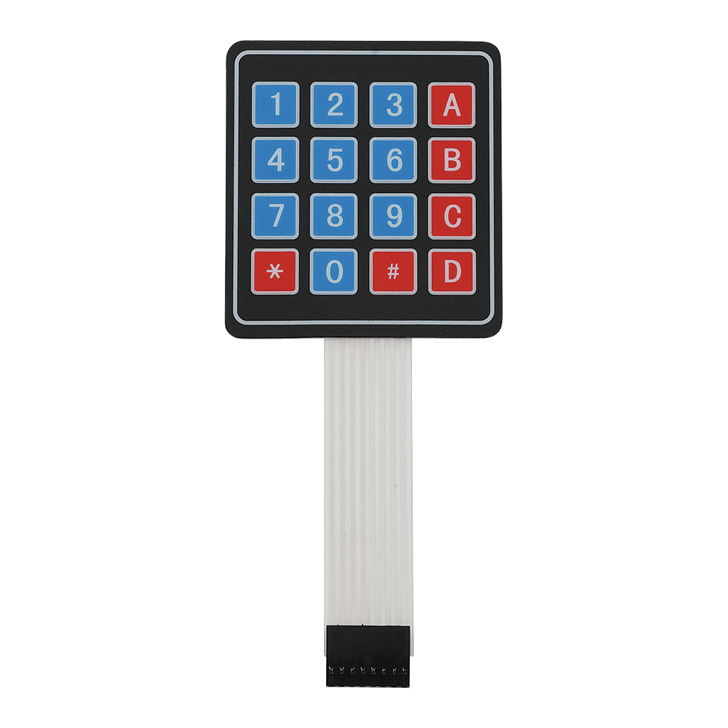

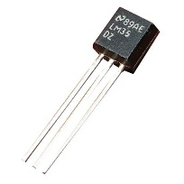
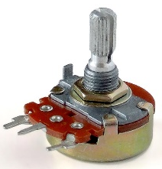
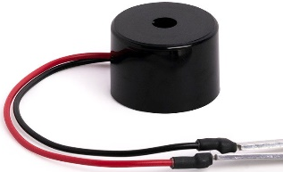
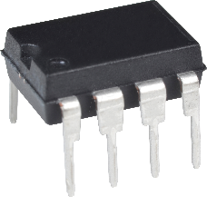
Project Components
Two ATMEGA 32 Microcontrollers.
16 Bit LCD.
Keypad.
7 Led.
Bluetooth Module HC-05.
Servo Motor.
DC Motor.
24AA16 EEPROM.
Dimming Circuit.
LM25 Temperature Sensor.
Buzzer.

Slide 7
Communication Protocols

Slide 8

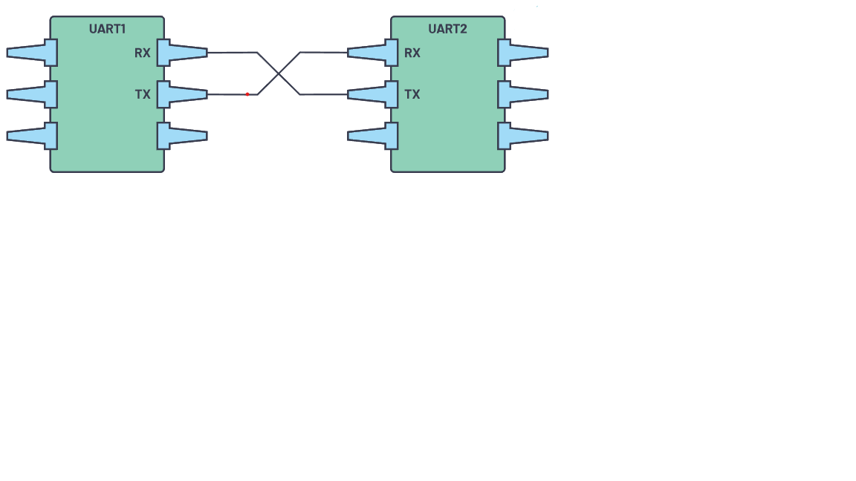



Communication Protocols
UART
Single Master & Single Slave.
Asynchronous.
Admin Mode.
Connect between MC and Mobile Phone by Bluetooth.
TX pin: Used to transmit data from MC to Mobile Phone
RX pin: Used to receive data from Mobile Phone to MC.

Slide 9
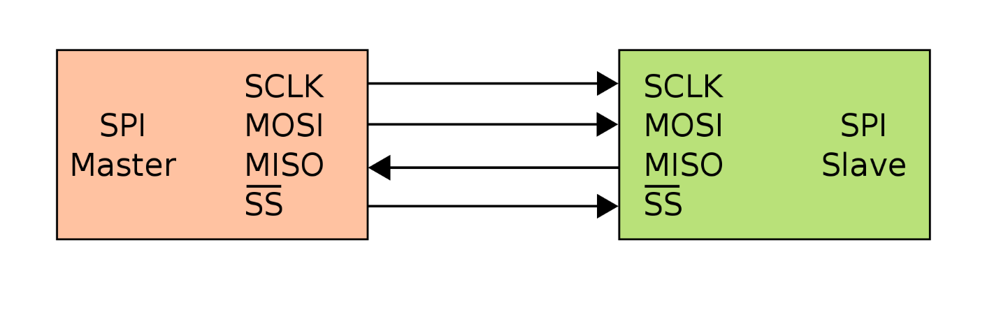
Communication Protocols
SPI
Single Master & Multi Slave.
Synchronous.
User Mode.
Connect between Master MC and Slave MC.
MOSI: Used to transmit data from Master to Slave
MISO: Used to receive data from Slave to Master.
SS: Slave select pin, connect slaves to it.
SCLK: Clock Pin.

Slide 10
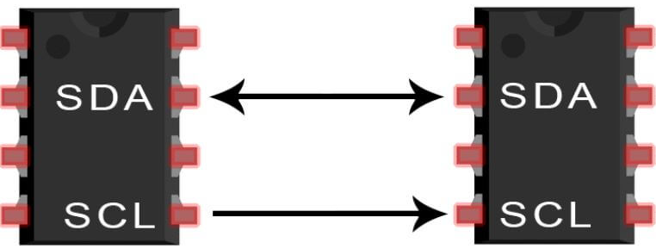

Communication Protocols
I2C
Multi Master & Multi Slave.
Synchronous.
User & Admin Modes.
Connect between MC and EEPROM.
Save User Password.
Save Door & Alarm last status.
SDA: Used to transmit & Receive data (Serial Data Line)
SCL: Clock Pin.

Slide 11
System Explanation

Slide 12



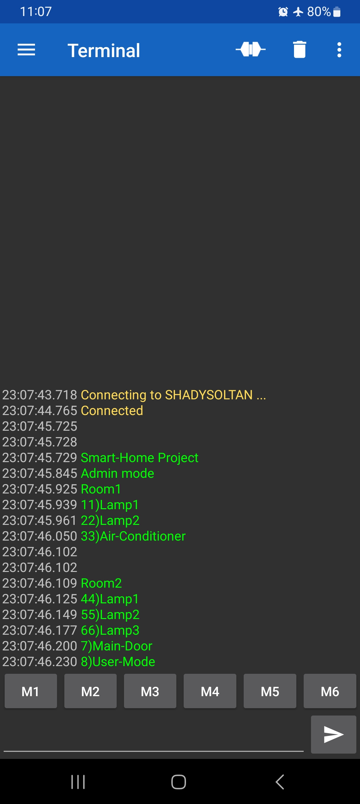

System Explanation
Admin Mode
= 0xFF
Alarm
Check
Check alarm status by location in EEPROM.
!= 0xFF
Door
Check
Check Door status by location in EEPROM.
= 0xFF
!= 0xFF
Admin
Menu
Transmit admin menu to mobile phone using UART.
Receive admin choice in Master Microcontroller.
UART
SPI
Master
Slave
Action
Transmit action from master to slave MC using SPI.
Transmit Alert MSG from master to mobile phone.
Switch to User Mode if desired.
I2C
Door Action

Slide 13


System Explanation
User Mode
= 0xFF
Alarm
Check
Check alarm status by location in EEPROM.
!= 0xFF
= 0xFF
Door
Check
Check door status by location in EEPROM.
!= 0xFF
Registration Menu
Check password existence location in EEPROM.
= 0xFF
!= 0xFF
Login Menu
Check entered password by user using keypad.
< 3Trials
> 3Trials

Slide 14
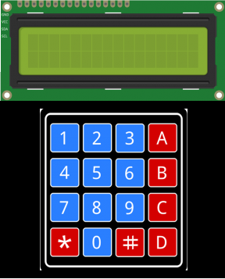

System Explanation
User Mode
Main Menu
Print on LCD (Room1 - Room2 - Admin - Lock).
Room1: 2LEDS and Air Conditioner.
Room2: 3LED one with Diming Circuit.
Admin: Switch to Admin Mode.
Lock: Ask for password before any action.
SPI
DIO
Master
UART
Alert
Slave
Action
Print current status for LEDS & AC as a reminder.
Print toggle option or return to Room menu.
IF Toggle, Transmit action from master to slave MC using SPI & alert MSG to admin using UART.
Return to room menu.

Slide 15
Flow Chart

Slide 16
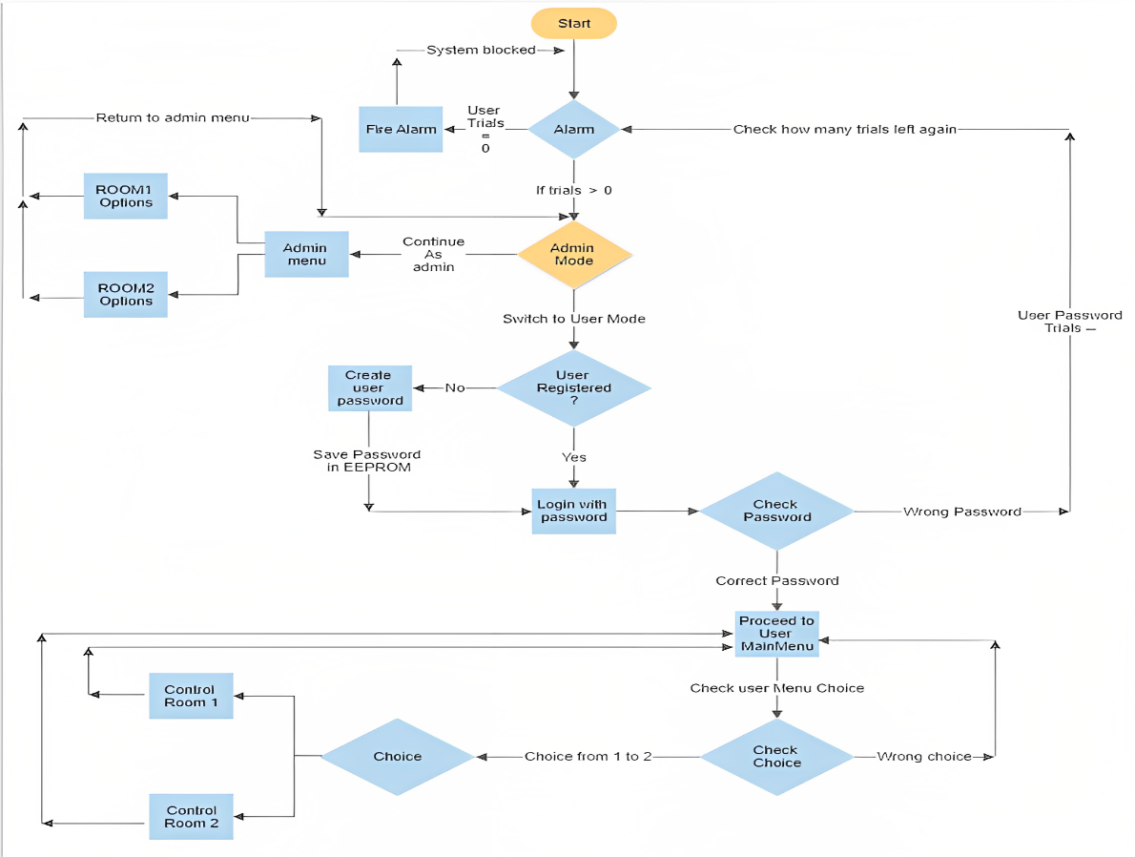
Flow Chart

Slide 17
Thank You
Presented by:
Eng. Shady Aly Soltan
Eng. Mohamed Bakr

