Slide 1
Emotions Models

Slide 2
Main Models Of Emotions
1-Discrete Emotion Models (DEMs)
2-Dimensional Emotion Models (DIEMs)

Slide 3
Discrete Emotion Models
The discrete model of emotions involves placing emotions into distinct independent classes
Discrete Emotion Models:
The Paul Ekman Model
6 basic emotions: happiness, sadness, anger, disgust, fear and surprise
The Robert Plutchik Model
Added 2 emotions (acceptance and trust) on the 6 proposed by Ekman and created new emotions using combinations of these emotions
OCC Model
Added 16 more emotions to the emotions proposed by Plutchik and Ekman and each emotion has a degree of intensity

Slide 4
Dimensional Emotions Models
The dimensional model presupposes that emotions are not independent and that there exists a relation between them hence the need to place them in a spatial space
Dimensional Emotions Models:
Russel and Mehrabian Model:
Three-dimensional model where third dimension represents the degree of control individuals had over their emotions
Russel Model:
Two-dimensional circle called circumplex of affect

Slide 5
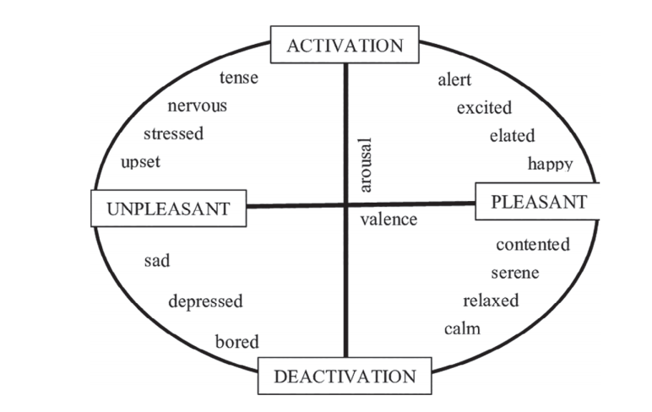
Russel Dimensional Emotion Model

Slide 6
Techniques And Algorithms
LSTM to CNN (65.97% Accuracy)
SVM and NB (59.2% Accuracy)

