Slide 1
Crossing Mask Detection
Automated validation of masks for crossings.
Shadya Gamal - 16.09.2026

Slide 2
Problem Statement
The Problem
Certain configurations of roads/railways pass under one another in a map. The crossing-under feature needs to be masked for optimal visibility.
Missing or misplaced masks degrade map quality and require manual correction.
Key Challenge
Detecting a "visual crossing" is harder than a geometric intersection - symbology greatly affect whether two map elements actually overlap on the printed map.
QA Goals
Detect every location where there is a valid crossing
Verify that a mask exists at each valid crossing location
Flag missing or misplaced masks for correction

Slide 3
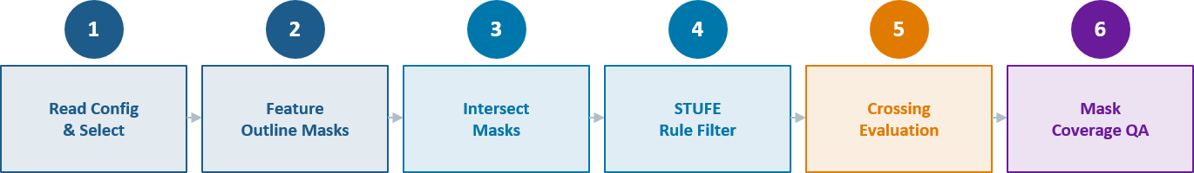
Pipeline Overview

Slide 4
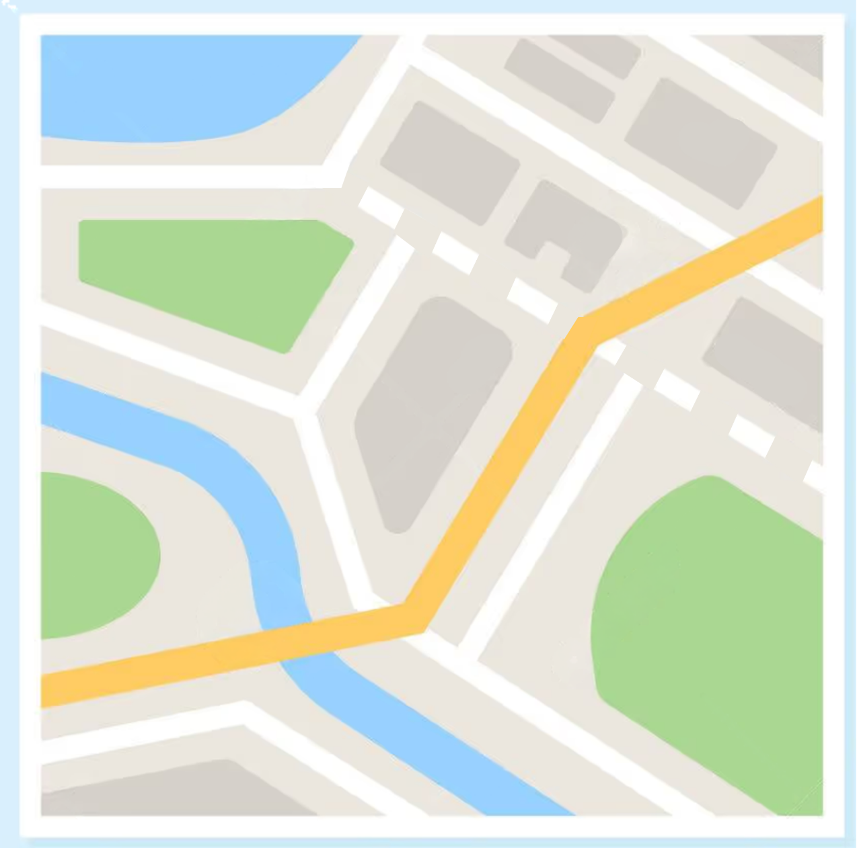


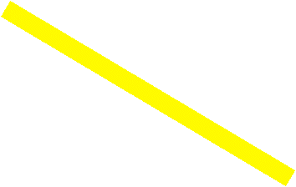





Step 1: Configuration & Selection
Process config parsed from XML:
name = "STRASSE einlinig unter STRASSE,
EISENBAHN einlinig (Dec)"
InputDataset:
DKM25_STRASSE; SYMBOL IN (6,7,8,9,29)
CrossingDatasets:
DKM25_STRASSE; SYMBOL IN (1,2,...,48)
DKM25_EISENBAHN; SYMBOL IN (1,4,8)
AboveExpression:
input.STUFE < crossing.STUFE
MaskDataset: DKM25_STRASSE_OUMASK
MaskAssociation: DKM25_STRASSE_OUREL
Notes:
This is what the config looks like in practice.
The STUFE expression tells us which layer is above: input.STUFE must be less than crossing.STUFE, meaning the input is the road on the bottom, the one that should be doing the masking.
The mask dataset and association table are also read from the config, so the QA check at the end knows exactly where to look for existing masks.

Slide 5

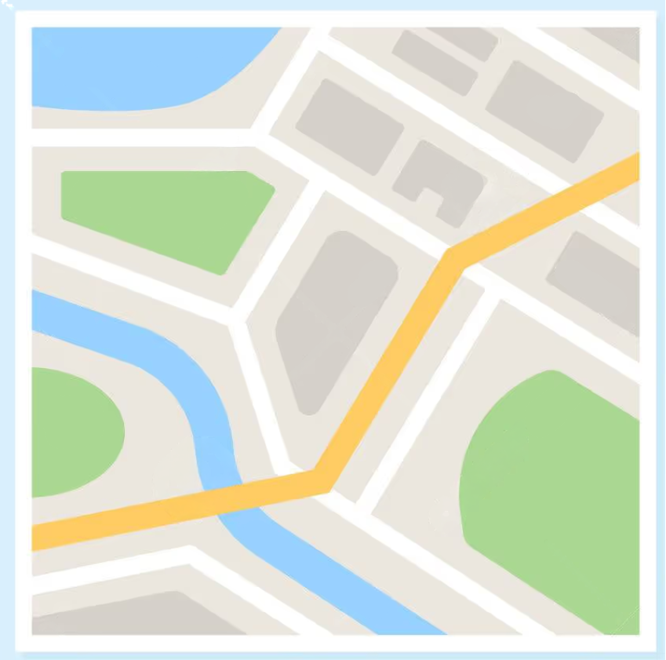
Step 2: Feature outline masks
Notes:
Why solid masks?
Road symbols are often dashed lines. A dashed mask has gaps, making it impossible to reliably count intersection points or detect polygon splits.
The script temporarily removes all CIMGeometricEffectDashes from the layer's CIM definition before calling FeatureOutlineMasks, then restores the original symbology immediately after.
The right image shows the clean, solid rectangular masks we get as a result.
Everything downstream depends on having these clean polygons.

Slide 6
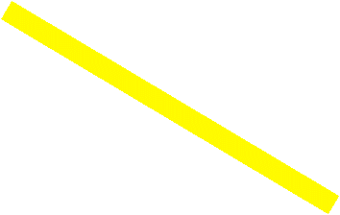

Step 3-4: Intersection + Filtering
We have two intersections, but do we have any crossings?

Slide 7
Step 5: Detecting True Crossings
True crossing
Not crossing
Not a True Crossing
Notes:
This slide gets to the heart of the problem.
On the left is a true crossing: two mask rectangles overlap, and that overlap forms an intersection polygon with exactly 4 corner points where the boundaries cross.
On the right are the cases we need to filter out.
A T-junction - where one line ends at the side of another - produces only 1 or 2 intersection points, not 4.
An end-to-end connection, where both lines terminate at the same point, produces a shared endpoint that sits right inside the overlap.
And parallel adjacent lines overlap along their edges but produce no polygon split when you erase them.
The key insight is that a true crossing always splits the mask into two disconnected pieces, while these false cases don't.

Slide 8
Crossing Criteria
Intersection point condition
  No less than 4 points
Erase condition:
  Erase the overlap polygon from the input mask. If partCount increases, the mask was split, confirming crossing.
Shared endpoints condition:
  If input and crossing lines share an endpoint that falls inside the overlap part, then it is not a true crossing.

Slide 9
Step 6: Mask Coverage Check & Output Flags
Mask Check
For each confirmed Crossing:
Look up the input line in DKM25_STRASSE_OUREL to find associated mask IDs.
Load mask polygons from DKM25_STRASSE_OUMASK.
Check if any mask polygon is not disjoint from the crossing overlap area.
Output Flags
OK: A true crossing with a valid mask.
NO_MASK: A true crossing, but no associated mask ID for that line.
MASK_MISPLACED: A mask exists, but it is spatially disjointed from the crossing area.
N/A : Not a crossing.

Slide 10
Example run – WU1207 Thun
Config[2]
37
True crossings confirmed
31
OK - mask present
53 701
Raw intersection candidates
361
After STUFE filter (−99%)
324
False crossings→ N/A
6
NO_MASK errors to fix

Slide 11
Summary
Reads process config from XML.
Generates solid Feature Outline Masks.
Intersects input and crossing masks to find candidate crossing locations.
Applies filtering rule based on the configuration.
Checks crossing conditions.
Checks that existing masks cover every valid crossing part;
flags missing or misplaced masks.

