Slide 1
ESC CSAW’18
ONE WEB BROWSER TO RULE THEM ALL
TheMapleCookieArmy
Eléonore Carpentier – INSA CVL
Corentin Thomasset – Grenoble-INP ESISAR – Polytechnique Montréal

Slide 2
CONTEXT AND ASSUMPTIONS
NO INTERNET
1.

NO ADMIN RIGHTS
HIGHLY SECURED
Air-gapped network.
SECURITY SCREENING
NETWORKS
ARE MONITORED
Notes:
Highly secured, air-gapped network.
No internet: No third party library / software can be installed.
No admin rights: No installation, No sudo, We consider an out-of-box set-up where only pre-installed are available to use.
Wireless connections are potentially monitored.
Security screening prevent employees from bringing exterior devices inside the protected area.

Slide 3
WIRELESS NETWORKS
2.
HARD TO CONTAIN EMISSION RANGE
Almost impossible to restraint to a given group of users.
BLE UP TO 100m
Varies with the Bluetooth adapter. Laptops and workstations have class 1 adapters (intended range 100m).

CAN BE SNIFFED
Consider anyone close enough to be able to see unencrypted traffic.
EXTENDED TO 500m
New Bluetooth 5 extend range up to 400m (1km outdoor free field)
Notes:
Almost impossible to restraint to a given group of users.
Can be sniffed using appropriate hardware. Consider anyone close enough to be able to see unencrypted traffic.
Close enough for BLE is up to 100m.
Varies with the Bluetooth adapter. Laptops and workstations have class 1 adapters (intended range 100m).
New Bluetooth 5 extend range up to 400m (1km outdoor free field)
https://www.sans.edu/cyber-research/security-laboratory/article/bluetooth
https://blog.nordicsemi.com/getconnected/things-you-should-know-about-bluetooth-range

Slide 4
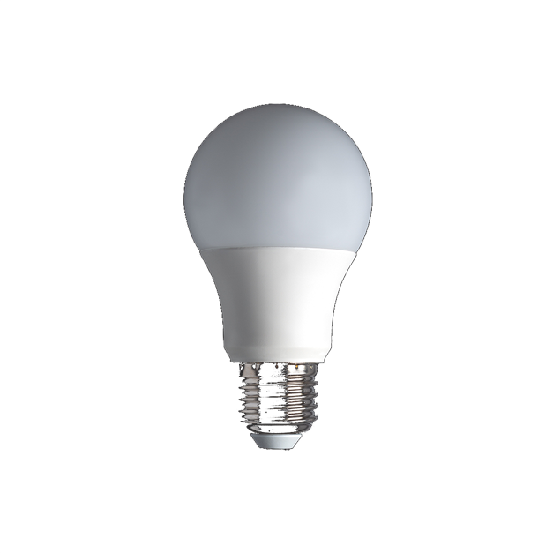
DATA EXFILTRATION USING BLE COMMANDS
3.

BLE COMMANDS
PAYLOAD
■
PAYLOAD
The principle is simple : the attacker sends Bluetooth packets with a hidden data payload to the IoT device and anyone within the emission range can sniff the connection and recover the data as this traffic is unencrypted.
Notes:
Method to covertly exfiltrate data over IoT devices Bluetooth connections.
The principle is simple : the attacker sends Bluetooth packets with a hidden data payload to the IoT device and anyone within the emission range can sniff the connection and recover the data as this traffic is unencrypted.

Slide 5
ATTACK DETAILS
4.
Skyne…
0x53
0x6B
0x79
Couleur 1: F5 F3 F6
Couleur 2: FB F7 F9
White: FF FF FF
White: FF FF FF
0x56F5F3F600F0AA
0x56FBF7F900F0AA
When using the 4 least significant bits of each color channel, the resulting bulb’s color change is almost unnoticeable and allows to exfiltrate 12 bits of data per Bluetooth command while remaining unsuspicious on the network level.
Notes:
We use steganography to hide data in the Bluetooth commands used to control the bulb.
The payload is embedded in the least significant bits of each color channel in legitimate color change commands : No suspicious commands on the network layer !
When using the 4 least significant bits of each color channel, the resulting bulb’s color change is almost unnoticeable and allows to exfiltrate 12 bits of data per Bluetooth command while remaining unsuspicious on the network level.
To be even more stealthy, the attacker can also delay each command to evade detection and lower the number of bits used to encode data in each color channel. In our final solution we have added an extra encryption layer to make sure the payload can’t be recovered if commands were intercepted.

Slide 6
ATTACK DETAILS
4.



DELAY
NUMBER OF LSB
ENCRYPTION
To be even more stealthy, the attacker can also delay each command to evade detection and lower the number of bits used to encode data in each color channel. In our final solution we have also added an extra encryption layer to make sure the payload can’t be recovered if commands were intercepted.
Notes:
To be even more stealthy, the attacker can also delay each command to evade detection and lower the number of bits used to encode data in each color channel. In our final solution we have added an extra encryption layer to make sure the payload can’t be recovered if commands were intercepted.

Slide 7
IN CONTEXT
5.
How to programmatically send custom BLE commands to the bulb in our scenario ?




⬅

SECURITY
SCREENING
NO
INSTALLATION
NO
PERMISSIONS
.EXE
SUSPICIOUS

Slide 8
YOUR WEB BROWSER, OUR LORD AND SAVIOR
6.



Web Bluetooth
API
~10 Lines
Javascript
Web
Application
Notes:
Thanks to the new Web Bluetooth API, recent web browsers can interact natively with BLE devices.
Simple : Just a few lines of javascript (~10 lines).
We can build a web app to control the bulb

Slide 9
IN CONTEXT
7.




No internet
No admin rights
No third party library
required.
Web browser are present by default on all smartphones.
The app code source can be printer as a
QR-Code.
Can be deployed as a fake Magic Blue Control app for smartphones.
Notes:
No internet, no admin rights, no third party library required.
Web browser are present by default on all smartphones, tablets, laptops, workstations.
Web browser are used even in air-gapped networks to access intranet resources.
The app source code is so simple it can be printed as a QR-Code to bypass TSA like security screenings.
Can be deployed as a fake Magic Blue Control app for smartphones.
Can be loaded and used later even without an internet connection.

Slide 10
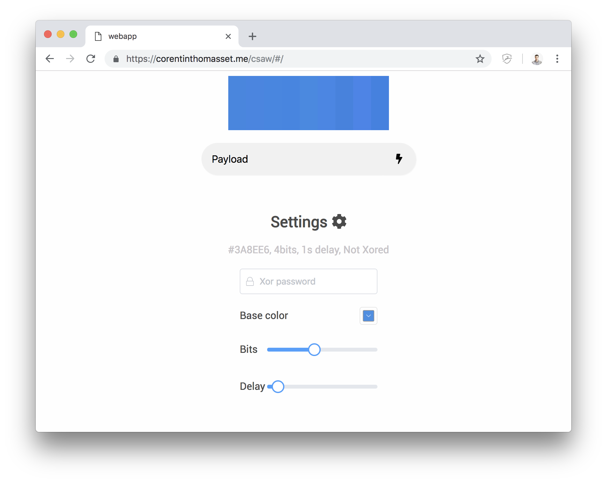
PROOFS OF CONCEPT
8.

QR-Code with limited
functionalities

Smartphone app

Python script to
encode & decode

Slide 11
FINAL THOUGHTS
9.


⬅

No firmware / hardware
modification of
the IoT Device.
The script size makes its installation easy even in highly secured environment
Does not require any third party software / library installation and can be ran without any privileges.
Transmission speed is high and can be adjusted to be more





No need of advanced computer science / security knowledge to run the attack.
Cross platform, runs on any device that has a web browser.
Easily applicable to any Bluetooth IoT Device.
Can be deployed as a fake Magic Blue Control app for smartphones.
Notes:
No internet, no admin rights, no third party library required.
Web browser are present by default on all smartphones, tablets, laptops, workstations.
Web browser are used even in air-gapped networks to access intranet resources.
The app source code is so simple it can be printed as a QR-Code to bypass TSA like security screenings.
Can be deployed as a fake Magic Blue Control app for smartphones.
Can be loaded and used later even without an internet connection.

Slide 12
Thank you
TheMapleCookieArmy
Eléonore Carpentier – INSA CVL
Corentin Thomasset – Grenoble-INP ESISAR – Polytechnique Montréal

