Slide 1


PROJECT GOLFERO
C. SHASHANK – BL.SC.U4AIE24011
C. DHANUSH – BL.SC.U4AIE24010
D. YUVA AKHIL – BL.SC.U4AIE24013

Slide 2
INTRODUCTION
GOLF IS A VERY INTERESTING GAME, OUR TEAM LOOKED AT IT AND THOUGHT WOAH WE CAN MODEL GOLF IN SUCH A WAY THAT IT CAN BE SOLVED WITH PLANNING AND LOW LEVEL GRID SEARCH
PROJECT GOLFERO IS A BEAUTIFUL TAKE ON THIS WE HAVE MODELED INTRICATE PHYSICS

Slide 3
MOTIVATION
Our team has been inspired by the game of golf, we have seen many golf games but very few tried to do what we did this is the major gap that we noticed in the golf video game market
Yes, maybe this version of our game is not a complete version we don't have proper sounds and animations but that is the v2.0

Slide 4
LITERATURE SERVEY (PHYSICS)
Baraff & Witkin (1997) basically laid down how game physics should behave, so we kind of followed the same vibe for our simulation logic.
Mehta (1985) explains how balls behave in air, especially drag and lift, which helped us justify using Magnus effect and drag coefficients.
Cross (2011) goes deep into sports ball interaction with surfaces, so we used similar reasoning for different terrain behaviors.

Slide 5
LITERATURE SURVEY (AI & OPTIMIZATION)
Hansen & Ostermeier (2001) present the CMA-ES optimization method; our low-level optimizer is inspired by their evolutionary approach.
Russell & Norvig (2009) shows how decision-making in AI systems generally works, which matches the high-level planner we wrote.
Sutton & Barto (2018) use reinforcement thinking for continuous decision loops; good foundation for our iterative AI shot decisions.

Slide 6
PROBLEM STATEMENT
So basically our problem was that normal golf simulators or physics demos are either too heavy, too unrealistic, or just boring. We wanted something that actually shows real-ish ball physics but still runs on normal systems without needing Unity or Unreal or whatever. No one shows how the AI actually thinks when choosing a golf shot. So our idea was to build a lightweight 2D/3D-ish golf game where the ball behaves properly on different terrains, with wind, drag, spin, all that stuff, and then make an AI that can look at the map and plan a shot like a real player. The problem was: can we simulate all that in pure C and also get the AI to talk to the game smoothly? That’s basically what we tried to solve.

Slide 7
NOVELTY
We built the whole golf physics from scratch in plain C, so nothing is copied from Unity/Unreal or preset engines.
Our AI gets the real game state and plans shots using both a high-level strategy and a low-level optimizer, which is not common in small student projects.
We use FIFO pipes for linux we have a work in progress socket version for windows but that has been bad to be honest
Terrain and obstacles are read directly from the map image, so both physics and AI react to the environment pixel-by-pixel instead of using tiles.

Slide 8
CO MAPPING
CO1 – Analyze intelligent agent components
We broke down the AI golfer into sensing (state input), reasoning (planner), and acting (shot execution).
Also analysed physics, terrain, and environment variables before designing the system.
CO2 – Apply search and decision-making techniques
AI uses heuristic-based target selection and optimized shot parameters.
Path-checking and obstacle avoidance directly use informed decision techniques.

Slide 9
CO MAPPING
CO3 – Use knowledge representation and constraints
Terrain types, hazards, and sand rules behave like constraints the AI must respect.
AI’s shot selection incorporates rule-based reasoning (avoid hazards, reduce risk, etc.)
CO4 – Implement planning and agent behaviour in a real system
Our AI performs full planning loops: observe → plan → execute → re-evaluate.
VS mode acts as a simple multi-agent environment (player vs AI).

Slide 10
METHODOLOGY
We first designed the core physics in C: gravity, drag, spin, bounce, and terrain-based rolling.
Then we added pixel-based terrain detection so the map image directly controls physics behavior.
After that, we built the game loop in Raylib for rendering, controls, and ball interactions.
We created a Python AI that reads the live game state (ball, wind, terrain) and plans the next sh

Slide 11
METHODOLOGY
The AI uses a high-level planner to choose a target and a low-level optimizer to fine-tune angle, direction, and power.
C and Python communicate through simple IPC (named pipes on Linux), sending structs back and forth every turn.
Finally, we integrated VS mode where the human and AI take alternate turns using the same physics engine.

Slide 12
RESULTS VIDEO DEMONSTRATION

Slide 13
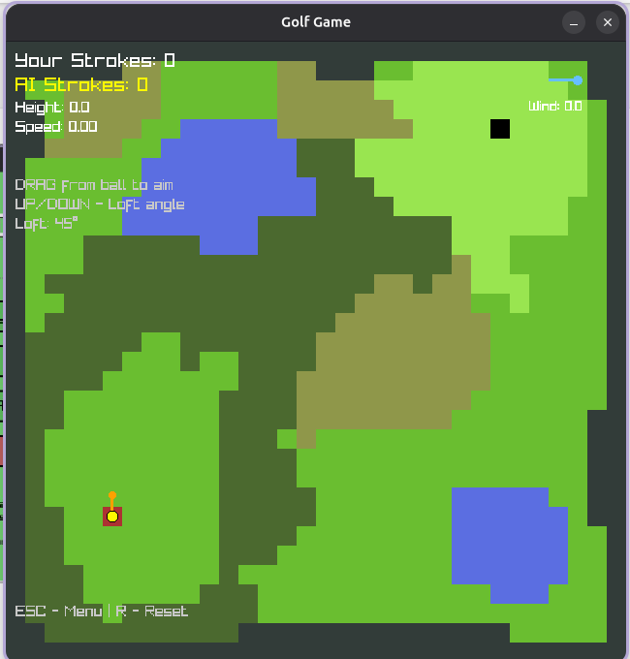
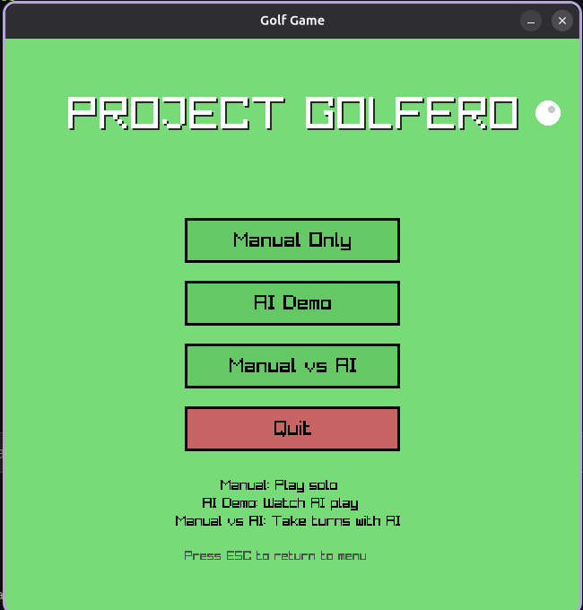

Slide 14
CONCLUSION
TO CONCLUDE WE HAVE SUCCESFULLY DEMONSTRATED THE USE OF PLANNING AND LOW LEVEL GRID SEARCH IN THIS MODELED VERSION OF GOLF WE MADE WITH C.
WE HAD OUR SETBACKS THIS CAN'T BE PLAYED ON WINDOWS AND MAC DUE TO COMPATIBILTY ISSUES
WE TRIED TO MAKE IT COMPATIBLE BUT IT DIDN'T WORK AS WE INTENDED.

Slide 15
FUTURE WORK PROJECT GOLFERO v2.0
Add proper sound effects so the ball doesn’t feel silent — like bounce sounds, sand thuds, wind noise, basically anything that makes it feel alive.
Put in some basic animations… right now everything just “appears,” so adding swing animations, ball trails, or tiny dust clouds would make it way nicer.
Improve the AI so it doesn’t shoot like it’s guessing half the time.

Slide 16
FUTURE WORK
Add slopes and more detailed terrain instead of our flat map (the ball deserves gravity that works in 3D).
Maybe generate random golf levels because drawing maps manually is pain.
Faster communication between Python and C so shots happen instantly and not after a mini nap.

Slide 17
REFERENCES
1] Baraff, D., & Witkin, A. (1997). Physically Based Modeling. SIGGRAPH Course Notes.
[2] Mehta, R. D. (1985). Aerodynamics of Sports Balls. Annual Review of Fluid Mechanics, 17(1), 151–189.
[3] Cross, R. (2011). Physics of Ball Sports. Reports on Progress in Physics, 74(2), 026601.
[4] Levin, A., Lischinski, D., & Weiss, Y. (2008). A Closed-Form Solution to Natural Image Matting. IEEE Transactions on Pattern Analysis and Machine Intelligence, 30(2), 228–242.
(Note: Cited for image-based terrain segmentation approaches.)
[5] LaValle, S. M. (2006). Planning Algorithms. Cambridge University Press.
(Free online official edition.)
[6] Hansen, N., & Ostermeier, A. (2001). Completely Derandomized Self-Adaptation in Evolution Strategies. Evolutionary Computation, 9(2), 159–195.
[7] Russell, S., & Norvig, P. (2009). Artificial Intelligence: A Modern Approach. Prentice Hall.
[8] Tanenbaum, A. S., & Bos, H. (2015). Modern Operating Systems (4th Edition). Pearson Education.
[9] Reynolds, C. W. (1999). Steering Behaviors for Autonomous Characters. In Proceedings of the Game Developers Conference.
[10] Hecker, C. (1996). Behind the Screen: Physics for Game Developers. Game Developer Magazine.
[11] Sutton, R. S., & Barto, A. G. (2018). Reinforcement Learning: An Introduction (2nd Edition). MIT Press.
[12] Parker, K. (2012). A Survey of Inter-Process Communication Mechanisms. ACM Computing Surveys, 44(2), 1–22.

