Slide 1

MOVIE RECOMMENDATION
SYSTEM
Let your project proposal begin!

Slide 2



MAIN CHARACTERS
A. NAZIMZADA
S. SARDAROV
A. GASIMOV

Slide 3


ABOUT
THE PROJECT
01
A recommendation system is a subclass of an information filtering system.

Slide 4
Researches & Related works
We reviewed some literatures and related works to get to know several approaches:
Popularity based(YouTube, Netflix)
Content based(Twitter, Facebook)
Collaborative based(Amazon)

Slide 5
Data Cleaning
Data Gathering
Web Scrapping
Sql Lite
We cleaned more than 7500 movie data
We took data from
…com
We transport our data to Sql lite

Slide 6
Data Processing
movieId | title | genres
1 | Toy Story | Adventure, Animation, Children, Comedy, Fantasy
2 | Jumanji | Adventure, Children, Fantasy
3 | Grumpier Old Men | Comedy, Romance
userId | movieId | rating | timestamp
1 | 6 | 5 | 9.65E+0.8
7 | 4223 | 2 | 1.11E+09
18 | 208 | 3 | 1.46E+09

Slide 7
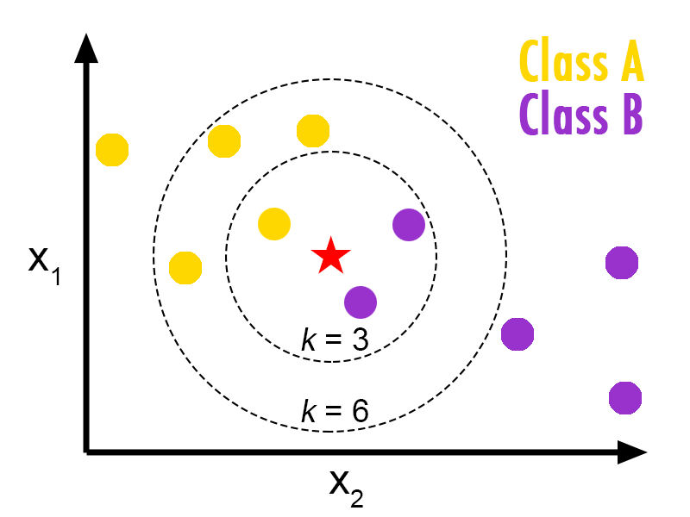
What is K-Nearest Neighbors?

Slide 8
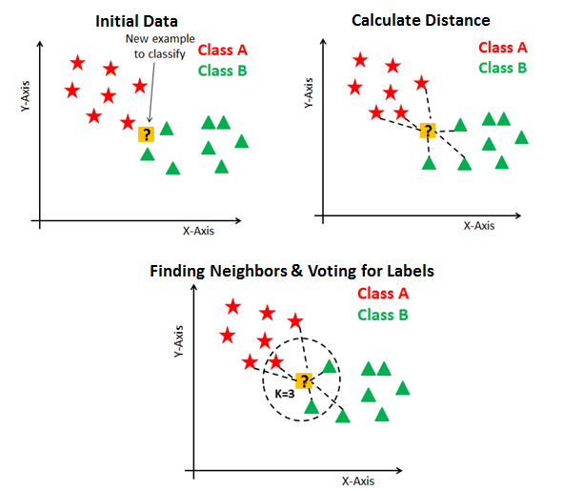
How to apply KNN?

Slide 9

SNEAK PEEK
Let’s see!

Slide 10
https://www.djangoproject.com
https://github.com/abd1007/Movie-Recommendation-System-Web-Application
https://www.udemy.com/course/machine-learning-projects-recommendation-system-website
https://scikit-learn.org/stable/modules/generated/sklearn.neighbors.KNeighborsClassifier.html
References

Slide 11

THANKS!
Do you have any questions?

