Slide 1

Test and Investigation Of Video Learning Project Team: CodeX
By: Prof. Dr. Andreas Pech and Mr. Damir Dobric
Shafait Azam Nayeem Ahmed
Matr No: 1345243 Matr No: 1344260

Slide 2
Introduction
Hierarchical Temporal Memory is machine learning mechanism which works on the concept of pattern recognition.
The HTM model process Sparse Distributed Representation to learn and recognize a specific pattern.
SDRs are generated from the raw data which have been taken from the real- world environment.
Spatial pooler and Temporal memory are the two building blocks of the HTM system.
SP is responsible for transforming input pattern into SDRs.
TM learns all of these temporal sequences of the SDRs.
HTM is different from the traditional deep learning mechanism.

Slide 3
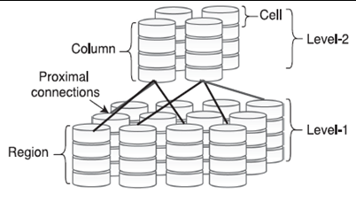
Introduction
Fig.1. Figure depicts the two HTM regions arranched in hirarchical order. Each region consists of vertical colums with stacked cells [2]

Slide 4
Introduction
HTM is different because it exploits the time continuity for unsupervised learning of invariant representations which does not depend on the static and dynamic nature of the input pattern [1].
The top down and bottom up information flow provides HTM to dissimilate the situation while processing unambiguous pattern [1].
Here in figure 1, the Level 1 represents the SP which is consists of identical processing units that can create unique SDR from raw data [2].
And Level 2 represents the TM which learns from the SDRs generated by SP and makes prediction from it [2].
Our goal was to test and investigate an existing project which is basically an application of HTM system.
We worked on the existing and also the migrated version of the video learning project.

Slide 5
Methodology
Initial testing has been done on the video learning project by three small size videos of moving circle, rectangle and triangle. These videos have been created in BLACK and WHITE color mode.
We have created three new video set (pentagon, hexagon and star) to increase total amount of dataset.
Our approach was to test various parameters of the existing project and analyze the impact of those parameters in the training accuracy.
We have tested parameters known as frameHeight, frameWidth, maxCycles, CellsperCoulmn etc with our newly created video sets.
As we have mentioned several times, that the previous version of video learning project had two functions known as Run1() and Run2(). We have tested those two functions separately.
Later, we have also tested the migrated version of the video learning project which is the improved version of the previous project in terms of training accuracy.

Slide 6
Methodology
We have run the project with several change parameters and our created video sets multiple times to check its performance. We have tested only the Run2() in this case because it is the multi-sequence learning.
We have solved an important issue of our video set. The HTM model do not perform well when we have frames which are identical to each other because same frames can not be recognized in the learning phase and machine keeps generating newborn cycles.
So we have decreased the image gap duration to 0.2s and it worked well. All the training phases – newborn stage, learning stage and prediction stage completed successfully.
Although the training phases are completed , it took significantly longer time than the previous version to complete a single run.

Slide 7
Test Results
As we have done so many testing, detailed documentation about these testing have been made. We have generated tables from these test reports which have been added to the final report.
We have also found some negative results which are included in the test reports.
In this presentation, we have added brief description of few of those testing which have been performed throughout our project time period.
Test case 1: (Previous Version Of Video learning)
we have generated a new video dataset known as Pentagon. Parameters were specified in the code and was used to run the Run1() function. By keeping all the parameters stagnant (HTM config) we have trained the HTM model with the SP + TM and documented the accuracy after 20 cycles. We have used 4 datasets in this experiment (Circle, Rectangle, Triangle and Pentagon). We wanted to test the impact of maxCycle parameters.

Slide 8
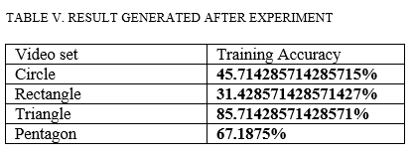
Test Results
Fig.2. Figure depicts the training accuracy(added in final report) of each of the video sets when we tried to test them as we have only changed the maxCycles parameters.
Test case 2: (Previous Version Of Video learning)
By keeping all the parameters stagnant we have trained the HTM model with the SP + TM (using 4 Videosets) and documented the accuracy after 1000 cycles. After the stable pattern was reached after each video set being trained, we documented the following result. We have tested Run2() in this experiment.

Slide 9
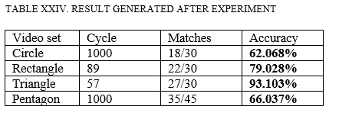
Test Results
Fig.2. Figure depicts the training accuracy(added in final report) of each of the video sets when we tried to test them as we have only changed the maxCycles parameters in the case of Run2().
Test case 3: (Migrated Version Of Video learning)
By keeping maxCycles, frameHeight, frameWidth and GetPredictedInputValues (3 for all cases) unchanged, we have manipulated ColumnDimensions and CellsPerColumn parameters in the htmConfig.json [4]. We have trained the model with our newly created Star video set and other four video sets (circle, rectangle, triangle and pentagon).

Slide 10
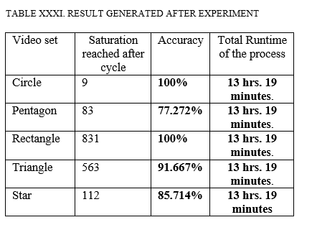
Test Results
We have got the following results (training accuracy) when the ColumnDimensions = 2048 and CellsPerColumn = 40. [We have used significantly larger video sets (5 videos). That’s, why we have started from higher column dimensions].
Fig.3. Figure depicts the training accuracy(added in final report) of each of the video sets when we tried to test them.

Slide 11
Conclusion
In conclusion, we can say that both versions of the project still have some limitations.
When we tried to test the migrated version with the videos which had similar frames next to each other the model did not perform well.
The prediction phase do not work with higher accuracy (>90%).
Encoding of the videos can still be improved.
In the previous version of the project, the video set which is trained last, has the higher training accuracy than all other videosets (Triangle). This should not be happening because the HTM model processes every data set in same manner.
Run time of the migrated version is significantly larger.

Slide 12
Thank you

Slide 13
References:
[1] Maltoni, D. (2011). Pattern recognition by hierarchical temporal memory. Available at SSRN 3076121
[2] A. M. Zyarah and D. Kudithipudi, "Neuromorphic Architecture for the Hierarchical Temporal Memory," in IEEE Transactions on Emerging Topics in Computational Intelligence, vol. 3, no. 1, pp. 4-14, Feb. 2019, doi: 10.1109/TETCI.2018.2850314
[3] https://github.com/ddobric/neocortexapi/tree/SequenceLearning_ToanTruong
[4] https://github.com/ddobric/neocortexapi-videolearning

