Slide 1
A Checkpoint on Multilingual Misogyny Identification
CSE431, Sec: 01, Team: 18
Paper Reviewed by:
20101129 Shafakat Sowroar Arnob
ST: Ehsanur Rahman Rhythm
RA: Adib Muhammad Amit

Slide 2
Introduction
Misogynous content expresses hate towards women through insults, harassment, discrimination, and objectification.
Women are the most targeted group for online misogyny, with a significant increase in hateful posts observed over time.
Misogyny on Twitter has been linked to domestic violence, highlighting the need to address and flag such content.
The research aims to identify misogyny in multiple languages and investigate its language-specific nature.
Two hypotheses are tested: (1) More data improves model performance even in different languages, and (2) Misogyny is language-specific, and a monolingual model performs better.
Monolingual and multilingual transformer models (such as BERT) are used to analyze data in different languages and assess model performance.

Slide 3
Related Works
Previous research on misogyny identification has primarily focused on monolingual approaches, with limited exploration in multiple languages.
Shared tasks such as AMI, HatEval, and IberEval have provided evaluation frameworks for identifying misogynous tweets in English, Italian, and Spanish, using techniques like TF-IDF, word embeddings, and sentence embeddings.
Common classifiers used for misogyny identification include recurrent neural networks, convolutional neural networks, shallow models, and transformer-based models, with the latter performing well.
In the multilingual context, some studies have employed machine translation to create bilingual misogynist data, while others have used multilingual transformers to identify misogyny in different languages.
The current research aims to address a novel question by investigating the language-specific nature of misogyny, rather than focusing solely on model performance or engineering.

Slide 4
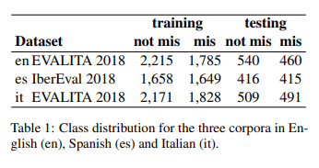
The multi-AMI Evaluation Framework
The multi-AMI Evaluation Framework focuses on misogyny datasets in three languages: English, Spanish, and Italian.
The datasets are derived from two editions of the AMI shared task: AMI at IberEval 2018 and AMI at EVALITA 2018.
The AMI at IberEval 2018 task focused on misogyny identification in English and Spanish tweets, while the AMI at EVALITA 2018 task addressed misogyny identification and classification in Italian.
The table presents the class distribution for the three corpora, indicating the number of instances labeled as misogynistic and non-misogynistic in the training and testing datasets for each language.

Slide 5
Model Description
The models used to identify misogynous tweets are based on different variations of BERT (Devlin et al., 2019).
In the monolingual settings, the models utilize bertbase-uncased for English, bertbase-spanish-wwm-uncased for Spanish, and AlBERTo for Italian.
In the multilingual settings, the models utilize multilingual BERT (mBERT), which is trained on Wikipedia articles in multiple languages.
The categorical cross-entropy loss function is used, along with the AdamW optimizer.
The models are trained with a learning rate of 1-8 (Loshchilov and Hutter, 2017), a batch size of 16, and 4 training epochs.

Slide 6
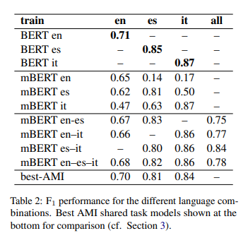
Experiments and Results
The experiments aimed to assess the impact of training material in diverse languages on predicting misogyny in multiple languages.
Monolingual BERT models consistently outperformed the best AMI approaches, indicating their effectiveness.
Including a second language during training improved predictions for mBERT models on English and Spanish but not on Italian.
Combining English and Spanish produced better results than combining either language with Italian, but combining all three languages had mixed effects.
The best overall performance on all three languages was achieved by excluding the training data in English.
These findings suggest that misogyny may be language-specific, as indicated by performance differences between mBERT and BERT models.

Slide 7
Error Analysis
Error analysis was conducted to compare the behavior of monolingual and multilingual models and identify misclassification patterns.
Both models showed similar false positives (FP) and false negatives (FN) across languages, with lexically diverse FN instances.
Differences were observed in misclassified instances, with Italian exhibiting unique patterns related to physical appearance and sexual objectification.
Certain words, such as "rape" and terms linked to women's roles, triggered errors, potentially indicating unintended biases.
In Italian, the co-occurrence of words like "bel" with "culo" and women reclaiming negative terms contributed to misclassifications.

Slide 8
Final Remarks
Monolingual models achieved state-of-the-art performance in identifying misogynistic tweets in English, Spanish, and Italian.
Including data from one or two additional languages had a mixed impact on performance, improving over mBERT models but showing a drop compared to monolingual BERT models.
Multilingual models can be used for data augmentation but are not suitable for zero-shot classification across languages, suggesting that misogyny might be language-specific.

Slide 9
Societal Impact and Limitations
The study examines whether misogyny is language-specific and aims to understand variations in misogyny across languages and cultures.
Policymakers can benefit from insights into these differences to develop tailored strategies to address misogyny and its impact.
The study's concentration on three languages without regional or cultural information is a limitation.
The development of a multilingual system capable of identifying misogynistic content can help raise awareness and create a more positive online environment for women.

Slide 10


