Slide 1

Data Integration and Large Scale Analysis 01 Introduction and Overview
Slides credit: Matthias Boehm
Last update: Oct 06, 2023

Slide 2

Announcements/Org
#1 Video Recording
Link in TUbe & TeachCenter
Optional attendance
Hybrid, in-person but video-recorded lectures
HS i5 and Webex: https://tugraz.webex.com/meet/shafaq.siddiqi

Slide 3
Agenda
Course Organization
Course Motivation and Goals
Course Outline and Projects

Slide 4


About Me
Data Management Group
09/2019 TU Graz, Austria
Teaching Assistant, TU Graz
Institute of Interactive Systems and Data Science, CSBME (ML systems internals, end-to-end data science lifecycle)
2017-2019 Sukkur IBA University
Lecturer (Computer Science)
Teaching and supervising FYPs in Bachelor programs
2020 PhD Student TU Graz, Austria
Data preprocessing for Heterogeneous Large Scale Data
Generation and Optimization of Data Cleaning Pipelines
https://github.com/apache/systemds
Data Management group

Slide 5
Course Organization

Slide 6
Basic Course Organization
Course Organization
Staff
Lecturer: M.Sc. Shafaq Siddiqi, ISDS
Language
Lectures and slides: English
Communication and examination: English
Course Format
VU 2/1, 5 ECTS (2x 1.5 ECTS + 1x 2 ECTS), bachelor/master
Weekly lectures (Fri 3pm, including Q&A), attendance optional
Mandatory exercises or programming project (2 ECTS)
Recommended papers for additional reading on your own
Prerequisites
Preferred: course Data Management / Databases is very good start
Sufficient: basic understanding of SQL / RA (or willingness to fill gaps)
Basic programming skills (Python, R, Java, C++)

Slide 7
Course Logistics
Course Organization
Website
https://shafaq-siddiqi.github.io./dia2023.html
All course material (lecture slides) and dates
Video Recording Lectures (TUbe)
Communication
Informal language (first name is fine)
Please, immediate feedback (unclear content, missing background)
Newsgroup: N/A – email is fine, TeachCenter forum for discussions
Office hours: by appointment or after lecture
Exam
Completed exercises or project
Final written exam (oral exam if <25 students take the exam and for Erasmus students)
Grading (30% project/exercises completion, 70% exam)

Slide 8
Course Logistics, cont.
Course Organization
Course Applicability
Bachelor programs computer science (CS), as well as software engineering and management (SEM)
Master programs computer science (CS), as well as software engineering and management (SEM)
Catalog Data Science: compulsory course in major/minor
Free subject course in any other study program or university

Slide 9
Course Motivation and Goals

Slide 10
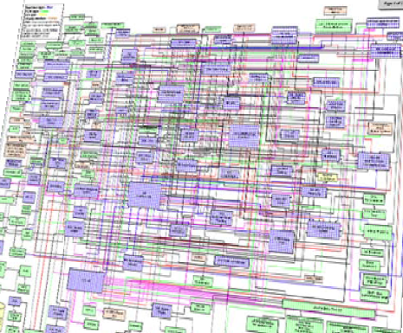
Data Sources and Heterogeneity
Course Motivation and Goals
Terminology
Integration (Latin integer = whole): consolidation of data objects / sources
Homogeneity (Greek homo/homoios = same): similarity
Heterogeneity: dissimilarity, different representation / meaning
Heterogeneous IT Infrastructure
Common enterprise IT infrastructure contains >100s of heterogeneous and distributed systems and applications
E.g., health care data management: 20 - 120 systems
Multi-Modal Data (example health care)
Structured patient data, patient records incl. prescribed drugs
Knowledge base drug APIs (active pharmaceutical ingredients) + interactions
Doctor notes (text), diagnostic codes, outcomes
Radiology images (e.g., MRI scans), patient videos
Time series (e.g., EEG, ECoG, heart rate, blood pressure)

Slide 11
The Data Science Lifecycle
Data Science Lifecycle
Classic KDD Process (Knowledge Discovery in Databases)
Descriptive (association rules, clustering) and predictive
1990-2010
Evaluate
Mining
Transform
Preprocess
Select
[Usama M. Fayyad, Gregory Piatetsky-Shapiro, Padhraic Smyth: From Data Mining to Knowledge Discovery in Databases. AI Magazine 17(3) (1996)]

Slide 12

The Data Science Lifecycle, cont.
Data Science Lifecycle
CRISP-DM
CRoss-Industry Standard Process for Data Mining
Additional focus on business understanding and deployment
[https://statistik-dresden.de/archives/1128]

Slide 13


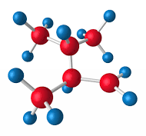

The Data Science Lifecycle, cont.
Data Science Lifecycle
Data-centric View:
Application perspective
Workload perspective System perspective
Data extraction, schema alignment, entity resolution, data validation, data cleaning, outlier detection, missing value imputation, semantic type detection, data augmentation, feature selection, feature engineering, feature transformations
Data Scientist
Data Integration Data Cleaning Data Preparation
Model Selection Training Hyper-parameters
Validate & Debug Deployment Scoring & Feedback
Data Integration Data Cleaning Data Preparation
Exploratory Process (experimentation, refinements, ML pipelines)
Data/SW Engineer
DevOps Engineer
Key observation: SotA data integration/cleaning based on ML

Slide 14
The 80% Argument
Data Science Lifecycle
Data Sourcing Effort
Data scientists spend 80-90% time on finding, integrating, cleaning datasets
Technical Debts in ML Systems
Glue code, pipeline jungles, dead code paths
Plain-old-data types (arrays), multiple languages, prototypes
Abstraction and configuration debts
Data testing, reproducibility, process management, and cultural debts
[Michael Stonebraker, Ihab F. Ilyas: Data Integration: The Current Status and the Way Forward. IEEE Data Eng. Bull. 41(2) (2018)]
ML
[D. Sculley et al.: Hidden Technical Debt in Machine Learning Systems. NIPS 2015]

Slide 15

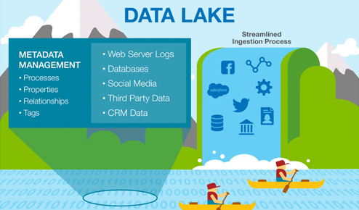



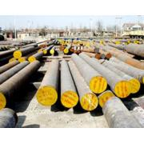


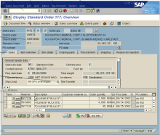
Complementary Architectures
Course Motivation and Goals
Distributed Computation
Frameworks
#1 Information System Pyramid
#2 Data Lake
Audio, Image, Video, Text, Streams, Logs
Operational Systems
Strategic Systems
Analytical Systems
DSS
Vertical Integration (e.g., ETL)
Catalogs
Distributed Data Stores
DWH
Material
ERP
CRM
SCM
eCommerce
Horizontal Integration (e.g., EAI)
Notes:
Integration Architecture

Slide 16
Course Goals
Course Motivation and Goals
#1 Major data integration architectures
#2 Key techniques for data integration and cleaning
#3 Methods for large-scale data storage and analysis

Slide 17
Course Outline and Projects

Slide 18
Part A: Data Integration and Preparation
Course Outline and Projects
Data Integration Architectures
01 Introduction and Overview [Oct 06]
02 Data Warehousing, ETL, and SQL/OLAP [Oct 13]
03 Message-oriented Middleware, EAI, and Replication [Oct 20]
Key Integration Techniques
04 Schema Matching and Mapping [Oct 27]
05 Entity Linking and Deduplication [Nov 03]
06 Data Cleaning and Data Fusion [Nov 10]

Slide 19
Part B: Large-Scale Data Management & Analysis
Course Outline and Projects
Cloud Computing
07 Cloud Computing Foundations [Nov 17]
08 Cloud Resource Management and Scheduling [Nov 24 ]
09 Distributed Data Storage [Dec 01]
Large-Scale Data Analysis
10 Distributed, Data-Parallel Computation [Dec 15]
11 Distributed Stream Processing [Jan 12]
12 Distributed Machine Learning Systems [Jan 19]

Slide 20
Overview Projects or Exercises
Course Outline and Projects
Team
1-3 person teams (w/ clearly separated responsibilities)
Objectives
Non-trivial programming project in DIA context (2 ECTS → 50 hours)
Exercise: Data engineering and ML pipeline
Data cleaning and integration of multi-modal data sources
ML model training and evaluation
Optional: Open source contribution to Apache SystemDS https://github.com/apache/systemds (from HW to high-level scripting)
Timeline
Oct 20: Exercise description
Jan 12: Final project/exercise deadline

Slide 21
Summary and Q&A
Course Goals
#1 Major data integration architectures
#2 Key techniques for data integration and cleaning
#3 Methods for large-scale data storage and analysis
Next Lectures
02 Data Warehousing, ETL, and SQL/OLAP [Oct 13]
03 Message-oriented Middleware, EAI, and Replication [Oct 20]

