Slide 1
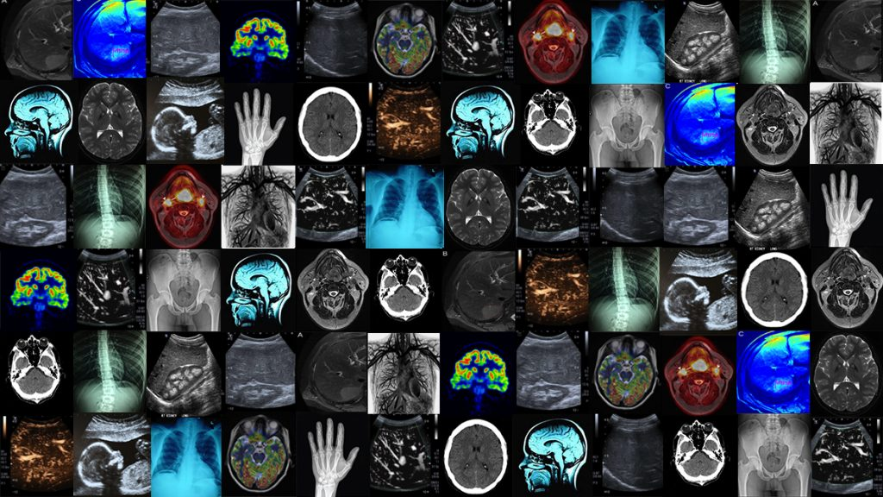
Cross-Architectural Knowledge Distillation in Medical Imaging : Multi-Scale Geometric Feature Fusion for Object Detection

Slide 2
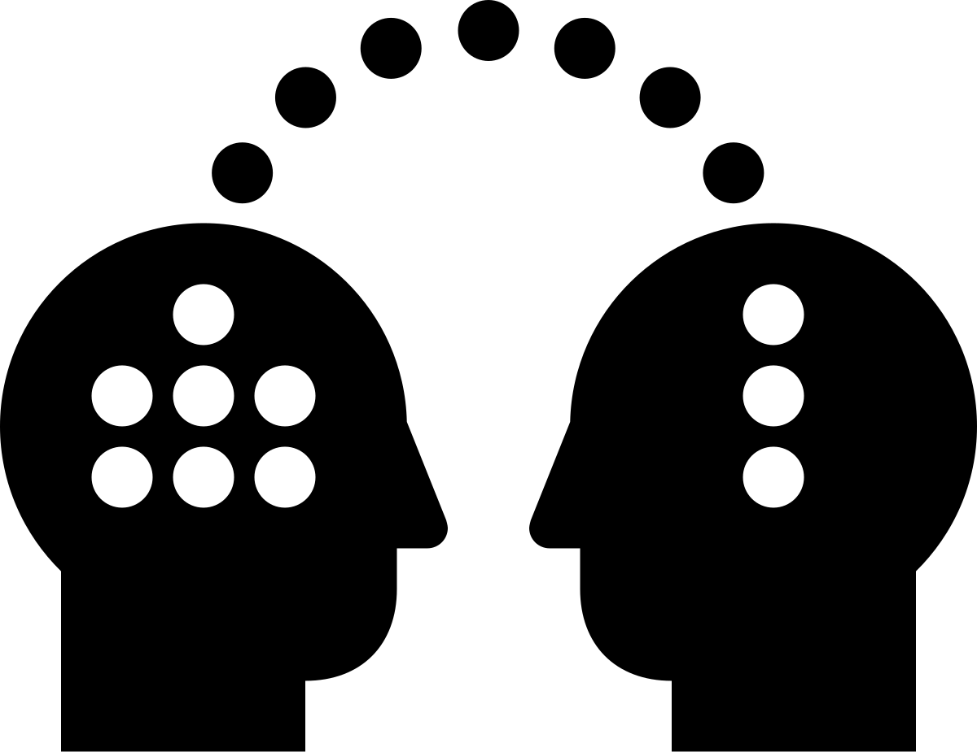
What is Knowledge Distillation?
Knowledge Distillation (KD) is a training technique where a smaller student model learns from a larger, more complex teacher model by mimicking its predictions. This helps compress knowledge while maintaining high performance, making models more efficient for deployment.

Slide 3
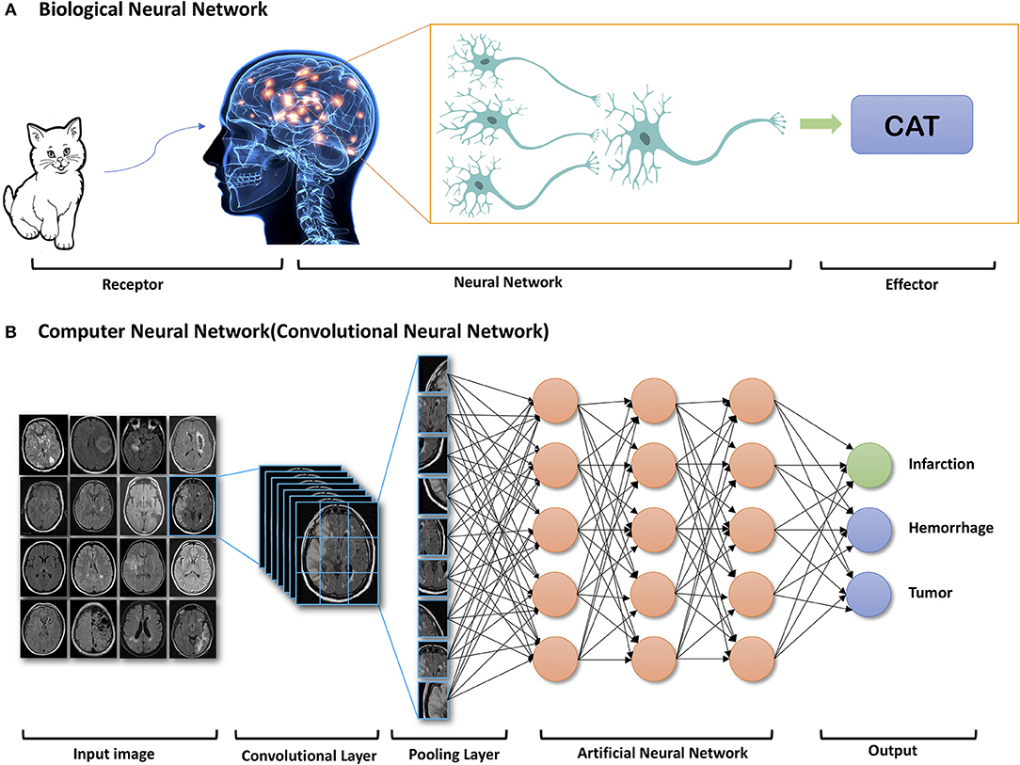
Why Cross-Architectural KD?
Improved Feature Representation – CNNs( VGG19) excel at capturing fine-grained spatial details
In an image of a face, fine-grained spatial details might include the texture of the skin, the shape of individual eyelashes, or the subtle gradients in lighting

Slide 4
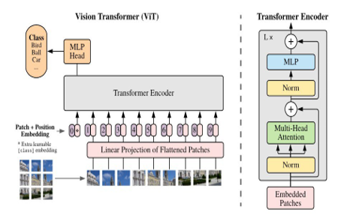
While Transformers (ViT) learn long-range dependencies, making the student model more effective in detecting subtle anomalies in medical scans (e.g., tumors, lesions).
Transformers' ability to learn long-range dependencies means they can effectively model relationships between distant parts of an image, making them particularly well-suited for detecting subtle, globally distributed anomalies in medical scans.

Slide 5

Better Generalization & Robustness
Combining CNN and ViT knowledge helps the student model generalize well across different imaging modalities (X-rays, MRIs, CT scans) and handle variations in contrast, noise, and resolution, crucial for medical diagnosis.

Slide 6

What problem are we solving?
Problem: Models like Transformers are computationally expensive and may not be practical for real-world medical applications, especially in resource-constrained settings.
Solution : By distilling knowledge from a large, high-performing teacher model into a smaller, more efficient student model, you reduce computational costs while maintaining high detection accuracy

Slide 7
What problem are we solving?
Problem: Medical images, such as brain MRI scans in the BraTS dataset, often contain complex structures, subtle anomalies, and overlapping. Detecting and localizing these objects accurately is challenging due to their irregular shapes, low contrast, and variability across patients.
Solution : Our work leverages multi-scale geometric feature fusion to capture both fine-grained details (local patterns) and global context, improving the model's ability to detect and localize objects in complex medical images.

Slide 8
Enhancing Tumor Sub-Region Detection
Problem: In brain tumor imaging, accurately distinguishing between different tumor sub-regions is critical for diagnosis and treatment planning but remains challenging due to their overlapping intensities and boundaries.
Solution: our approach focuses on capturing both local and global features, enabling the model to better differentiate between tumor sub-regions and improve segmentation accuracy.

Slide 9
What problem are we solving?
Problem: Medical imaging datasets often have limited annotated data, and models may overfit to specific datasets or fail to generalize to new cases.
Solution: Knowledge distillation helps improve generalization by transferring robust feature representations from the teacher to the student. Additionally, multi-scale feature fusion ensures the model is robust to variations in object size, shape, and appearanc

Slide 10

Whats our Novelty?
Multi Scaler Geometric feature Fusion

Slide 11
How it will be done
Capture features at different scales to ensure the model can detect both small and large objects, as well as subtle details and global context.
Extract features from different layers of the network
Extract geometric properties (e.g., shapes, boundaries, curvature) from the feature maps to better represent the structure of objects.
By Using geometric operators (e.g., edge detection filters) to extract geometric features.

Slide 12
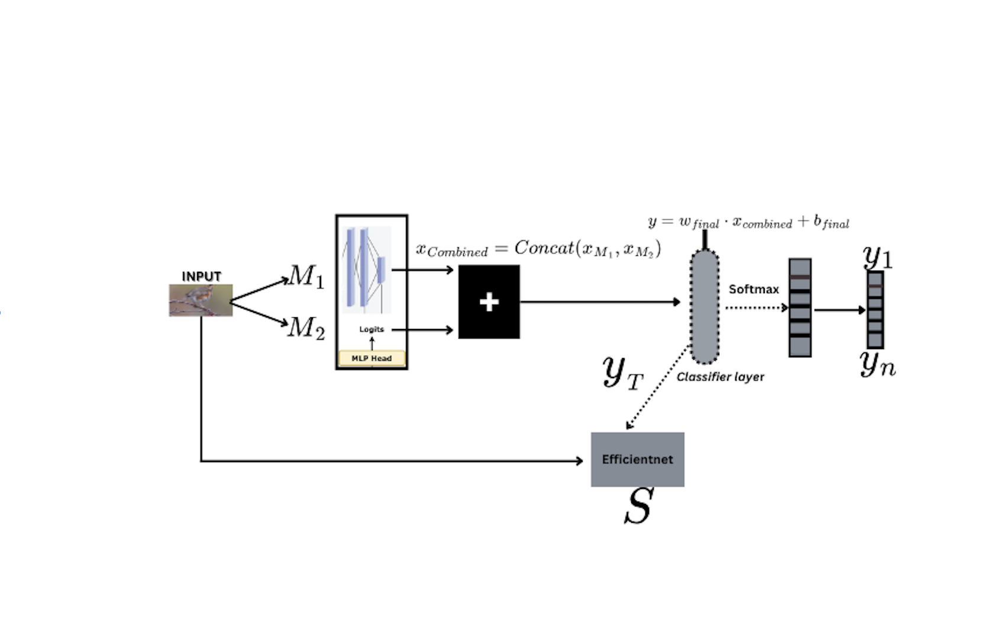

Slide 13
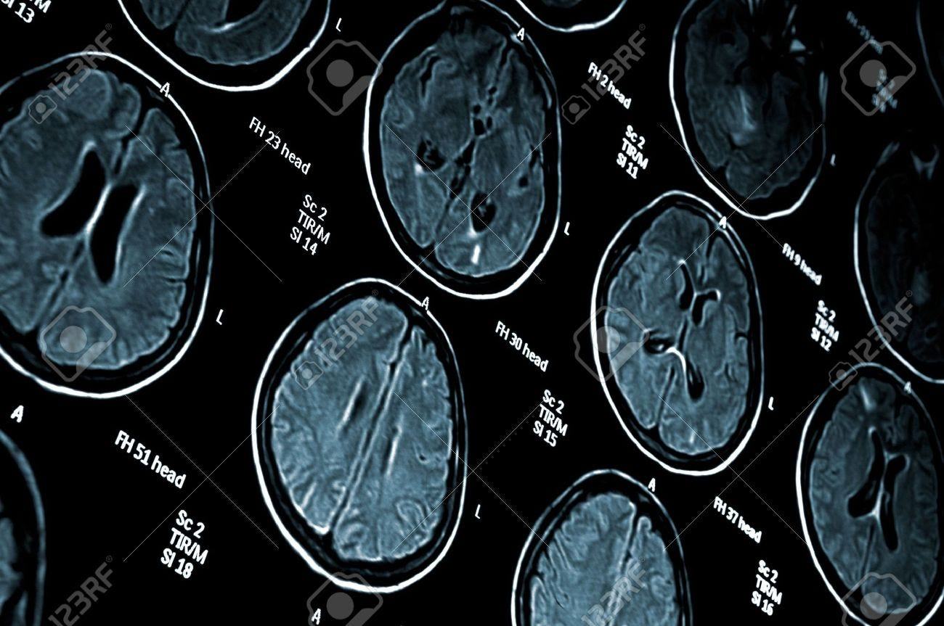
BraTS dataset (BraTS 2023)
It includes multi-modal MRI scans (T1, T1ce, T2, FLAIR) with annotated labels for tumor sub-regions (e.g., enhancing tumor, edema, necrotic core)

Slide 14

Conclusion
Our approach not only enhances the model's ability to handle multi-modal MRI data but also improves generalization across diverse cases. This work contributes to the development of robust, automated diagnostic tools, paving the way for more accurate and efficient brain tumor analysis in clinical practice.

