Slide 1



AI-Powered Supply Chain
Disruption Assistant
CAPSTONE PROJECT · LIVE DEMO
Describe what broke. Six agents check it against 100,000 past disruptions, estimate the damage and recovery time, and recommend a response you can defend.
100,000 past disruptions
6 cooperating agents
Checked by an LLM judge
Notes:
Introduce the assistant: an operations manager describes a disruption in plain English and gets an evidence-backed briefing: how bad it is, what worked before, what to do and how long recovery takes.

Slide 2





The problem and why it matters
Business need
The problem
Decide in seconds, not hours
Supplier failures, disasters, strikes, cyber attacks and trade restrictions hit production and revenue. To decide what to do, teams search old disruption records by hand: slow and inconsistent.
Evidence-backed briefing, no manual digging
Consistent, defensible decisions
Every recommendation cites real past cases
Questions they need answered
1
Has this happened before, and how was it resolved?
Prioritize objectively
One P1 to P4 score from severity, impact and loss
2
How bad will it be: impact, loss, recovery time?
Invest in resilience
3
Which response works best, and how fast do we recover?
See which supplier profiles need a backup source
Notes:
The PRD's three professional questions drive the whole design. Business need: speed, consistency, objective prioritization and resilience planning.

Slide 3






What the assistant does
Describe the disruption in plain English. Get an evidence-backed briefing back, live, in seconds.
Understands it
Finds precedent
Predicts the impact
Reads type, industry, region, supplier tier, backup and severity from the text
Hybrid search over 100,000 past disruptions with metadata filters
Production, revenue loss and recovery time, each with a P10 to P90 range
Recommends a response
Checks itself
Learns from feedback
Ranks 5 strategies on comparable past cases and writes the action plan
An LLM judge scores the plan on 5 criteria and sends it back once if weak
Ratings re-weight strategies; real outcomes retrain the models
Notes:
Six capabilities map to the PRD: RAG similarity search, hybrid search, classification agent, recommendations, prediction models, LLM-as-Judge and the feedback loop.

Slide 4
The data: 100,000 past disruptions
15
61 days
fields per event: what happened, who it hit, how bad, how it was handled
median time to full recovery (range 8 to 798)
56%
24%
of suppliers had a backup ready
ended with a permanent supplier change
Each record becomes one narrative chunk
“Moderate severity 2 Factory Incident (plant fire, explosion, equipment breakdown…) affecting a Tier-1 Pharmaceuticals supplier in Asia-Pacific with no backup supplier. Production dropped 54.3%…”
Notes:
Kaggle Supply Chain Disruption and Recovery dataset: 100,000 rows, 15 fields, no missing values. It is fully structured, so preprocessing writes one narrative per record, with synonyms such as typhoon or ransomware, so free-text questions match.

Slide 5
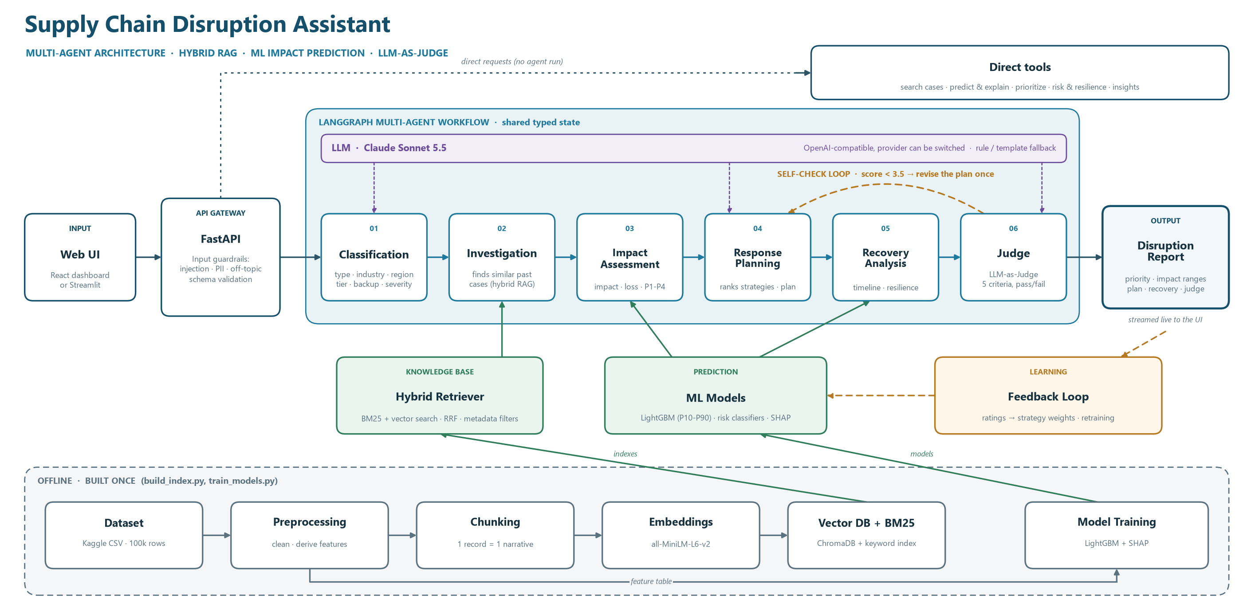
Architecture
Notes:
One request flow: UI, FastAPI gateway with guardrails, six LangGraph agents, report. Below: the retriever and ML models the agents use, the feedback loop, and the offline lane that builds the indexes and models once.

Slide 6
Data flow: from CSV to answer
BUILT ONCE
Dataset
Preprocess
Chunk
Embed
Index
100k rows
clean · derive
1 record = 1 narrative
MiniLM, 384-dim
ChromaDB + BM25
EVERY QUESTION
Question
Guardrails
Classify
Hybrid search
Agents → report
plain English
injection · PII · topic
type · severity · filters
BM25 + vectors (RRF)
predict · plan · judge
0.83
~60 ms
0.92
Precision@10 on 180 everyday searches (same type and industry)
median search time over 100,000 cases, no LLM needed
Precision@10 when the agent adds automatic filters (30 scenarios)
Notes:
Hybrid search: BM25 keyword scores and MiniLM vector similarity are fused with weighted Reciprocal Rank Fusion (alpha 0.6). Metadata filters apply before ranking. If too few cases match, the agent relaxes filters step by step.

Slide 7

Agent workflow (LangGraph)
Agents share one typed state; each adds its part and a trace entry the UI shows live.
Self-check: score below 3.5 → the plan is revised once
01
02
03
04
05
06
Classification
Investigation
Impact
Response
Recovery
Judge
type, industry, region, tier, backup, severity
similar cases + a pool of comparable ones
impact, loss, recovery ranges; priority P1 to P4
ranks 5 strategies, LLM writes the plan
timeline, milestones, resilience
scores 5 criteria; passes at 3.5
Scoring decides, the LLM explains
Transparent priority P1 to P4
Strategies are compared on hundreds of comparable past cases with the same backup status. Score = 45% recovery time, 25% revenue loss, 15% supplier-change risk, 15% evidence. Output guardrails strip any number or case ID not in the evidence.
35% severity, 25% production impact, 25% financial loss, 10% supplier tier, 5% no backup. P1 ≥ 70, P2 ≥ 50, P3 ≥ 30. Unknown impact or loss comes from the ML predictions, and every factor is shown.
Notes:
Six LangGraph nodes after the guardrail. The LLM is used by Classification, Response Planning and the Judge; everything numeric comes from data and models. Without an LLM every step falls back to rules or templates.

Slide 8
Prediction models: LightGBM
8 INPUTS
14 LightGBM models
FEEDS
Disruption type
Industry
Impact agent
4 OUTCOMES × 3 MODELS (P10 · P50 · P90)
headline ranges + priority
Region
Supplier tier
Production impact %
Response agent
Revenue loss (log scale)
what-if per strategy
Supplier size
Backup supplier
Recovery agent
Full recovery days
timeline, supplier change
Severity
Response (what-if)
Partial recovery days
Risk page
2 RISK CLASSIFIERS
resilience score
Changing the response input gives a what-if estimate for each of the 5 strategies.
High-impact risk · Permanent supplier change
SHAP
why each number came out
80k / 20k
0.70 R²
Tied
rows to train / held back to test (80/20 split)
production impact; the P10 to P90 range holds the true value ~79% of the time
with random forest and linear models, so the data, not the model, is the limit
Notes:
Why LightGBM: strong on tabular data, handles categories natively, and quantile objectives give the P10 to P90 ranges. Each of the 4 outcomes has 3 models; the 2 classifiers give the high-impact and supplier-change probabilities. TreeSHAP explains every prediction factor by factor. The LLM never produces these numbers.

Slide 9






Technology stack
LLM
EMBEDDINGS
VECTOR DB + KEYWORD
AGENTS
Claude Sonnet 5.5
all-MiniLM-L6-v2
ChromaDB + BM25
LangGraph
JSON output, sticks to evidence; provider switchable
free, local, 384-dim vectors
metadata filters, fused with RRF
typed state, self-check loop, live streaming
ML AND EXPLAINABILITY
API
FRONT END
EVALUATION
LightGBM + SHAP
FastAPI + Pydantic
React + Streamlit
DeepEval · RAGAS · pytest
P10 to P90 ranges, per-factor explanations
20 endpoints; validation doubles as guardrails
React (Vite, TypeScript) dashboard; both use one API
LLM metrics plus 74 offline tests
Notes:
Python 3.13 backend, everything runs locally. Without an API key the system still runs end to end on rules and templates.

Slide 10

Evaluation results
100%
0.92
0.92
Classification
Retrieval Precision@10
High-impact detection
type, industry, region, tier and backup on 30 scenarios (Claude)
with automatic filters, 30 golden scenarios
ROC-AUC on 20,000 held-out disruptions
0.70
1.00
3.92 / 5
Production impact R²
DeepEval faithfulness
LLM judge
off by 7.8 points on average vs 14.3 for guessing
and answer relevancy 1.00 on 10 full plans
10 of 10 scenarios pass; scored by Claude Sonnet 5.5
Where it is weaker: RAGAS faithfulness
RAGAS faithfulness is 0.42 when it grades the whole plan, because RAGAS treats every action step (“open a daily call with the supplier”) as a factual claim that the evidence cannot support. Graded on the explanation alone, the part that makes factual claims, it scores 0.86.
Notes:
LLM-based scores come from Claude Sonnet 5.5, which generated and judged the answers. Label-based metrics (retrieval, classification, models) need no LLM and act as a cross-check. The judge score 3.92 is the mean over the 10 demo scenarios after the plan-writer improvements (all 10 pass); the evaluation report's earlier run, before those improvements, scored 3.48 with a 60% pass rate.

Slide 11

Challenges and learnings
CHALLENGE
WHAT WE DID
No free text to search
One narrative per record with synonyms, plus metadata filters before ranking
LLMs can invent numbers
Scoring picks the strategy; the LLM writes from a fact sheet and guardrails remove unsupported numbers and IDs
Past strategy choice is confounded
Compare strategies only on comparable cases with the same backup status
Some outcomes are hard to predict
Three model families tie, so the data is the limit: show ranges, not single numbers
Grading answers with an LLM
Cross-check with label-based metrics and 74 offline tests
Notes:
Key learning: keep the LLM for language, and let data, models and transparent scoring make the decisions.

Slide 12
Questions?
THANK YOU
Notes:
Close and take questions. Repository docs: README, design document, API documentation, evaluation report and dataset details.

