Slide 1

Presentation on
E-Commerce(Online Shopping)

Slide 2
Group members:
LMS USERNAME | NAME | BATCH
2129a42178 | SEENU.S | A42
2129a42179 | SHAFETHA.K | A42
2129a42180 | SHANMUGA RAJAN.G | A42
2129a42181 | SHREE VASANTH.B | A42

Slide 3
introduction
E-Commerce Defination
About Our System

Slide 4
What is e-commerce ?
It is commonly known as Electronic Marketing.
It consist of buying ad selling goods and services over an electronic system such as the internet and other computer network

Slide 5
Our system
Our system is a e-commerce website from where people can buy products through online.
Admins monitor the activity of the users and checks the transactions.

Slide 6

The Process of E-Commerce
Buyer
Electronic distribution
1.Search and Identification
5.After-sale service
2.Selection and Negotiation
4.Product and Service Delivery
3.Purchasing

Slide 7
Features:
Menu
Catalog Browsing
Categories List
Product List
Catalog Management
Product Browsing
Product Reviews
Related Products
Shopping Cart
Checkout
Auto Generated Bill
Payment Gateway

Slide 8
Languages:
HTML 5
CSS 3
Bootstrap
PHP
MySQL
Tools:
Adobe Photoshop
Sublime Text
Xampp

Slide 9
Data Flow Diagram:
Website
Administrator
Website
management
Website Activity
Purchase
Product Information
eEasy Shopping Store
Application
Seller
CUSTOMER
Sales
Retrieve Purchase details & Desire Product Information
Product Information
Visitor

Slide 10
Advantages of E-commerce:
Faster buying/selling procedure, as well as easy to find products.
Buying/selling 24/7.
More reach to customers,there is no theoretical geographic limitations.
Low operational costs and better quality of services.
No need of physical company set-ups.
Easy to start and mange a business.

Slide 11
Disadvantages of e-commerce:
Unable to examine products personally.
Not everyone is connected to the internet.
There is the possibility of credit card number theft.
Mechanical failures can cause unpredictable effects on the total processes.

Slide 12
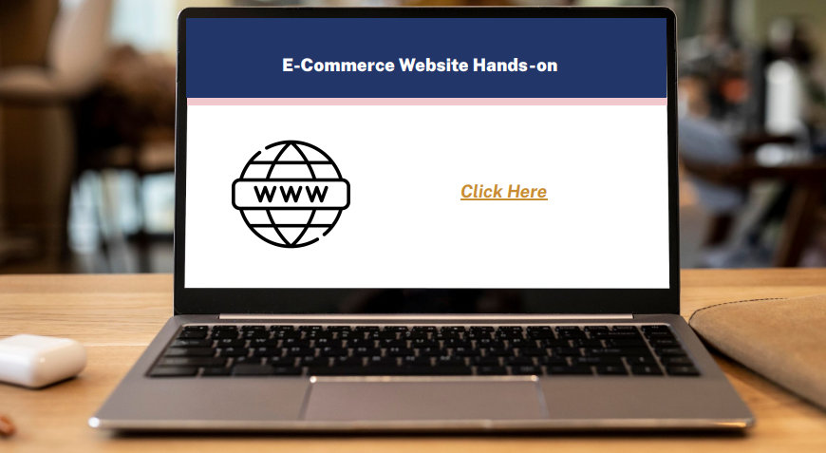
Click here

Slide 13


