Slide 1
Cardiac Patient Analytics
Python Hackathon • Team 6 — PyForce
INTEGRATED PATIENTS
2,008
7 cleaned source files
From cleaned multi-source cardiac data to descriptive insights,
prescriptive priorities, predictive readmission risk and an integrated
dashboard.
6-MONTH READMISSION
38.5%
6-MONTH MORTALITY
2.8%
Team
Shaffy • Radhika • Poulami • Samreet • Sharmila
Team 6 • PyForce | 1/7

Slide 2
1. Data Preprocessing / Cleaning
1
Clean source files
Standardize fields, types and values before integration.
FINAL PATIENTS
FINAL COLUMNS
2,008
171
2
Validate patient_id
One row per patient
Integrated feature set
Check missing IDs, uniqueness and duplicate patient records.
Why this matters
3
Merge 7 datasets
A predictive or prescriptive result is only as trustworthy as the data feeding it. The project therefore validates patient IDs before merging, uses one-to-one merge checks, and verifies the final dataset for duplicate IDs and duplicate column names. This creates a single consistent patient-level dataset for all downstream analysis.
Use patient_id with one-to-one left merges to preserve the
master cohort.
4
Quality checks
Verify final rows, unique patients, duplicate IDs and
duplicate column names.
5
Save final dataset
Create one analysis-ready CSV used across all three
analytics stages.
Pipeline
7 cleaned CSVs → patient_id validation → one-to-one merge → quality checks → Team6_PyForce_cleaned_data.csv
Team 6 • PyForce | 2/7

Slide 3
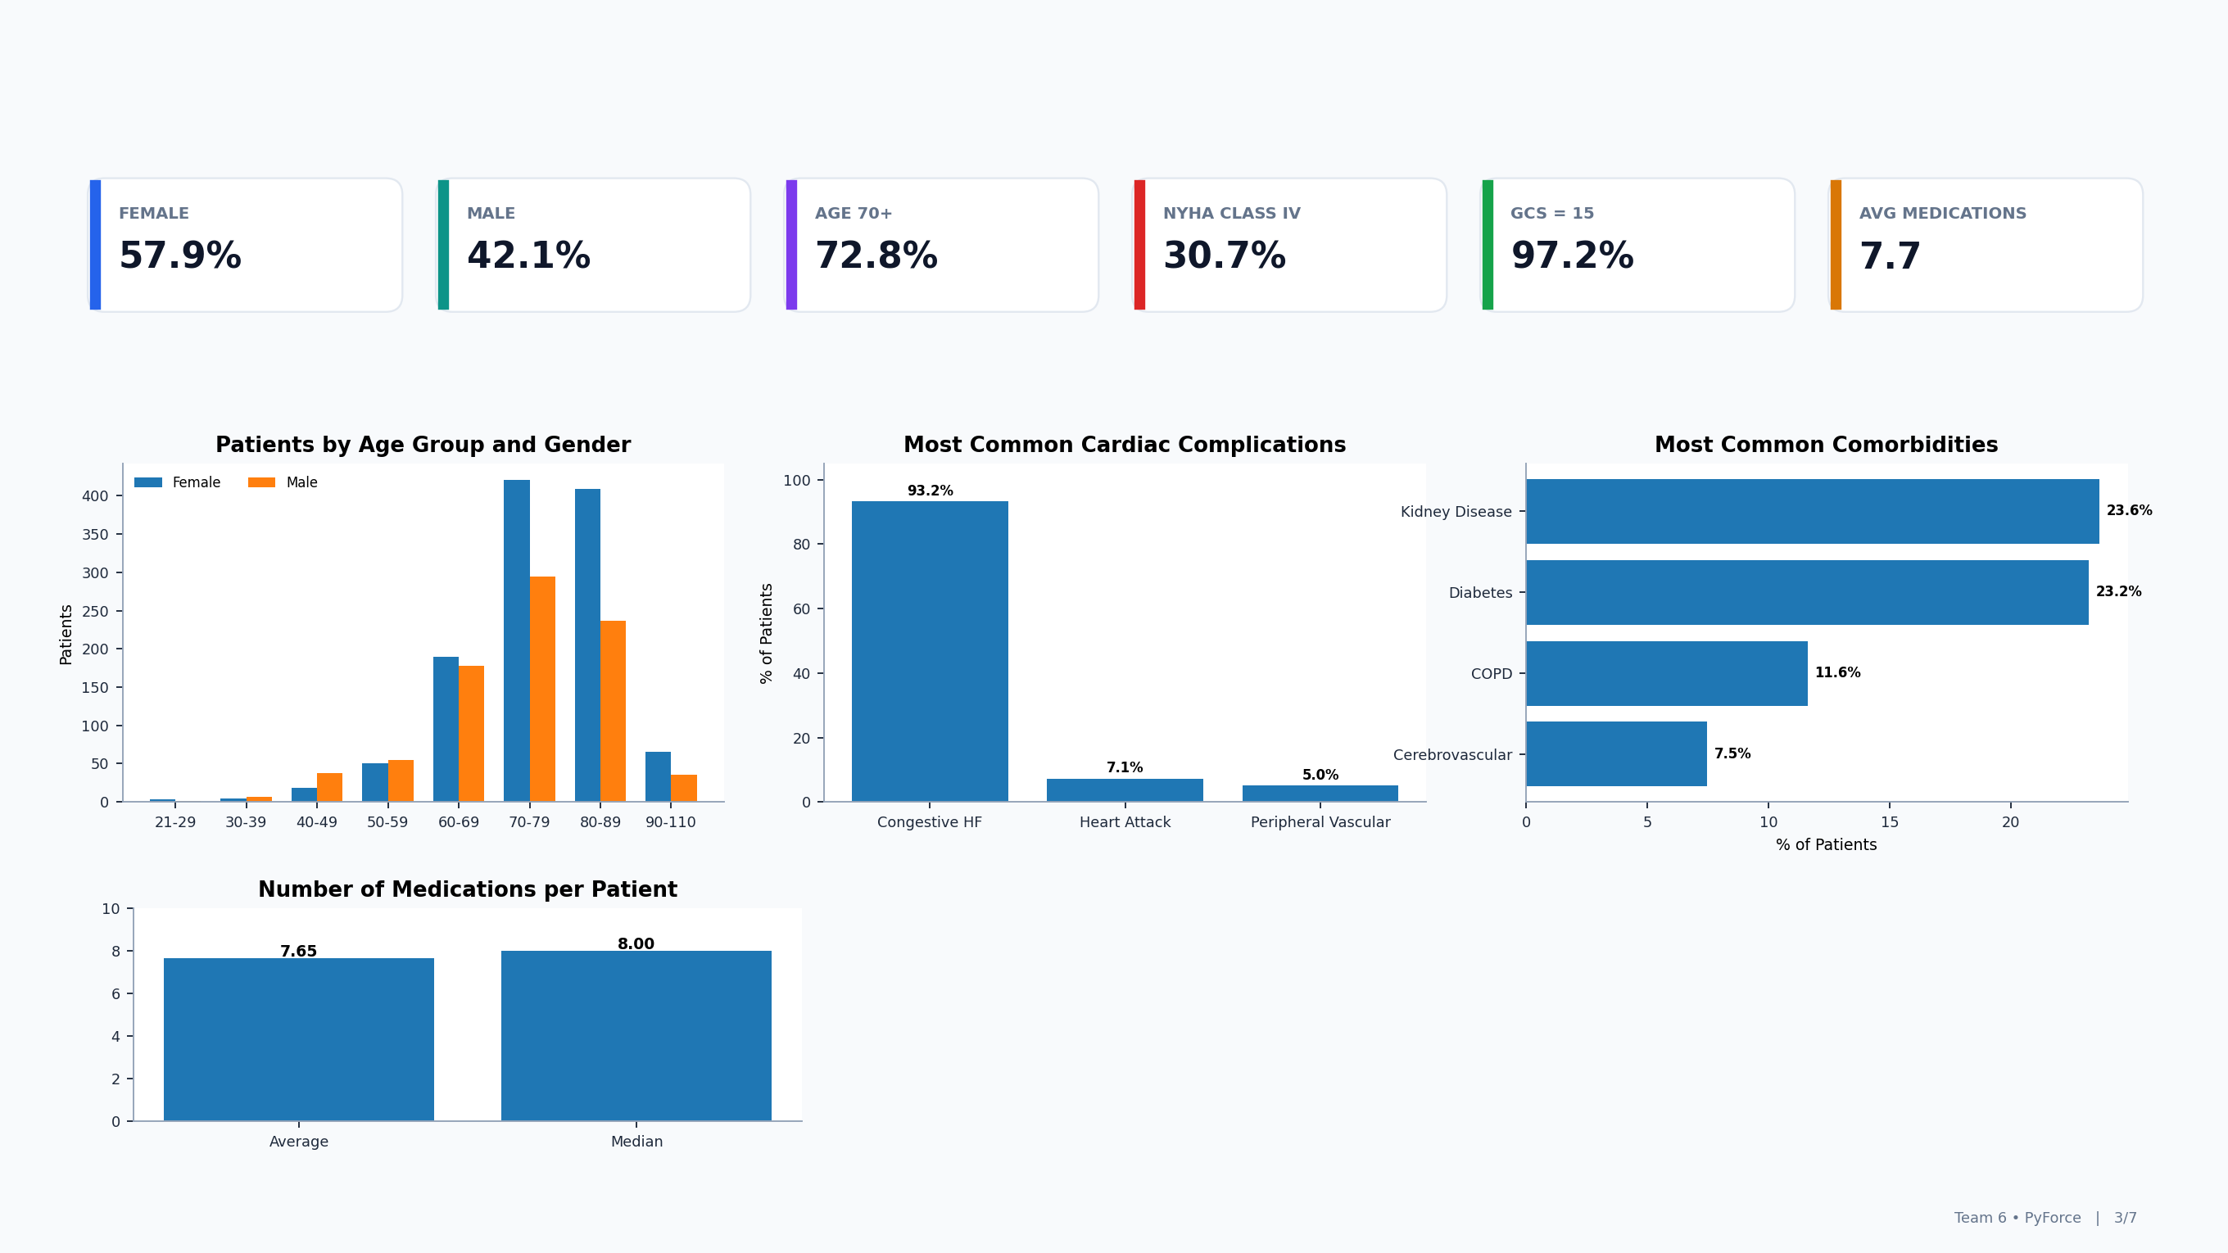
2. Descriptive Analysis
Descriptive Takeaways
The cohort is older and female-majority (57.9% female vs. 42.1% male), with most patients concentrated in the 70–89 age range. Congestive heart failure is the dominant cardiac complication; kidney disease and diabetes are the leading comorbidities, and patients take about 7.7 medications on average.

Slide 4
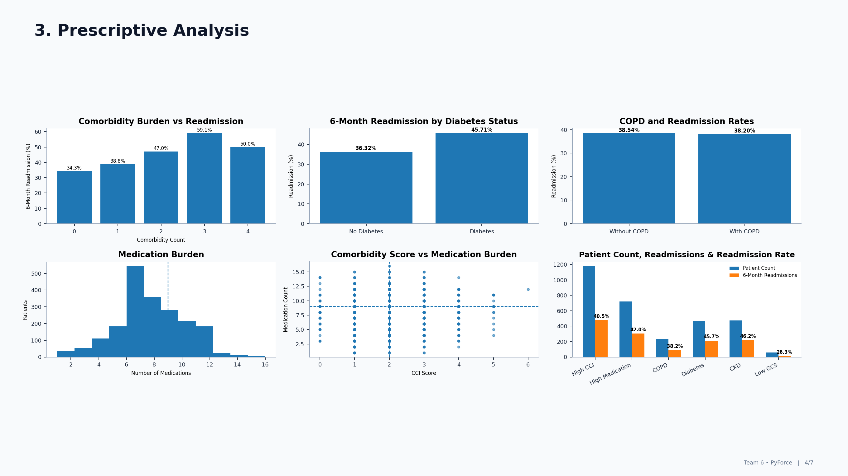
HIGH PRIORITY
176
HIGH READMISSION
40.9%
HIGH MORTALITY
9.7%
Prescriptive takeaway
Readmission risk rises with comorbidity burden and is higher in diabetic patients (about 46% vs 36%), while COPD shows little difference, so these patterns help flag the 176 high-priority patients for closer follow-up.
These findings support prioritization and care coordination, but they don't define clinical treatment rules.

Slide 5
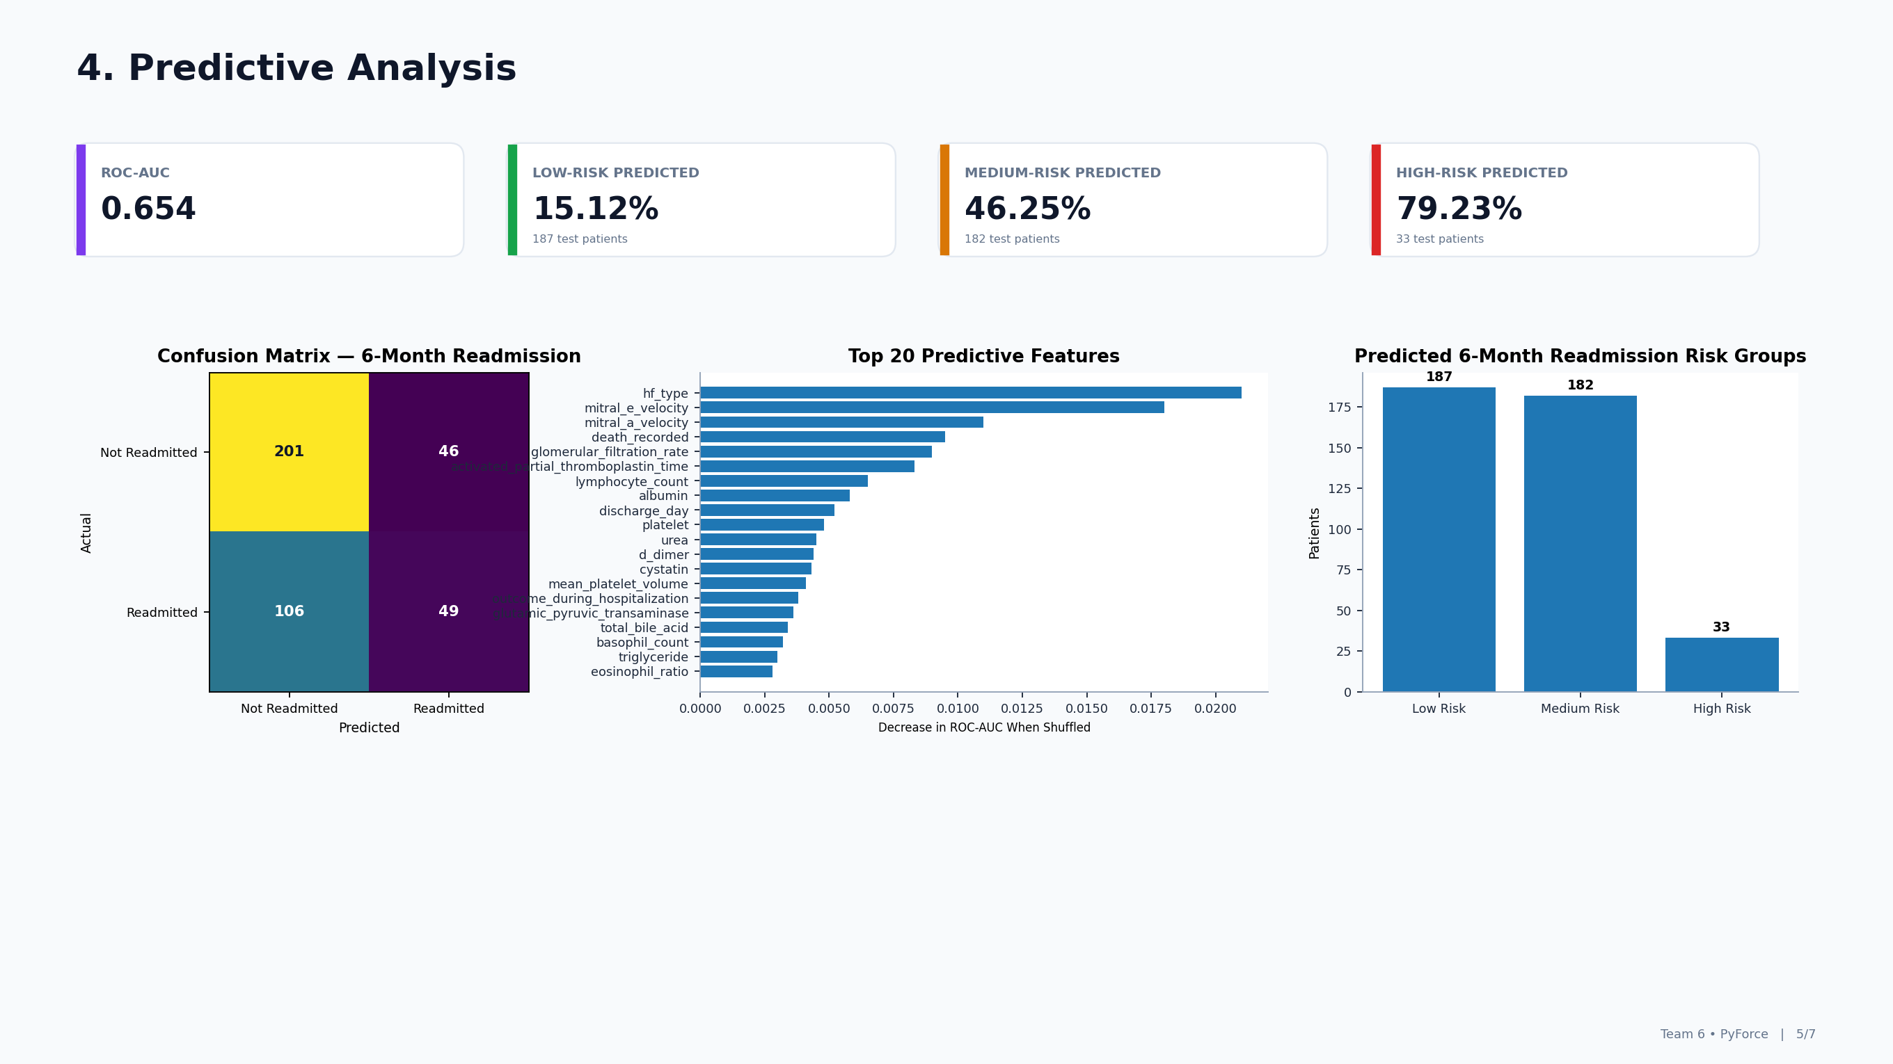
Factors considered & effect on risk grouping
The model combines demographics, cardiac condition/severity, comorbidities, responsiveness, laboratory measures, medication-related variables and other hospital characteristics. Their combined nonlinear patterns produce a probability that places each test patient into Low, Medium or High predicted 6-month readmission risk.
Interpretation
The confusion matrix shows the model separates many non-readmitted patients but misses a meaningful share of readmitted patients. Feature importance highlights the variables that most affect ROC-AUC, while the risk-group chart converts model probabilities into an operational view: Low, Medium and High Risk patients.

Slide 6
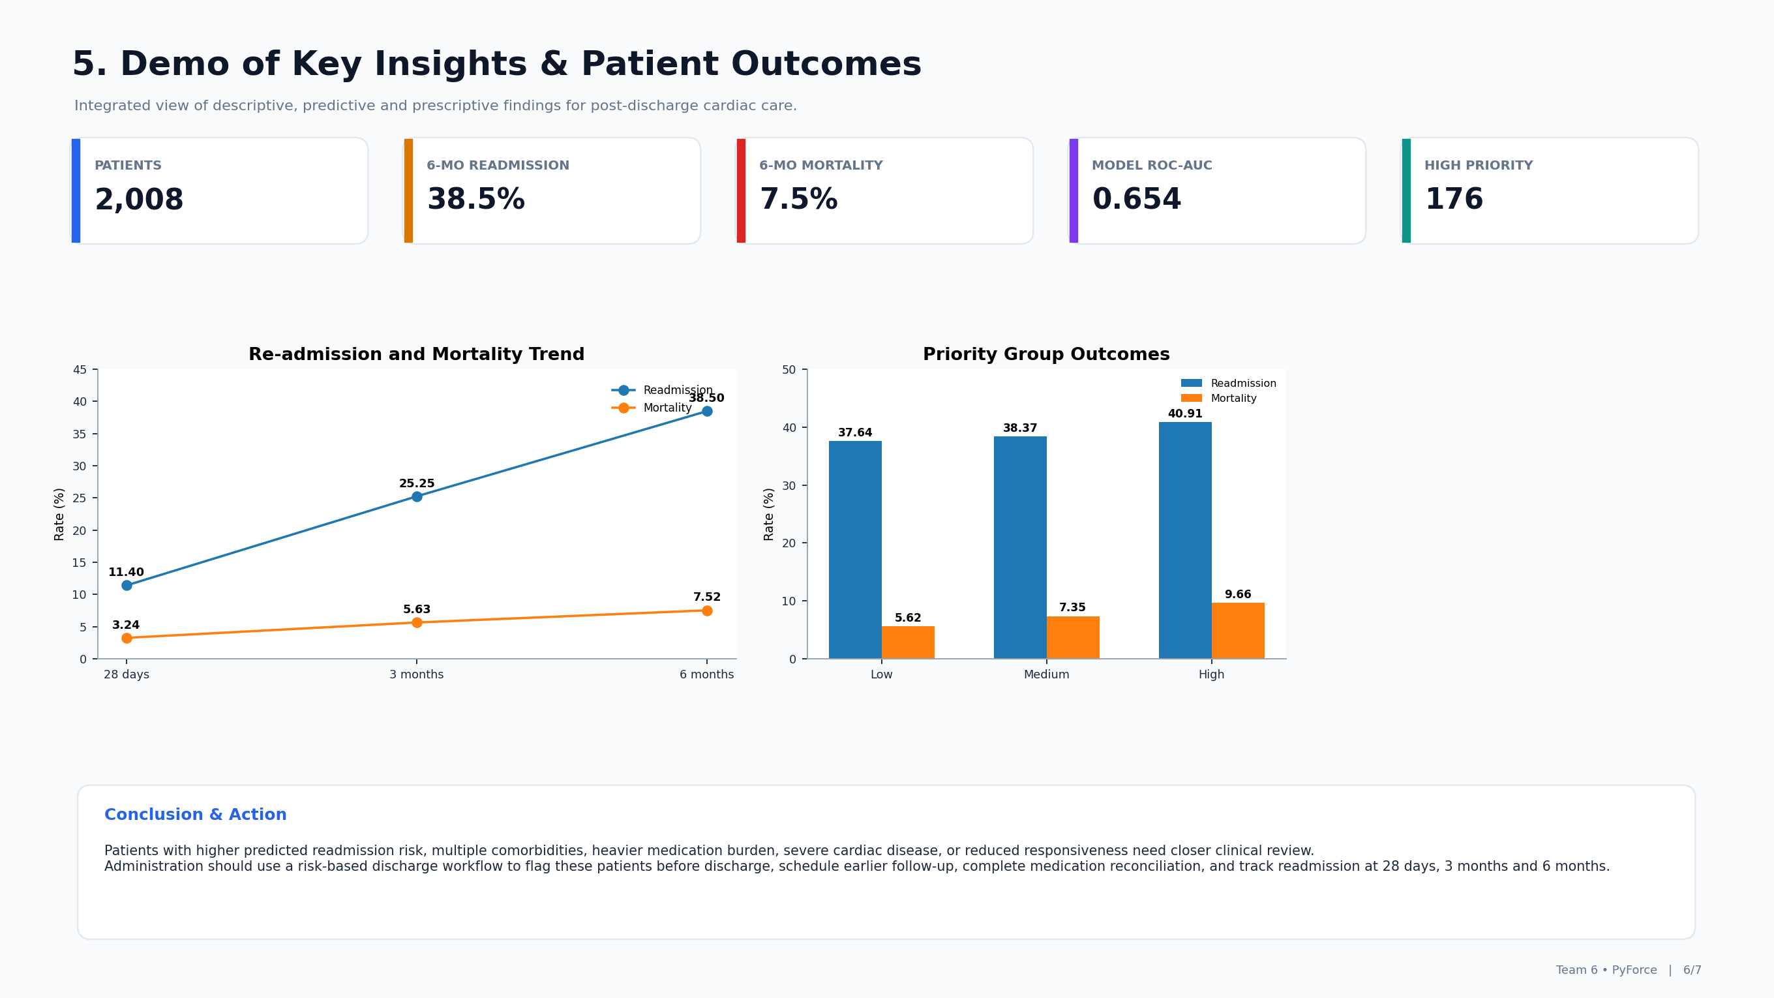
Decision Flow
Review patient profile, cardiac severity and comorbidities.
Estimate 6-month readmission risk with the predictive model.
Compare risk with responsiveness and medication burden.
Flag higher-risk patients for discharge planning and earlier follow-up.
Conclusion & Action
Patients with higher predicted readmission risk, multiple comorbidities, heavier medication burden, severe cardiac disease, or reduced responsiveness need closer clinical review.
Administration should use a risk-based discharge workflow to flag these patients before discharge, schedule earlier follow-up, complete medication reconciliation, and track readmission at 28 days, 3 months and 6 months.

Slide 7
Thank You
Team 6 — PyForce
Shaffy • Radhika • Poulami • Samreet • Sharmila
Clean Data → Understand Patients → Identify Priorities → Predict Risk → Demonstrate Actionable Insights
Team 6 • PyForce | 7/7

