Slide 1

A Horizontal Federated Random Forest for Heart Disease Detection from Decentralized Local Data
Authors:
Shafin Mahmud Jalal
Md. Ashfaqul Haque
Md. Rezuwan Hasan
Md. Golam Rabiul Alam
Presented BY:
Md. Ashfaqul Haque

Slide 2
Index
Necessity of Federated Learning
Introduction
Impact of Federated Learning in Medical Sector
Dataset Description
Methodology
Analysis of the Experimentation
Conclusion

Slide 3



Necessity of Federated Learning
Server
Good ML Model
Lots of Data
Chance of leaking data
Sending Data
Site 1
Site 2
Site n

Slide 4
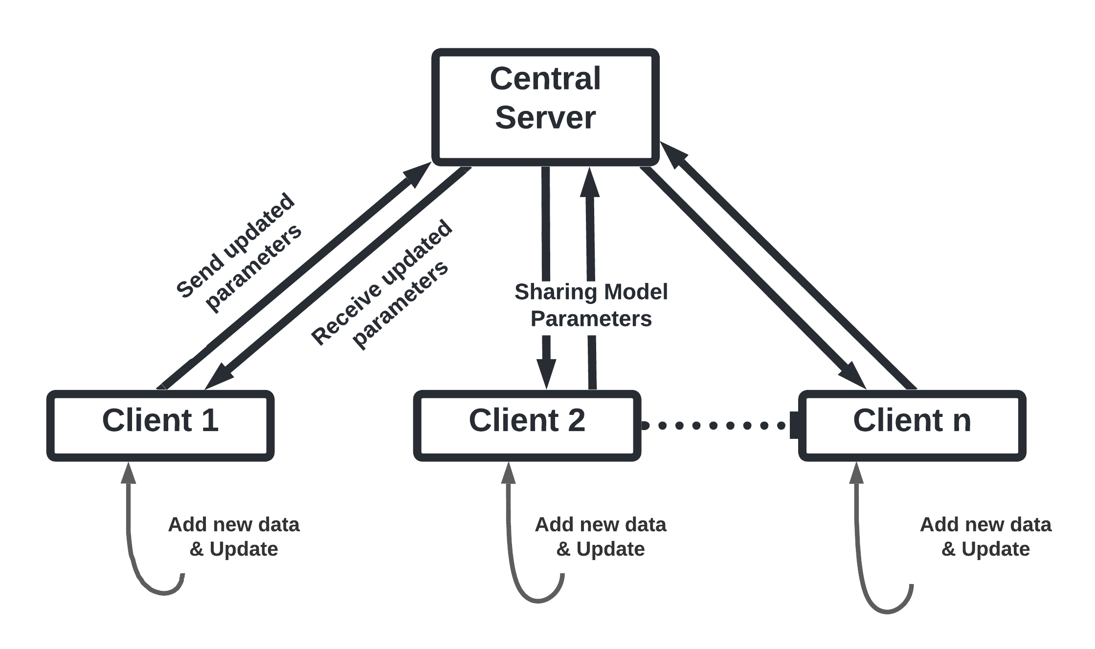
Introduction
Federated learning with ML model.
Share information but keep data privacy.
Better prediction modeling.

Slide 5
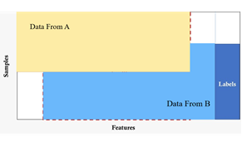
Impact of Federated Learning in Medical Sector
Keeping patients’ information private at the same time sharing the essence of information.
Covering the shortage of information in a single healthcare institute.
Brings variety in data results more Accurate ML models.
Fig. 1 Horizontal Federated Learning.

Slide 6
Dataset
The Total data set consists of : 1190 samples &
Five Hospitals
Cleveland : 303 samples
Hungarian : 294 samples
Client 1
Client 2
Switzerland : 123 samples
Long Beach : 200 samples
Statlog : 270 samples
Federated central Server

Slide 7
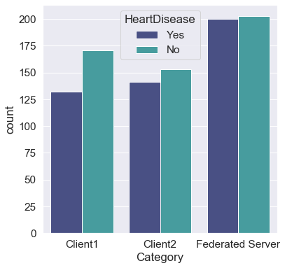
Dataset Description
Fig. 2 Heart disease distribution comparison on the federated server and both clients.

Slide 8
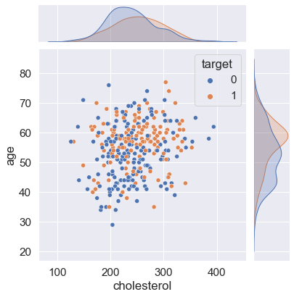
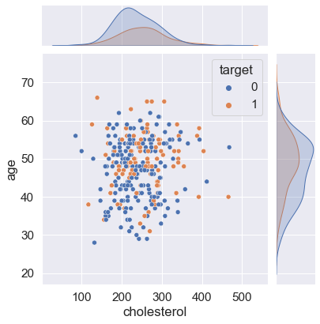
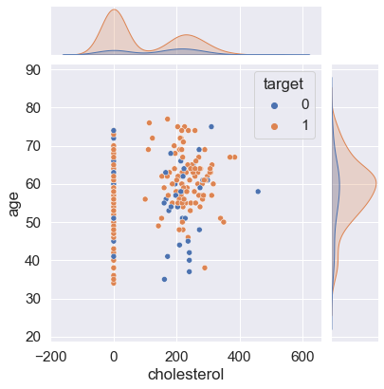
Dataset Description (contd.)
(a)
(b)
(c)
Fig. 3 Blood Pressure Versus Cholesterol Plot in terms of Heart Disease (a) Federated Central, (b) Client1, (c) Client2

Slide 9
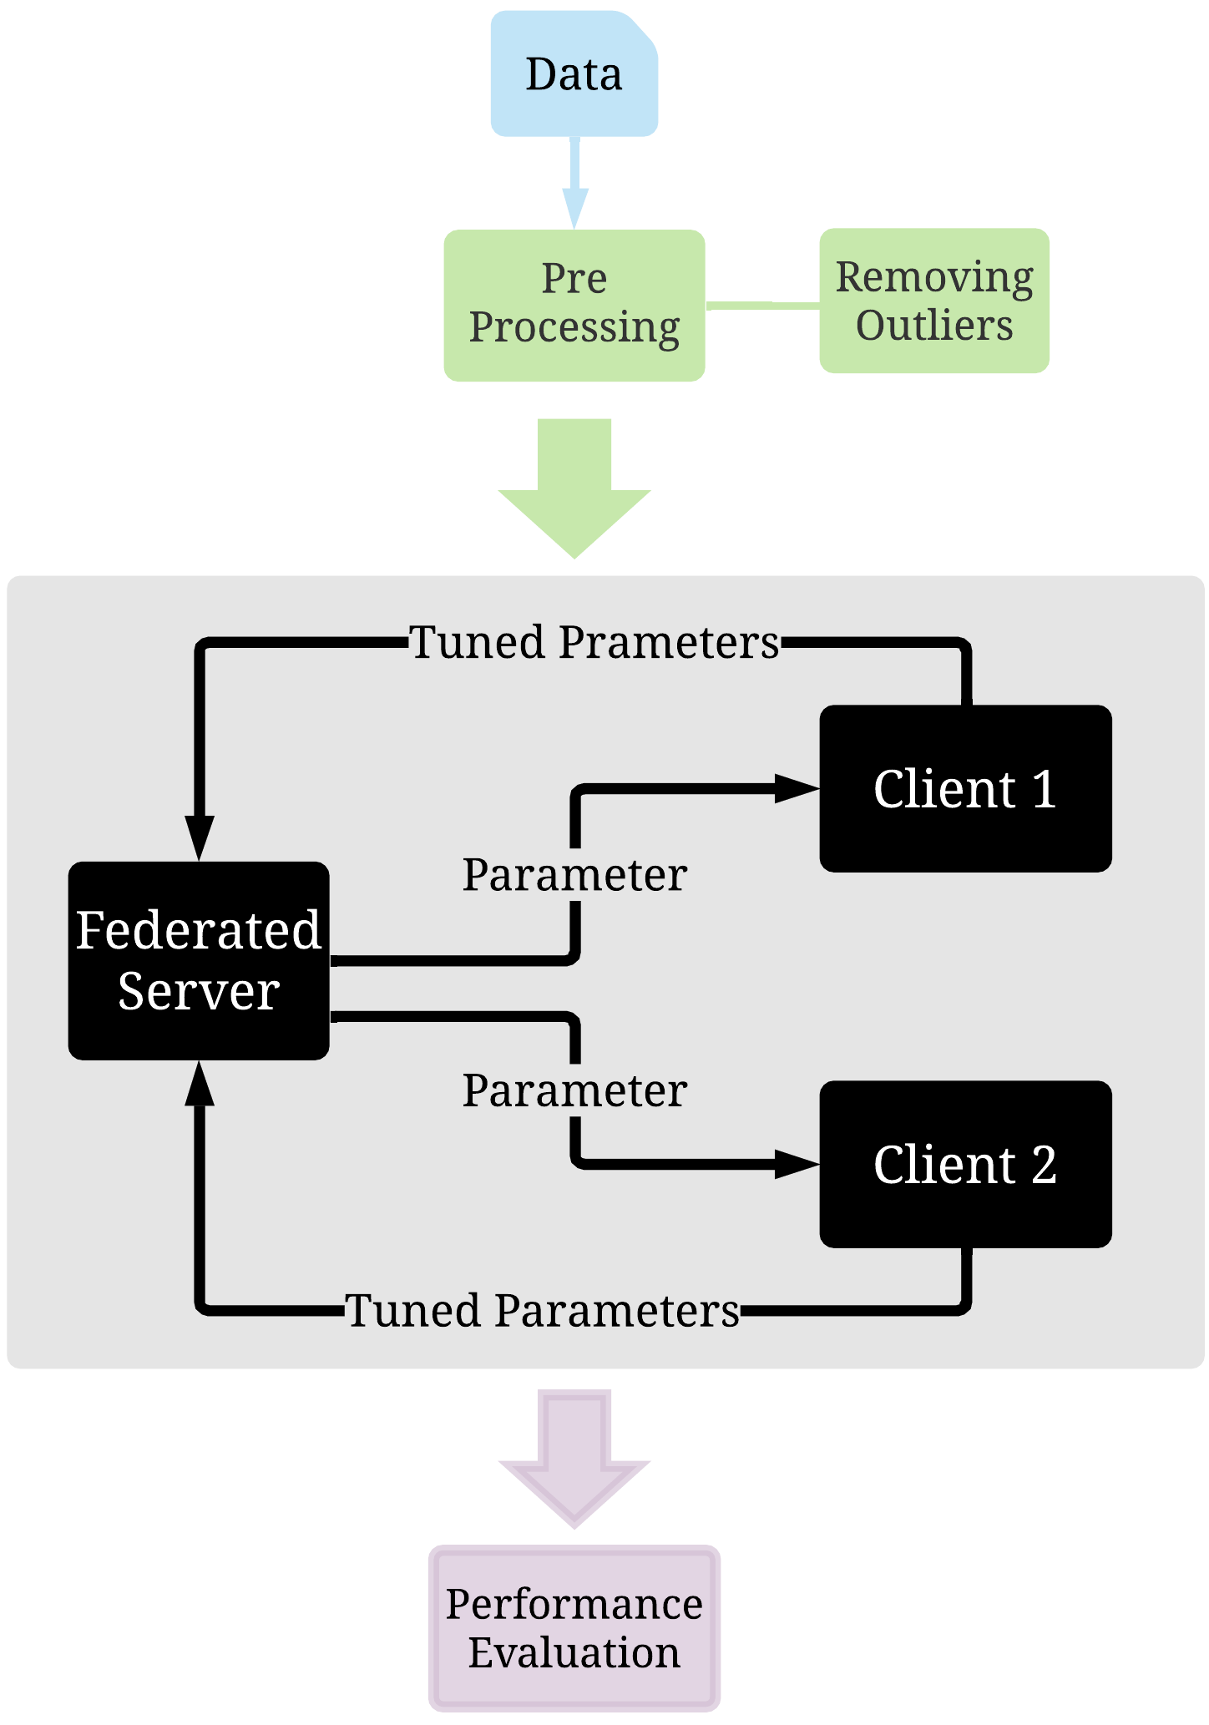
Methodology

Slide 10
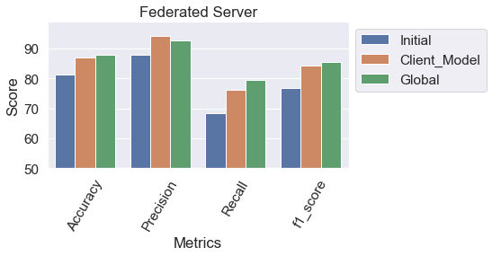
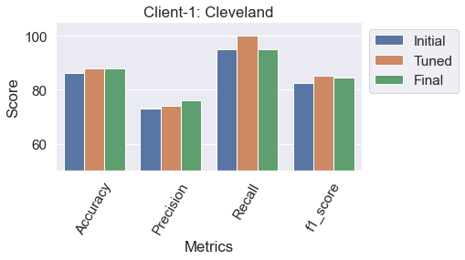
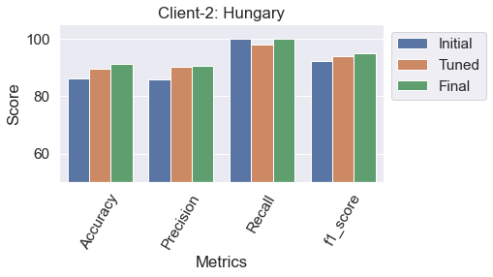
Analytics of the Experimentation
Accuracy Improvement:
Federated server : 7.1%
Client 1 : 2%
Client 2 : 6%
F1-score Improvement:
Federated server : 9.6%
Client 1 : 2.2%
Client 2 : 2.9%
(a)
(b)
(c)
Fig. 4 Performance Evaluations of (a) Central Server, (b) Client1, and (c) Client2

Slide 11
Analytics of the Experimentation (contd.)
 | Sample size | No. of Estimators | Accuracy | Precision | Recall | F1-score
Federated Central | 579 | 35 | 92.41 | 95.08 | 87.88 | 91.34
Client 1 | 288 | 35 | 97.22 | 96 | 96 | 96
Client 2 | 291 | 35 | 90.41 | 89.55 | 100 | 94.49
Table.1 Evaluation with the updated data

Slide 12
Conclusion
Possibility of new data flow. Considered it in our work.
Implementation done only on heart disease patients’ data but we can apply our model in other areas of the healthcare sector
Where patients’ data from one institute would be beneficial to others where data sharing is beneficiary.

Slide 13
Thank You
Thank You

